Slide 1
Culture and politics in Europe
What is culture?
Main concepts and theoretical approaches.

Slide 2
Structure – culture and related concepts
Culture – the anthropological, artistic and institutionnal views
Culture, subcultures, high and popular culture, countercultures
Identity and stereotypes
Group or collective culture
Czechia and Czech culture

Slide 3
What is culture?
Culture is an exceptionnally complex word (Terry Eagleton, Culture, 2016).
It can mean:
A body of artistic and intellectual work (1) – may involve innovation
A process of spiritual and intellectual development (2)
Values, customs, beliefs and symbolic practices by which man and women live (3)
A whole way of life (4) – generally a question of habit
„The difficulty about the idea of culture is that we are continually forced to extend it, until it becomes almost identical with our whole common life“ (Raymond Williams, Culture and Society, 1958).

Slide 4
Culture culture (n.)mid-15c., "the tilling of land, act of preparing the earth for crops," from Latin cultura "a cultivating, agriculture," figuratively "care, culture, an honoring," from past participle stem of colere "to tend, guard; to till, cultivate„ UNESCO – „Building peace in the minds of men and women“ defined culture as the "set of distinctive spiritual, material, intellectual, and emotional features of society or a social group, and that it encompasses, in addition to art and literature, lifestyles, ways of living together, value systems, traditions and beliefs.". – anthropological view
→ The artistic view
Fine art is expression by making something beautiful or appealing to the emotions by visual means: drawing, painting, printmaking sculpture Literature: poetry, creative writing
Performing arts including drama are (expression using the body: dance, acting, singing) Auditory art (expression by making sounds ): music, singing
→ The institutionnal view
Protect heritage and foster creativity /UNESCO/cultural policy
Definition by stakeholders (Ministry of Culture)

Slide 5
One culture?
Subculture - an ethnic, regional, economic, or social group exhibiting characteristic patterns of behavior sufficient to distinguish it from others within an embracing culture or society
Counterculture - a culture with values and mores that run counter to those of established society (hippies) – official and unofficial culture (underground and censorhip in undemocratic regimes)
High and popular culture (culture vs. entertainment) - High culture can be defined as a subculture that is shared by the upper class of the society - the elites. Popular culture can be defined as a subculture that is shared by everyone or the mass of the society. the spread of popular culture is mainly due to mass media.

Slide 6
Identity and stereotypes Stereotype - a widely held but fixed and oversimplified image or idea of a particular type of person or thing. Identity - the quality of a group that makes it different from others

Slide 7
Group culture
Institutionnal culture - A social system of meaning and custom that is developed within an institution to assure its adaptation and survival. These are characterized by a set of unspoken rules that shape values, beliefs, habits, patterns of thinking, behaviors, and styles of communication (Def1) A particular set of rules and norms that govern an organization (Def2)
Corporate culture - A company's culture will be reflected in its dress code, business hours, office setup, employee benefits, turnover, hiring decisions, treatment of clients, client satisfaction, and every other aspects of operations.

Slide 8
Cultural diversity as a value to protect
Cultural exception (Gatt, Uruguay round – WTO, 1993) – special treatment for cultural goods and service
From biodiversity to cultural diversity - Convention on the Protection and Promotion of the Diversity of Cultural Expressions (2005) – UNESCO:
„Affirming that cultural diversity is a defining characteristic of humanity, Conscious that cultural diversity forms a common heritage of humanity and should be cherished and preserved for the benefit of all..“
“Cultural diversity” refers to the manifold ways in which the cultures of groups and societies find expression. These expressions are passed on within and among groups and societies. Cultural diversity is made manifest not only through the varied ways in which the cultural heritage of humanity is expressed, augmented and transmitted through the variety of cultural expressions, but also through diverse modes of artistic creation, production, dissemination, distribution and enjoyment, whatever the means and technologies used.

Slide 9
UNESCO – The World Heritage List
To be included on the World Heritage List, sites must be of outstanding universal value and meet at least one out of ten selection criteria.
These criteria are explained in the Operational Guidelines for the Implementation of the World Heritage Convention which, besides the text of the Convention, is the main working tool on World Heritage. The criteria are regularly revised by the Committee to reflect the evolution of the World Heritage concept itself.
Until the end of 2004, World Heritage sites were selected on the basis of six cultural and four natural criteria. With the adoption of the revised Operational Guidelines for the Implementation of the World Heritage Convention, only one set of ten criteria exists.

Slide 10
World Heritage List
to represent a masterpiece of human creative genius (I)
to exhibit an important interchange of human values, over a span of time or within a cultural area of the world, on developments in architecture or technology, monumental arts, town-planning or landscape design (II)
to bear a unique or at least exceptional testimony to a cultural tradition or to a civilization which is living or which has disappeared (III)
to be an outstanding example of a type of building, architectural or technological ensemble or landscape which illustrates (a) significant stage(s) in human history (IV)
to be an outstanding example of a traditional human settlement, land-use, or sea-use which is representative of a culture (or cultures), or human interaction with the environment especially when it has become vulnerable under the impact of irreversible change (V)
to be directly or tangibly associated with events or living traditions, with ideas, or with beliefs, with artistic and literary works of outstanding universal significance. (VI)
to contain superlative natural phenomena or areas of exceptional natural beauty and aesthetic importance (VII)
to be outstanding examples representing major stages of earth's history, including the record of life, significant on-going geological processes in the development of landforms, or significant geomorphic or physiographic features; (VIII)

Slide 11
World Heritage List
to be outstanding examples representing significant on-going ecological and biological processes in the evolution and development of terrestrial, fresh water, coastal and marine ecosystems and communities of plants and animals (IX)
to contain the most important and significant natural habitats for in-situ conservation of biological diversity, including those containing threatened species of outstanding universal value from the point of view of science or conservation (X)

Slide 12
Czech culture – Intangible heritage
Slovácko Verbuňk, recruit dances
Shrovetide door-to-door processions and masks in the villages of the Hlinecko area
Ride of the Kings in the south-east of the Czech Republic
Puppetry in Slovakia and Czechia
Falconry, a living human heritage
Blaudruck/Modrotisk/Kékfestés/Modrotlač, resist block printing and indigo dyeing in Europe
Handmade production of Christmas tree decorations from blown glass beads

Slide 13
Czech culture
Czechia (16) - Tangible heritage
Historic Centre of Český Krumlov
Historic Centre of Prague
Historic Centre of Telč
Pilgrimage Church of St John of Nepomuk at Zelená Hora
Kutná Hora: Historical Town Centre with the Church of St Barbara and the Cathedral of Our Lady at Sedlec
Lednice-Valtice Cultural Landscape
Gardens and Castle at Kroměříž
Holašovice Historic Village
Litomyšl Castle
Holy Trinity Column in Olomouc
Tugendhat Villa in Brno
Jewish Quarter and St Procopius' Basilica in Třebíč
Ancient and Primeval Beech Forests of the Carpathians and Other Regions of Europe *
Erzgebirge/Krušnohoří Mining Region *
Landscape for Breeding and Training of Ceremonial Carriage Horses at Kladruby nad Labem
The Great Spa Towns of Europe *

Slide 14
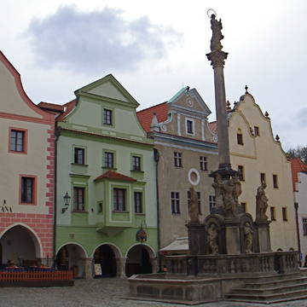
Historic Center of Český Krumlov
© UNESCO

Slide 15
Kutná hora

Slide 16
Prague

Slide 17
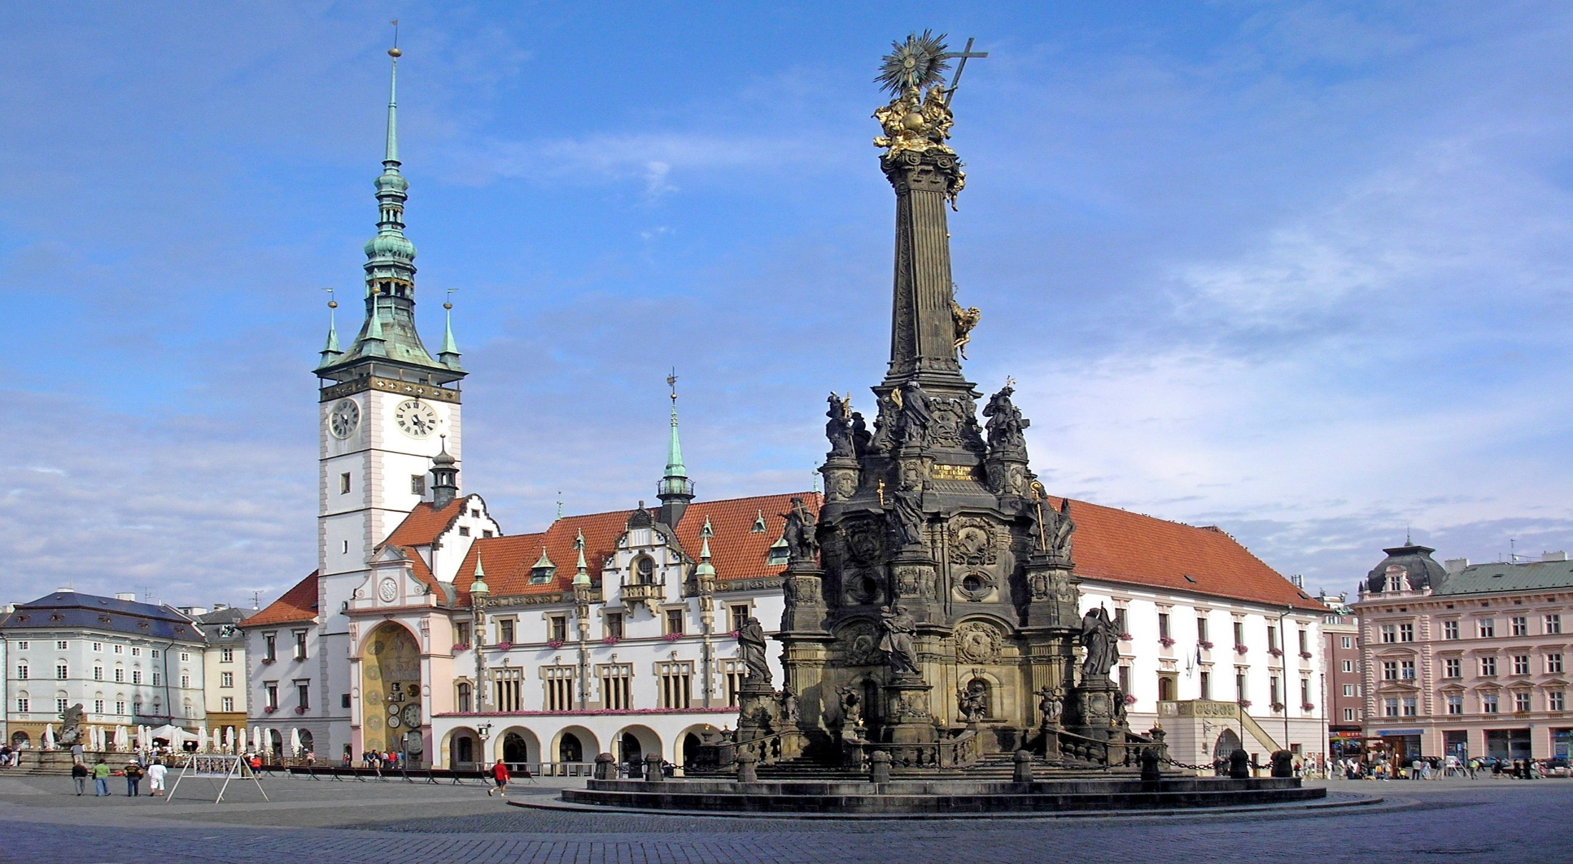
Olomouc

Slide 18
Intangible heritage – bluepringt technique (2018)

Slide 19
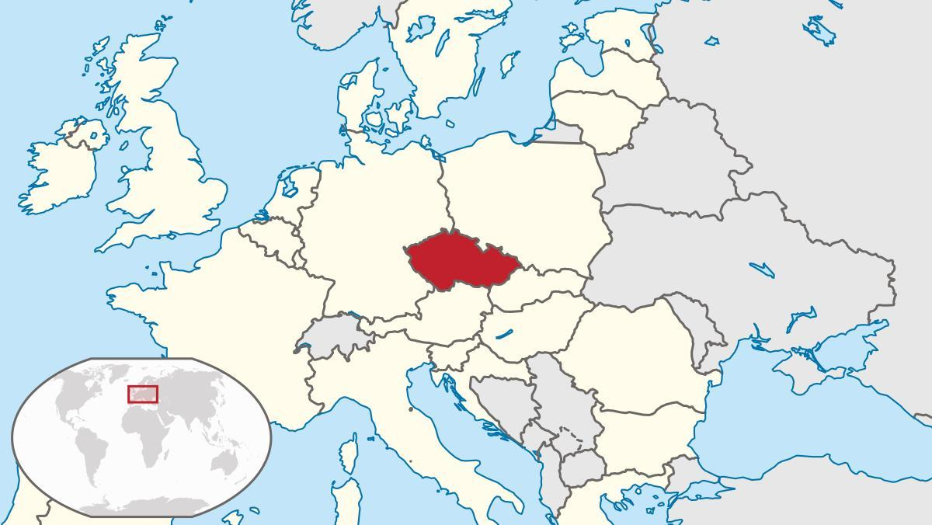
Czechia – why Czechia ? Small country in the heart of Europe

Slide 20
What does Czechia represent for you?
Beer
Open affection
Jan Hus
Crystal glass
Heavy food
Bad in languages
Cheep
Music is not everywhere
Kafka, Kundera
Masaryk, Havel

