Slide 1
Review of Poland‘s position paper by the European Parliament

Slide 2
Core values/beliefs of the European Parliament
Climate change is human-made
The Paris Agreement and the goals for 2050 must be reached
Central: decrease of CO2 emissions
Climate neutral energy sector

Slide 3
Coal industry
“Vetoing the EC’s climate neutrality goal for 2050 does not mean that Poland will give up on its plan to lower emission (Abnett, 2020). The Climate Minister of Poland had said that Poland still wants to achieve climate neutrality but only at its own pace”
“due to the fact that our country represents the biggest coal dependent state in the European union, we will not contribute to the European coal plan for 2050”
Source: OECD

Slide 4
THERE IS NO TIME
By 2050, without new policies...
The world economy is expected to be four times larger and it will need 80% more energy.
Global energy mix would not differ significantly from today, with the share of fossil energy at about 85%, renewables including biofuels just over 10%, and the balance nuclear. The BRIICS are projected to become major energy users, increasing their reliance on fossil fuels.
And as a consequence…
Global greenhouse gas (GHG) emissions projected to increase by 50%, primarily due to a 70% growth in energy-related CO2 emissions.
The atmospheric concentration of GHGs could reach 685 parts per million (ppm) CO2- equivalents by 2050 and this would cause an increase in the global average temperature. This one is expected to be 3 degrees celsius to 6 degrees celsius above pre-industrial levels by the end of the century.
Source: OECD

Slide 5
Reducing the coal consumption is also challenging for countries like Germany, which consumes more coal than Poland (almost double).

Slide 6
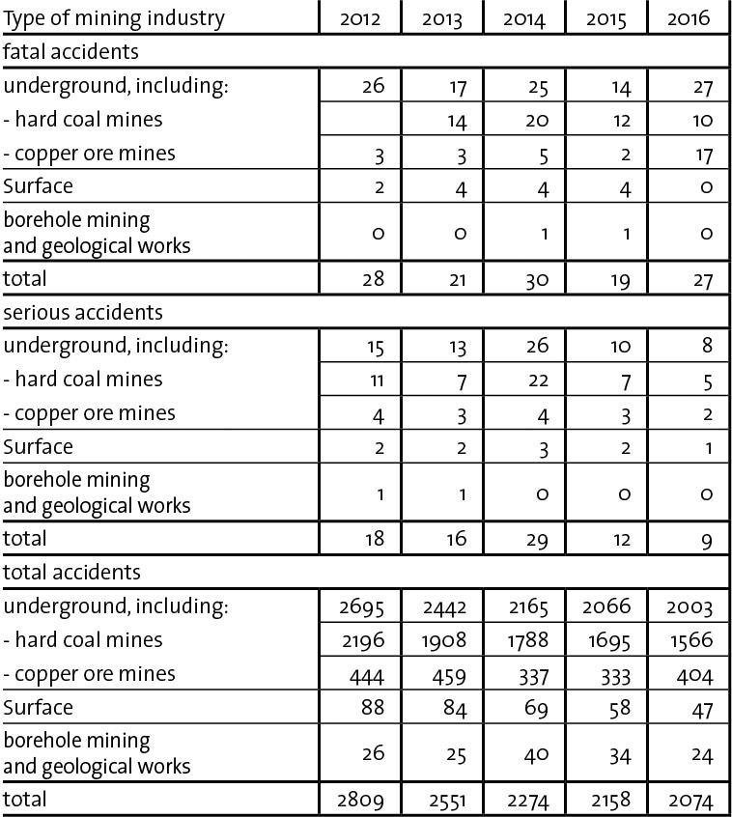
Coal: Catastrophic for environment but Good for people?
From 2012 to 2016, approximately 7% of the miners working in Poland suffered accidents.
In 2017, across the EU, the annual cost of air pollution from coal power plants is staggering.
Numerous health problems (mainly respiratory) to coal miners later in their life.
Accident rates in the mining industry between 2012 and 2016.
Notes:
From 2012 to 2016, approximately 7% of the miners working in Poland suffered accidents.
In 2017, across the EU, the annual cost of air pollution from coal power plants is staggering. Every year, there are 28 600 000 cases of lower respiratory symptoms; 4 100 000 lost working days; 2 100 000 days of medication; and 18 200 premature deaths associated with air pollution. The combined cost of all of this is between EUR 15.5–42.8 billion. Specifically in Poland, a recent report by the WHO and the OECD estimated that health costs from air pollution are equal to 20% of the country’s GDP. These costs are most likely higher, because healthcare costs and loss of workers productivity are not factored into the WHO/OECD assessment.
Numerous health (respiratory problems) to coal miners later in their life.

Slide 7
Challenges
“implementation of EU climate policy represents a big challenge for the Polish economy and political stability”
“Poland employs almost half of the 237,000 people who work in the coal industry in the EU”
Trust in Commissions supporting guidance
Strength EU position
Longterm economic benefits
Aware that jobs get lost, but:
> new jobs will be created
> retraining possibilities

Slide 8
Costs
“Investments which can not be bordered only on the shoulders of the polish people. So, if there is a collective interest in being prepared for tomorrow's outcome, it should also be carried collectively”
“An estimate of 900b€ is expected by Poland to fully transform its economy to carbon neutrality and the EU can only provide 100b€ to the whole EU countries”
“Either the EU budget will be significantly increased or the transition will only fully occur after 2050”
“But Visions need financial support”

Slide 9
Costs
EU supports deal financially
Member states must bear costs too
Green deal creates new infrastructures
Intrinsic incentives needed

Slide 10
Teamwork
“It should be more seen as an appeal to Poland’s more developed neighbors and historical partners that there are specific conditions in our national state which will determine our individual actions towards our collective goal”
No member state excluded
No excuses for inaction

Slide 11
Corona crisis
“the Polish government announced its concern of the impact of the pandemic on the economy of Poland (…) makes it more difficult to meet the EU’s climate goal set to 2050”
Economic cutbacks are likely
Stick to longterm goals, we must continue
The pandemic is affecting almost every country in the world‘s economy
For long-term goals there are always setbacks, if we abandoned a goal on any eventuality no goals would be achieved

Slide 12
Chances
“Gigantic Off-Shore parks in the Baltic Sea, adapted to the never-ending resources of the wind and tides. Vast lands ready for reforestation”
Parliament welcomes visions and hopes that Poland soon starts to implement them.
Tidal wave energy technology has many issues and is not very efficient (buoys need to be turned when not in perfect weather, and produce very little energy)

Slide 13
Perspective
“Poland has not been a frontrunner in climate change policies but accepts the binding international and regional agreements”
Hope that Poland changes its mind
Fight together against climate change

Slide 14
Statement
All member states are expected to comply without individual benefits or particular exemptions.
“A Project which can not be achieved by forcing the same responsibilities on inhomogeneous states, especially with the assumption which is not clearly proven to be the only way to reach the European collective goals. The European Union with its long traditions of social equality and esteem for sovereignty, represents the principle of common but different responsibilities. That is what the polish people believe in.” (Poland’s Position Paper)
The EU hopes to set an example for the rest of the world, inspire, and apply pressure to the countries that have not taken action. Agreeing with Poland would mean to also agree on what the USA and specifically China are doing regarding the environment.
Notes:
Parliament believes that the European Green deal is necessary, and that it is not as strict as experts and scientists would want or advice, it may even fall short. But it is the very least to do, and all member states are expected to comply without individual benefits or particular exemptions.
The main objectives of the Green Deal are clearly stated and understood all around. But there is a vital one that Poland has failed to understand. “A Project which can not be achieved by forcing the same responsibilities on inhomogeneous states, especially with the assumption which is not clearly proven to be the only way to reach the European collective goals. The European Union with its long traditions of social equality and esteem for sovereignty, represents the principle of common but different responsibilities. That is what the polish people believe in.” (Poland’s Position Paper)
By the acceptance and implementation of the European Green Deal, the EU hopes to set an example for the rest of the world, inspire, and apply pressure to the countries that have not taken action. Agreeing with Poland would mean to also agree on what the USA and specifically China are doing regarding the environment. Therefore failing this critical objective and justifying the actions of two of the countries that could do the most for the environment.

Slide 15
Sources
https://www.bpb.de/apuz/265493/polen – image, slide 1
https://www.indexmundi.com/energy/?product=coal&graph=consumption&display=rank – graphic, slide 5
https://mining-report.de/english/condition-trends-accident-rates-polish-mining-industry-2016/ -table, slide 6
https://www.sciencedirect.com/science/article/pii/S0168851017302361#bib0055 - slide 6

