Slide 1
PERSONALITY
PhDr. Eva Švarcová, Ph.D

Slide 2
Concept definition I.
Personality can be understood as a mental unit characterized by:
internal unity and structuring of its components (i.e. psychological properties and processes),
individual specificity (difference from other personalities),
developmental continuity (relative stability of psychological characteristics despite the ongoing development changes).
Notes:
Positive: Optimism, confidence, self-esteem, extraversion, emotional strength, friendliness, creativity. Negative: Irrationality, fear, emotional fragility, depression, anxiety, suicide.

Slide 3
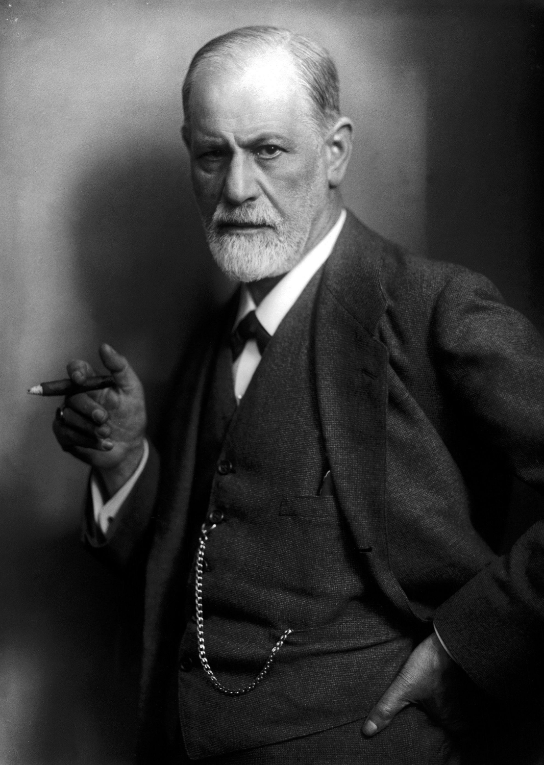
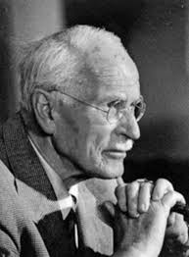
Concept definition II.
The human psyche is a highly complex phenomenon in which it is difficult to navigate.
Behaviour and experience should therefore be considered as a starting point for understanding personality in its context.
Sigmund Freud Carl Jung
Austrian neurologist and the founder of psychoanalysis.
Swiss psychologist and psychiatrist who founded analytic psychology.
Notes:
Hjumen sajki

Slide 4
Developmental influences I.
Biological determinism, the idea that most human characteristics, physical and mental, are determined at conception by hereditary factors passed from parent to offsprings.
1) biological determination - the basis is the innate constitution of a person.
It consists of the sense organs, nervous system, hereditary predispositions and instincts (congenital and specific biologically effective behaviour).

Slide 5
Developmental influences II.
2) socio-cultural determination - stimuli of the environment into which a person was born.
The process of personality formation by gaining social experience = socialization.
It results in the internalization of knowledge, norms, attitudes, habits, rules and roles applicable in a given society.

Slide 6
Mental development I.
Biological and socio-cultural determinants of the human psyche interact.
Hereditary equipment so called genotype (the genetic constitution of an organism), is a set of hereditary disposition to develop certain symptoms.
Their specific manifestation (expression), however, depends on the stimuli of the external environment - the specific realization of the genotype due to the environment is called phenotype (all the observable characteristics of an organism that result from the interaction of its genotype (total genetic inheritance) with the environment.

Slide 8
The Powerful Link Between Appearance and Personality
Illustration of how we rate faces on the following four factors:
(A) competence,
(B) dominance,
(C) extroversion, and
(D) trustworthiness.
The faces are presented from lowest scores on the left to highest scores on the right.
Notes:
For example, prominent cheekbones and high eyebrows have been found to be an indicator of trustworthiness (Olivola et al. 2014). Yet the shape of cheekbones and height of eyebrows presumably are primarily genetically determined (and hence not a mark of a certain kind of behavior).

Slide 9
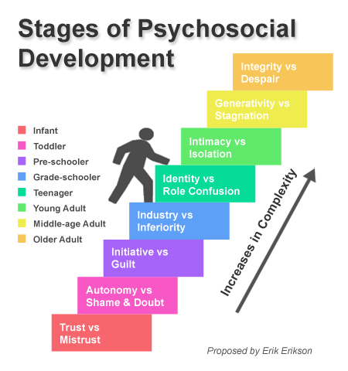
Psychological development II.
Psychological development: the development of human beings’ cognitive, emotional, intellectual, and social capabilities and functioning over the course of the life span, from infancy, childhood, adolescence to adulthood (old age).

Slide 10
Personality structure in general I.
Personality structure is a summary of psychological dispositions and assumptions that affect the mental life of an individual.
The structure consists of stable elements:
personality traits (features),
skills,
temperament,
character.
Let me introduce one of the latest researches on Personality conducted in 2018 at Northwestern University.

Slide 11
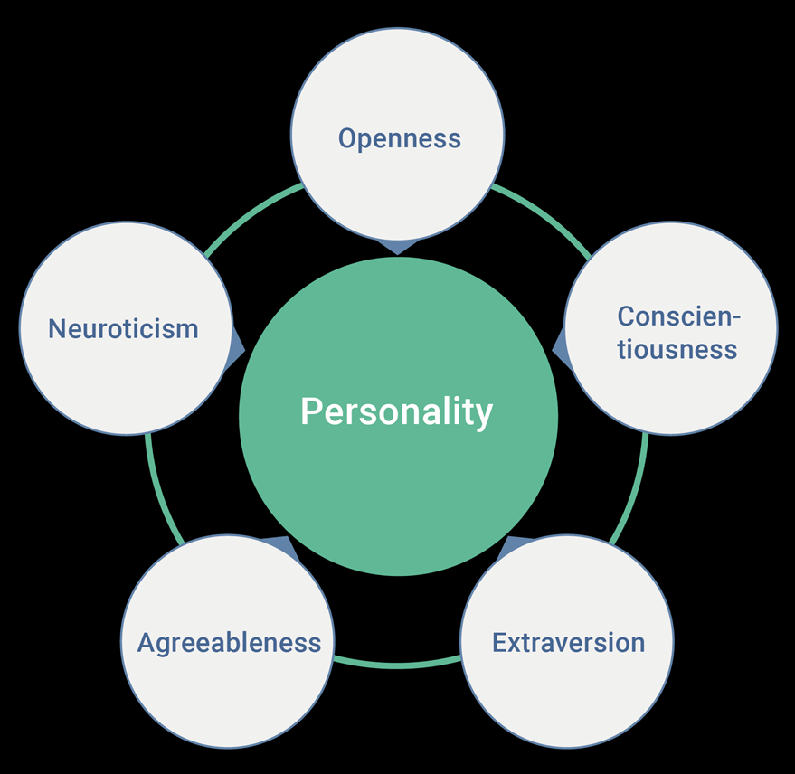
Personality structure in general I.
personality traits :5 Traits
In the field of psychology, there are five higher-order and widely accepted personality traits: neuroticism, extraversion, openness, agreeableness, and conscientiousness.
Open Source Psychometrics Project _test

Slide 12
Personality structure in general I.
Neuroticism — Individuals who score high on neuroticism are more likely than average to be moody and to experience such feelings as anxiety, worry, fear, anger, frustration, envy, jealousy, guilt, depressed mood, and loneliness.
High scoring individuals tend to be: awkward, pessimistic, fearful, self-critical, unconfident, insecure, and oversensitive
Low scoring individuals tend be: confident, sure of themselves, brave, and unencumbered by worry

Slide 13
Personality structure in general I.
Extraversion — Individuals who score high in extraversion are more likely to be outgoing, social, and the centre of attention. They enjoy being with people, participating in social gatherings, and are full of energy. A person low in extraversion is less outgoing and is more comfortable working alone.
High scoring individuals tend to be: sociable, assertive, merry, energetic, articulate, affectionate, and socially confident
Low scoring individuals tend to be: shy, introspective, thoughtful, and overall reserved with self-expression

Slide 14
Personality structure in general I.
Openness —Individuals who score high in openness are typically very intellectual curious and exhibit high emotional intelligence. Openness involves six facets, or dimensions, including active imagination (fantasy), aesthetic sensitivity, attentiveness to inner feelings, preference for variety, and intellectual curiosity.
High scoring individuals tend to be: original, daring, clever, insightful, curious, intellectual, and complex/deep
Low scoring individuals tend to be: routine-based, less abstract, and sticks with what they know and what is comfortable

Slide 15
Personality structure in general I.
Agreeableness — Individuals who score high in agreeableness are typically well-tempered and tend to err on the side of compassion and empathy over suspicion/cynicism. It is also a measure of one’s trusting and helpful nature, and whether a person is generally well-tempered or not. High agreeableness is often seen as naive or submissive. Individuals with low agreeableness are often competitive or challenging people, which can be seen as argumentative or untrustworthy.
High scoring individuals tend to be: altruistic, trusting, patient, tactful, sensitive, unselfish, well-liked, and respected
Low scoring individuals tend to be: cold-hearted, rude, ill-tempered, sarcastic, and antagonistic

Slide 16
Personality structure in general I.
Conscientiousness — Individuals who score high in conscientiousness are typically very efficient and organized. They have the tendency to be dependable, show self-discipline, act dutifully, aim for achievement, and prefer planned rather than spontaneous behaviour. High conscientiousness is often perceived as being stubborn and focused. Low conscientiousness is associated with flexibility and spontaneity, but can also appear as sloppiness and lack of reliability.
High scoring individuals tend to be: leaders, energetic, reliable, ambitious, persistent, hard working, and resourceful
Low scoring individuals tend to be: procrastinators, impulsive, headstrong, and hasty/reckless with decisions

Slide 17
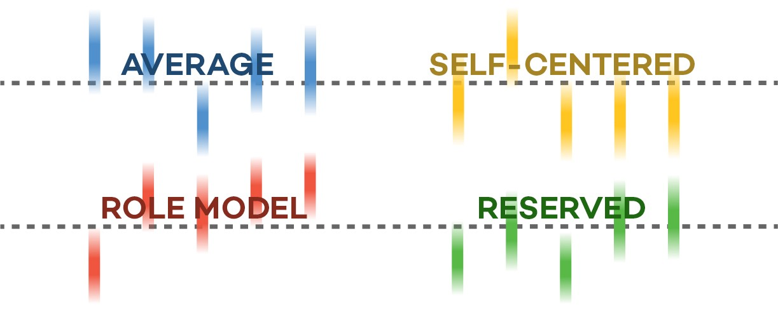
Personality structure in general I.
Using the 5 traits 4 distinct personality clusters were uncovered.

Slide 18
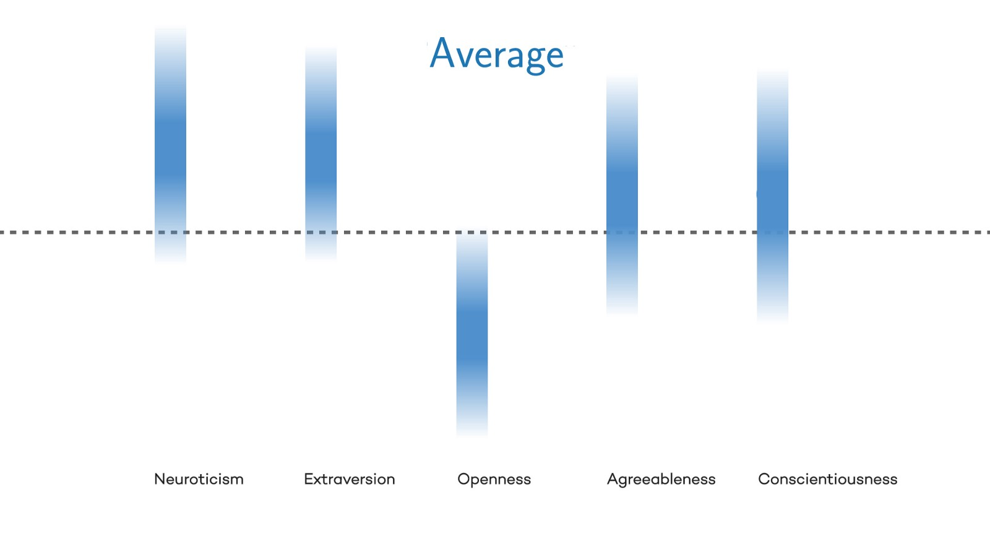
Personality structure in general I.
Average
Most common personality type
High in neuroticism and extraversion — tending to be more sociable, assertive, pessimistic, and over-sensitive
Low in openness — tending to be more routine-based and less open to abstraction
Tend to seek attention, but are not overly intellectually curious
More likely to be female, than male

Slide 19
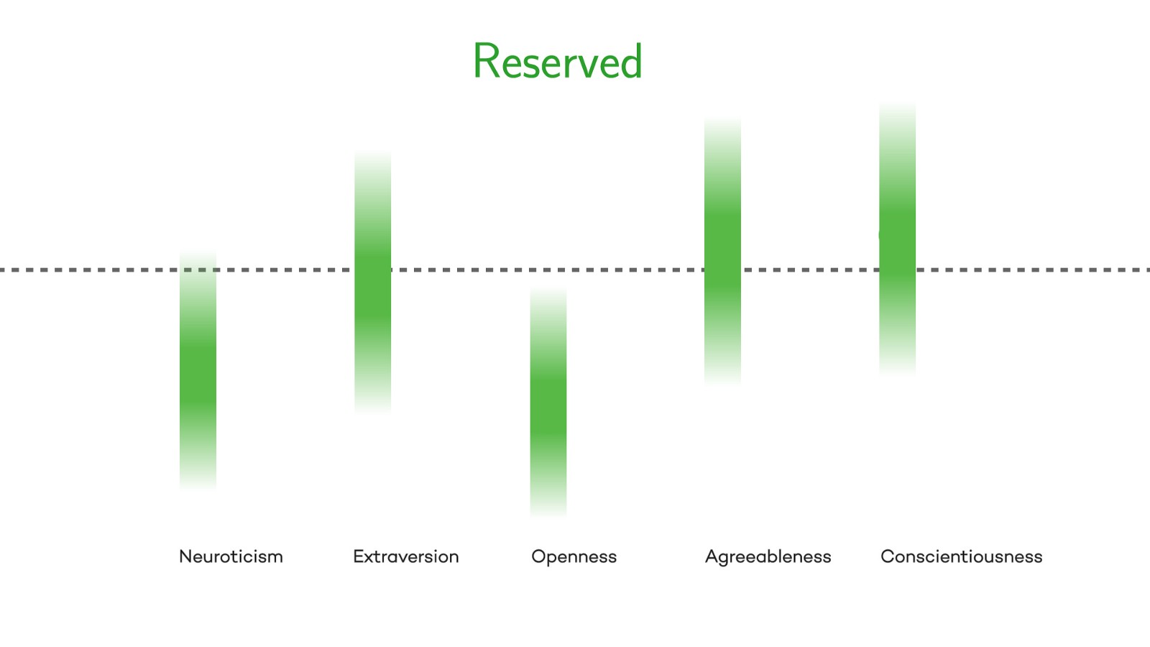
Personality structure in general I.
Reserved
Higher states of agreeableness and conscientiousness — tending to be more trusting, sensitive, well-liked, and reliable
Lower openness and neuroticism — tending to stay the course with confidence
Emotionally stable
Somewhat extraverted, but not overly so

Slide 20
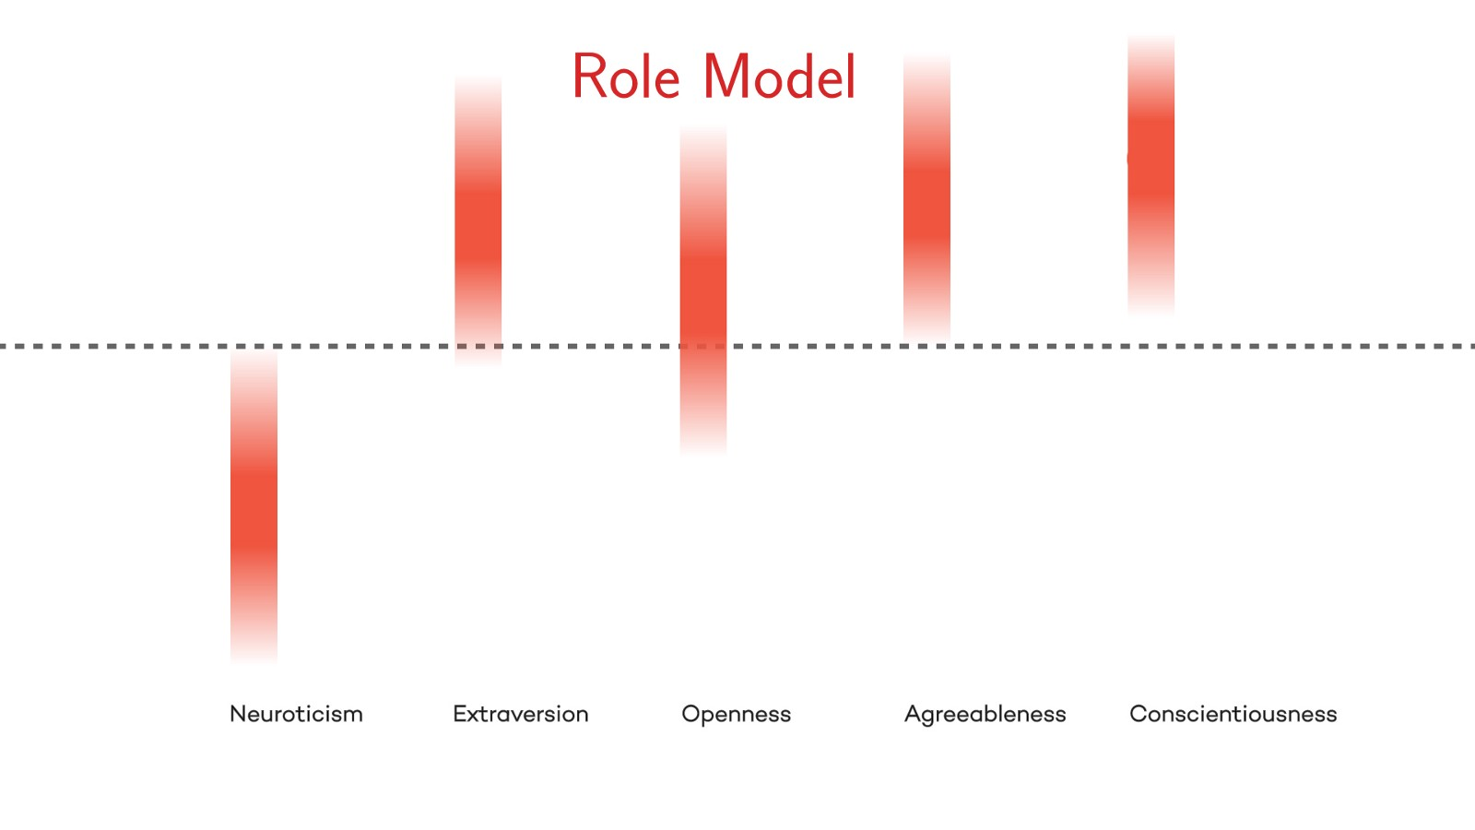
Personality structure in general I.
Role Models
High in extraversion, openness, agreeableness, and conscientiousness — tending to exhibit qualities that evoke respect and admired leadership
Low in neuroticism — tending to be more confident and brave, taking calculated risks
Dependable and open to new ideas
Strong leaders
More women than men
Likelihood to be a role model increases with age

Slide 21
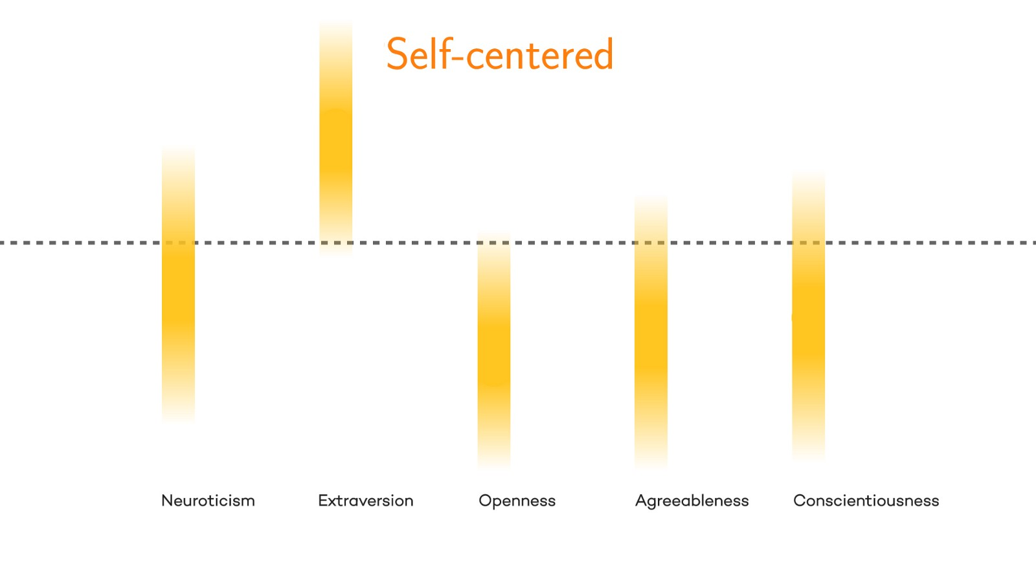
Personality structure in general I.
Self-Centred
High in extraversion — tending to be very socially confident, energetic, and outgoing
Low in openness, agreeableness, and conscientiousness — tending to be impulsive, headstrong, ill-tempered, cold-hearted, and routine-based
Typically self-serving at the expense of others
Likelihood to be self-centred decreases with age

Slide 22
Take aways
Understanding ourselves and our peers is critical to cultivating productive relationships
Personalities are a spectrum, and a clustered label shouldn’t necessarily define who we are.
More importantly, personalities are not static — they can and do change over time.

Slide 23
Personality structure in general II.
Skills = prerequisites for identifying and solving problems, as well as prerequisites for practical implementation of specific activities.
Within the skills we distinguish: mental knowledge, abilities, proficiency, dexterity.
Intelligence = a set of skills used to identify and solve problems.
Personality traits = characteristics that are specific to a particular individual.

Slide 24
Freud' s personality structure
The id presses us to act instantly and seek instant gratification. The ego asks us to delay and to think more carefully about our decision. And our super ego is our conscience letting us know if this behaviour is moral and right.
Notes:
Freud's Theory: Id
This is a psychoanalytic theory that is comprised of three elements that work together to explain an individual personality. This is a three part model comprised of the id, the ego, and the super ego. The first element is the id, which is comprised of unconscious feelings and urges, which is a need for instant, and often instinctual, gratification.
Freud's Theory: Ego
The second component is the ego, which is derived from the id and acts to be acceptable in the real world. The ego considers the benefits and the costs in making a decision and does not automatically seek out instant gratification. This is known as the reality principle, that acts to satisfy the id in socially appropriate ways.
Freud's Theory: Super Ego
The third component is the superego which is comprised of moral ideals and values. According to Freud, the superego develops around age five and helps us make moral judgments. This is where one develops a sense of right or wrong.
Freud believes everyone has an id, ego, and super ego. The id presses us to act instantly and seek instant gratification. The ego asks us to delay and to think more carefully about our decision. And our super ego is our conscience letting us know if this behavior is moral and right.

Slide 25
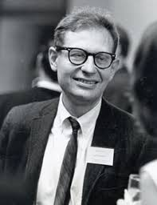
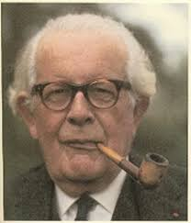
Personality structure in general III.
To identify personality traits expressions temperament and character has been used since antiquity .
E.g. Hippokrates (Sanguine, Choleric, Melancholic, Phlegmatic), Eyseck a Jung (Extrover, Introvert);
Jean Piaget (Heteronomous personality stage, Autonomous personality stage, Social conformity stage), Lawrence Kohlberg (pre-conventional, conventional and post-conventional stage).
Cognitive development_Piaget
Kohlberg´s 6 stages of moral development

Slide 26
Thank you for your attention

Slide 27
References
DRAPELA, V. Přehled teorií osobnosti. Praha: Portál, 1997. ISBN 80-7178-134-7.
KERN, H. a kol. Přehled psychologie. 1. vyd. Praha: Portál, 1999.
NAKONEČNÝ, M. Úvod do psychologie. 1. vyd. Praha: Academie, 2003. ISBN 80-200-0993-0.
ŘEHULKA, E. Úvod do studia psychologie. 2. vyd. Brno: Paido, 1997.
ŠTEFANOVIČ, J. Psychologie pro gymnázia a pedagogické školy. 3. vyd. Praha: SPN, 1974.
VÁGNEROVÁ, M. Úvod do psychologie. 1. vyd. Praha: UK, 1997.

