Slide 1
Diffusion and Expansion or parallel evolution?
First theories of origin, first classification of fairytales.
Material: First Research on Fairytales (handout)
Aarne-Thompson-Uther Tale Type Index (handout)
Propp´s Morphology of the Folktale (handout)

Slide 2
Diffusion and Expansion or parallel evolution?
First theories of origin
Material: First Research on Fairytales (handout)
1. Migratory theory = theory of diffusion
( = theory of monogenesis)

Slide 3
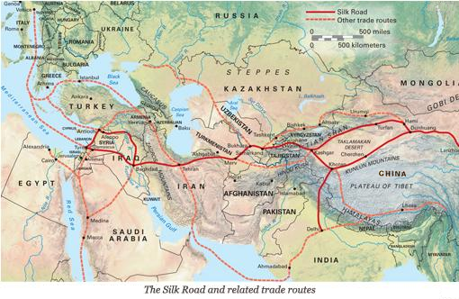
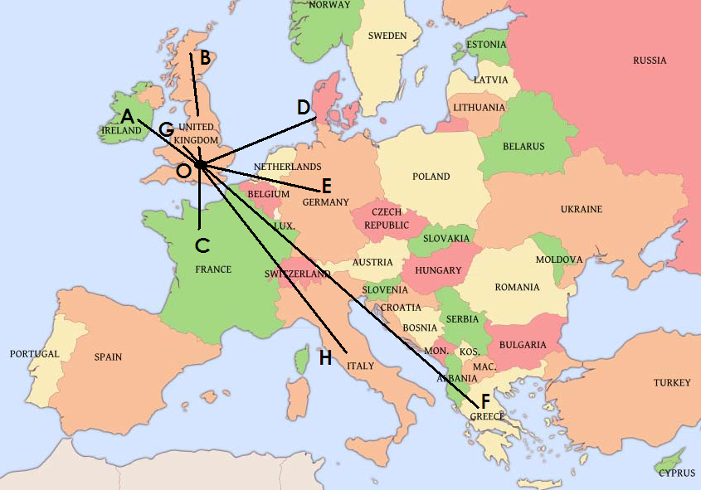
Diffusion and Expansion or parallel evolution?
First theories of origin
Material: First Research on Fairytales (handout)
1. Migratory theory = theory of diffusion
( = theory of monogenesis)

Slide 4
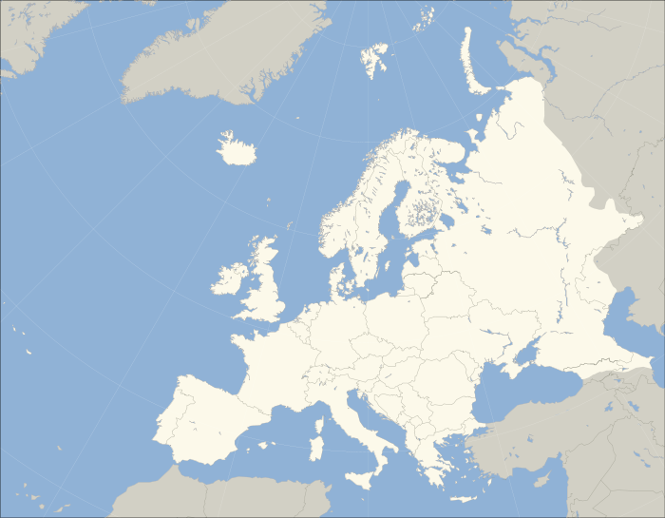
Diffusion and Expansion or parallel evolution?
First theories of origin
Material: First Research on Fairytales (handout)
A
B
C

Slide 5
Diffusion and Expansion or parallel evolution?
First theories of origin
Material: First Research on Fairytales (handout)
1. Migratory theory = theory of diffusion
( = theory of monogenesis)
2. Theory of paralel evolution
( = polygenesis)

Slide 6
2. Theory of paralel evolution ( = polygenesis):

Slide 7
2. Theory of paralel evolution ( = polygenesis):
a) natural school

Slide 8
2. Theory of paralel evolution ( = polygenesis):
a) natural school

Slide 9
2. Theory of paralel evolution ( = polygenesis):
a) natural school

Slide 10
2. Theory of paralel evolution ( = polygenesis):
a) natural school
b) cosmological / mythological school
(Grimm, Erben)

Slide 11
2. Theory of paralel evolution ( = polygenesis):
a) natural school
b) cosmological / mythological school
(Grimm, Erben)

Slide 12
2. Theory of paralel evolution ( = polygenesis):
a) natural school
b) cosmological / mythological school
(Grimm, Erben)
c) anthropological school

Slide 13
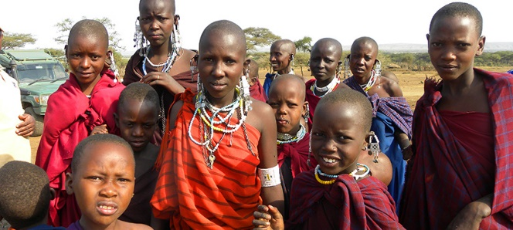
2. Theory of paralel evolution ( = polygenesis):
a) natural school
b) cosmological / mythological school
(Grimm, Erben)
c) anthropological school

Slide 14
2. Theory of paralel evolution ( = polygenesis):
a) natural school
b) cosmological / mythological school
(Grimm, Erben)
c) anthropological school
d) pre-psychological theories

Slide 15
2. Theory of paralel evolution ( = polygenesis):
a) natural school
b) cosmological / mythological school
(Grimm, Erben)
c) anthropological school
d) pre-psychological theories

Slide 16
First classification of fairytales.
Material: Aarne-Thompson-Uther Tale Type Index (handout)
Propp´s Morphology of the Folktale (handout)

Slide 17
First classification of fairytales.
Material: Aarne-Thompson-Uther Tale Type Index (handout)
Propp´s Morphology of the Folktale (handout)
So many tales everywhere?!
Let´s make some order!

Slide 18
First classification of fairytales.
Material: Aarne-Thompson-Uther Tale Type Index (handout)
Propp´s Morphology of the Folktale (handout)
So many tales everywhere?!
Let´s make some order!
Organizing, labeling, ordering
( = first classification)

Slide 19
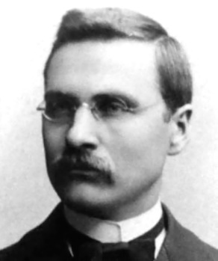
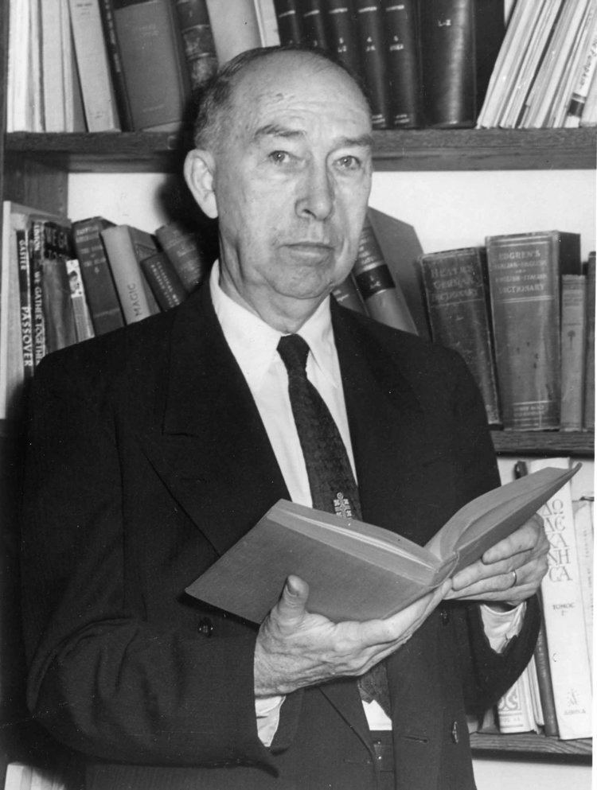
Organizing, labeling, ordering ( = first classification)
historical-geographical school:
Aarne-Thompson

Slide 20
Organizing, labeling, ordering ( = first classification)
historical-geographical school:
Aarne-Thompson Index
The Types of the Folktale: A Classification and Bibliography.
(1910, 1928, 1961)
- a cataloque of European folk tales types
= Tale Type Index = AT

Slide 21
Organizing, labeling, ordering ( = first classification)
historical-geographical school:
Aarne-Thompson Index
Fairy Tales
2.1 Supernatural Opponents 300–399
2.2 Supernatural or Enchanted Relatives 400–459
2.2.1 Wife 400–424
2.2.2 Husband 425–449
2.2.3 Brother or Sister 450–459
2.3 Supernatural Tasks 460–499
2.4 Supernatural Helpers 500–559
2.5 Magic Items 560–649
2.6 Supernatural Power or Knowledge 650–699
2.7 Other stories of the supernatural 700–749
The Types of the Folktale: A Classification and Bibliography.
(1910, 1928, 1961)
- a cataloque of European folk tales types
= Tale Type Index = AT

Slide 22
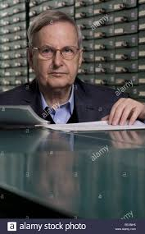
Organizing, labeling, ordering ( = first classification)
historical-geographical school:
Aarne-Thompson (-Uther´s) Index
Fairy Tales
2.1 Supernatural Opponents 300–399
2.2 Supernatural or Enchanted Relatives 400–459
2.2.1 Wife 400–424
2.2.2 Husband 425–449
2.2.3 Brother or Sister 450–459
2.3 Supernatural Tasks 460–499
2.4 Supernatural Helpers 500–559
2.5 Magic Items 560–649
2.6 Supernatural Power or Knowledge 650–699
2.7 Other stories of the supernatural 700–749
The Types of the Folktale: A Classification and Bibliography.
(1910, 1928, 1961)
- a cataloque of European folk tales types
= Tale Type Index = AT

Slide 23
Organizing, labeling, ordering ( = first classification)
historical-geographical school:
Aarne-Thompson (-Uther´s) Index
Fairy Tales
2.1 Supernatural Opponents 300–399
2.2 Supernatural or Enchanted Relatives 400–459
2.2.1 Wife 400–424
2.2.2 Husband 425–449
2.2.3 Brother or Sister 450–459
2.3 Supernatural Tasks 460–499
2.4 Supernatural Helpers 500–559
2.5 Magic Items 560–649
2.6 Supernatural Power or Knowledge 650–699
2.7 Other stories of the supernatural 700–749
The Types of the Folktale: A Classification and Bibliography.
(1910, 1928, 1961)
- a cataloque of European folk tales types
= Tale Type Index = ATU

Slide 24
Organizing, labeling, ordering ( = first classification)

Slide 25
Organizing, labeling, ordering ( = first classification)
Russian formalism:
Vladimir Propp

Slide 26
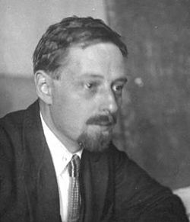
Organizing, labeling, ordering ( = first classification)
Russian formalism:
Vladimir Propp

Slide 27
Organizing, labeling, ordering ( = first classification)
Russian formalism:
Vladimir Propp: Morphology of the Folktale (1928)

Slide 28
Organizing, labeling, ordering ( = first classification)
Russian formalism:
Vladimir Propp: Morphology of the Folktale (1928)
31 narrative functions

Slide 29
Organizing, labeling, ordering ( = first classification)
Russian formalism:
Vladimir Propp: Morphology of the Folktale (1928)
31 narrative functions
16. STRUGGLE
17. BRANDING
18. VICTORY
19. LIQUIDATION
20. RETURN
21. PURSUIT
22. RESCUE
23. UNRECOGNIZED ARRIVAL
24. UNFOUNDED CLAIMS
25. DIFFICULT TASK
26. SOLUTION
27. RECOGNITION
28. EXPOSURE
29. TRANSFIGURATION
30. PUNISHMENT
31. WEDDING
1. ABSENTATION
2. INTERDICTION
3. VIOLATION of INTERDICTION
4. RECONNAISSANCE
5. DELIVERY
6. TRICKERY
7. COMPLICITY
8. VILLAINY or LACK
9. MEDIATION
10. BEGINNING COUNTER-ACTION
11. DEPARTURE
12. FIRST FUNCTION OF THE DONOR
13. HERO'S REACTION
14. RECEIPT OF A MAGICAL AGENT 15. GUIDANCE

Slide 30
Organizing, labeling, ordering ( = first classification)
Russian formalism:
Vladimir Propp: Morphology of the Folktale (1928)
31 narrative functions
7 Characters:
The villain
The dispatcher
The (magical) helper
The princess or prize and her father
The donor
The hero or victim/seeker hero
The false hero
16. STRUGGLE
17. BRANDING
18. VICTORY
19. LIQUIDATION
20. RETURN
21. PURSUIT
22. RESCUE
23. UNRECOGNIZED ARRIVAL
24. UNFOUNDED CLAIMS
25. DIFFICULT TASK
26. SOLUTION
27. RECOGNITION
28. EXPOSURE
29. TRANSFIGURATION
30. PUNISHMENT
31. WEDDING
1. ABSENTATION
2. INTERDICTION
3. VIOLATION of INTERDICTION
4. RECONNAISSANCE
5. DELIVERY
6. TRICKERY
7. COMPLICITY
8. VILLAINY or LACK
9. MEDIATION
10. BEGINNING COUNTER-ACTION
11. DEPARTURE
12. FIRST FUNCTION OF THE DONOR
13. HERO'S REACTION
14. RECEIPT OF A MAGICAL AGENT 15. GUIDANCE

Slide 31
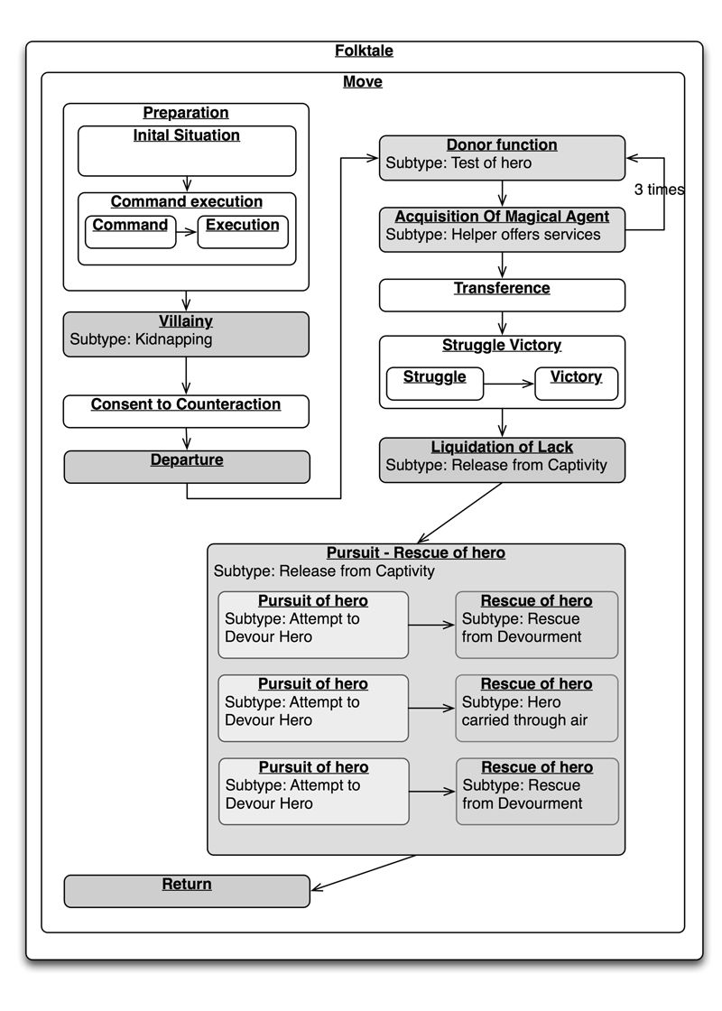
Organizing, labeling, ordering ( = first classification)
Russian formalism:
Vladimir Propp: Morphology of the Folktale (1928)
31 narrative functions
7 Characters:
The villain
The dispatcher
The (magical) helper
The princess or prize and her father
The donor
The hero or victim/seeker hero
The false hero
16. STRUGGLE
17. BRANDING
18. VICTORY
19. LIQUIDATION
20. RETURN
21. PURSUIT
22. RESCUE
23. UNRECOGNIZED ARRIVAL
24. UNFOUNDED CLAIMS
25. DIFFICULT TASK
26. SOLUTION
27. RECOGNITION
28. EXPOSURE
29. TRANSFIGURATION
30. PUNISHMENT
31. WEDDING
1. ABSENTATION
2. INTERDICTION
3. VIOLATION of INTERDICTION
4. RECONNAISSANCE
5. DELIVERY
6. TRICKERY
7. COMPLICITY
8. VILLAINY or LACK
9. MEDIATION
10. BEGINNING COUNTER-ACTION
11. DEPARTURE
12. FIRST FUNCTION OF THE DONOR
13. HERO'S REACTION
14. RECEIPT OF A MAGICAL AGENT 15. GUIDANCE

Slide 32
Russian formalism: Vladimir Propp: Morphology of the Folktale (1928)

Slide 33
Russian formalism: Vladimir Propp: Morphology of the Folktale (1928)
Claude Lévi-Strauss
(1908-2009) - structuralist theory of
mythology

Slide 34
Fairytale and Society. Fairytale and World around Us. Sociohistorical/ anthropological approach to fairytales

Slide 35
Fairytale and Society. Fairytale and World around Us. Sociohistorical/ anthropological approach to fairytales
L. Röhrich: Magic

Slide 36
Fairytale and Society. Fairytale and World around Us. Sociohistorical/ anthropological approach to fairytales
L. Röhrich: Magic
L. Röhrich: Manners and Customs (both in: Folktales and Reality, 1978)

Slide 37
Fairytale and Society. Fairytale and World around Us. Sociohistorical/ anthropological approach to fairytales
L. Röhrich: Magic
L. Röhrich: Manners and Customs (both in: Folktales and Reality, 1978)
V. Propp: Historical Roots of the Wondertale
(in:Theory and History of Folklore, 1928 )

