Slide 1
Theory Construction
1. Introduction to the course and How to write a good research paper?
Dina Abdelhafez
Notes:
1-How to be practical and make the research paper an easy task
2-Choosing the phenomenon (their specification), the thesis statement (problem understudies), then conceptual framework steps, and the
How to make RQ matrix and synthesis matrix for the literature, it can be part of the assignment.
Besides, this course can help the attendees to go through their ladder of concept in order to enrich their research study with sufficient concepts and be able to conceptualize, then operationalize this concept according their research goal. Then, they can pick their research method to collect the data and the sample frame without going in too many details about tools of qualitative and qualitative methodologies.

Slide 2
Overview
Introduction & Course goals and practical arrangements
structure of the paper
Searching for academic papers
Paraphrasing and proofreading
Citation and plagiarism
Theory Vs Theorizing
The sociological imagination
What you need to theorise
Theorizing as a Social scientist

Slide 4
1. Course goals and practical arrangements
‘Theory Construction’ explores the nature of theorising in the social sciences and helps you in reflecting on/thinking about your research.
The emphasis lies not on theories, but on creative, independent and disciplined theorising as a practical skill.
Central questions:
How to think about the social world?
How to translate your interests into public and social policy research questions, research designs and empirical analyses?
What are the main building blocks in social inquiry and how can we use them? e.g. the use of concepts, causal explanations, different levels of analysis, comparison,…

Slide 5
Learning Goals
Elementary knowledge and practical skills for conceptualizing social science inquiry, i.e. “learning to think sociologically”.
Knowledge and insight about
Specificity of theorising in the social sciences and public and social policy in particular
Different phases in the development of your research object
Typical problems in social science inquiry
Practical skills needed to theorise independently:
Apply heuristics that help you to theorise creatively
Identify research goals and develop adequate strategies to transform them into adequate research designs, questions and strategies
Construct research questions, hypotheses and models
Notes:
Heuristic means enabling a person to discover or learn something for themselves

Slide 6
Course content
Part 1: Introduction
Theorising in the social sciences
Creative theorising
Working seminar
Part 2: Approaches in theorising
Research processes, designs and goals
Working seminar
The (post-)positivist approach
The interpretive approach
Reviewing a sociological issue (literature review)
Part 3: Issues in theory construction
Levels of analysis (micro, meso and macro)
Working seminarComparing

Slide 7
Lectures
Wednesday at 2:00 pm ROOM J2019
Reviewing, discussing, and explaining the reading material in an interactive and reflective way.
Each class is based upon approximately two or three texts (chapters or articles)
You are expected to skim the texts related to the theme of the class ahead. I will announce the text for the next week at the end of every lecture
You do not need to study these texts by heart, but you are stimulated to use them for your own research (e.g. master thesis, bachelor thesis, seminar work,other course essays,
Powerpoint presentations of the lectures (in English) are available on Moodle after the lectures.
Notes:
The orientation of the lectures Divide the lectures as per topic and after each topic a break for pairs or groups to talk by answering one questions
1-What do you understand?
2-What do not you understand?
3-How can you reflect this in your topic?
Taking notes is overwhelming for some people, so we will share the lectures together and they are summaries for the reading, so for more details go to the same points in the reading materials and read more, if you did not understand, so come back to me

Slide 8
Evaluation
The assessment of this course consists of two parts:
Throughout the semester, students are required to complete three individual assignments, assessing the competences and skills (45% of the final grade).
A written exam (in English) testing knowledge and understanding of course contents (55% of the final grade). The exam is “open book”: students are allowed to use the reading materials (but not the power point presentations).

Slide 9
The individual assignments
Explained in the corresponding working seminars (briefly stated in syllabus).
After each assignment there will be feedback.
Late submissions receive a reduction of 2 out of 20, repeated for every extra week of delay. These assignments are mandatory: is not possible to take the exam unless all three assignments are submitted.
If you are unable to meet the deadline due to medical or familial reasons, contact the teaching staff as soon as possible (that is, before the deadline), and provide a (medical) certificate proving the inability to finish the assignment.
Written exam with open book or reading materials except for the slides (55%)
Three individual assignments (45%)

Slide 10
Any other questions?
Please read the general information in the syllabus
Questions:
Office hours before lectures on Wednesday, but send to me email to be there for you
Via email: 73198435@fsv.cuni.cz
You can ask me everything in person, before, during of after the lecture

Slide 11
2. Important techniques and Skills
structure of the research paper
Searching for academic papers
Paraphrasing Vs plagiarism
Proofreading
Citation

Slide 12
Paper structure
For this course:
Introduction
Body
Conclusion.
The references

Slide 13
Research Paper structure
it consists of eight parts
A front title page
The introduction
The theory section
The methods section
The analysis/outcomes
Discussion
The conclusions
The references

Slide 14
Searching for academic papers
Use Google scholar for searching for any academic paper.
Random articles or blogs are not considered a trusted reference.
If you can’t access the paper through our library access, so you can use
Www.sci-hub.se
After you go to the journal for this article’s website search for the doi for this article.
Copy this doi and paste it in the search bar for ”Sci-hub” to access this article and download it for free.
We do not read articles word by word, so we skim it by reading abstract, if the article is related to your topic, so read introduction, so if you feel that it is related to your topic, so go a head and read the conclusion, if find it is interesting, so going through each paragraph read first sentence to know what the paragraph idea, if it is related to your idea, so read in-depth.

Slide 16
Searching for a phenomenon
Choose the area you are interested to study.
Find the specific topic them by finding
Glossary for…
Review on literature for…
Literature review about (your idea/ topic).

Slide 17
Paraphrasing Vs plagiarism
We do not copy and paste from articles because copying more than two successive words is plagiarism.
We read the sentence and write it by our own words, so if you do not understand the sentence, translate it in your mother tongue language and then write it with your English.
If you use an article from your language and you only translate-copy-paste without paraphrasing, this is plagiarism and cheating.
Academic writing encompasses using transaction/linking words to make your paper easy to follow. Use these links
https://awelu.srv.lu.se/the-writing-process/drafting/unity-and-clarity/linking-words-and-phrases/
https://dictionary.cambridge.org/grammar/british-grammar/

Slide 18
Proofreading
After finish writing your paper use your free access as student in UK for
Grammarly.com

Slide 19
Citation
Mention all the articles you use to write this paper by following the citation style
Do not forget the in-text citation and References at the end of the paper.

Slide 20
3. What would a sociologist say?
Notes:
Obesity seems to be a purely individual feature, the outcome of an individual lifestyle, genetic and medical dispositions, etc.
Yet, there are quite a lot of sociologically meaningful features to this situation / sociologically interesting questions to ask :
‘norms and values’ : there is a fairly large consensus within our society, across different social groups, as to what constitutes the ‘legitimate’ and ‘illegitimate’ physique
‘social structure’ : obesity is not evenly distributed across different population groups
Possible causes: poverty (less money/means to buy healthy food), lack of knowledge, socialize into different eating behaviors
Effects? Consequences?

Slide 21
Theory?
3. Theory Vs Theorising
Theorising?
“abstract”, “technical” and “philosophical”
Concepts and definitions
A body of ideas on how the social world works
A practical, intellectual skill
Trying to understand social phenomena by thinking about possible descriptions/interpretations and explanations
Notes:
A lot of people tell me that “I’m just not good in theory. It’s not my thing. Habitus, power, differentiation: those are all abstract concepts. I don’t know what to do with it, it’s difficult, it’s abstract, it’s boring.
If you think like that about theory, I’ve got good news for you and even better news.
The good news is: this course is not about theory. You will not have to learn (a load) of new abstract concepts and reproduce their definitions.
The better news is: in this course you will theorise yourself! You will learn to think independently on social phenomena. You’ll learn to come up with explanations, ways in which you can turn interesting stuff into empirical research. And you’ll learn how you can usefully use existing theories.
This course is about theorising as a practical, intellectual skills. As something you do. As something all good social scientists do, whether they are interested in “theories” or not…

Slide 22
Theorising
Trying to understand particular social phenomena by thinking about possible descriptions/explanations
A set of practical, intellectual skills, rather than knowledge of existing ideas and concepts (yet, some knowledge of sociological concepts will come in handy)
You can use existing theories and concepts, but the key point is that you do it yourself!
Is more like a puzzle, emerges from whatever fascinates you, start your imagination, or draws you in…

Slide 23
R. Swedberg, The art of social theory, pp16-28.
Theory: “a statement about the explanation of a phenomenon”
Theorising: “the process through which a theory is produced.”
“to see, to observe, and to contemplate”

Slide 24
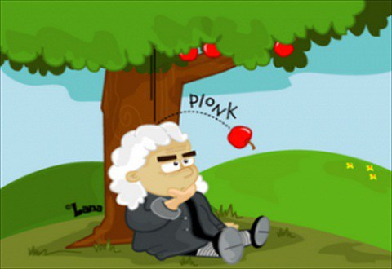
The sociological imagination
All sciences try to describe/explain particular phenomena (as accurately as possible)
What is specific about the social sciences is the sociological imagination…

Slide 25
C.W. Mills, The sociological imagination, pp5-11.
“the capacity to range from the most impersonal and remote transformations to the most intimate features of the human self – and to see the relations between the two”
The ability to “grasp history and biography and the relations between the two”
So that “the individual can understand his own experience and gauge his own fate only by locating himself within his period”

Slide 26
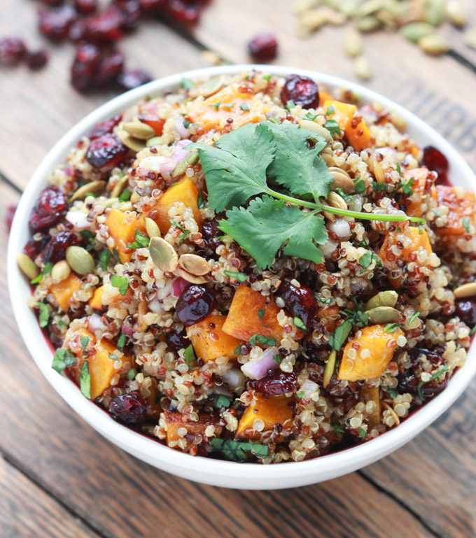
E.g. your favourite lunch…
May seem a matter of personal taste…
Yet it is strongly related to your social identity: subcultures among peers, media consumption, where you live,…
And to your level of education, class, ethnic background, age, gender, the time you live in…

Slide 27
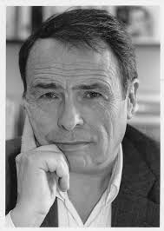

Slide 28
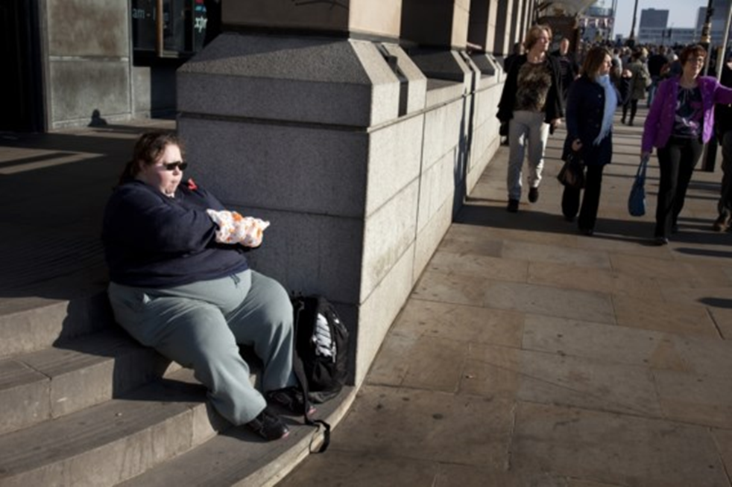
Differences in class-habitus do not just translate in different cultural, consumer, food, etc. preferences, but effectively become materialized in the physical contours of the body, its size and shape
Drawing on survey-data (on weight and weight-concern, food preferences, sporting practices, etc) , we can learn (Vandebroeck, 2016)
a) that the probability of effectively ‘embodying’ culturally legitimate/ideal body-types is unequally distributed across social space;
b) that people more readily attribute the most stigmatized (i.e. corpulent) body-types to dominated social categories (i.e. the ‘unemployed’ and ‘workers’), while disproportionately assigning the most valorized body-types (i.e. slim, toned) to dominant categories (i.e. business[wo]men and artists)
c) that physical differences are not only imbued with an aesthetic, but also a moral significance and deemed indicative of traits like ambition, intelligence and self-control.
In sum, “bodies not only function as key markers of class-differences, but also help to naturalize and legitimize such differences“ (Vandebroeck)

Slide 29
4. Sociological imagination: connecting personal troubles with public issues (Mills)
Troubles: individual, personal, singular, immediate relations, private affairs
Issues: organisation of personal milieux, institutions, public matters…
e.g. unemployment
10 unemployed men and women in a city with high employment is a matter of personal trouble: we look at his mentality, his skills and the immediate opportunities for solving the problem
100,000 unemployed men and women in a small city is a public issue: we examine the labour market, education system, welfare support, government regulation,…
e.g. marriage
Personal troubles among married couples
Public issues: rising divorce rates
Notes:
Not just how individuals are determined by social structures or context. No, it works the other way around as well: how structures are often the result of individual actions and preferences…
e.g. Marriage: examining high divorce rates by conducting in-depth interviews, by listening to people’s stories. Maybe our requirements are changing of what we expect from a relationship… What does marriage mean to people? How does this result in rising divorce rates?

Slide 30
What you need to theorise
R. Swedberg,The art of social theory, pp169-180.
A deep knowledge of what makes something social
Being familiar with a number of concepts and theories
Notes:
What does it mean to look at things from a sociological perspective? And how do you develop this capacity?

Slide 31
4.1. A deep knowledge of what makes something social
What is the social?
What are the causes and effects of the social?
How does the social change?
What makes a particular topic important?

Slide 32
4.1. A deep knowledge of what makes something social
What is the social?
Durkheim: Activities related to groups or categories of people
Weber: Undertaking actions that are meaningfully oriented to the behaviour of other actors
E.g: donating money to “music for life”
Durkheim: Examine the correlation of donating with class, ethnic background, age and gender
Durkheim: Researching it as a form of “social integration”
Weber: an individual strategy to improve one’s social status…

Slide 33
4.1. A deep knowledge of what makes something social
What is the social?
What are the causes and effects of the social?
Durkheim: explain the social by means of the social
e.g. suicide rates: disintegrated, individualistic societies with loss of meaningful social contact…
Weber: explain the social by examining individual, yet culturally motivated actions and their consequences (Weber)
e.g. a desire for individual wealth produces a competitive cultural mentality…

Slide 34
4.1. A deep knowledge of what makes something social
What is the social?
What are the causes and effects of the social?
How does the social change?
Societies and social groups are never static
They need to be continually reproduced, they demand continuous work

Slide 35
4.1. A deep knowledge of what makes something social
What is the social?
What are the causes and effects of the social?
How does the social change?
What makes a particular topic socially important?
Requires social importance: something that is relevant to many people (e.g. unemployment, loss of identity, violence, divorce,…)

Slide 36
4.2. Knowledge of existing sociological concepts
e.g. social actions, power, status, meaning, strategie, social facts, individualisation, rituals, anomie, solidarity, superdiversity,…
You need to know a number of them, so that you have plenty to choose from when you try to theorise a phenomenon
Engage in casual, indiscriminate reading: read anything that fascinates you…

Slide 37
4.2. Knowledge of existing public policy concepts
Toward better theories of the policy process Sabatier, P. A. (1991).
E.g. types of institution (the presidency, administrative agencies, interest groups, legislatures, local government, political parties).
Types of political behavior outside these institutions (public opinion, voting, political socialization).
The researcher have to read about empirical work related to the phenomena:
a) The importance of policy communities/networks/subsystems involving actors from numerous public and private institutions and from multiple levels of government;
b) The importance of substantive policy information;
c) The critical role of policy elites vis-a-vis the general public;
d) The desirability of longitudinal studies of a decade or more; and
e) Differences in political behavior across policy types
Political scientists and policy scholars share a common interest in developing better theories of the policy process than the stages heuristic. Such theories should integrate many of the contributions of policy scholars with political scientists' traditional focus on the preferehces, interests, and resources of various actors, institutional rules, and back- ground socioeconomic conditions.

Slide 38
4. What you need to theorise
A deep knowledge of what the social is
What is the social?
What are the causes and effects of the social?
How does the social change?
What makes a phenomenon important?
Being familiar with existing sociological concepts
E.g. social action, power, status, meaning,…
Read deeply and with great attention!
Asking these questions should be a matter of intuition, of trained sensitivity
Read widely but follow your interests!
Think instrumentally as to how you can usefully apply these concepts to the phenomenon you’re studying

Slide 39
5. Theorising in the social sciences
R. Swedberg, The art of social theory, pp16-28.
Phase 1. The prestudy or early theorizing (“context of discovery”)
Observe and focus on something interesting or surprising
Generate ideas that help you understand and/or explain the phenomenon
Think creatively and wildly (almost anything goes)
Phase 2. The main study (“context of justification”)
Turning early theories into research questions and designs
Execute the research, draw conclusions from your data and theorise again
Construct a fully-fledged theory of your phenomenon
Refute alternative explanations

Slide 40
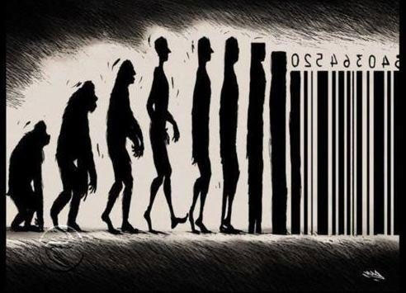
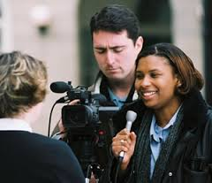
5. Theorising in the social sciences
The social sciences are just “one among many ways of constructing representations of social life – of telling about society”
e.g. journalism, documentaries, film, novels, art, street-level discussions,…

Slide 41
6. Theorizing as a Social scientist
6.1. Address socially significant phenomena
General issues, rather than personal troubles
E.g. “my uncle is an alcholic” vs “ rise in alcoholic young people”
E.g. “I have lost my job” vs “youth unemployment in Spain”
Socially significant because it is rare or unusual
E.g. an organisation that works completely horizontal…
E.g. an individual from poor background becoming CEO
Or because of their historical significance
E.g. the abolition of slavery
E.g. the rise of “total institutions” for the mentally ill

Slide 42
6. Theorizing as a Social scientist
6.2. Engage directly or indirectly with social theories
Theory as “a set of loosely connected, ongoing conversations about abstract ideas with other social scientists and social thinkers”
E.g. studying a religious cult:
A social scientist will compare this cult with (studies on) other cults, trying to show the relevance of the new one being studied…
Whereas a journalist might simply focus on the bizarre or unusual practices of this particular cult…

Slide 43
6. Theorizing as a Social scientist
6.3. Use large amounts of evidence
In-depth information about a limited number of cases
Or a limited amount of information about a large number of cases…
Purposefully collected through a specific research design to collect the right type of data to answer specific scientific questions

Slide 44
6. Theorizing as a Social scientist
6.4. Analyse that evidence systematically
Software programmes
Specialised in-depth interviews
E.g. why do some men and women choose not to have children
A journalist might simply tell the stories of a handful of women, or present some general statistics
In-depth interviews (2 to 4 hours each)
30 to 60 persons
All need to be transcribed and analysed in detail…

Slide 45
6. Theorizing as a Social scientist
What distinguishes social-scientific research from other ways of telling and thinking about society
It addresses socially significant phenomena
Engages directly or indirectly with social theories
Incorporates large amounts of appropriate evidence
Its results emerge from a systematic analysis of this evidence

Slide 46
Summing up
“Theory construction” is about creative, independent and disciplined theorising in the social sciences.
The emphasis lies on acquiring practical, intellectual skills that enable you to theorise yourself, rather than on learning and applying existing theories.

