Slide 1
Turkey and “Mosque Diplomacy” in the Western Balkans
Eva Závadová

Slide 2
Concept of Neo-Ottomanism
Why Mosques?
Ahmet Davutoglu and The Strategic Depth
Restoring islamic heritage
Symbolizing the Ottoman era
Unification of the region
Turkey as a peacemaker
Religious as an instrument
Religious and symbolic value
Direct connection with society
Mosques and madrasas
Educational institutions, scholarships
Notes:
there has been an evolution of the neo-ottomanism narrative - the interest in Balkans in its nowadays intensity came a little bit later
Geo-culture
he was a theorist - turkish foreign policies was completely evolved as a political theory
emphasis on the Ottoman past and Islamic religion as a common bond
a Peacemaker in the Caucasus and Balkans

Slide 3
Actors
Goals
TIKA - Prime Ministry Turkish Cooperation and Coordination Agency
Diyanet - Directorate of Religious Affairs
Gulen movement
Nye’s concept of attraction
Influence in the Western Balkans
Establishing relations with countries
Neutralization of other actors
Turkey’s religious agenda
Notes:
Rise of AKP and Erdogan
expansion in last decade
development assistance
justice and development party
consultancy in every WB country
religious agenda - mixed with politics, but also maybe a way to estabilsh turkey as the main Islam branch sice there are also other states building influence - like SA, Iran etc.
2016 coup criminalization of the organization in WB
different reactions, strengthening of soft power
appointing imams, consultancy
religious books, cultural activities

Slide 4
Namazgah Mosque in Tirana
Mega-mosques - Ottoman style?
Prime Minister Edi Rama and election campaign 2014
Albanian Muslim Community pro-Turkish wing
Turkey’s demand to appoint AMC chairman
Action again Gulen movement
Manifestation of personal friendship
“unique symbol of the brotherhood between nations”
Mufti and director Skënder Bruçaj
Notes:
Deportation of Gulen supporter o cccurred after the earthquaek 2019 s a transsactionaf for Turkish investments
whom he believed was a member or a sympathizer of the Gülen Movement, should be removed from office, and refused to shake his hand. - 2015
Erdogan’s demeanour as actions interfering with the nation’s domestic affairs
Turkish funds = mosque under Erdogan’s authority

Slide 5
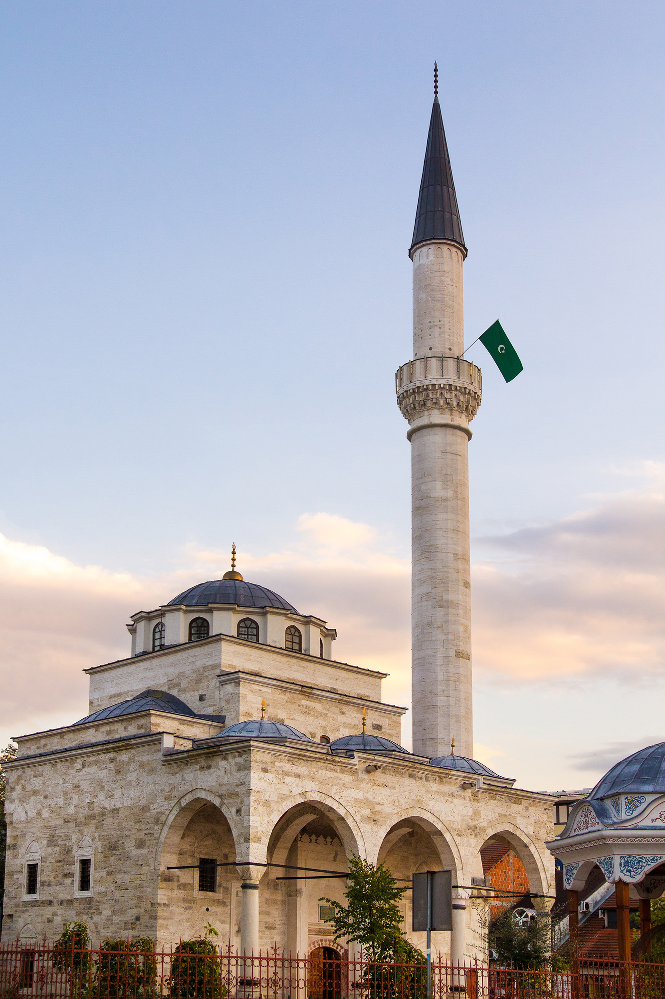
Ferhadija Mosque in Banja Luka
Destroyed Ottoman cultural heritage as a symbol of neglect
Donor Coordination Forum (DCF) in BiH
IZBIH - SDA - Turkey and AKP
Salafism and Wahhabism - Turkey as a neutral player?
“Bosnia-Herzegovina, with its Muslims, Catholics, Orthodox and Jews, is one body, one heart.” - Davutoglu, 2016
Notes:
Alija Izetbegović in Turkey
during the foundation of the destroyed mosque in 2001, one person was killed by serb nationalist
Davutoglu at the opening

Slide 6
Central Mosque in Pristina
Answering to people’s needs
Western disinterest?
Construction postponed until 2020
Conference hall, youth center, library, Quran courses
“Turkey is Kosovo and Kosovo is Turkey.” Erdogan, 2013 in Pristina
Bayrampaşa mosque in Mitrovica (2014)
Notes:
To create the preconditions for soft power, the state’s actions must somehow be recognized by the local public, and this is clearly the case with the Bayrampaşa- and Antalya mosques.

Slide 7
Conclusion
Religion as a political instrument
Internal destabilization
Supporting Muslim minorities
Importance of Islamic communities institutions
High participation - manifestation of mutual friendship

Slide 8
References
Ahmet Erdi Öztürk. Religion, Identity and Power : Turkey and the Balkans in the Twenty-First Century. Edinburgh University Press; 2021. Accessed March 16, 2024. https://search.ebscohost.com/login.aspx?direct=true&db=e000xww&AN=2802614&lang=cs&site=ehost-live
Öztürk, Ahmet Erdi, and Jeffrey Haynes. 2021. Religion, identity and power: Turkey and the Balkans in the twenty-first century. Edinburgh: Edinburgh University Press. https://doi.org/10.1515/9781474474719.
Ali, M., 2022. TURKEY’S SOFT POWER POLICY TOWARDS THE BALKANS: CHALLENGES AND PERSPECTIVES. Journal of Liberty and International Affairs (Bitola), 8(2), pp.255-265.
K se, I., 2019. Turkey's Soft Power Policy towards the Balkans after the 1990's: Challenges and Opportunities. Codrul cosminului (Suceava, Romania), 25(2), pp.407-424.
Rašidagić, Ešref Kenan, and Zora Hesova. 2020. “Development of Turkish Foreign Policy Towards the Western Balkans with Focus on Bosnia and Herzegovina.” Croatian international relations review 26 (86): 96-129. https://doi.org/10.37173/cirr.26.86.4.
Historic Bosnian mosque reopens in move towards reconciliation | Reuters
Turkey's gift of a mosque sparks fears of ‘neo-Ottomanism’ in Kosovo | Cities | The Guardian
Mosqued objectives (economist.com)

