Slide 1
ADORNO: ART AND SOCIETY
Introduction

Slide 2
Aesthetic approach
Aesthetic experience of art
Sociological aspects
Philosophical aspects
Art

Slide 3
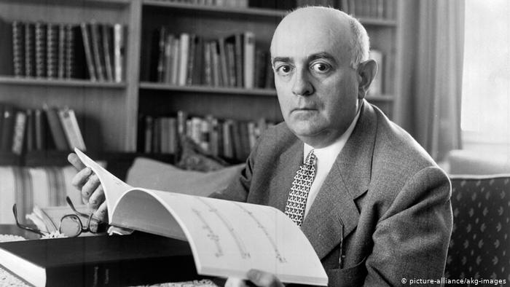

Slide 4
Theodor W. Adorno (1903-1969)
Frankfurt am Main
Exile 1934-1949
1958 director of the Institute of Social Research

Slide 5
1933 Kierkegaard: Construction of the Aesthetic
1944/47 Dialectic of Enlightenment
1949 Philosophy of New Music
1951 Minima Moralia: Reflections from Damaged Life
1956 Against Epistemology
1958 Notes to Literature I

Slide 6
1961 Notes to Literature II
1963 Hegel: Three Studies
1964 The Jargon of Authenticity
1966 Negative Dialectics
1970 Aesthetic Theory (published posthumously)

Slide 7
Institute for Social Research
„Frankfurt School“
founded 1923 by Felix Weil
1930 Max Horkheimer named the director
Zeitschrift für Sozialforschung (Journal for Social Research)
Theodor W. Adorno (1903-1969), Walter Benjamin (1892-1940), Max Horkheimer (1895-1973), Herbert Marcuse (1898-1980)
1933 moved to Geneva, 1934 New York
1949 Adorno and Horkheimer return to Frankfurt

Slide 8
1951 reopening of the Institute
„Second generation“: Jürgen Habermas, Albrecht Wellmer
„Third generation“: Axel Honneth (current director of the Institute), Christoph Menke, Juliane Rebentisch

Slide 9
Adorno‘s Style of Writing
Parataxis
No explicit coordination or subordination of sentences, paragraphs or entire chapters
Topics of one part intersect those of the others
Rejection of a presupposed first principle or origin from which philosophy may proceed
No hieararchy

Slide 10
Negative Dialectics
Adorno‘s arguments highlights unavoidable tensions between opposites
Negative because it refuses to affirm any underlying identity of final synthesis of the opposites
The main opposition occur between the particular and the universal and between culture and society

