Slide 1
COMMISION VS BIG TECH
BLANCA BLANCO AND JIMENA JOS

Slide 2
INTRODUCTORY QUESTIONS
What is the EU Single Market?
How is related to Monopolies?
What are the disadvantages of Monopolies?
Why does the European Commission regulate Monopolies?

Slide 3
PRIMARY LAW WITH CONSTITUTIONAL FORCE
Article 101 TFEU (ex Article 81 TEC)
Prohibited Anti-Competitive Practices: The article bans agreements, decisions, and coordinated actions between businesses that distort competition in the EU’s internal market. Specifically, it prohibits:
Fixing prices or trading conditions.
Restricting production, markets, technology, or investments.
Dividing markets or supply sources.
Discriminatory conditions that harm competition.
Imposing unrelated contract obligations.
Automatic Nullity: Any agreement violating this rule is automatically void.
Possible Exemptions: Certain agreements may be allowed if they enhance production, distribution, or technological progress, benefit consumers, and do not impose unnecessary restrictions or eliminate competition in a substantial market segment.

Slide 4
PRIMARY LAW WITH CONSTITUTIONAL FORCE
Article 102 TFEU (ex Article 82 TEC)
This article prohibits the abuse of a dominant market position by one or more companies if it affects trade between EU Member States.
Examples of Abuse:
Unfair pricing or trading conditions (directly or indirectly).
Restricting production, markets, or technology to the detriment of consumers.
Discriminatory treatment in equivalent transactions, harming competition.
Forcing additional obligations in contracts that are unrelated to the agreement

Slide 5
PRIMARY LAW WITH CONSTITUTIONAL FORCE
Article 105 TFEU (ex Article 85 TEC)
The European Commission is responsible for ensuring the enforcement of Articles 101 and 102 TFEU. It can investigate potential infringements, either on its own initiative or at the request of a Member State, with the support of national authorities. If a violation is found, the Commission proposes measures to stop it.
If the infringement continues, the Commission issues a reasoned decision, may publish it, and can authorize Member States to take corrective actions under conditions set by the Commission.
The Commission also has the power to adopt regulations concerning categories of agreements when authorized by the Council under Article 103(2)(b) TFEU.

Slide 6
COMMISSION AS AN ANTITRUST ENFORCER
ANTITRUST CASES AGAINST GOOGLE BY THE EU
Google Shopping Investigation
Android Investigation
Ad Sense Investigation
Adtech Investigation
Acquisition of Fitbit

Slide 7
COMMISION VS AI
1. What is the EU Artificial Intelligence Act?
2. Why should you care?
3. How can organizations apply it?

Slide 8
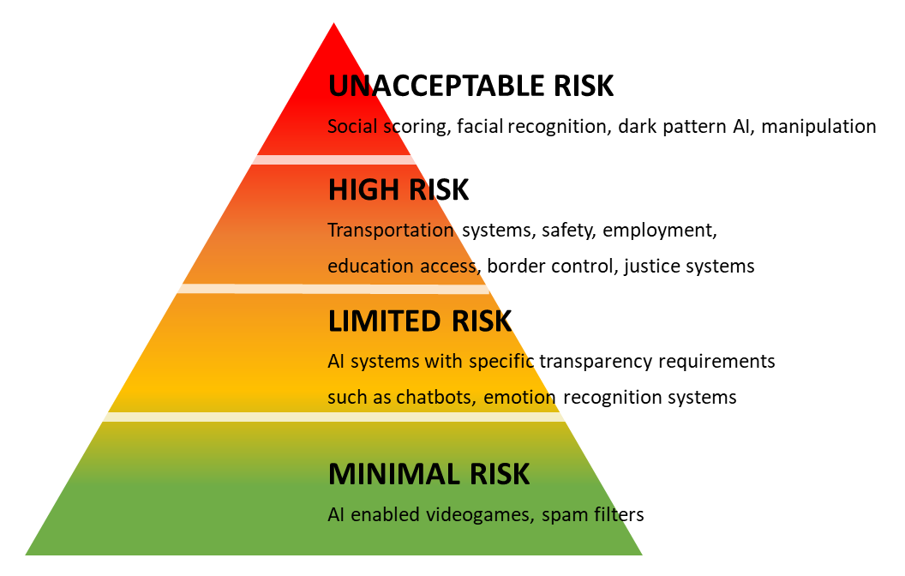
THE FIRST REGULATION ON AI WORLDWIDE
DIFFERENT RULES FOR DIFFERENT RISK LEVELS:
Transparency Requirements
Supporting Innovation

Slide 9
AI ACT GOVERNANCE
Three advisory bodies will oversee governance:
European AI Board: Representatives from EU Member States.
Scientific Panel: Independent AI experts.
Advisory Forum: Diverse commercial & non-commercial stakeholders.

Slide 10
DEBATE QUESTIONS
"Should the EU have stricter antitrust rules for big tech companies like Google, or do these rules slow down innovation and competition?"
"Does the EU AI Act protect people while allowing AI to grow, or does it limit progress too much?"

