Slide 1
Democratic backsliding
and nationalism
25th April 2019

Slide 2
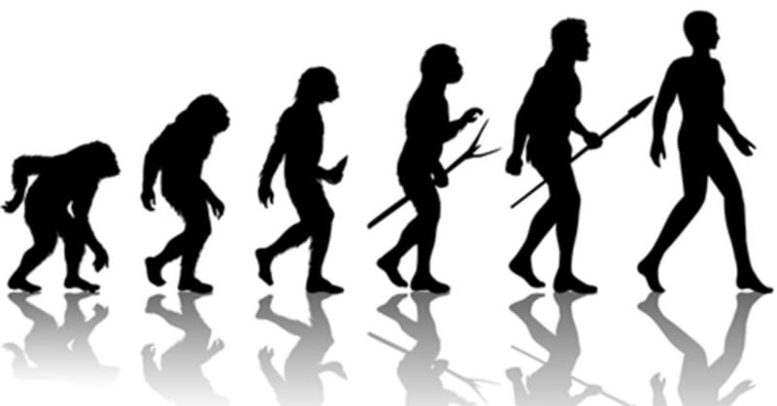
Democratic backsliding / fatigue in the CEE
transition studies criticized for being teleological and evolutionary
democratic backsliding / fatigue in the CEE being discussed since 2010
the “convergence dream” has failed, deconsolidation process
What comes next?

Slide 3
What are the current threats to democracy in the CEE region?

Slide 4
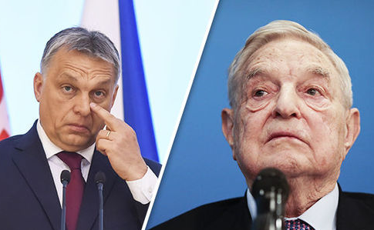
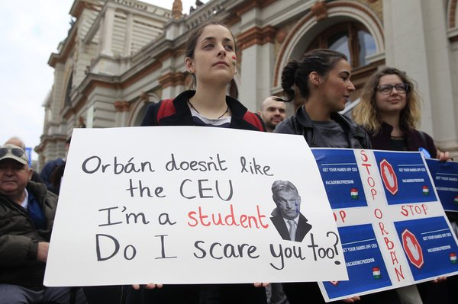
Hungary: “illiberal democracy”
right-wing nationalist Fidesz party (Viktor Orbán), ⅔ majority
changes to constitution and the electoral system (parliamentary districts, dual cit.)
undermining the independence of courts and prosecution service
control of public service and commercial media (shutdown of Népszabadság)
closure of Central European University (CEU), reorganization of Hungarian Academy of Sciences (HAS)
witch-hunt against civil society organizations and George Soros
Notes:
https://www.ft.com/content/92fbc4b6-3431-11e9-bd3a-8b2a211d90d5
https://www.nytimes.com/2018/04/08/world/europe/hungary-election-viktor-orban.html
https://www.nytimes.com/2018/12/12/world/europe/hungary-courts.html

Slide 5
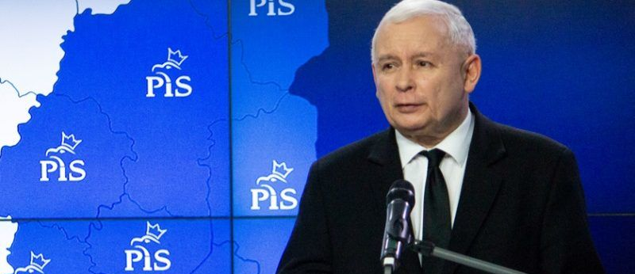
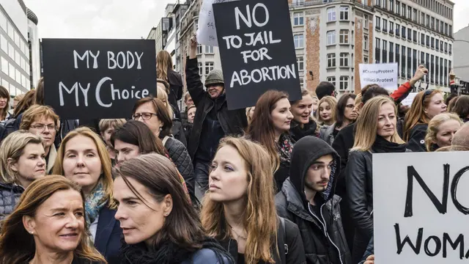
Poland: “cultural counter-revolution”
the right-wing nationalist Law and Justice party (Jarosław Kaczyński)
Kaczysnski aligned with the Polish Catholic Church (conservative values, abortion ban)
weakening of the constitutional court and prosecution service
takeover of state broadcasting, but comparing to Hungary, the polish media market is still diverse
strong civil society and protest culture (54% of the Polish trust NGOs), but lack of financial resources for NGOs
Notes:
https://spectator.sme.sk/c/22086898/victory-of-zuzana-caputova-in-context-of-v4-politics.html?ref=tab
https://www.nytimes.com/2018/06/16/world/europe/poland-kaczynski-smolensk.html
https://www.youtube.com/watch?v=P8MQTgdjcLE

Slide 6
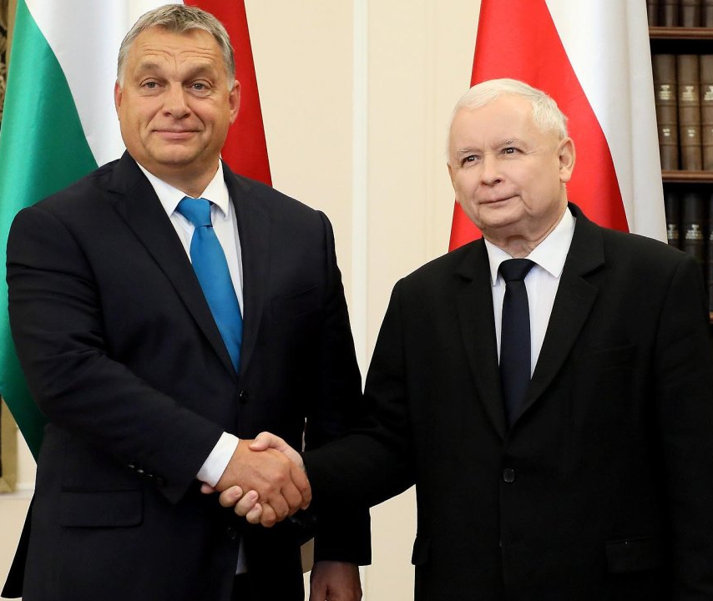
EU: Article 7 against Hungary and Poland
2017: triggered by the EU commission against Poland,
2018: launched by the European Parliament against Hungary
warns there is a clear risk of a serious breach of EU values (⅘), could decide unanimously to launch sanctions (suspending voting rights)
unlikely to happen as both Poland and Hungary have pledged to veto punishment on the other.
Notes:
Watch
https://www.youtube.com/watch?v=nBWVuzG8h3Y
https://www.youtube.com/watch?v=j3dSjfd4y6I

Slide 7
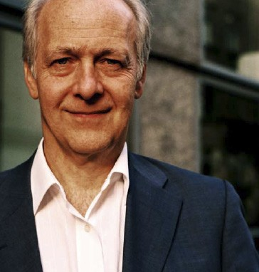
“Illiberal democracy,” to use Orbán’s preferred term, seeks a strong executive power and sees checks and balances, constitutional courts, and other presumably politically neutral institutions as imposing undue constraints on the sovereignty of the people. “Legal impossibilism,” to use Kaczyñski’s phrase, is the enemy.”
Jacques Rupnik

Slide 8
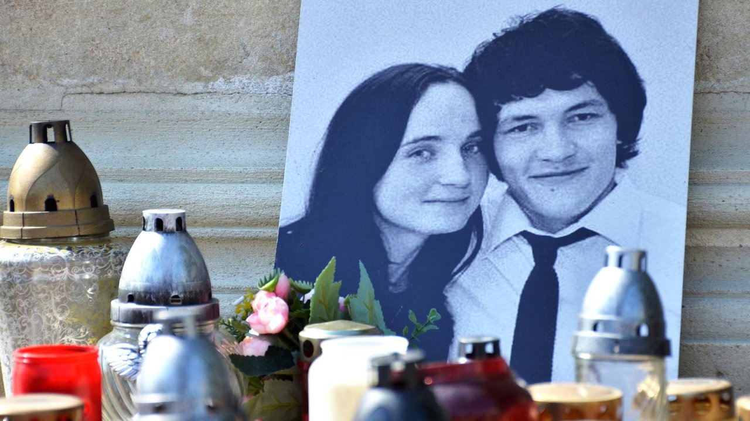
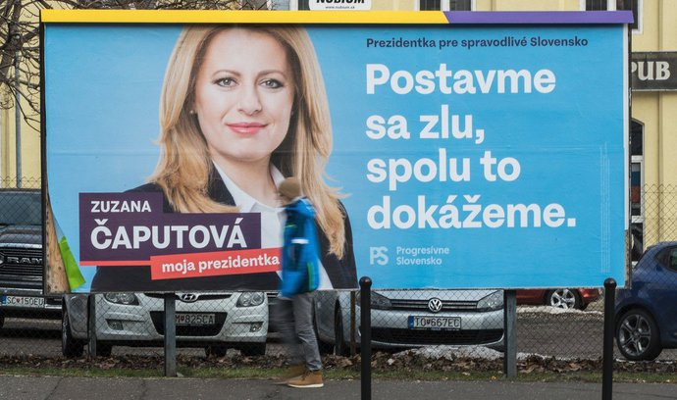
Slovakia
investigative reporter Ján Kuciak was shot to death after uncovering corrupt links between government officials and organized crime
social-democratic prime minister Robert Fico resigned
selective and delayed justice
the population perceives the judiciary as one of the most corrupt sectors
new president Zuzana Čaputová: fairness, decency and honesty need to return to Slovakia
Notes:
https://spectator.sme.sk/c/22086898/victory-of-zuzana-caputova-in-context-of-v4-politics.html?ref=tab

Slide 9
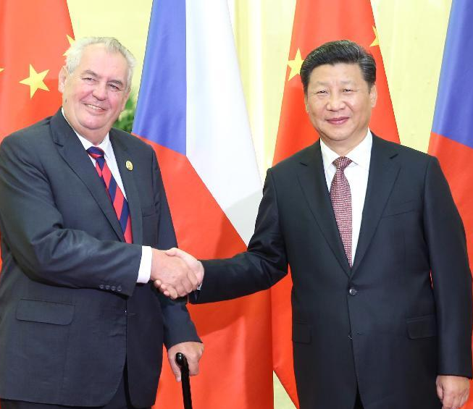
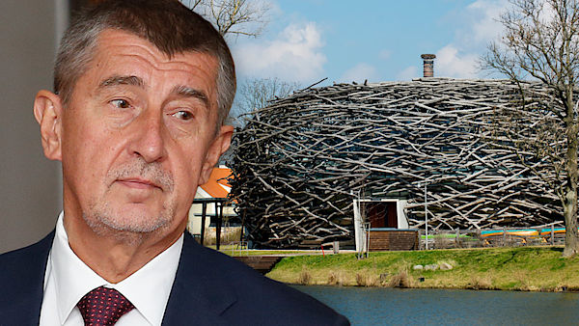
Czech Republic
populist Hnutí ANO (“state as a firm”), prime minister Andrej Babiš, minority government supported by president Miloš Zeman (Russia and China ally)
Babiš prosecuted for EU subsidies fraud (“Stork's Net), registered as communist-era secret informant, owner of major Czech media outlets
Latest issue: Minister of Justice replaced with Zeman's counselor Marie Benešová, independence of prosecution service in threat
Notes:
https://observer.com/2018/01/how-czech-president-milos-zeman-became-vladimir-putins-man/

Slide 10
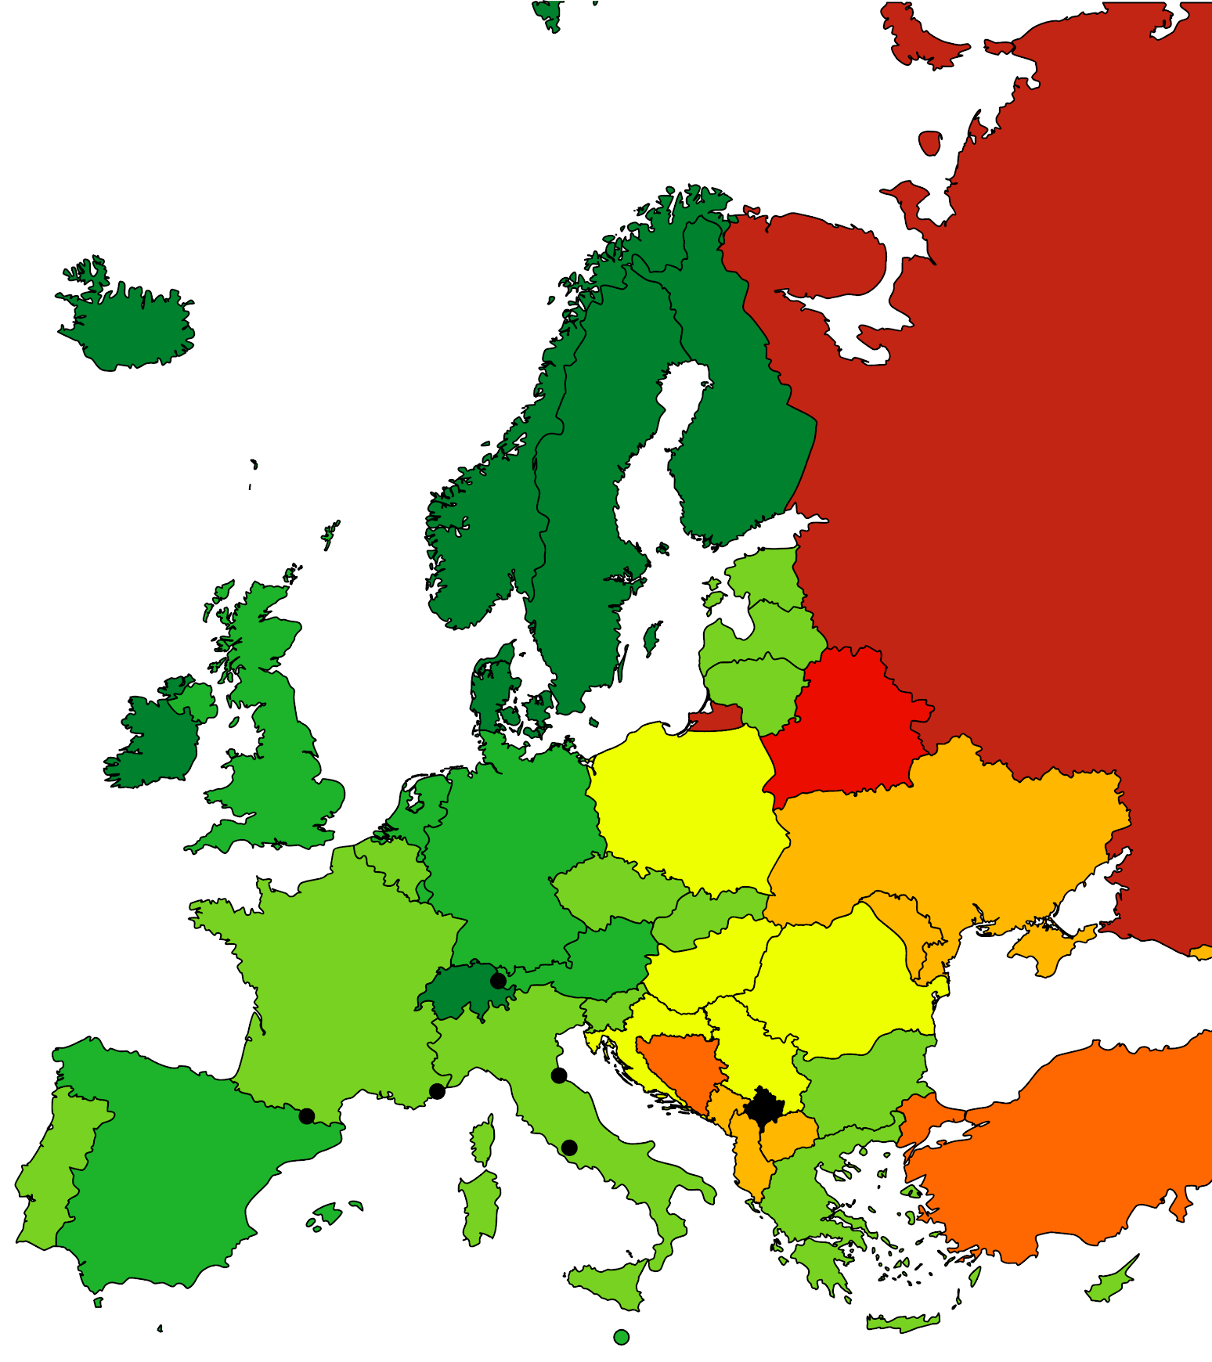
The Economist Democracy Index
experts' assessments + public-opinion
60 questions, five categories:
electoral process and pluralism
civil liberties
functioning of government
political participation
political culture
Notes:
The Economist Intelligence Unit Democracy Index

Slide 11
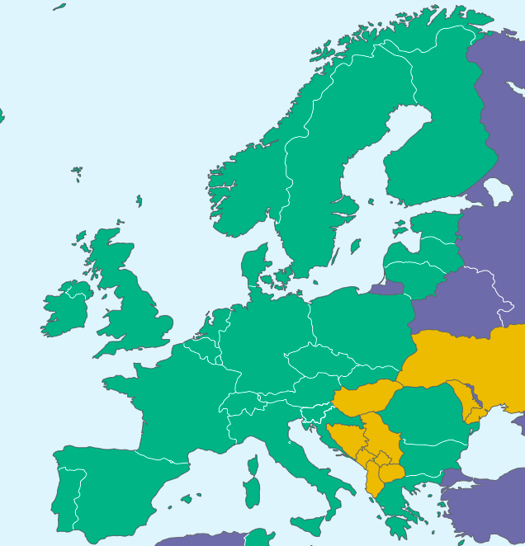
Freedom House 2019
methodology is derived from the Universal Declaration of Human Rights
Political rights
Electoral Process
Political Pluralism and Participation
Functioning of Government
Civil liberties
Freedom of Expression and Belief
Associational and Org.Rights
Rule of Law
Personal Autonomy and Ind. Rights

Slide 12
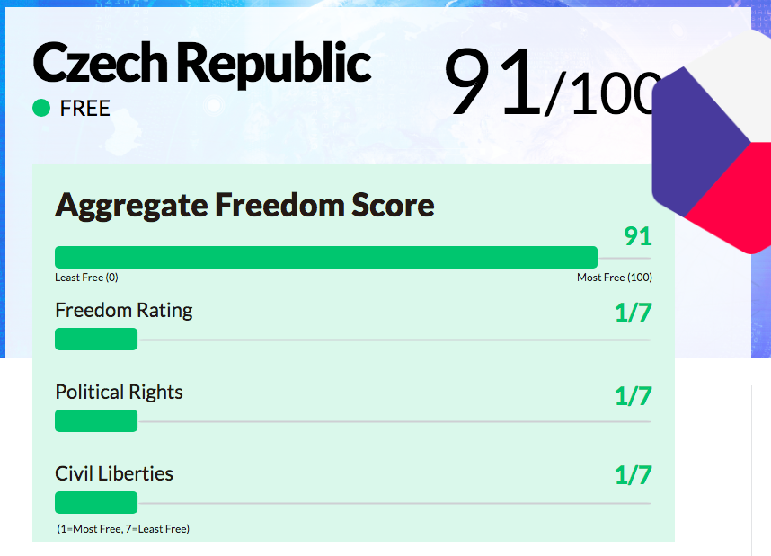
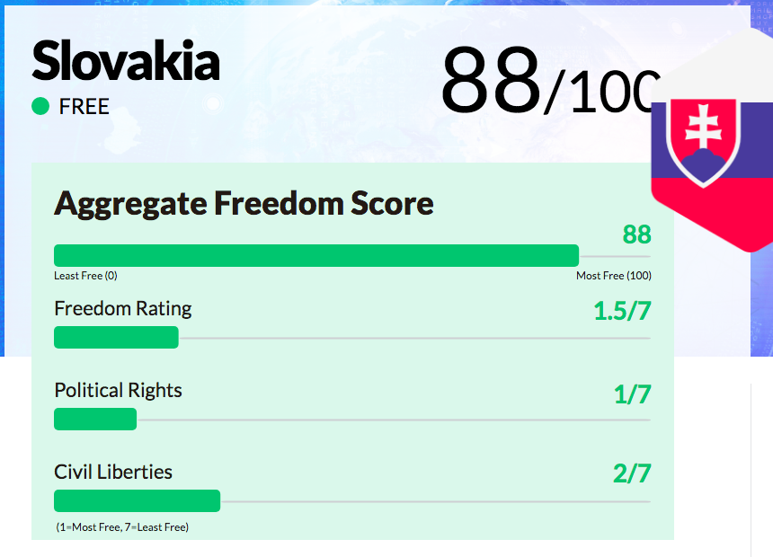
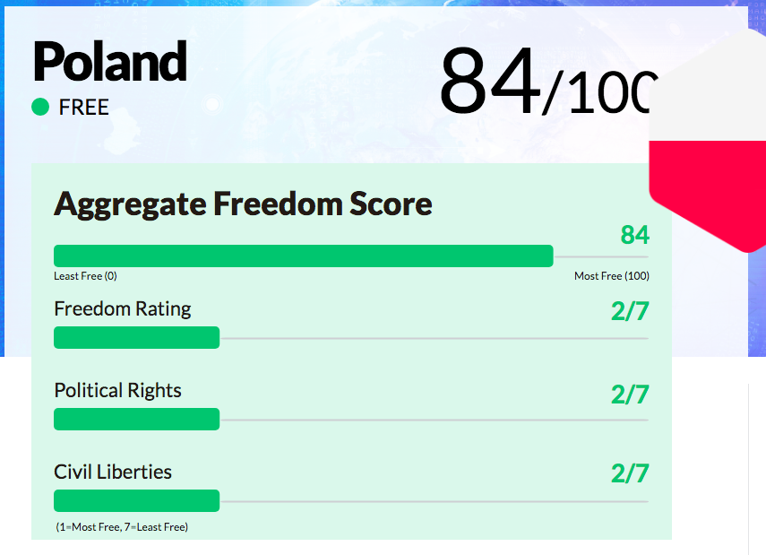
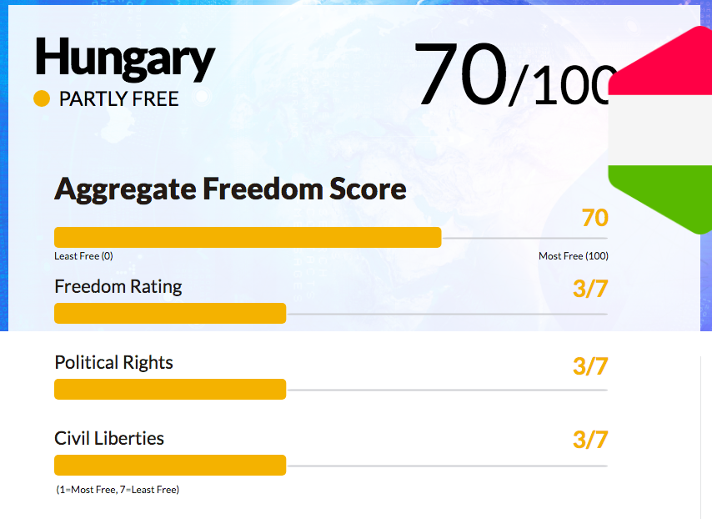

Slide 13
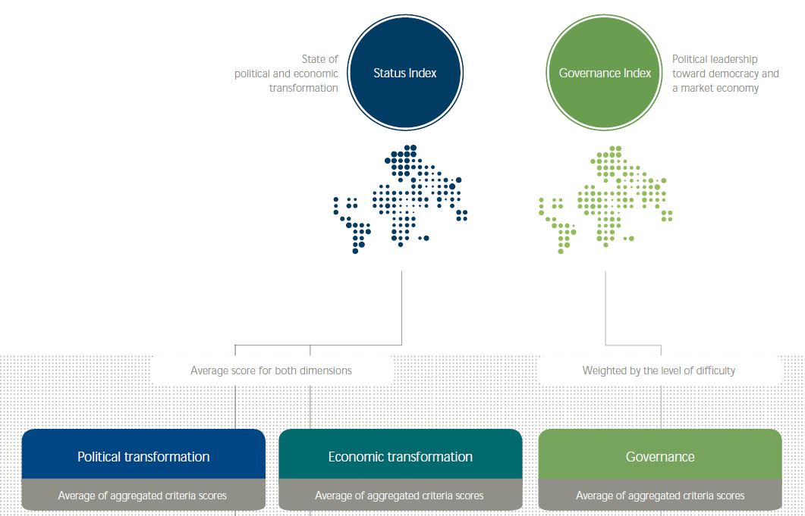
Bertelsmann Stiftung’s Transformation Index (BTI)

Slide 14
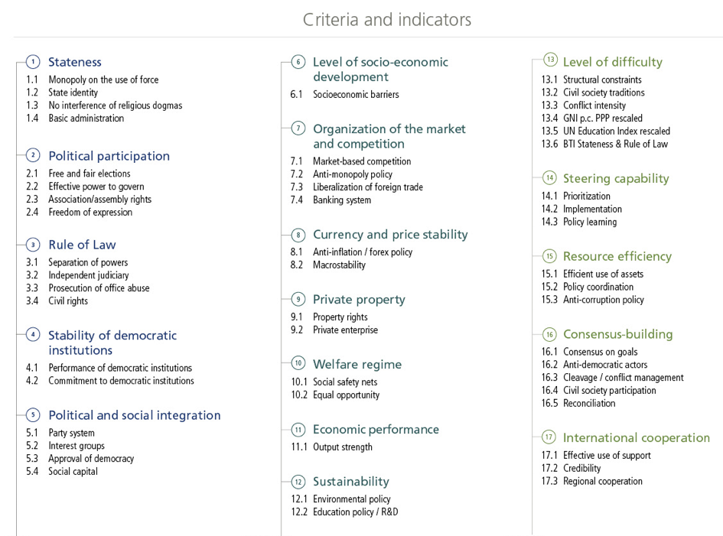

Slide 15
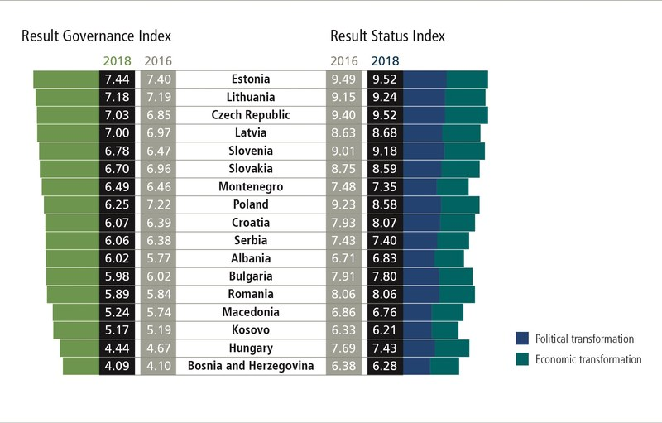

Slide 16
Blank Democratic Spots (Rupnik and Zielonka 2013)
the role of clientele-corruption networks (oligarchs)
weak state, underdeveloped political institutions, law is full of loopholes
rule of law is replaced by the rule of informal ad hoc arrangements orchestrated by people who have no accountability
the prominence of the mass media
political parties in Central and Eastern Europe lack a sound social and ideological base (few members and weak local structures), they are dependent on the media, hence their attempts to colonize the media
the sustained importance of the politics of memory and historical justice (twenty years after the fall of communism, “lustration” is still in place)

Slide 17
“Over the years, students of Central and Eastern Europe have acquired a comprehensive set of data on formal laws and institutions, but their knowledge of informal rules, arrangements, and networks is rudimentary at best.”
Jacques Rupnik

Slide 18
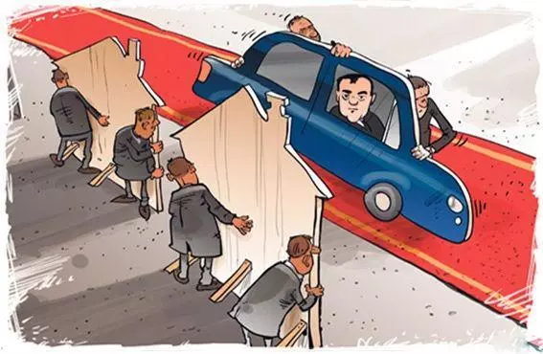
Emptying of democracy (Atilla Ágh 2016)
a defective, Potemkin democracy
the institutions essential to democracy are not destroyed or fundamentally questioned, but are rather, over time, re-interpreted and subject to changes
systematic destruction of checks and balances (the media and the judiciary)
turning the rule of law into “rule by law”

Slide 19
Illiberal swerves or turns? (Bustikova, Guasti 2017)
volatility and uncertainty (“swerves”) an integral part of democracy
Illiberal Swerve | Concentration of political power undermining the constitutional order and checks and balances. Contested sovereignty that increases polarization (populist appeals, exclusionary identity politics, exclusion of minorities)
Illiberal Turn | 3. Dominant party winning two consecutive elections.

Slide 20
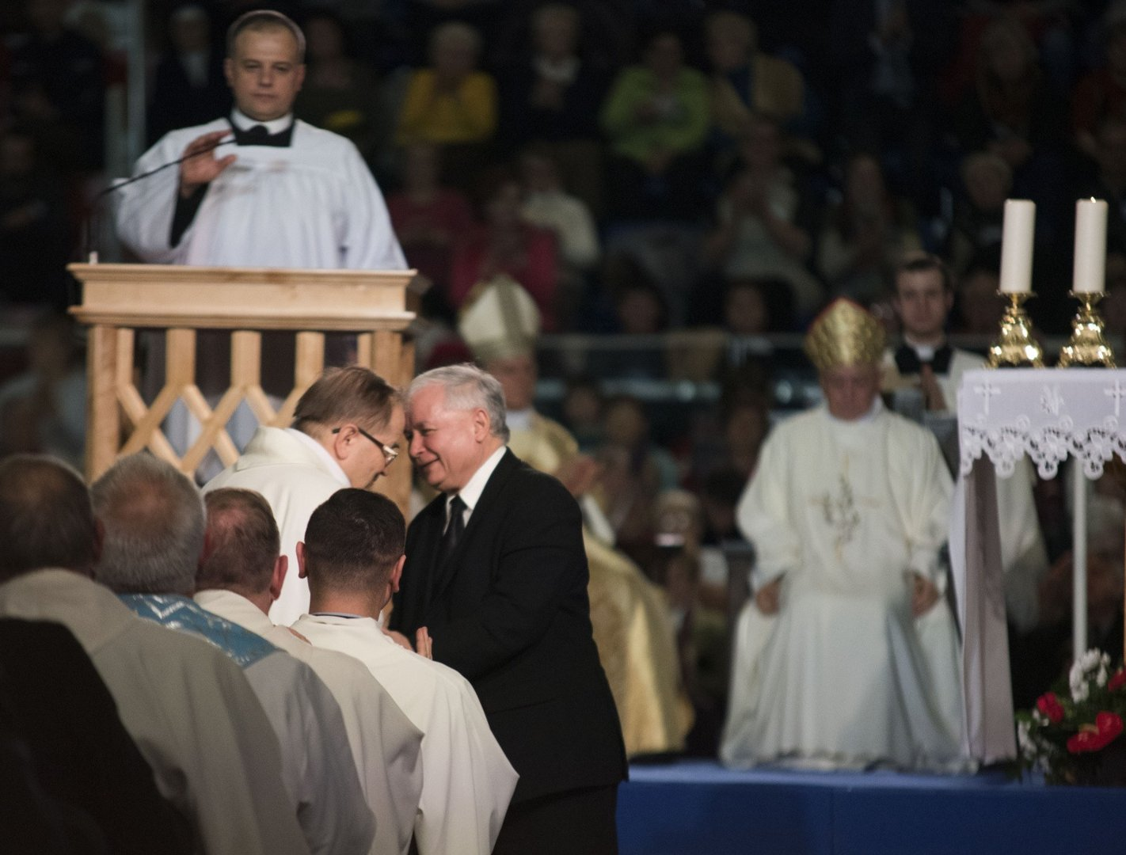
Uncivil society - ally of the swerving leaders
racists, nationalists, and ethno-populists articulate exclusionist narratives, raise militias to protect the borders, promote extreme religious conservatism (anti-abortion, anti-LGBT rights), and attack the EU
Example: the Catholic-nationalist network around the Radio Maryja (Tadeusz Rydzyk), which has forged a synergistic political-economic relationship with PiS

Slide 21
Why so popular? (Rupnik 2016)
winners and losers of post-1989 transition (elites versus “the people”)
Orbán and PiS are culturally on the right, but economically “left”. The right-versus-left divide has been replaced by a split between national conservatives and pro-European liberals.
Leftist parties have been championing societal pluralism (legalized abortion, the rights of gays and other minorities) but subordinating the social question to the task of promoting free-market reforms.
The nationalists of the right propose compassionate conservatism and concern for those whom the transition to the market has left behind.
It is a culture war — rather than the economy — that has weakened liberalism and facilitated the slide toward “illiberal democracy”.

