Slide 1
European Green Deal

Slide 2
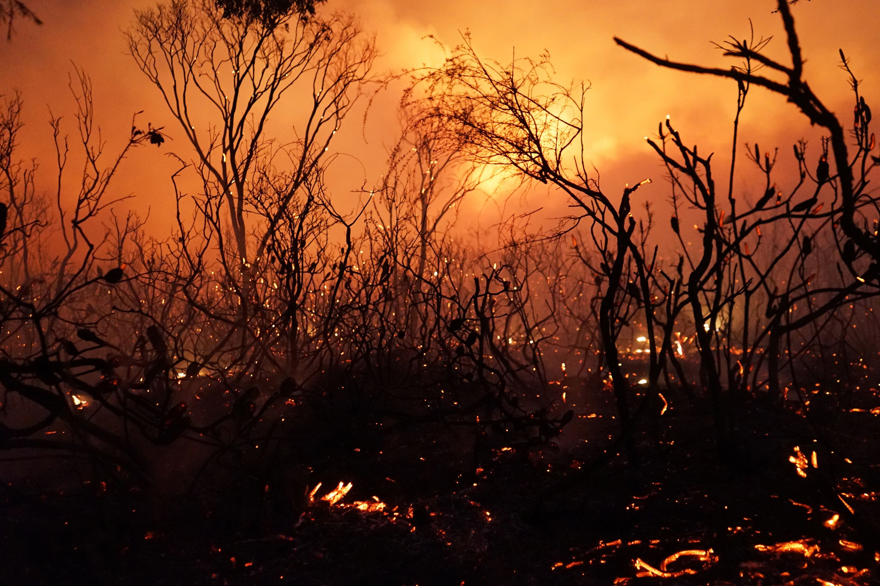
Human-made
Affects all beings on the planet
Global warming main problem
Health-related consequences predicted
Dramatic negative impacts on our life quality, natural resources, and living spaces are expected

Slide 4
“Climate challenges and inequality can only be solved together… We are not equal in the face of the climate change… The ecological crisis I therefore aggravating the social crisis and the crisis of inequality… We must understand that ecological and social progress go hand in hand.”
– MEP President Sassoli

Slide 5
The devastating impact of climate change on the European farmland

Slide 6
- The European Union as leader against climate change
- Investments in research are required
- Higher ambitions should be settled for the EU’s 2030 goal of emissions

Slide 7
Picture sources
https://www.europarl.europa.eu/portal/en slide 1
https://www.nbcnews.com/news/world/world-must-take-unprecedented-steps-avert-worst-effects-global-warming-n917656 slide 2
https://foreignpolicy.com/2018/12/03/global-warming-will-set-fire-to-american-leadership/ slide 2
https://climate.nasa.gov/effects/ slide 3
https://www.maschinenmarkt.vogel.de/der-european-green-deal-perspektive-fuer-die-industrie-a-905390/ slide 6
https://www.euractiv.de/section/energie-und-umwelt/news/forschung-pariser-klimaziel-schon-jetzt-nicht-mehr-erreichbar/ slide 5

