Slide 1
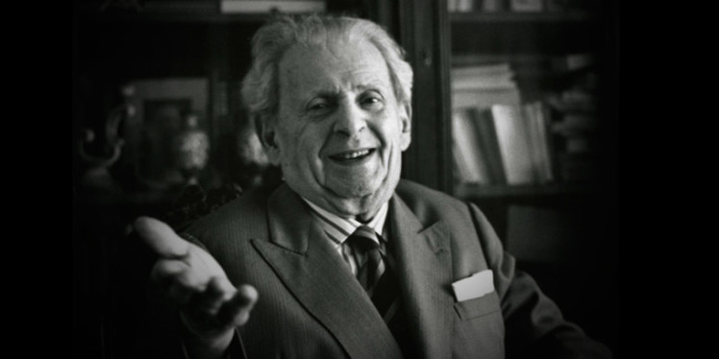
Emmanuel Lévinas (1906 – 1995)

Slide 2
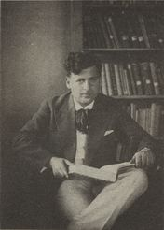
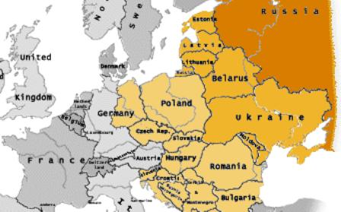
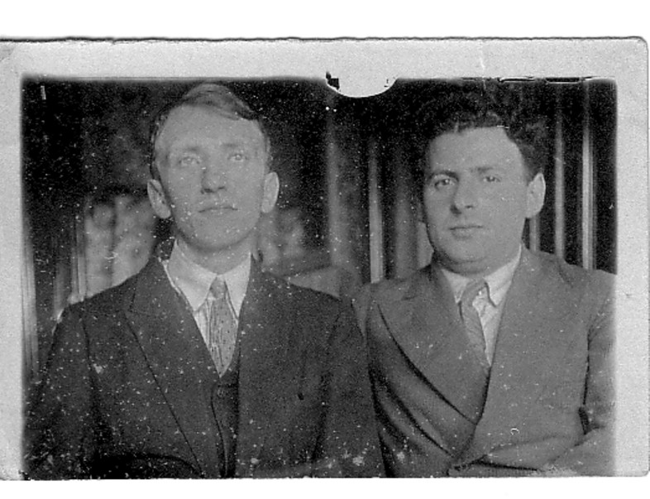
Kaunas
Kharkow
M. Blanchot and E. Lévinas
Strasbourg
1906 born in Kaunas (Lithuania)
1916 moved to Kharkow (Ukraine)
1920 return to Kaunas, Jewish gymnasium
University of Strasbourg,
friendship with Maurice Blanchot

Slide 3
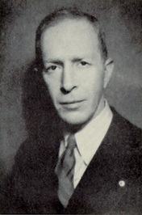
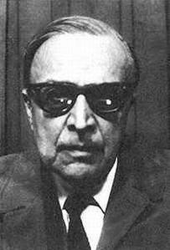
Alexandre Koyré
Aleksandr Vladimirovič Koyre
Александр Владимирович Койре
philosophy od science
From the Closed World to the Infinite Universe
Alexandre Kojève
Aleksandr Vladimirovič Koževnikov
Александр Владимирович Кожевников
Introduction to the Reading of Hegel:
Lectures on the Phenomenology of Spirit (1947)

Slide 4
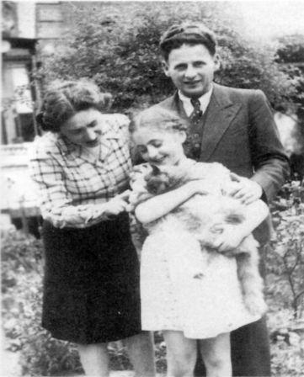
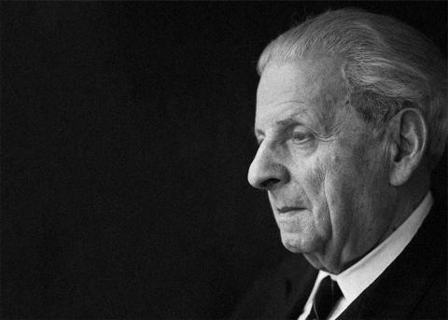
1928 University of Freiburg (Husserl, Heidegger)
translation of Husserl's Cartesian Meditations
1940 prisoner of war
1961 Totality and Infinity (Doctorat d´Etat)
École normale Israélite orientale (Paris)
University of Poitiers
1967 University of Nanterre
1973 Sorbonne University
1974 Otherwise than Being or Beyond Essence
1995 died in Paris

Slide 5
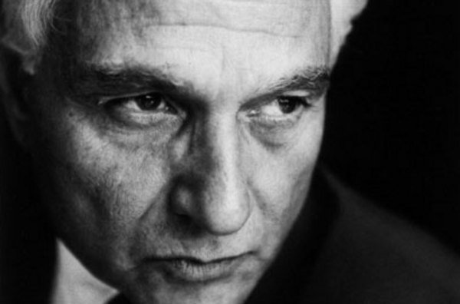
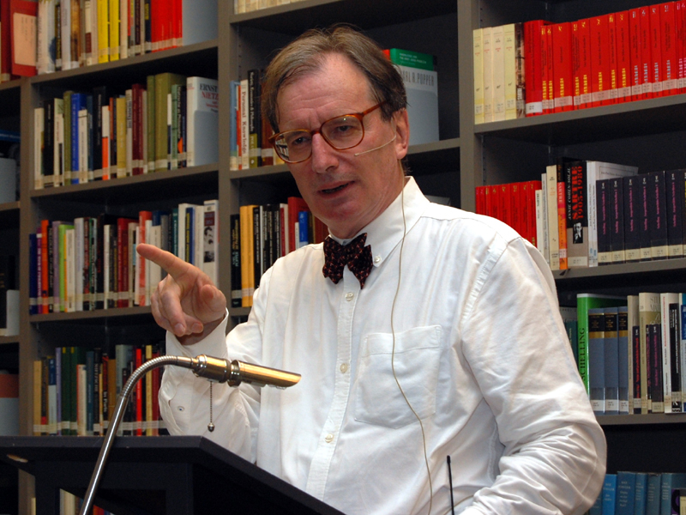
Jacques Derrida
Writing and Difference
an essay, "Violence and Metaphysics„
Eulogy at Levinas's funeral, later published as Adieu à Emmanuel Lévinas
"If one defines a great philosopher as someone without whom philosophy would not have been what it is, then in France there are two great philosophers of the 20th Century: Bergson and Lévinas.„
Jean-Luc Marion

Slide 6
1930. La théorie de l'intuition dans la phénoménologie de Husserl
(The Theory of Intuition in Husserl's Phenomenology)
1931. Méditations cartésiennes. Introduction à la phénoménologie
(with Edmund Husserl and Gabrielle Peiffer)
1932. Martin Heidegger et l'ontologie
1934. Quelques réflexions sur la philosophie de l'hitlérisme
1935. De l'évasion
1947. De l'Existence à l'Existent
(Existence and Existent)
1948. Le Temps et l'Autre
(Time and the Other)
1949. En Découvrant l’Existence avec Husserl et Heidegger
(Discovering Existence with Husserl and Heidegger)
1961. Totalité et Infini: essai sur l'extériorité
(Totality and Infinity: An Essay on Exteriority)
1972. Humanisme de l'autre homme
(Humanism of the Other)
1974. Autrement qu'être ou au-delà de l'essence
(Otherwise than Being or Beyond Essence)
1982. Ethique et infini
(Ethics and Infinity: Dialogues of Emmanuel Levinas and Philippe Nemo)
1988. A l'Heure des nations
1991. Entre Nous

Slide 7
METAPHYSICS
ONTOLOGY
ETHICS

Slide 8
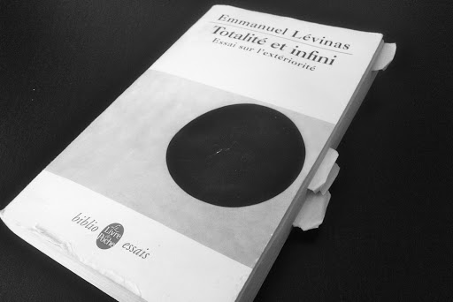
Emmanuel Lévinas, Totality and Infinity
Comments on the 1st part: Metaphysics and Transcendence
1. Desire for the Invisible, pp. 33 – 35.
Text in pdf on Moodle
„The true life is absent.“ But we are in the world.
Emmanuel Lévinas
„La vraie vie est absente. Nous ne sommes pas au monde.“
Arthur Rimbaud

Slide 9
other in a weak sense and Other in an eminent sense.

Slide 10
subject – object relation
adequation
metaphysical relation
non-adequation
dimension of height

Slide 11
Homework
Week: 20th – 24th April
Find out one Lévinas´ text (article or a chapter of a book)
in English, French, Spanish or Icelandic or an article about Lévinas and make a short summary.
For example: Difficile liberté (Difficult Freedom)
Send me your paper via e-mail before 1st May.
Collecting Levinas's important writings on religion, Difficult Freedom contributes to a growing debate about the significance of religion—particularly Judaism and Jewish spiritualism—in European philosophy. Topics include ethics, aesthetics, politics, messianism, Judaism and women, and Jewish-Christian relations, as well as the work of Spinoza, Hegel, Heidegger, Franz Rosenzweig, Simone Weil, and Jules Issac.

