Slide 1
POLITICAL SOCIOLOGY OF CENTRAL EUROPE
Introducing the concept of Central Europe
Lecture 1 (21 February 2019)

Slide 2
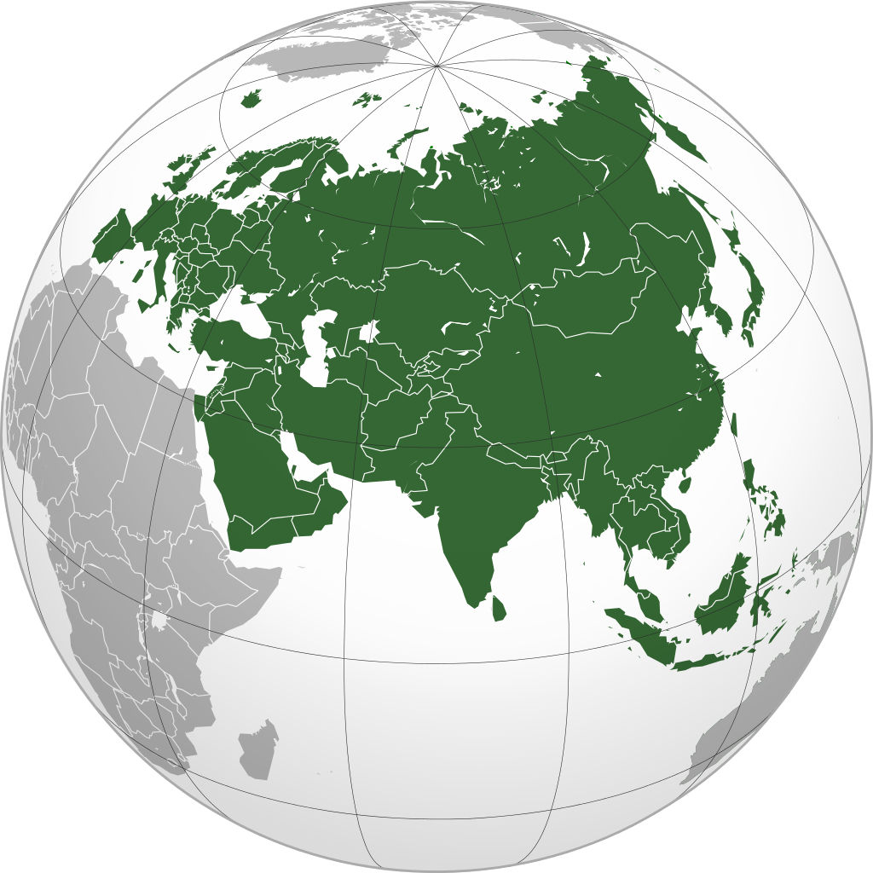
Boundaries of Europe
Europe as a part of Eurasia
Europe as a historical concept
the boundary between Europe and Asia is not clear
conventional borders: Ural mountains (or Don river)
Where does Russia belong to?
Jan Křen: without Russia, Europe would not be the same as we know it

Slide 3
the West | the East
western Christianity (Roman Catholic, later Protestantism) | Orthodox Christianity, Islam
dual structure: state/church | caesaropapism: state=church
renaissance, humanism, reformations, enlightement | „dark ages“, backwardness
feudalism with the estates, partial absolutism with signs of pluralism (aristocracy, church), plural democracy | autocracy, despotism, totalitarianism
bottom up civil society | top down civil society

Slide 4
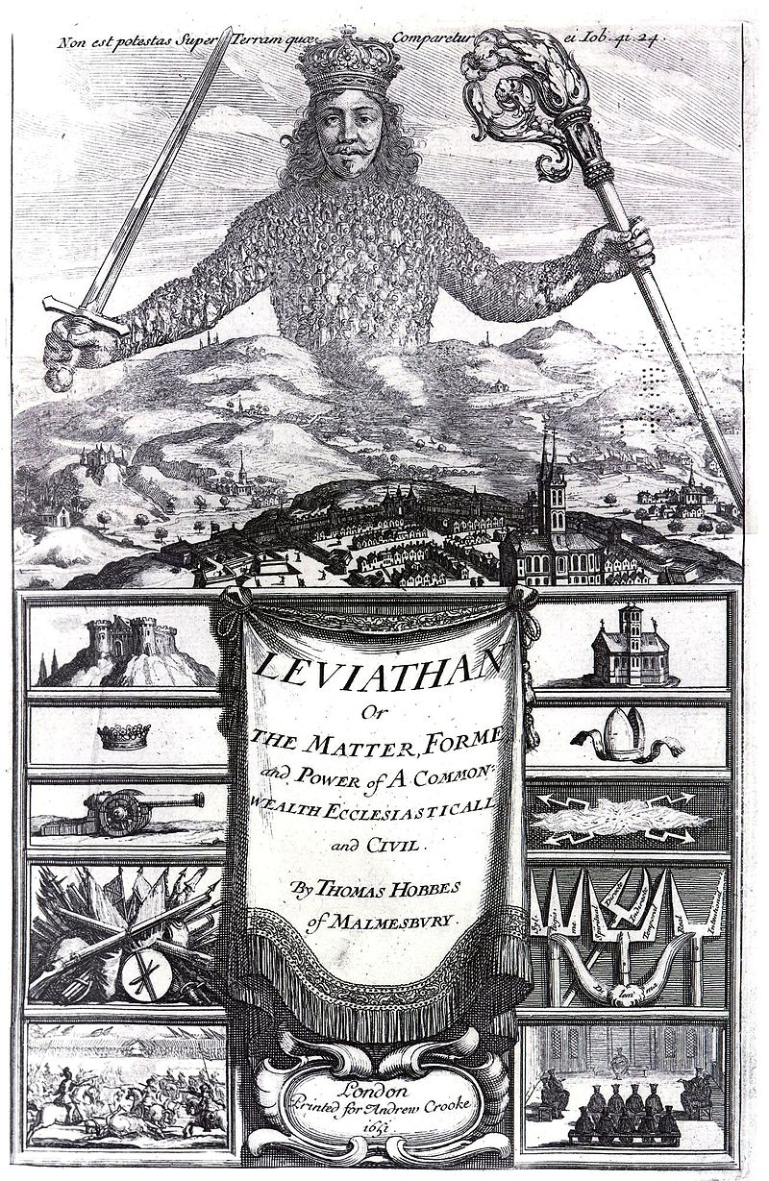
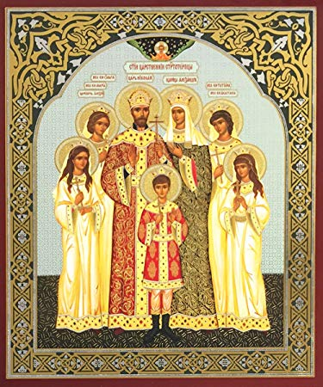
the West the East
social contract, rule of law
bigger role of the state

Slide 5
Geography as destiny
distance from the West - seems to correlate with level of economic development

Slide 6
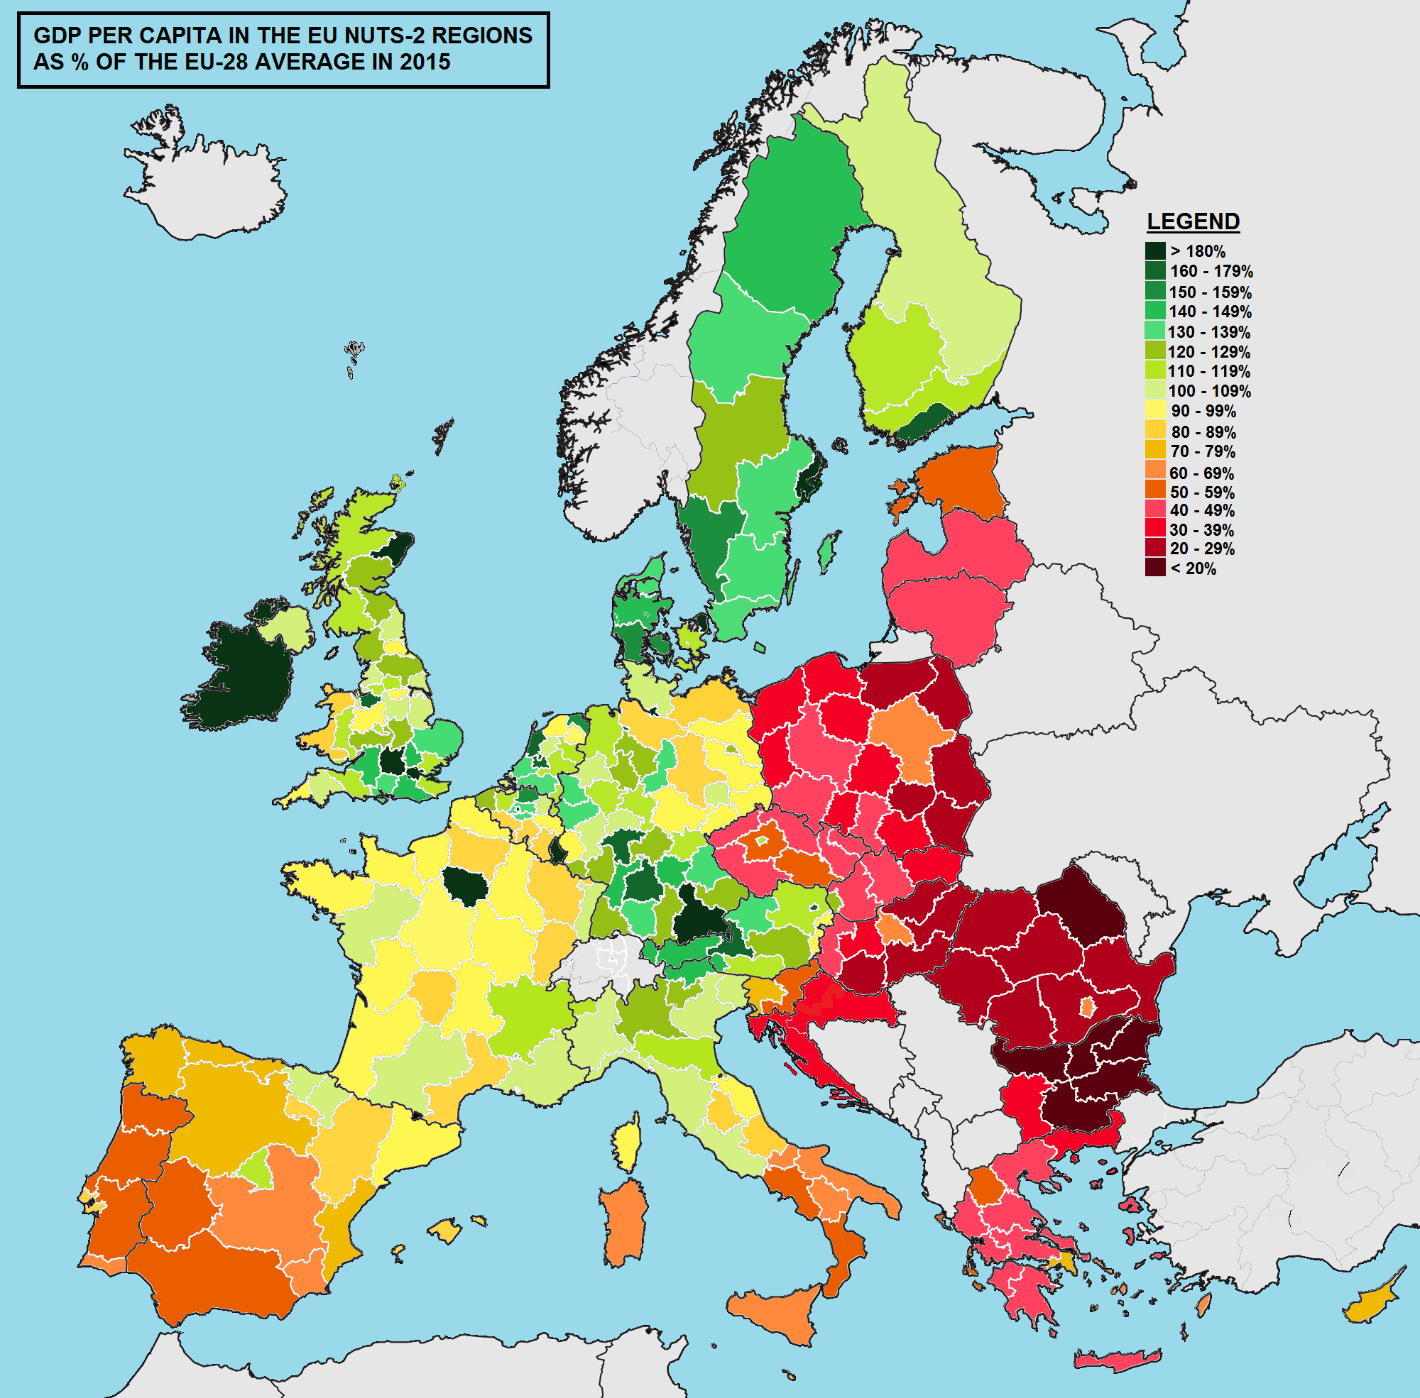

Slide 7
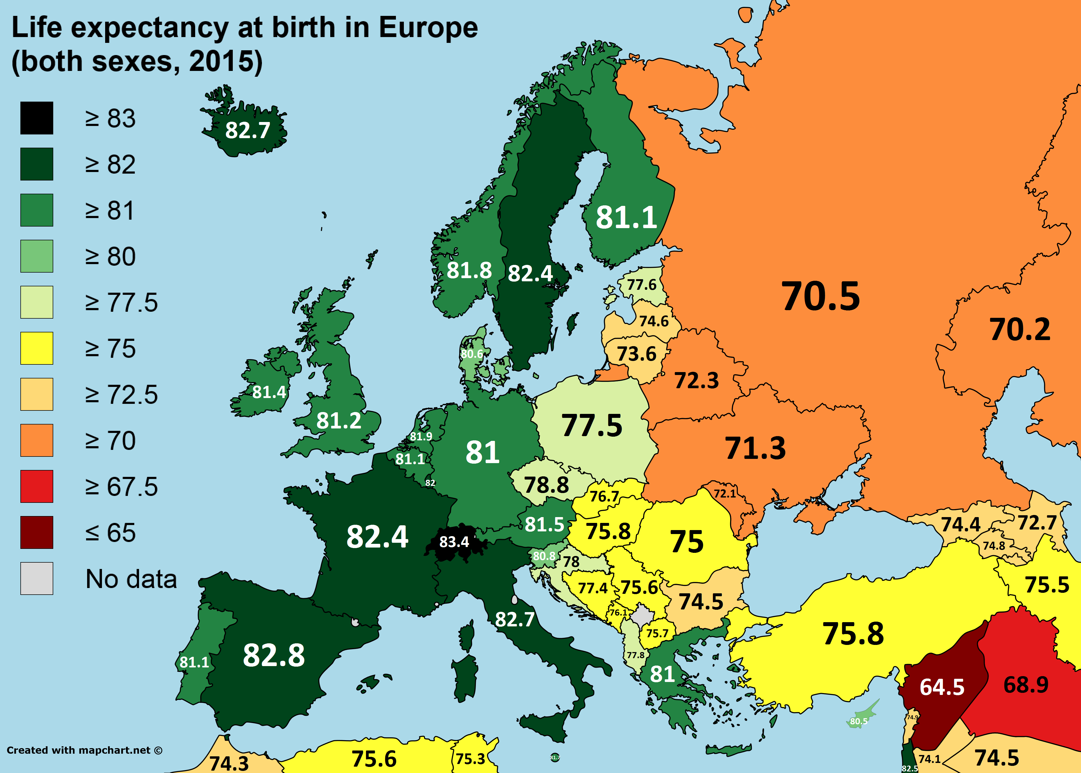

Slide 8
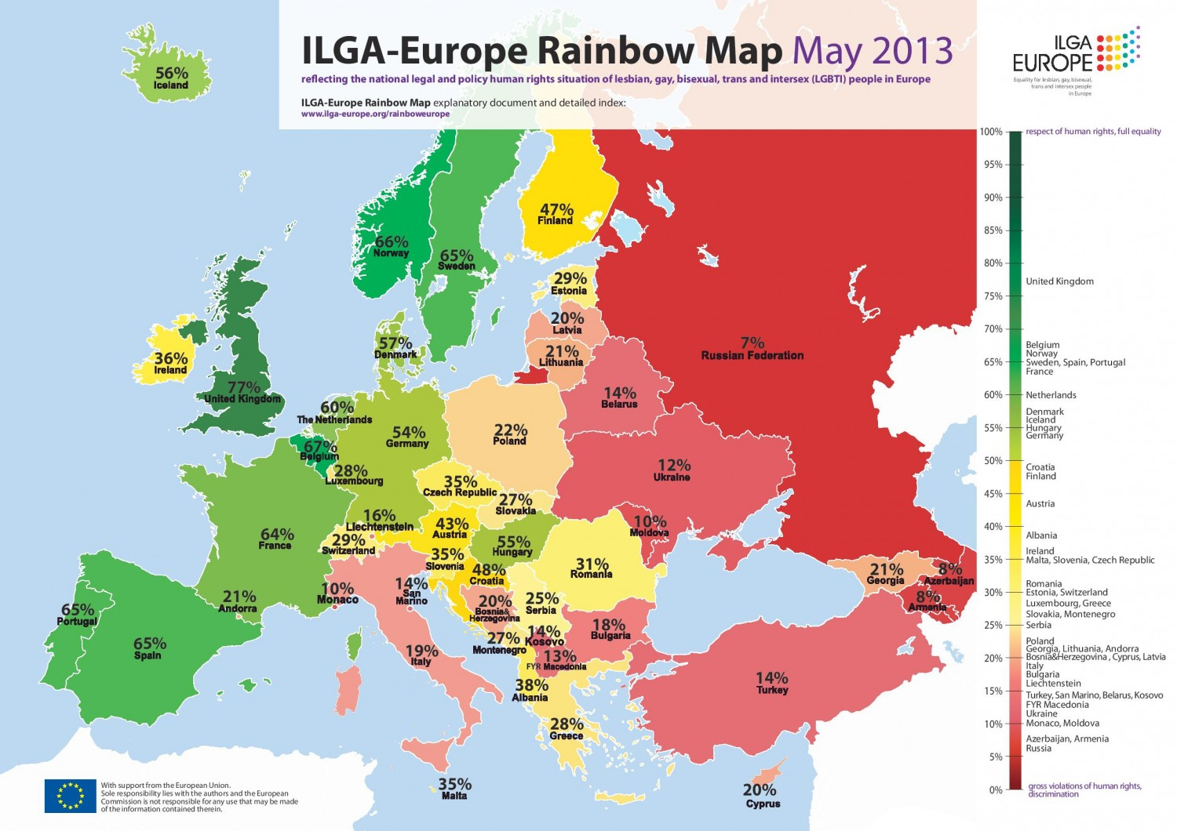

Slide 9
CENTRAL EUROPE
contradictive term, dynamic historical concept, not a static spatial one
Jenö Szücs: CE geographically as the Western border of Eastern Europe X historically as the Easter border of Western Europe
Oskar Halecki: CE as a zone of transition between the West and the East

Slide 10
Scope of Central Europe
Lonnie R. Johnson recognizes 7 definitions of CE; Central Europe as a mode of self-perception (1996: 6)
Rupnik mentions geographer Karl Sinnhuber who examined even 16 various definitions of CE
Germany? Austria? Slovenia? Baltic states? Balkan? Ukraine?
Šabič & Drulák (2012: 8) – 3 characteristics of CE:
historically always „in the line of fire“ within wars
the states that emerged from the ruin of Austria-Hungary and tried to devolop a Communist model of society after 1945
first wave of Europeanization (eastern expansion of the EU)

Slide 11
„Tell me where Central Europe is, and I can tell who you are.“
Jacques Rupnik

Slide 12
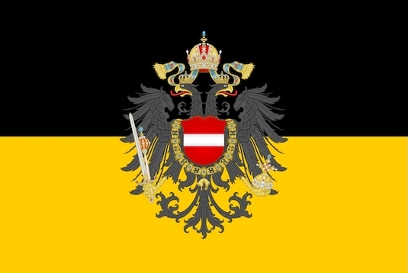
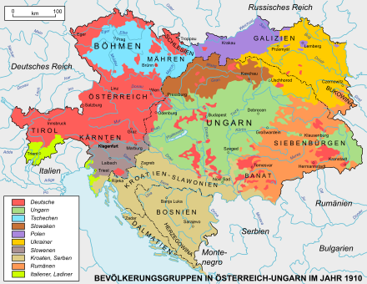
Historical origins of Central Europe
Austrian Empire
multinational great power (1804 to 1867; Austro-Hungarian Empire 1867-1918)
pluralist state X supremacy of the German language
rejection of ethnic nationalism
X nation-building

Slide 13
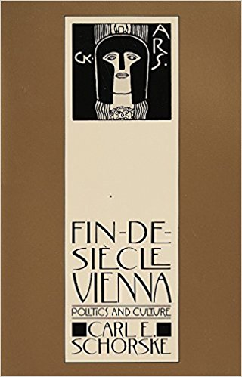
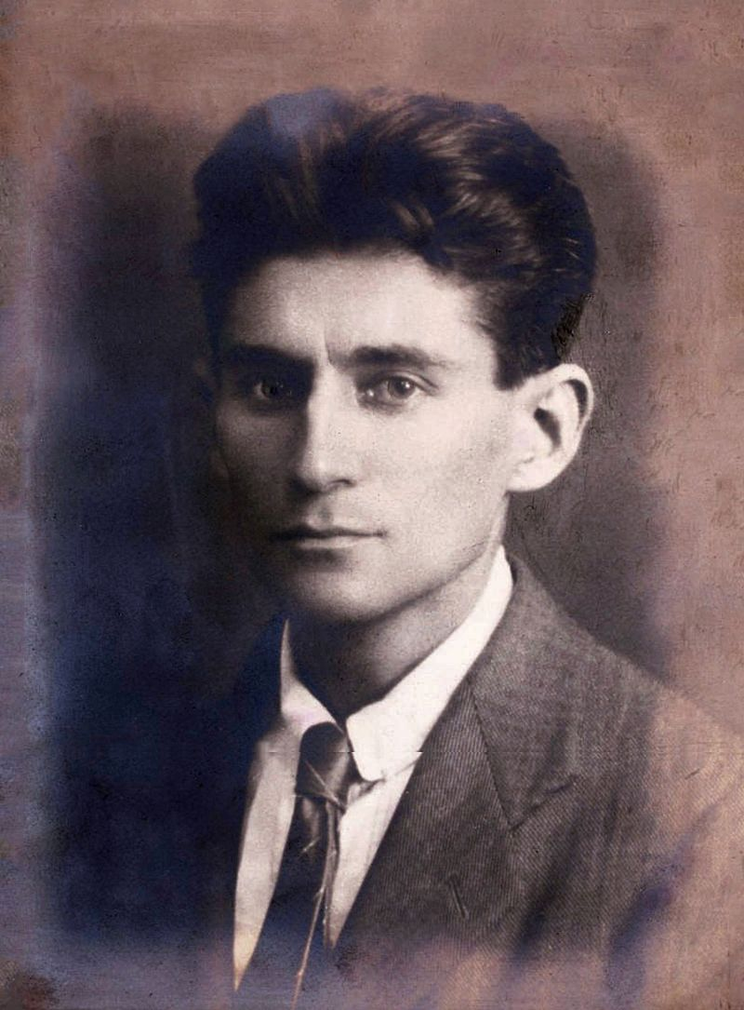
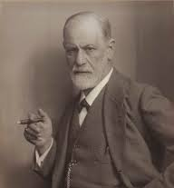
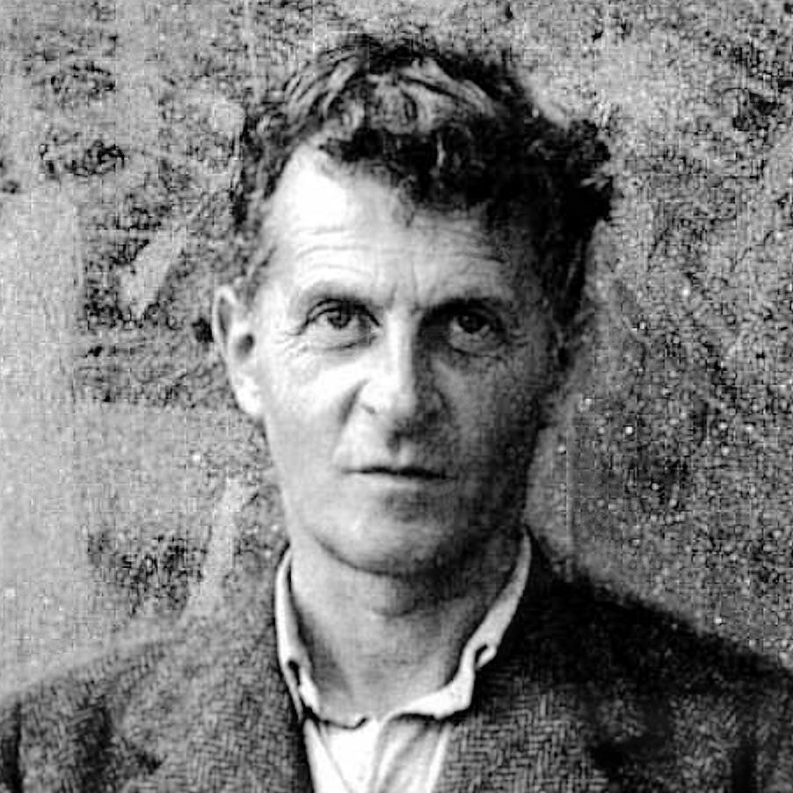
Central Europe as a cultural melting pot
CE as a romantic idea of cultural plurality
interactions between different cultures
artistic and intellectual creativity
culture of cafés and alcohol drinking
second generation of universities
jewish culture

Slide 14
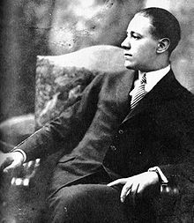
If you ask me what is my native country, I answer: I was born in Fiume, grew up in Belgrade, Budapest, Pressburg, Vienna and Munich,
and I have a Hungarian passport; but I have no fatherland. I am a very typical mix of old Austria-Hungary: at once Magyar, Croatian, German and Czech; my country is Hungary, my mother tongue is German.
Ödön von Horváth

Slide 15
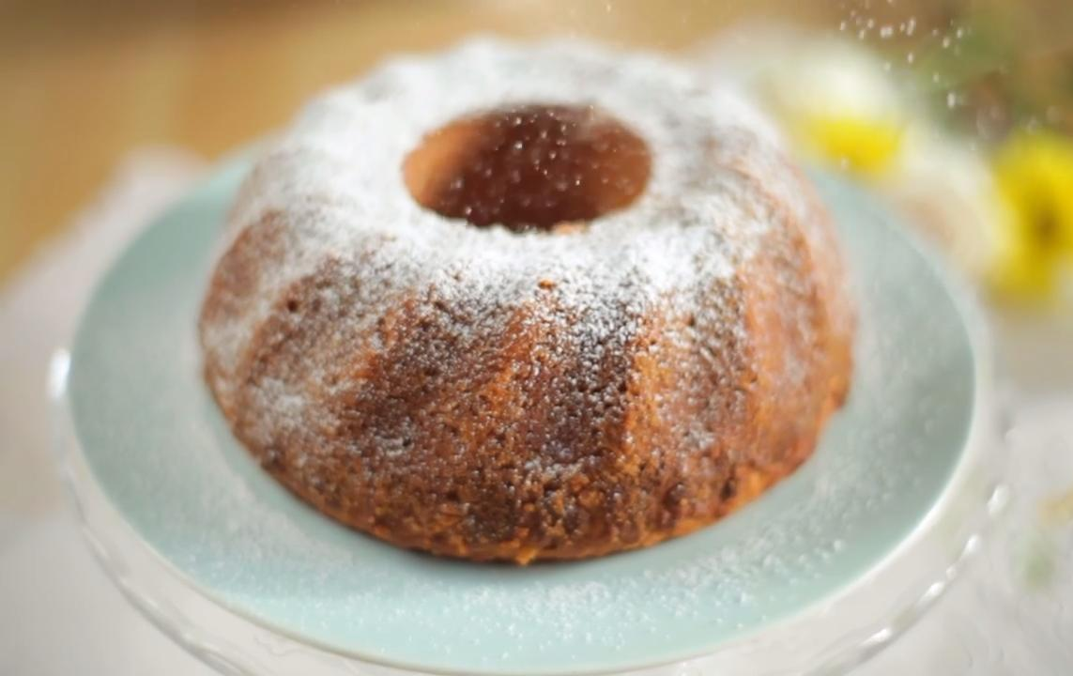
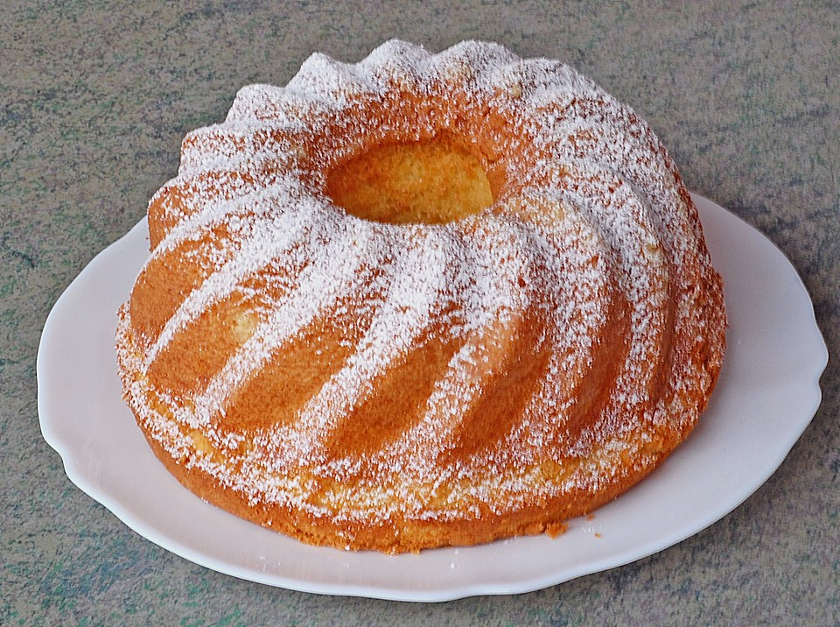
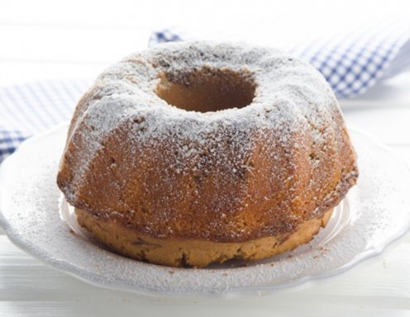
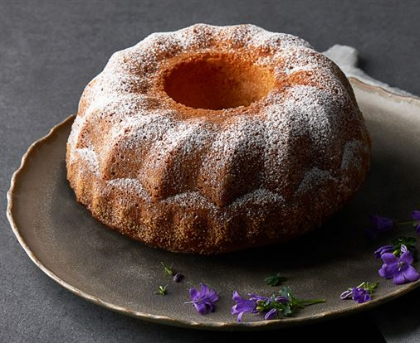
Polish „babka“
Austrian „Gugelhupf“
German „Mamakuchen“ or „Marmorkuchen“
Czech „bábovka“

Slide 16
Nation-building
German nationalism => unification of Germany
Slavic nationalism => political fragmentation
nationalism of the Slavs as a reaction to the rise of German nationalism
feelings of insecurity
romantic, ethno-linguistic nationalims – nation defined by language, „ethnos“, and mythical version of its history
=> deconstruction of Central Europe as a pluralist and multicultural society

Slide 17
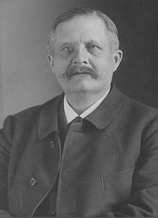
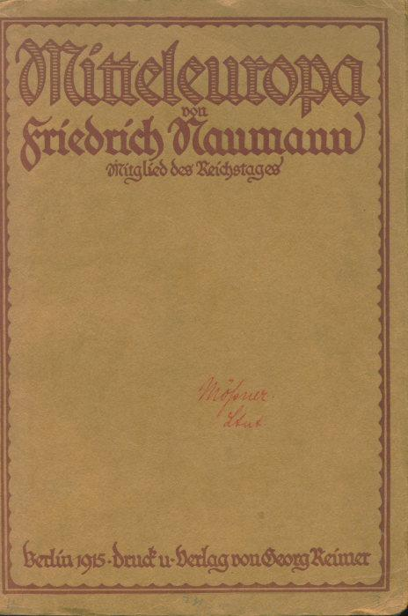
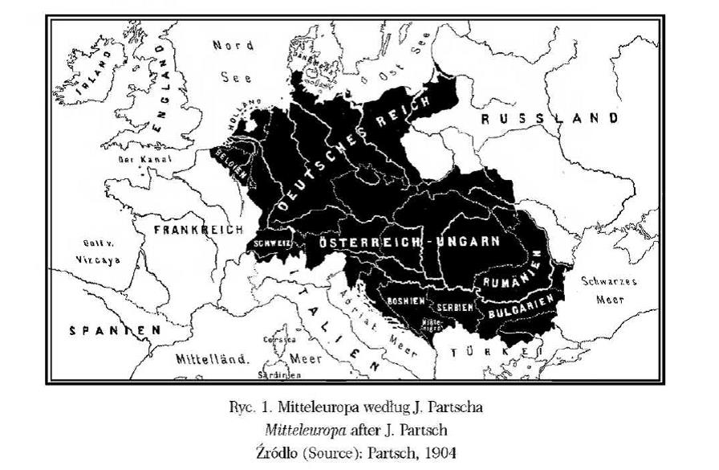
Competing Ideas of Europe (between the two wars)
MITTLEEUROPA
origins: Friedrich Naumann, 1915
loose confederation of the small nations squeezed in between and vulnerable to large European powers (Russia, France/Britain)
it would have included the Balkans
geopolitics of CE under German leadership
the idea of an alliance of the countries of -Central Europe as historically and culturally different from the Soviets and the East stayed

Slide 18
Other Projects
Czechoslovakia:
Czechs have felt Western European, East begins with Russia
Masaryk (1850-1937): “New Europe”: modernized, fully democratic but it doesn’t include “barbarian” Turkey, big role for US relations, and Wilsonian self-determination
Edvard Beneš (1884-1948): Pan-European Union
Milan Hodza (1878-1944): agrarian economic union in Central Europe and alliance needed for the survival of these small nations
Jaroslav Krejčí (1931): supported a European confederation; being Czech = double adherence to one’s own nation and European culture
Hungary:
Oszkar Jaszi: Danube confederation of Central European small nations + a third road (in terms of political/economic order)

Slide 19
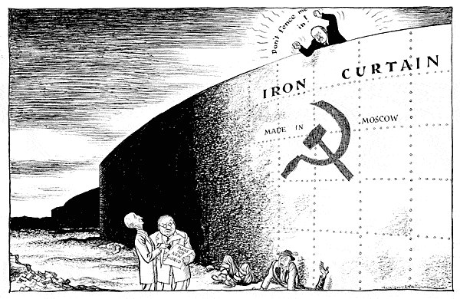
Post-war period: Trapped behind the Iron curtain
Second world war escalated in expulsion of Germans (10 millions)
CE as a part of the East, bipolar structure of the worlds
Jacques Rupnik (1990): „The fate of the Central European nations has been shaped by the two dominant powers, Russia and Germany“

Slide 20
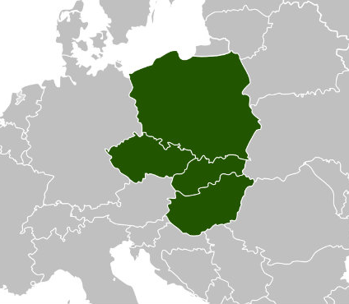
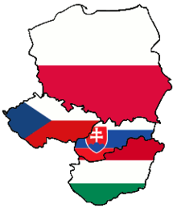
Current Central Europe
Jacques Rupnik: „with the collapse of the Berlin wall, discussion of Central Europe takes on new meaning.“
Visegrád group
discussion of intellectuals in 1980‘ (Milan Kundera, Czeslaw Milosz, György Konrad)

Slide 21
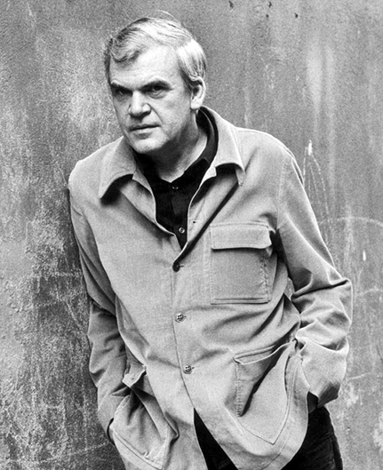
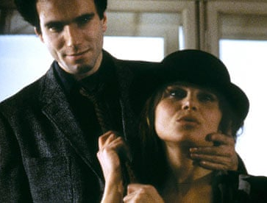
Milan Kundera (*1929)
Europeanness = culture matters more than consumption and the market and more than power
1956 Hungarian freedom fighter’s last words: “We are dying for Europe”
reviving Central Europe as culturally different both from the barbaric East and the hedonic West

Slide 22
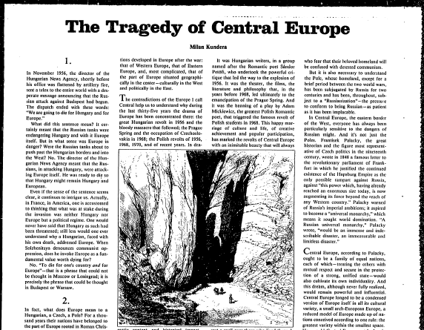
Task for the next week via Moodle
https://dl1.cuni.cz/login/index.php

