Slide 1
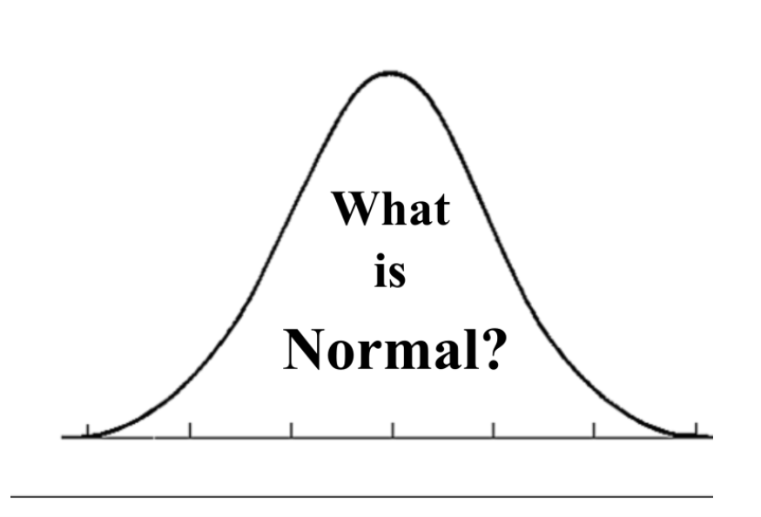
NORM AND NORMALITY IN PSYCHOLOGY

Slide 2
Definition of a Norm
Within our society, we have so called social norms which are standards that we are encouraged to live by in terms of what is right and wrong & acceptable or unacceptable when it comes to believes & behaviours.
A social norm is the accepted behaviour that an individual is expected to conform to in a particular group, community, or culture.
These norms often serve a useful purpose and create the foundation of correct behaviours. In other words, social norms allow you to expect the events that will occur in a particular setting. This allows you to prepare yourself for a situation and reduces the amount of stress that you would feel leading up to a situation that you felt uncertain of what was expected.

Slide 3
Definition of a Norm
Social norms are most noticeable when they are not followed. They remain stable because most people are taught to follow them and agree to do so willingly. Even if a person doesn't feel like following a social norm, he or she may do it because of the social pressure that's placed on him or her to conform.
When you do not conform to the social norms that are accepted by your culture or group, it's considered an abnormal behaviour. This is called deviance. There are varying degrees of deviance that are accepted by different groups.

Slide 4
Four key types of norms
Mores: structure the difference between right and wrong: religious doctrines. Violating them typically results in disapproval and punishment.
Folkways:
mark the distinction between rude and polite behaviour: queueing.
Taboos: a prohibition of certain behavior. The violator is considered to be unfit to live in the society. Incest and cannibalism are both considered taboos in most places.
Law: a norm that is formally inscribed at the state level and is enforced by police. When someone violates a law, a state authority will impose a sanction (imprisonment).

Slide 5
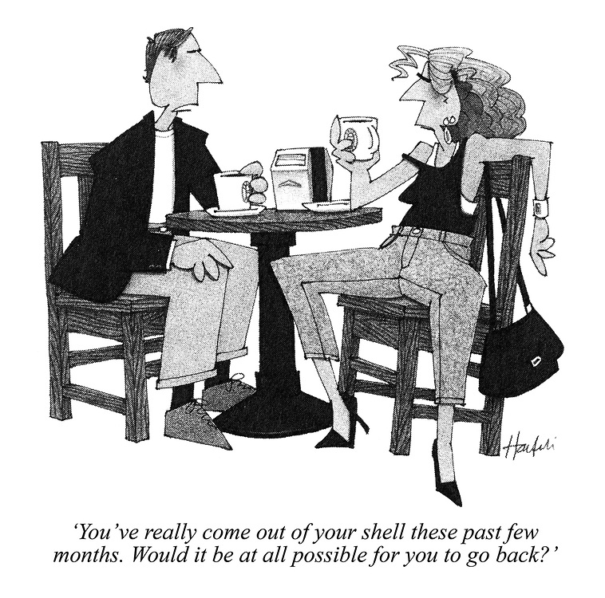
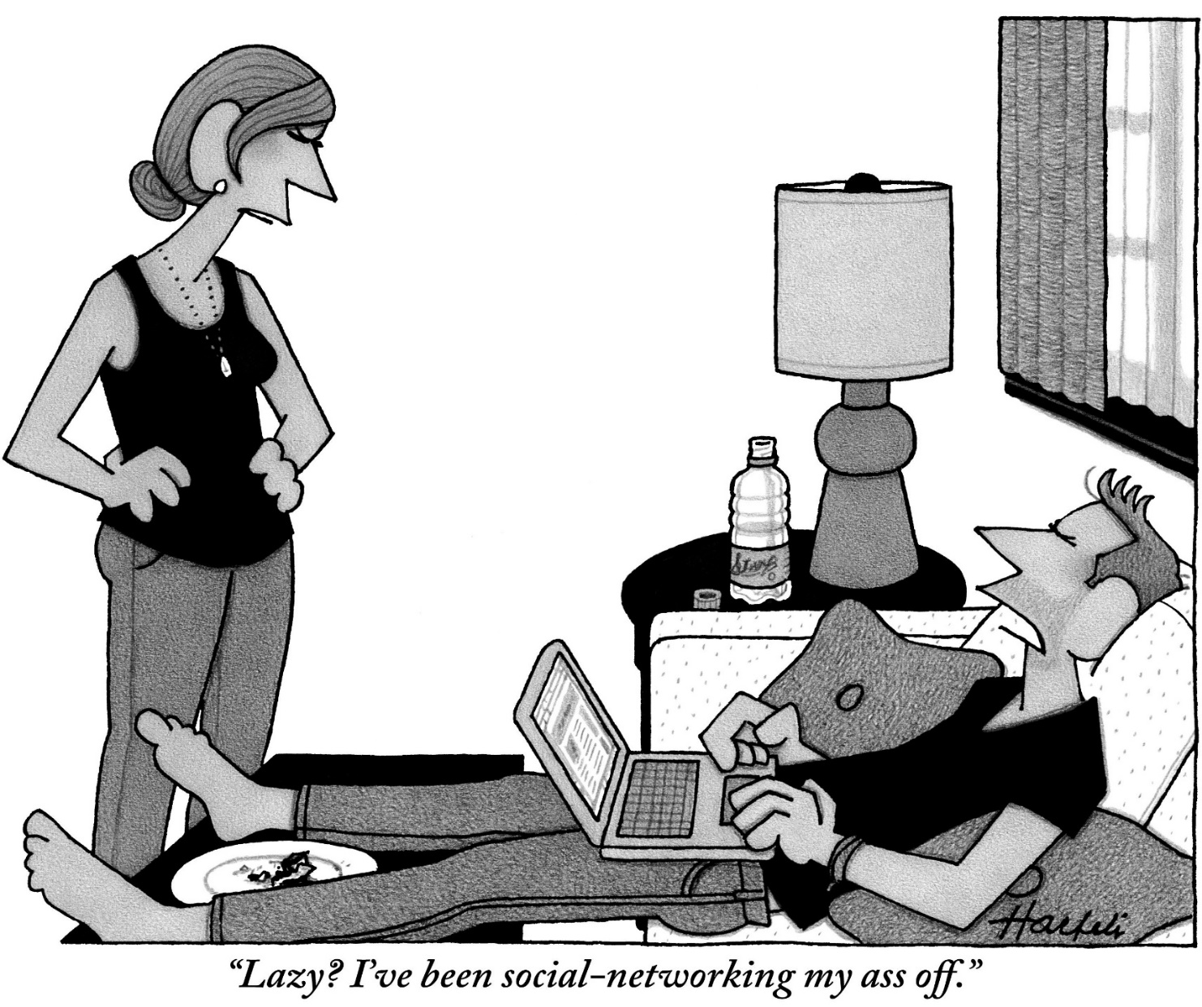

Slide 6
Definition of a Norm
When it comes to interpreting psychological test scores, researchers often use NORMS. In terms of testing, norms can be described as the average scores among an identified group of people. Such NORM provides a basis at which test scores of individuals can be compared.
NORM REFERNCE TEST (NRT) This type of test identifies whether the test taker performed better or worse than other test takers
CRIETERION REFERNCE TEST (CRT): CRT interprets a test score compares an individual’s performance to some criterion other than performance of other individuals.

Slide 7
Definition of a Norm
DEVELOPMENTAL NORMS:
Developmental norms are defined as standards by which the progress of a child's development can be measured. Developmental Norms – child age, stages of age. For example, the average age at which a child walks, learns to talk, or reaches puberty would be such a standard and would be used to judge whether the child is progressing normally.

Slide 8
Definition of Normality
Normality can be defined as a set of characteristics that are an indicator of mental health:
Reasonable perception of reality.
Ability to control your behaviour.
Self-esteem and acceptance.
Ability to create emotional bonds, empathy.
Activity.
Norm is a kind of ideal that we strive to achieve. (Atkinson, 2003)

Slide 9
NORM

Slide 10
Definition of Abnormality I.
The definition of abnormality can be determined in terms of various criteria:
Deviation from statistical standard.
Deviation from social norm.
Maladaptive (non-adaptive) behaviour (affects negatively an individual or society).
Personal problems (lack of well-being, mental suffering, anxiety).

Slide 11
Definition of Abnormality II.
When assessing abnormality, it is necessary to take into account:
Individual personality - people perceive and respond to the same situations differently, typically for them.
Situation - man's behaviour and acting should always be evaluated in context (death x loss of gloves).
The environment in which an individual lives - the influence of social learning.

Slide 12
Non-adaptive Behavior

Slide 13
Causes of Non-adaptive Behavior
situations involving unreasonable tasks and requirements;
problematic situations (new situations, lack of experience,…);
situations involving obstacles (material, moral, social) - result: frustration, deprivation;
conflict situation (++, + -, -; internal, external conflict);
stress (physical, chemical, biological, psychological, social, etc.).

Slide 14
Model of non-adaptive behaviour

Slide 15
Solution of arduous situations
Sometimes, in difficult (arduous) situations, one does not use the means for optimal adaptation,
resorts to non-adaptive behaviors;
can use different mechanisms to deal with the current situation;
however, they can become addictive ways of acting;
throughout life, successful techniques are strengthened.

Slide 16
Occupant behaviour in buildings

Slide 17
Some Defense Mechanisms

Slide 18
Aggressiveness
Especially children react aggressively;
it could take various forms - from serious violence and tantrums, threats through gestures and facial expressions, verbal threats, insults, sarcasm, irony to the so-called innuendo and teasing;
in particular, direct aggression is evaluated negatively (swearing, beating, destruction of property, etc.), therefore aggression is manifested more often in a hidden, indirect form.

Slide 19
Transfer of Aggression
To another person (rage at the superior - transmission to a colleague);
to things (vandalism, property destruction);
self-aggression - you sees yourself as a source of problems, he/she is trying to cope with aggression towards others, or when he/she feels guilty;
self-punishment or redemption can occur;
extreme form - self-harm (self-mutilation), can lead to a suicide;
milder form - one can deny anything he desires (restrictions).
The more advanced the society, the more it has developed repressive measures.

Slide 20
Aggression

Slide 21
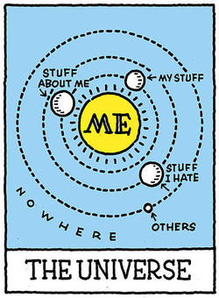
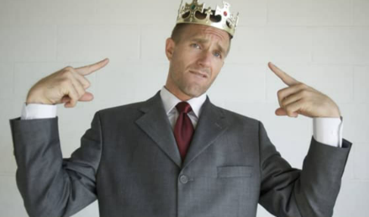
Egocentrism
Self-orientation, concentration, attracting attention;
common in children - not yet capable of empathy;
jumping into speech, bringing toys, requiring attention, ...

Slide 22
Egocentrism in Adulthood
Sign of social and personality immaturity;
draw attention to themselves by speaking loudly, promoting their own interests, wearing striking clothing and emphasizing the entire exterior, talking only about themselves;
it often develops in individuals who were either pampered and admired in their childhood or, on the contrary, rejected, pushed back, underestimated.
The inability to see others’ perspectives: only one’s own perspective.

Slide 23
Fixation
Freezing, stopping development,
the reactions of the individual even at an older age stagnated at a lower developmental level.
One tries to impose the same, albeit ineffective, solution to the precarious situation; he/she was disappointed once and no longer trusts anyone.
Failing to successfully complete a stage, Freud suggested, would cause that person to remain essentially “stuck.” In other words, they would become fixated at that point in development.
Notes:
Oral Fixations: As mentioned previously, Freud might suggest that nail-biting, smoking, gum-chewing and excessive drinking are signs of an oral fixation. This would indicate that the individual did not resolve the primary conflicts during the earliest stage of psychosexual development, the oral stage.
For example, Freud might suggest that if a child has issues during the weaning process, they might develop an oral fixation.
Anal Fixations: The second stage of psychosexual development is known as the anal stage since it is primarily focused on controlling bowel movements. Fixations at this point in development can lead to what Freud called anal-retentive and anal-expulsive personalities.
Anal-retentive individuals may have experienced overly strict and harsh potty training as children and may grow to be overly obsessed with orderliness and tidiness.
Anal-expulsive individuals, on the other hand, may have experienced very lax potty training resulting in them being very messy and disorganized as adults.
In either case, both types of fixations result from not properly resolving the critical conflict that takes place during that stage of development.
Phallic Fixations: The phallic stage of development is primarily focused on identifying with the same-sex parent. Freud suggested that fixations at this point could lead to adult personalities that are overly vain, exhibitionistic, and sexually aggressive. At this stage, of development boys may develop what Freud referred to as an Oedipus complex. Girls may develop an analogous issue known as an Electra complex. If not resolved, these complexes may linger and continue to affect behavior into adulthood, according to Freud

Slide 24
Fixation

Slide 25
Examples of Psychological Fixations

Slide 26
Identification
Identification with real persons and fictional characters e.g. film, book;
child - most often identifies either with parents or ,when playing, with people of different professions (teacher, doctor, nurse, designer, driver, pilot,…);
identification indicates a very positive relationship of an individual to a particular person.

Slide 27
Projective identification

Slide 28
Problematic Identification
Fixed identification with parents - in adolescence can be an obstacle to the socialization of personality;
dangerous - identification with some antisocial person or otherwise impaired;
pathological form of identification - some delusions (e.g. identification with historical personality).

Slide 29
Isolation
Exaggerated form of escape
reactions from simple distance to complete loss of contact with the outside world;
partial isolation can be considered the norm for introverts;
pathology - when the perception of the outside world is replaced by hallucinations and the individual creates his own world (psychotic autism).
loneliness

Slide 30
How loneliness can affect our health

Slide 31
Negativism
Manifestation of defiance especially in young children (active - opposite, passive - not responding);
developmentally - about 3 years (defiance period) the second similar period is puberty;
man provokes - it can be an effort
to attract attention,
to strengthen self-confidence,
to gain independence,
to be in opposition at all costs.

Slide 32
Compulsive Behavior
One of many forms of dissociation (splitting mental state, disrupting the unity of inner life and action);
actions that the individual must constantly repeat,
ritual, magical defence, relieving anxiety. (e.g. sewer cover, pass under a bridge while a train is running, or milder forms like holding inches, knocking on wood);
pathology - when a person is strongly forced to fulfil task and failure to do so causes anxiety or rage.

Slide 33
Compulsive behaviour
compulsive behaviour is a conscious act driven by a desperate need to ease anxiety and stress.
At it simplest, compulsive behaviour is a response to the thought “If I don’t do this action, something terrible will happen.”
The most common compulsive disorders are hoarding – the excessive accumulation, and the inability to discard, possessions regardless of their value; and obsessive-compulsive disorder (OCD) – a pattern of uncontrollable, unreasonable thoughts and fears that lead to repetitive behaviours.

Slide 34
Symptoms of Obsessive-Compulsive Disorder include:
excessive cleaning, bathing, and handwashing;
repeatedly checking things – cell phones, locks, the oven;
obsessive orderliness – arranging things in a particular or precise way;
compulsive counting;
ritualistic tapping, touching, or rubbing;
demanding encouragement or reassurances;
following a strict routine.

Slide 35
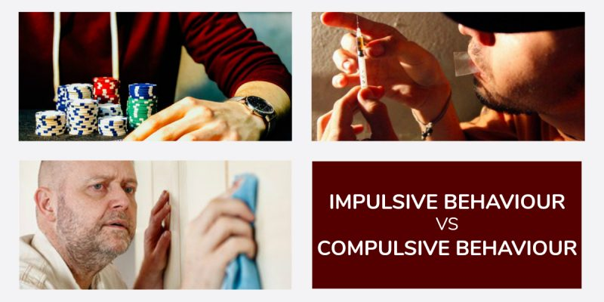
Impulsive vs compulsive behaviour
In today’s modern society, the promotion of stress, fear, and anxiety has become a part of daily life, as has our constant need for happiness and validation. Satisfying these innate human emotions is what has led to the increase in impulse control disorders, compulsive behaviour disorders, and addiction in our community.
Impulsive behaviour is usually driven by the desire for positive or pleasurable results, such as relief from emotional pain or the need for feeling of happiness
Current research into the origins of impulse control disorders indicates that genetics, neurological imbalances, and the environment in which an individual lives or was raised are a factor.

Slide 36
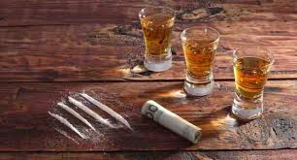
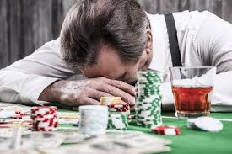
Impulse Control Disorders include:
substance abuse;
pathological gambling;
sexual addiction;
binge eating;
compulsive shopping;
intermittent explosive disorder;
kleptomania;
pyromania;
trichotillomania.

Slide 37
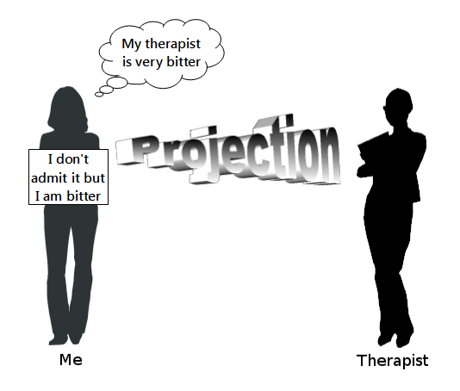
Projection
Basically, it involves blaming the other person, attributing one's own opinions, motives, ideas to others;
it is used primarily by people with low empathy;
the individual attributes his / her shortcomings, mistakes, bad qualities to his / her surroundings - justifies his / her behaviourur, e.g. all lie (stealing, cheating, being unfaithful, drinking,…), so it is ok; I hate someone because he/she hates me;
projection may lead to disruption of the relationship between the individual and the environment.
Notes:
There are three general types of psychological projection:
Neurotic Projection is the most common type of projection where someone attributes feelings, motives, desires, and attitudes they deem unacceptable onto someone else. This type most closely meets the definition of psychological projection.
Complementary Projection occurs when an individual believes that everyone else shares the same opinions and thoughts he or she does. For example, a woman is concerned about climate change, but when she realizes not everyone feels the same way, she is shocked.
Complimentary Projection occurs when someone assumes that other people possess the same skills they do. For example, a talented cook may think that everyone should be able to make the same dishes he can with ease.
Projection does not always have negative effects. Complementary projection gives people a sense of mutuality and helps them relate to others more easily.

Slide 38
Rationalization
Additional explanation or justification of certain behaviour (often initially impulsive) based on reasoning;
some motives of behaviour are socially unacceptable - the individual will therefore replace them with another, socially appreciated;
rationalizes by finding an acceptable motive (neglected child - independent) for its unacceptable conduct;
it also serves to reduce guilt and remorse (the positive and negative role of rationalization).
rationalization

Slide 39
Regression
Return to the manifestations of the already developed stage of development;
often in children at birth of a sibling, in a child's illness, etc. (wetting oneself with an older child who has already managed to defecate);
in adulthood - older people's desire for the past, the "old golden days„
younger people sudden increased focus on parents, friends from childhood or previous partner after love disappointment.

Slide 40
Regression

Slide 41
Transgression
Opposite direction of shift of developmental stage of reaction;
some form of defence - by skipping the stage of development, a kind of premature maturity;
again the reaction to a difficult life situation.

Slide 42
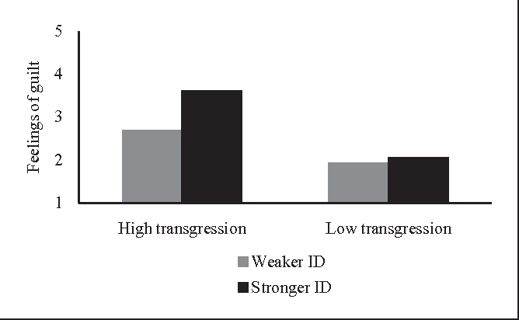
Transgression
Transgression as the act of violating norms, laws, budgets, etc. is traditionally esteemed as an unwanted, destructive act of behaviour.
In general - the process of an overstepping of a boundary.
Eg. Transgression is assumed to result in increased alcohol consumption relative to the perceived norm.

Slide 43
Repression or suppression
It is actually an escape into oblivion, suppression of unpleasant, harrowing thoughts or ideas - if they in some way threaten us or contradict our conscience, social norms, morality, etc. (e.g. we forget the name of the person that hurt us).

Slide 44
What is Repression
The ‘subconscious defence mechanism to direct one’s own desires and impulses towards pleasurable instincts by excluding them from one’s consciousness and holding or subduing them in the unconscious’.
It is our subconscious mind which avoids or suppresses these negative or unpleasant impulses from coming to the surface; as a result, we are not even aware of the existence of such impulses within ourselves.
The repression plays a role in the psyche of the average person and can lead to mental illnesses.

Slide 45
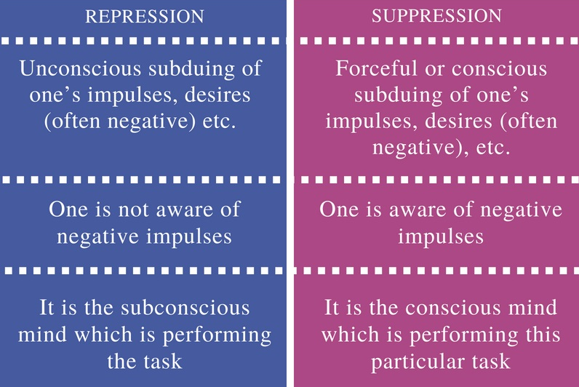
What is Suppression
Suppression means the act of consciously suppressing our impulses, feelings, memories, desires etc. and eventually making them not have any impact on our behaviour. In simple terms, suppression means the conscious avoidance of negative impulses.

Slide 46
Denial (negation)
In addition to suppression, there is also a technique of denial - one denies unfavorable facts with which he/she cannot deal with (smoker - cancer);
it can calm a person for a while, but it does not solve the problem;
it can take the form of reverse reaction
repressed sexual tendencies will result in strong resistance to sexuality, puritanism (reactive creation).

Slide 47
Denial
Psychology has identified denial as the primary defence mechanism that most people use to cope with highly stressful situations. It often involves blocking external events from our conscious awareness. Essentially, if a situation is too much for us to handle, then we refuse to experience it at all.

Slide 48
Kübler-Ross model; five stages of grief

Slide 49
Resignation
It is a passive, apathetic, indifferent relationship to the burden;
often accompanied by depressed feelings of helplessness;
sometimes the individual's constant failure to solve problem situations can lead to resignation.
defense mechanism

Slide 50
Escape
In this way, especially the children are dealing with difficult situations;
Escape can take various forms:
the easiest is simple escape (getaway, retreat) - child or adult simply escape from a difficult situation (against the enemy, sorrow, pain ...)
is considered a more positive response than aggression,people with an excess of these mechanisms are called cowards,
an individual can also use verbal escape (excuse) or escape by gestures, facial expressions, etc.

Slide 51
Forms of escape I.
A special form of escape is escape into fantasy (day dreaming)
it substitutes satisfaction that was not actually achieved,
day dreaming must not replace life, be an escape from life;
another case of escape is the so-called borrowed fantasy, or escape into literature, film, computer games with heroes, into mysticism,
this type of escape can be enhanced by alcohol or drugs.

Slide 52
Forms of escape II.
A specific form of escape is escape to disease,it is not a simulation - one experiences difficulties that are an unconscious means of protection from a difficult situation,
in the role of a patient he/she gets rid of unpleasant duties, gains free time, compassion, respect, everyone cares more for him/her, etc.
an extreme form of escape is suicide or suicide attempt
a very complex issue - this is only one of the options, one of the mechanisms for dealing with the difficult situation.

Slide 53
Thank you for attention

Slide 54
Literatura
Atkinson, R., L. Psychologie. Praha: Portál, 2003.
Smolík, 2002.

