Slide 1
BLEEDING
SHOCK

Slide 2
BLEEDING
- blood escaping from the circulatory system
- loss of 15 or more % of the total blood volume becomes dangerous
- quick and excessive loss of blood can cause death
Types of bleeding:
internal
external
arterial
venous
capillary
mixed

Slide 3
BLEEDING
traumatic
nontraumatic
minor
moderate
severe
Protect yourself!
Use medical gloves (plastic wrap, plastic bag)!
Wash your hands immediatelly afterwards!

Slide 4
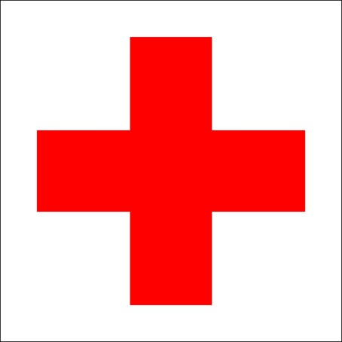
SEVERE EXTERNAL BLEEDING
FIRST AID - PRESSURE BANDAGE
apply direct pressure on the wound (palm, fingers)
apply pressure bandage
immobilize, elevate, cool
check the bandage (if blood soaks through, apply another layer of pressure bandage)
shock treatment
DO NOT apply direct pressure if embedded object or open fracture!
PRESSURE BANDAGE
sterile layer
pressure layer
fixing layer

Slide 5
SEVERE EXTERNAL BLEEDING
FIRST AID - TOURNIQUET
- drastic measure used for stopping excessive bleeding
- device for compression of blood vessels when life-threatening bleeding cannot be stopped by direct pressure
- tightly encircling bandage
Negatives:
Continuous application for longer than 2 hours can result in permanent nerve, muscle, vessel damage and skin and other tissues necrosis, even in loss of an extremity.
The application is very painfull, if conscious.

Slide 6
USE OF A TOURNIQUET?
amputation
3 layers of pressure bandage do not work
open fracture of long bone
embedded object
multiple casualties
multiple injuries
entrapment
apply on bare skin
apply on thigh or upper arm
mark time and date (on cheek)
shock treatment
DO NOT loosen the tourniquet!

Slide 7
2015 FIRST AID GUIDELINES
CONTROL OF BLEEDING
Apply direct pressure, with or without dressing where possible.
Do not try to control major external bleeding by using pressure points or elevation of an extremity.
However it may be beneficial to apply localised cold therapy with or without pressure, for minor or closed extremity bleeding.
Use a haemostatic dressing when direct pressure cannot control severe external bleeding or the wound is in a position where direct pressure is not possible. Training is required to ensure the safe and effective application of these dressings.

Slide 8
FIRST AID GUIDELINES
USE OF A TURNIQUET
Use a tourniquet when direct wound pressure cannot control severe external bleeding in a limb. Training is required to ensure the safe and effective application of a tourniquet.

Slide 9
SHOCK
- life-threatening condition
- flow of blood throughout the body is reduced limiting amount of oxygen blood carries to body cells
Types of shock:
Hypovolemic
Cardiogenic
Septic
Anaphylactic
Neurogenic
Obstructive
Combined
Undifferentiated

Slide 10
SIGNS AND SYMPTOMS
1. Compensated stage
pale skin
anxiety, confusion
rapid breathing, rapid pulse
weakness, thirst
2. Decompensated stage
gray clammy skin
acral cyanosis
confusion, disorientation
somnolence, loss of consciousness
rapid shallow pulse
3. Irreversible stage
unconsciousness
no peripheral pulse
failure of vital functions

Slide 11
FIRST AID
calm and reassure
shock position (on back with elevated legs)
treat the wounds, immobilise
keep warm
DO NOT give anything to drink or eat!
DO NOT give any oral medicaments!

Slide 12
2015 FIRST AID GUIDELINES
SHOCK
Place individuals with shock into the supine (lying on back) position.
Where is no evidence of trauma use passive leg raising to provide further transient improvement in vital signs.

Slide 13
INTERAL BLEEDING
- bleeding into chest, head, abdominal cavities, digestive tract or tissues surrounding large bones and pelvis
- serious medical emergency
Types:
traumatic
nontraumatic
SIGNS AND SYMPTOMS
depend on localization
developing shock like
FIRST AID
shock treatment
DO NOT give anything to drink or eat; no oral medicaments!

Slide 14
NOSE BLEED
FIRST AID
sit down
lean forward
pinch nose
cold compress on the neck
DO NOT speak, cough, blow the nose, swallow the blood!
If it lasts for more than 20-30 minutes see a doctor.
https://www.youtube.com/watch?v=PmmhxW0vVXA

Slide 15
BLEEDING FROM MOUTH
FIRST AID
sit down
lean forward
apply pressure with gauze for 15 minutes
bite the gauze for 15 minutes
cold compress
DO NOT speak, cough, swallow the blood!
DO NOT drink or eat hot meals for at least 2 hours!
If it lasts for more than 20-30 minutes see a doctor.

Slide 16
BLEEDING FROM EAR
- may signalize serious head injury
FIRST AID
sit down
tilt head on injured side
sterile dressing over the ear
if unconscious recovery position on injured side
DO NOT try to stop the bleeding!
DO NOT try to remove any object from the ear!

Slide 17
GASTROINTESTINAL BLEEDING
- blood in vomit or stool
- medical emergency
- many causes like gastric, duodenal ulcer or cancer, intestinal cancer, oesophageal varices, inflamation diseases, hemorrhoids
FIRST AID
half-sitting position / position on back
if vomiting, position on side
cold compress over abdominal area
treatment for shock
DO NOT give anything to drink or eat; no oral medicaments!

Slide 18
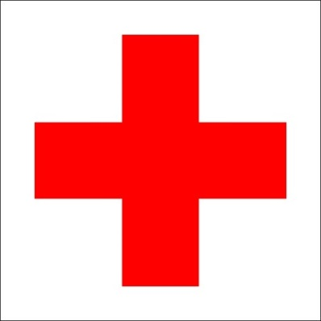
BLEEDING FROM RESPIRATORY TRACT
- coughing blood
- medical emergency
- many causes like pneumonia, lung cancer, tuberculosis, absces
FIRST AID
half sitting position
cold compress on chest
shock treatment

Slide 19
GYNECOLOGICAL BLEEDING
FIRST AID
position on back with flexed knees
apply sanitary pad or absorbing clean cloth
shock treatment

