Slide 1
Morphology and Physiology of Bacteria, Bacterial Genetics
Microbiology 1/MicRobiology
Kateřina Petříčková
Institute of Immunology and Microbiology, First Faculty of Medicine, Charles University 2019/2020

Slide 2
TOPICS OVERVIEW
PHYLOGENY OF BACTERIA
STRUCTURE AND SHAPE OF BACTERIAL CELLS
Prokaryote vs. Eukaryote, Eubacteria vs. Archaea
Components of bacterial cells as virulence markers
BACTERIAL METABOLISM
BACTERIAL GROWTH
BACTERIAL GENETICS
GENOMES – CHROMOSOMES AND EXTRACHROMOSOMAL ELEMENTS
HORIZONTAL GENE TRANSFER, EVOLUTION
MOLECULAR CLONING AND GENE-EDITING TECHNIQUES BASED ON BACTERIAL GENETIC ELEMENTS AND ENZYMES

Slide 3
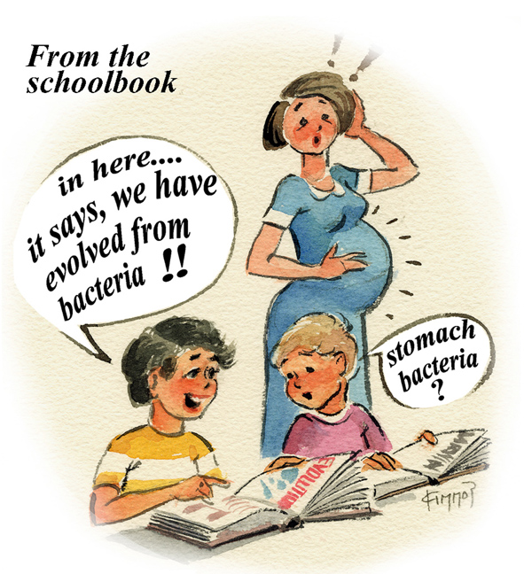
1. PHYLOGENY OF BACTERIA

Slide 4
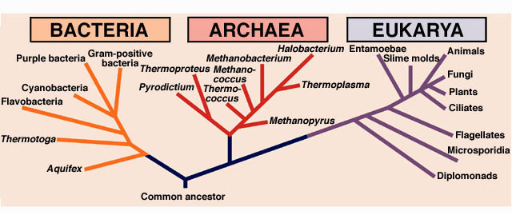
Prokaryotes
EUBACTERIA
ARCHAEA

Slide 5
Medically relevant – mostly eubacteria … but …
Human associated ARCHAEA:
Euryarchaeota – methanogenic archaea
Methanobrevibacter smithii (gut and vagina)
Methanosphaera stadtmanae (gut)
Methanosphaera oralis (oral cavity)
Link to diseases?
Lower incidences of methanogens, lower production of methane in diarrheal conditions of GIT
Higher methane production correlates with alterations in intestinal motility, such as constipation
Periodontitis (M. oralis)
Probably non-pathogenic sensu stricto, more as a component of „unnatural microbial community“

Slide 6
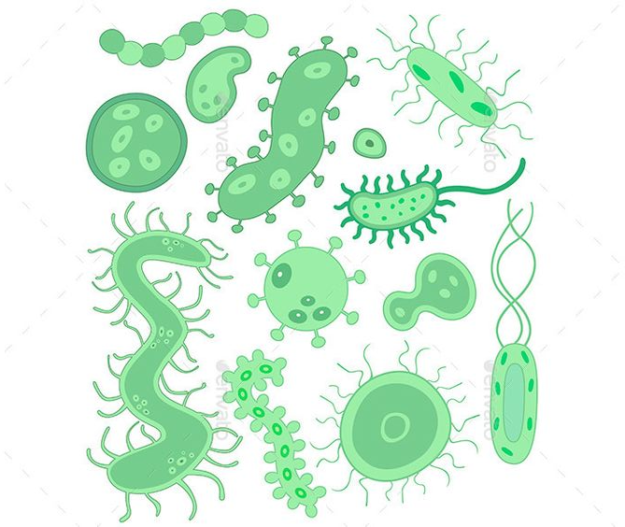
2. STRUCTURE AND SHAPE OF BACTERIAL CELL

Slide 7
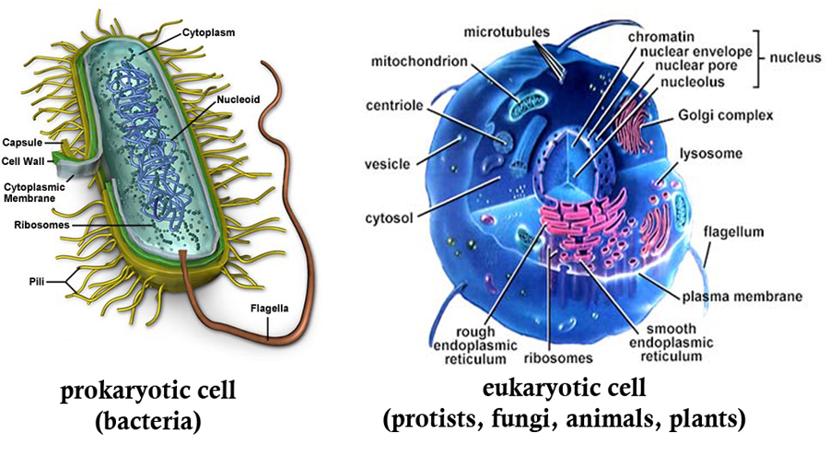
Prokaryotic vs. Eukaryotic cell

Slide 8
Characteristics | PROKARYOTES | EUKARYOTES
Size | < 2 μm | 2-100 μm
Structure of nucleus | Chromosome – typically single and circular (exceptions - Streptomyces, Borrelia) | Nuclear membrane Nucleolus Linear DNA, chromosomes
Mitosis, meiosis | - | +
Membranes | Cytoplasmic, no steroles | Steroles, endoplasmic reticulum, Golgi complex
Ribosomes | 70S Small 30S subunit (16S rRNA) Large 50S subunit (5S and 23S rRNA) | 80S Mitochondria and chloroplasts 70S
Organelles | No | Yes, compartments
Respiratory chain | In cytoplasmic membrane | In mitochondria
Cell wall | In all (excluding Mycoplasma, certain species can form transient cell wall-deficient forms, CWD, e.g. Borrelia) Peptidoglycan (Eubacteria), pseudomurein (Archaea) | Not in animals and protista
Endospores | Yes | No
Flagellar movement | Rotating | No rotation
Cytoskeleton | Yes | Yes

Slide 9
Bacteria vs. archaea
 | Archaea | Bacteria
Cell wall | Pseudopeptidoglycan, pseudomurein no muramic acid | Peptidoglycan muramic acid
Habitat | Extreme and harsh environments hot springs salt lakes marshlands oceans gut of ruminants and humans. | Ubiquitous soil, water, air plant and animal bodies also hot springs radioactive waste water Earth's crust
Growth & Reproduction | Asexual binary fission budding fragmentation Do not form spores | Asexual binary fission budding fragmentation Some form spores
Ribosomes | Prokaryotic type - different 16S rRNA | Prokaryotic type

Slide 10
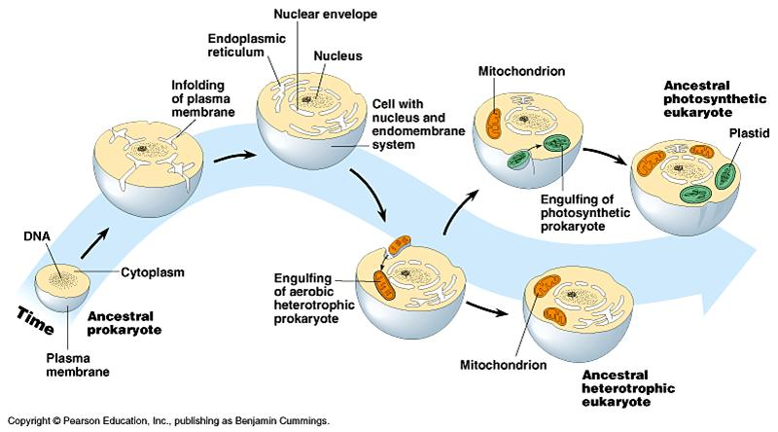
Endosymbiotic theory (symbiogenesis)

Slide 11
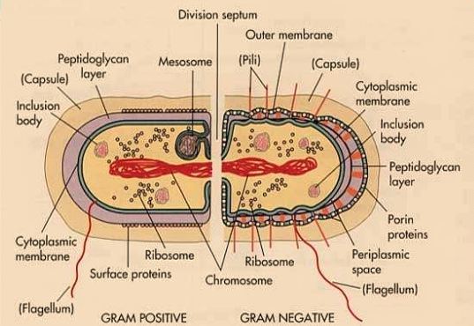
Structure of bacterial cell

Slide 12
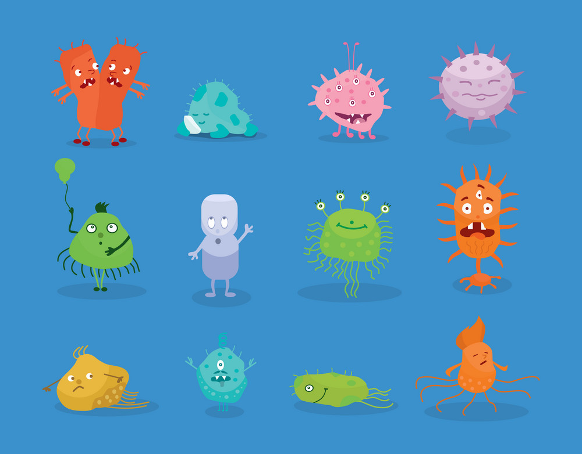
Shapes of bacterial cells

Slide 13
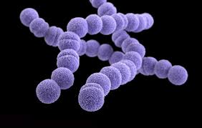
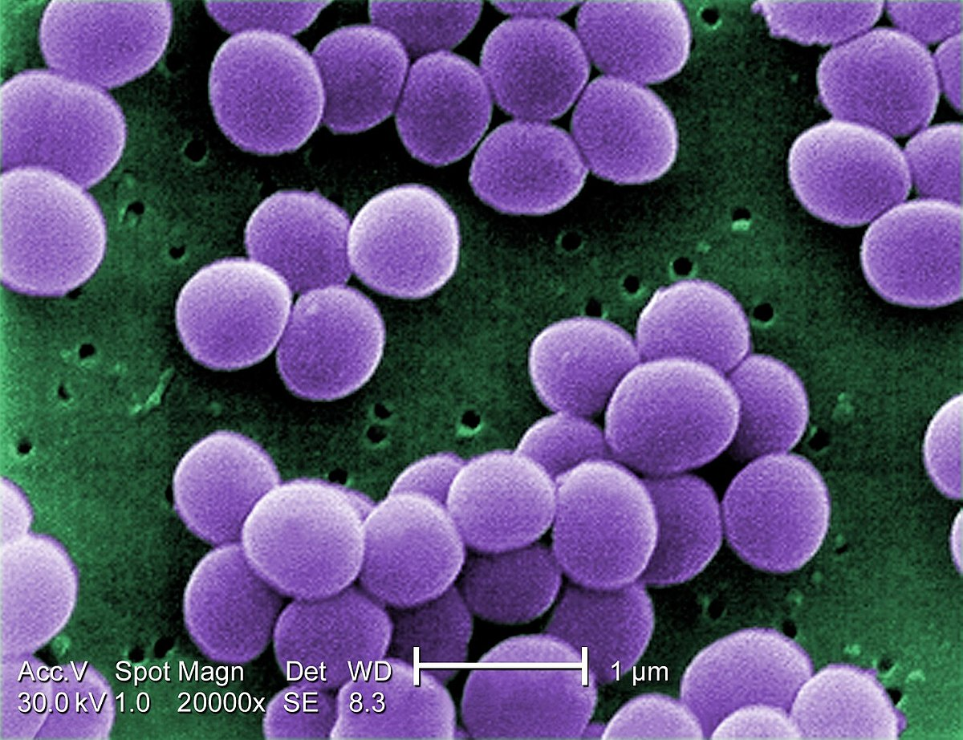
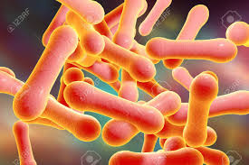
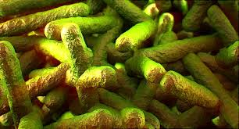
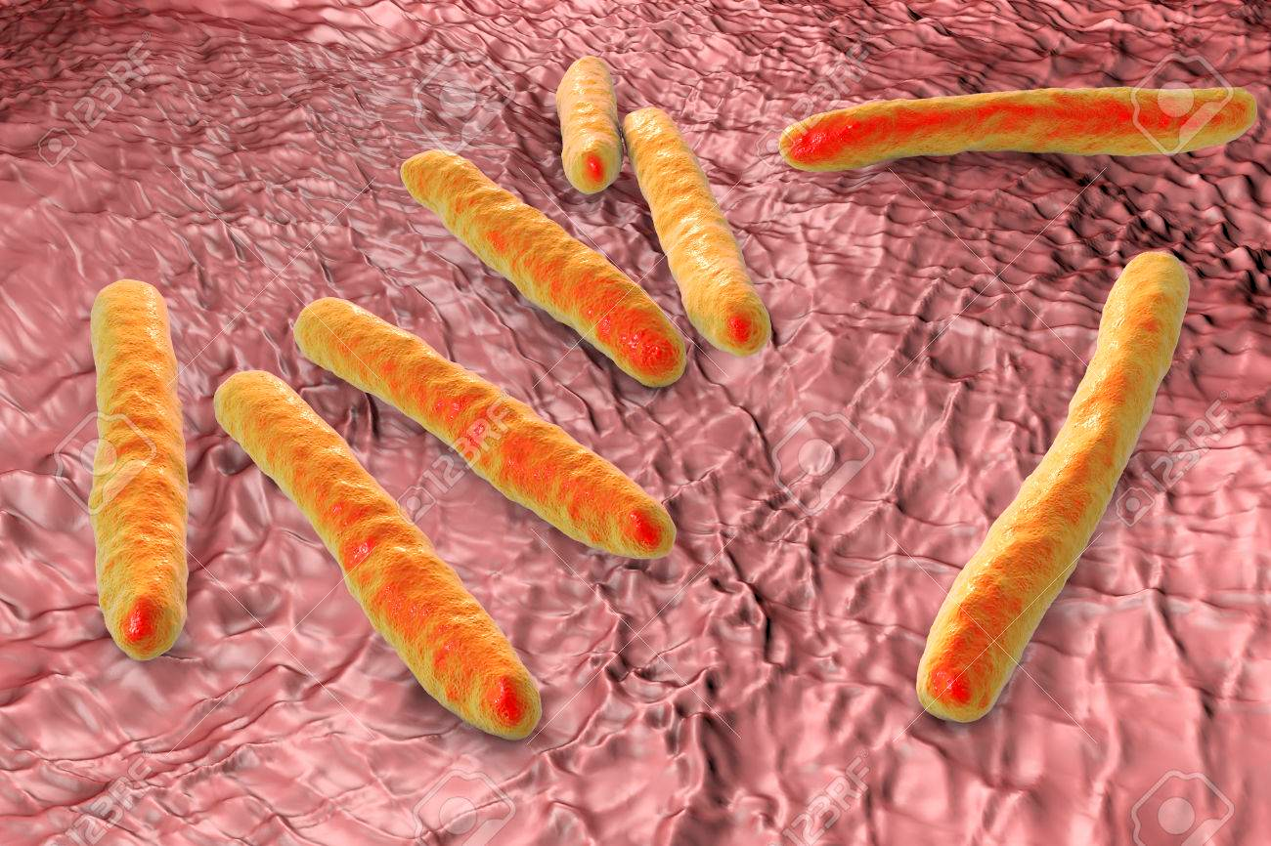
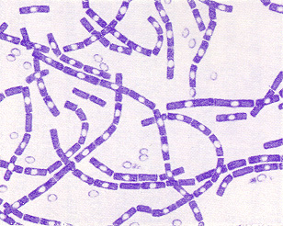
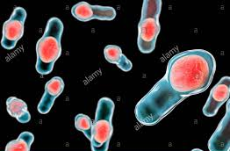
8 clinically relevant groups of G+
COCCI:
RODS:
SPORE-FORMING:
Streptococcus
Enterococcus
Staphylococcus
Corynebacterium
Listeria
Mycobacterium
Bacillus
Clostridium
Bacillus anthracis

Slide 14
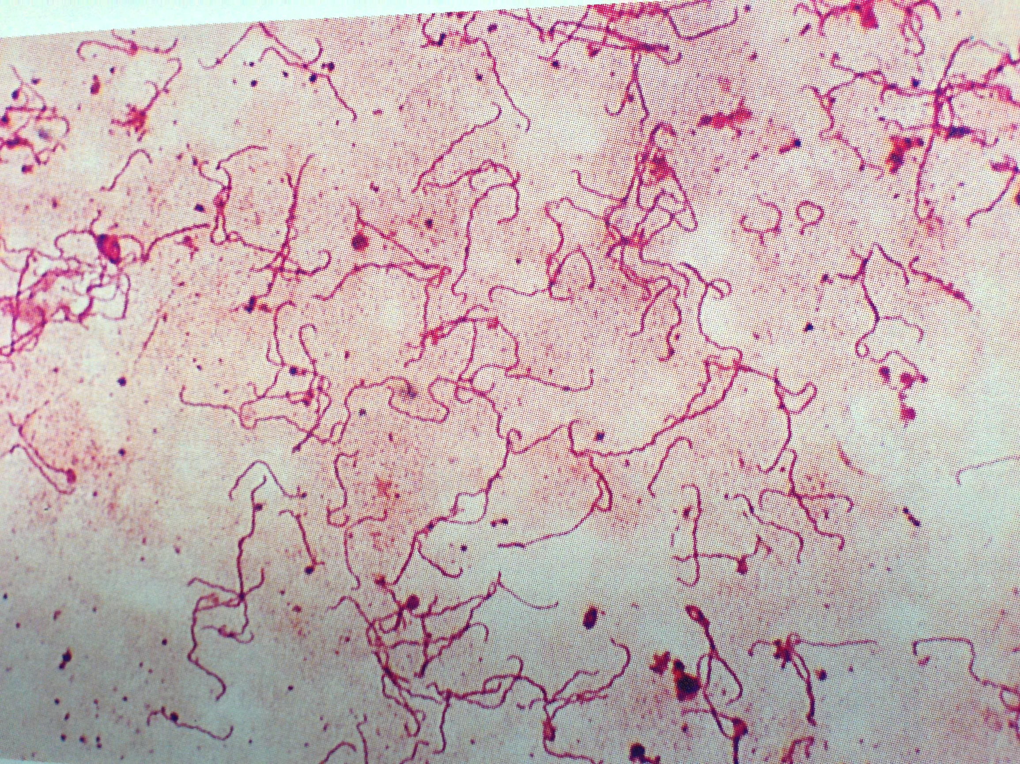
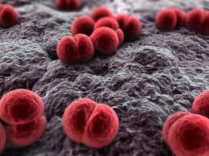
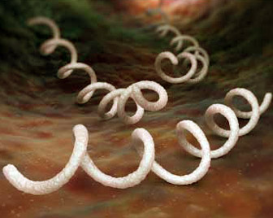
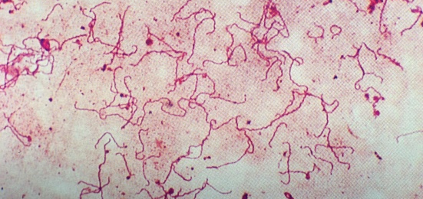
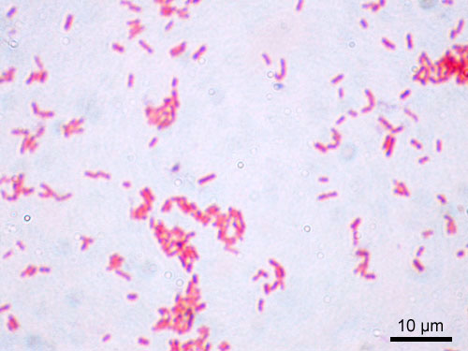
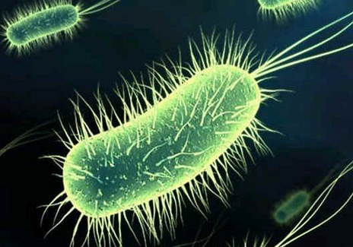
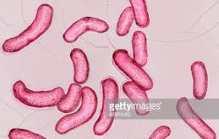
clinically relevant groups of G-
COCCI:
SPIROCHATES:
RODS:
twisted rods:
Neisseria - diplococcus
(spiral shape)
e.g. Treponema pallidum (syphilis)
Enterobacteriaceae
e.g. Escherichia coli
Vibrio cholerae

Slide 15
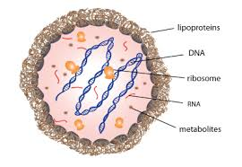
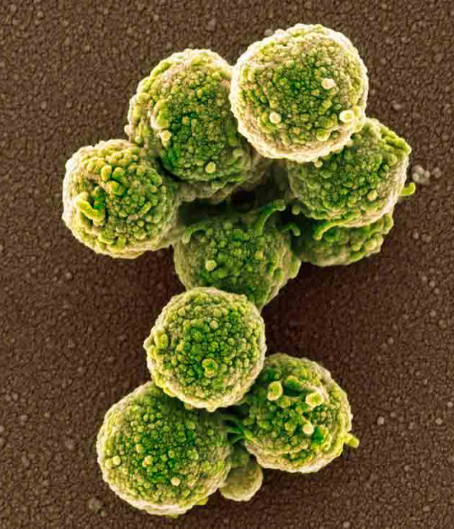
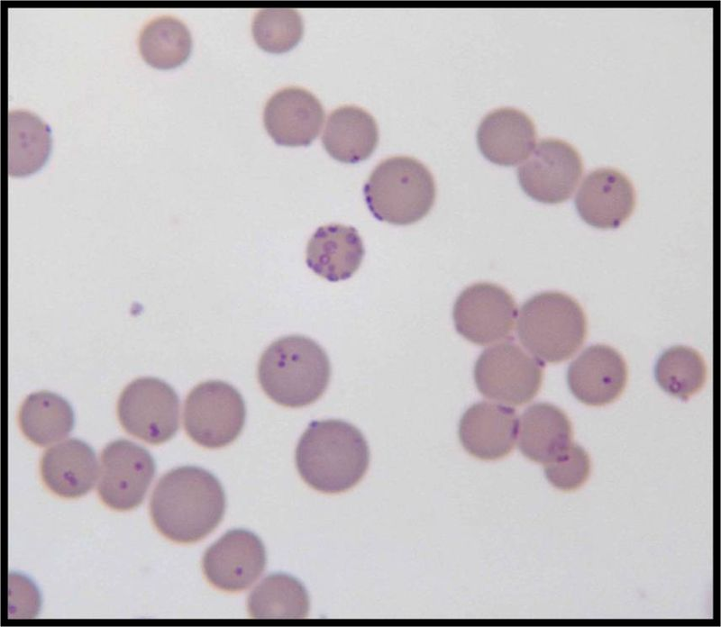
Bacteria lacking cell wall
Do not Gram stain
Mycoplasma
+ transient CWD forms, L-phase
E.g. Bacillus, Nocardia, Borrelia
Escape from the atb and immune system action?

Slide 16
Cell structures and virulence
Virulent microbes cause diseases
Pathogenicity = ability to cause diseases
Virulence = measure of pathogenicity
Virulence factors:
Cell structures – pili, flagella, polysaccharide capsules, etc.
Endo- and Exotoxins

Slide 17
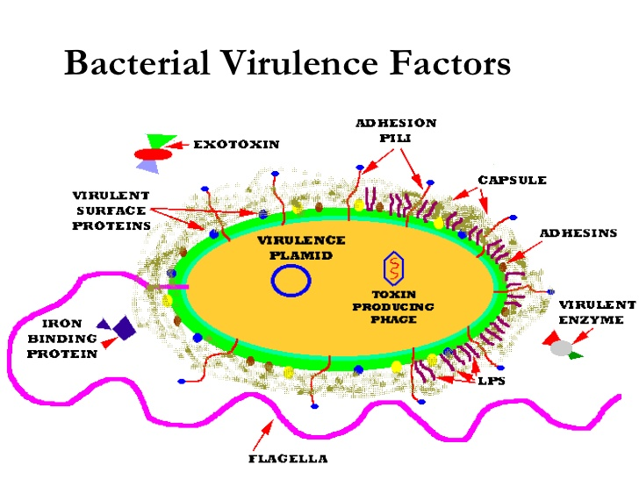

Slide 18
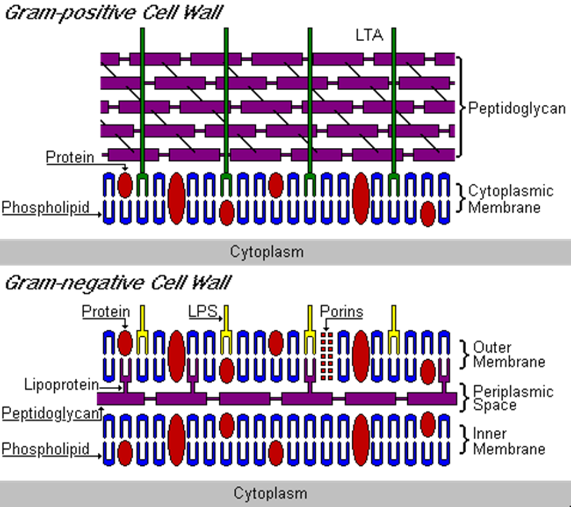
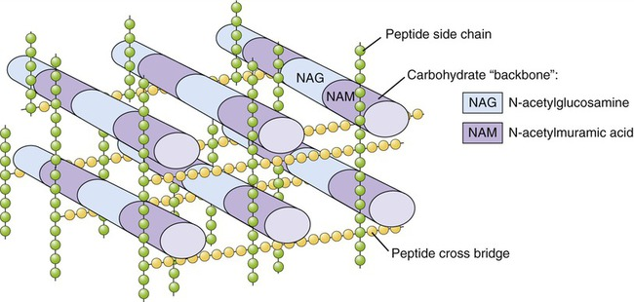
Peptidoglycan
Major component of bacterial cell wall
Network structure
Glucane chain-
N-acetylglucosamine
N-acetylmuramic acid
Rigidity

Slide 19
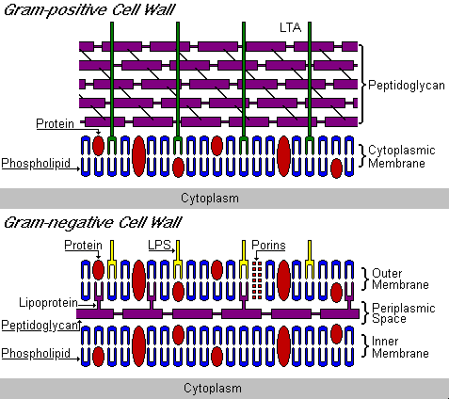
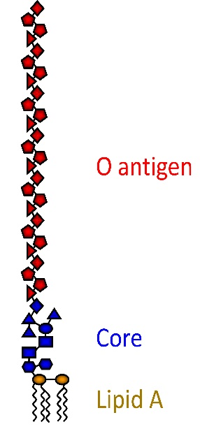
Bacterial cell wall
Lipoteichoic acid
LTA, lipoteichoic acid
Teichos (greek) – wall
Acidic polysaccharide
Antigenic
Adhesion of streptococci
LPS
Lipoprotein: binds the outer membrane to PG
Outer membrane: the main barrier
Periplasmic space – degradative enzymes
LPS – lipopolysaccharide / ENDOTOXIN
O antigen: glucan polymer, antigenic, variable
Core: sugars, other compounds
Lipid A – conserved, phosphorylated glucosamine with FA – released after cell lysis:
→ fever, diarrhea, endotoxic shock
Lipopolysaccharide

Slide 20
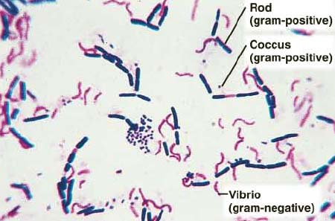
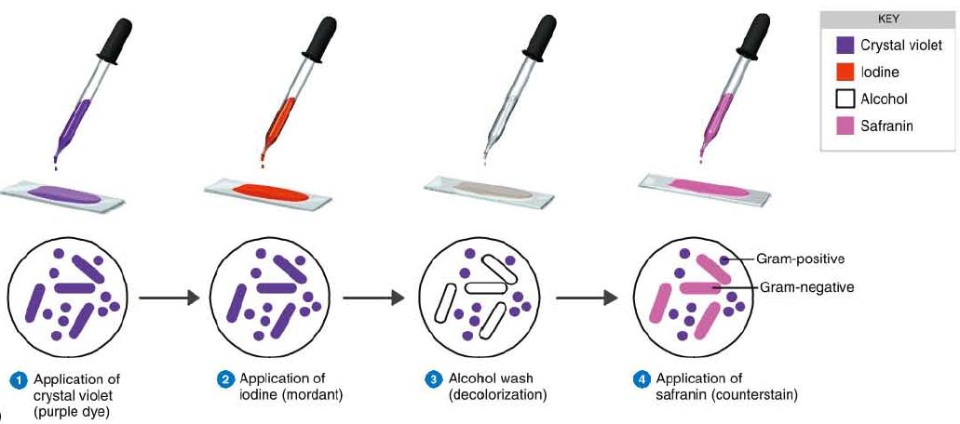
Gram staining

Slide 21
Gram staining
Gram-positive bacteria
due to thick peptidoglycan retain violet stain
Bacillus, Listeria, Staphylococcus, Streptococcus, Enterococcus, Clostridium
Gram-negative bacteria
thin layer of peptidoglycan between two membranes
spirochaetes, Proteobacteria
Gram variable
a mix of pink and purple cells (e.g. in Bacillus and Clostridium, caused by the decrease in PG thickness during rapid growth)
Gram-indeterminate bacteria
do not respond predictably to Gram staining
E.g. many species of Mycobacterium

Slide 22
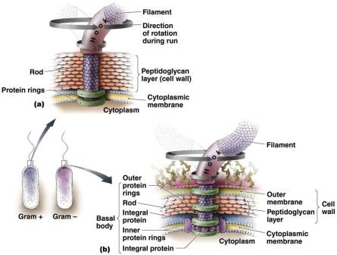
Cell structures as virulence markers
Flagellum
Protein filament (flagellin as a major component)
Basal body – anchores in the cm
Rotation
Chemotaxis

Slide 23
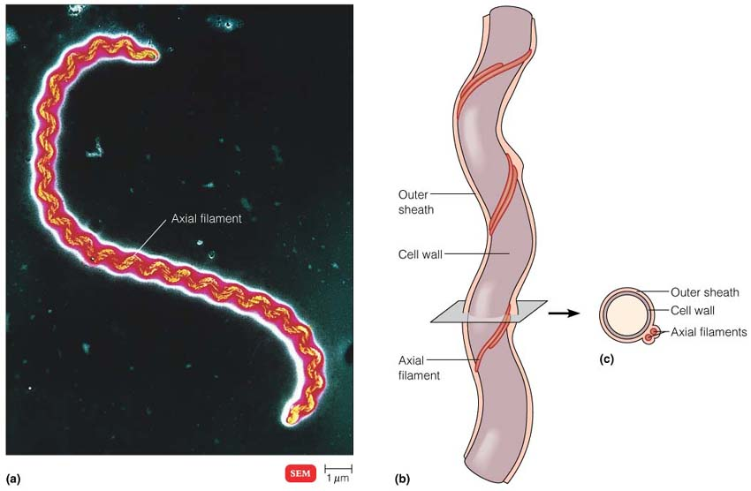
Cell structures as virulence markers
Axial filament
Spirochaetes
Similar to flagella, wrapped around the cell
E.g. Leptospira

Slide 24
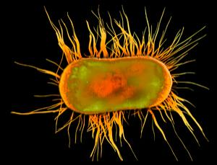
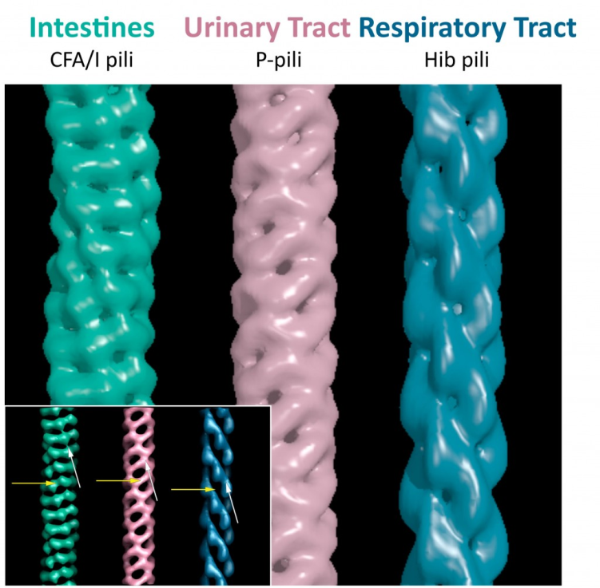
Cell structures as virulence markers
Pili (fimbriae)
Hair-like structures on the cell surface
Straight, short, fragile, non-motile
Some associated with bacterial conjugation (sex or F pili)
Adhesion to the host epithelial cells (adhesins):
Neisseria gonorrhae
cervical cells or oral epithelium
E. coli, Campylobacter jejuni
intestinal epithelium – diarrhea
Bordetella pertussis
lung ciliated epithelial cells
Molecular structures of pili adjusted to the surface specificities of target host cells

Slide 25
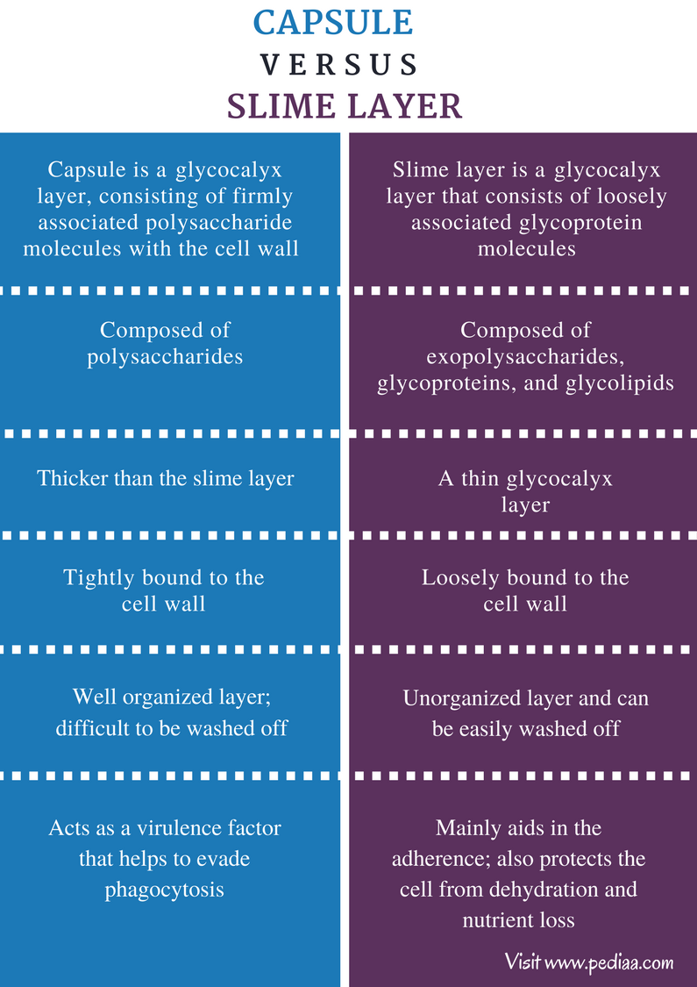
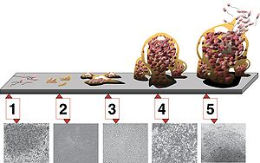
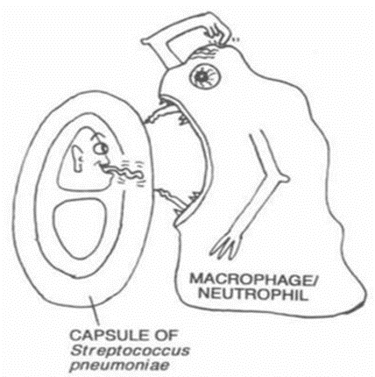
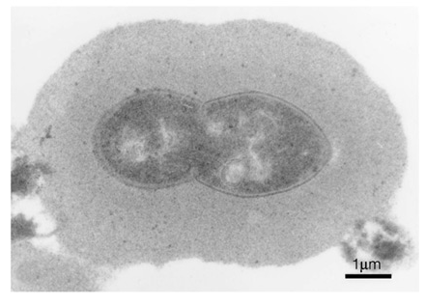
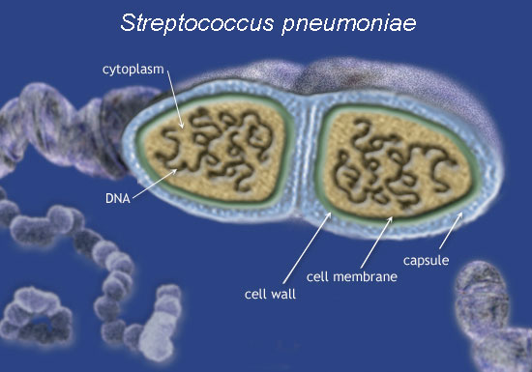
Cell structures as virulence markers
glycocalyx – capsules and slime layers
Outside the cell wall of some G- and G+, dispensable, polysaccharide (PS)
adhesion to surfaces - dental enamel, prostheses, cathetres –Staphyloccous epidermidis
Protection against antibiotics and immune system attacks (phagocytosis)
BIOFILM formation – highly organized, multicellular and multispecies, extracellular matrix
Co-adherence – secondary colonization of already adherent bacteria → community → dental PLAQUE
capsule may be also formed by poly-aminoacids (Bacillus anthracis)
virulence factor – antibodies against the capsule
Streptococcus pneumoniae
S smooth (with capsule) = virulent form
R rough (without capsule) = avirulent form

Slide 26
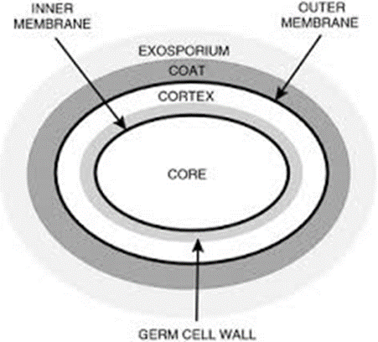
Cell structures as virulence markers
endospores
Dormant cells – no metabolism, survival in bad conditions
Resistant to: high temperatures (boiling)
UV and radiation
drying
organic solvents
lysozyme
Contains DNA, germination enzymes
Stabilized by calcium dipicolinate
Enveloped with cortex – dehydrated peptidoglycan
Bacillus and Clostridium

Slide 27
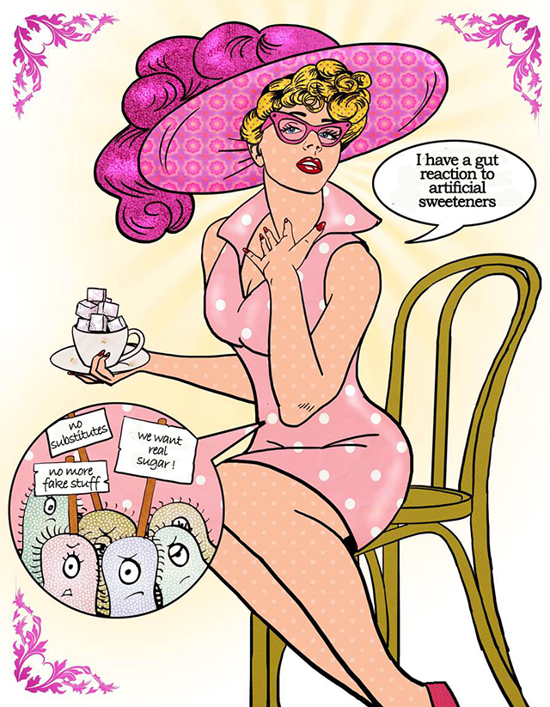
3. Bacterial metabolism

Slide 28
Bacterial metabolism
Complex of all chemical reactions in an organism
Energy metabolism
Oxidation = loss of electrons or an increase in oxidation state by a molecule, atom, or ion.
Reduction = gain of electrons or a decrease in oxidation state by a molecule, atom, or ion.
Simple molecules
ANABOLISM
energy
energy
CATABOLISM
Complex molecules

Slide 29
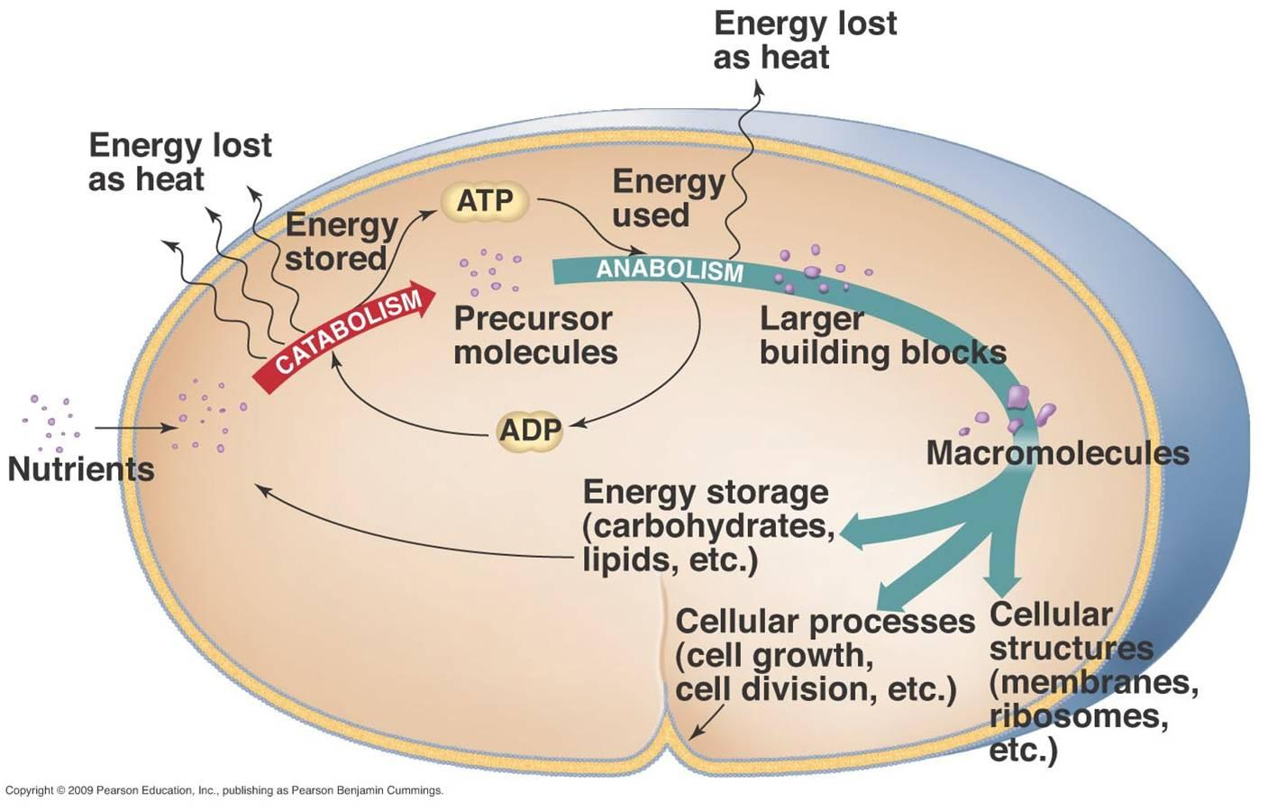
Metabolism overview

Slide 30
MODE OF NUTRITION
Chemoheterotrophs chemolithoheterotrophs = inorganic energy sources chemoorganoheterotrophs = organic energy source

Slide 31
chemoorganotrophy
Organic compounds: energy and carbon source
RESPIRATION
Aerobic – O₂ terminal electron acceptor
Anaerobic – different electron acceptor
FERMENTATION

Slide 32
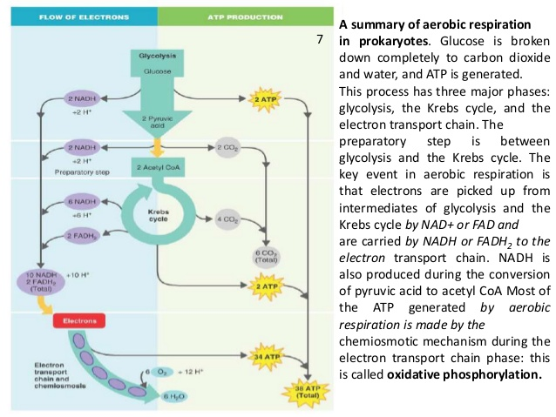
Chemoorganotrophy - respiration
AEROBIC/ANAEROBIC RESPIRATION
4 sub-pathways:
GLYCOLYSIS
OXIDATIVE DECARBOXYLATION OF PYRUVATE
KREBS CYCLE
ELECTRON TRANSPORT RESPIRATORY CHAIN

Slide 33
Chemoorganotrophy - respiration
AEROBIC RESPIRATION
Electrons released by oxidation transferred by an electron-transport chain to the oxygen as a final electron acceptor
C₆H₁₂O₆ + 6 O₂ 6 CO₂ + 6 H₂O
38 ADP + 38P 38 ATP

Slide 34
Chemoorganotrophy - respiration
AEROBIC RESPIRATION
GLYCOLYSIS
1 glucose 2 pyruvate molecules
Embden-Meyerhof pathway
Final products:
2 pyruvates
2 NADH₂
2 ATP
Oxidation (cleavage)

Slide 35
chemoorganotrophy - respiration
AEROBIC RESPIRATION
OXIDATIVE PYRUVATE DECARBOXYLATION
A bridge between glycolysis and Krebs cycle
2 pyruvates 2 acetates(Ac-CoA)
2 CO₂
2 NADH₂

Slide 36
chemoorganotrophy - respiration
AEROBIC RESPIRATION
KREBS CYCLE (TCA, citrate cycle)
Sequence of reactions starting and ending up with citrate
2 acetates (Ac-CoA) → 4 CO₂
_{Final products:}
2 ATP
6 NADH₂
2 FADH₂
4 CO₂

Slide 37
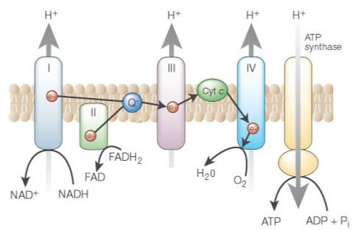
chemoorganotrophy - respiration
AEROBIC RESPIRATION
ELECTRON –TRANSPORT CHAIN
Oxidative phosphorylation
Oxygen as a final electron acceptor
H₂O (oxidative)
ATP
(phosphorylation)

Slide 38
chemoorganotrophy - respiration
ANAEROBIC RESPIRATION
difference in the electron-transport system:
FINAL ELECTRON ACCEPTOR IS NOT THE OXYGEN:
nitrate NO₃⁻ nitrite NO₂⁻ Paracoccus denitrificans, Escherichia coli
sulphate SO₄²⁻ hydrogen sulphide H₂S Desulphovibrio, Desulphomaculum
CO₂ methane CH₄ Archaea
fumarate succinate Enterobacteria

Slide 39
Chemoorganotrophy - FERMENTATION
FERMENTATION
Anaerobic proces
No electron-transport chain
Incomplete oxidation of carbohydrate molecules, which serve both as donors and final acceptors of electrons
Glycolysis (→ 2 pyruvate molecules)
Following fermentation steps
Final product depends on: organism
substrates
present enzymes

Slide 40
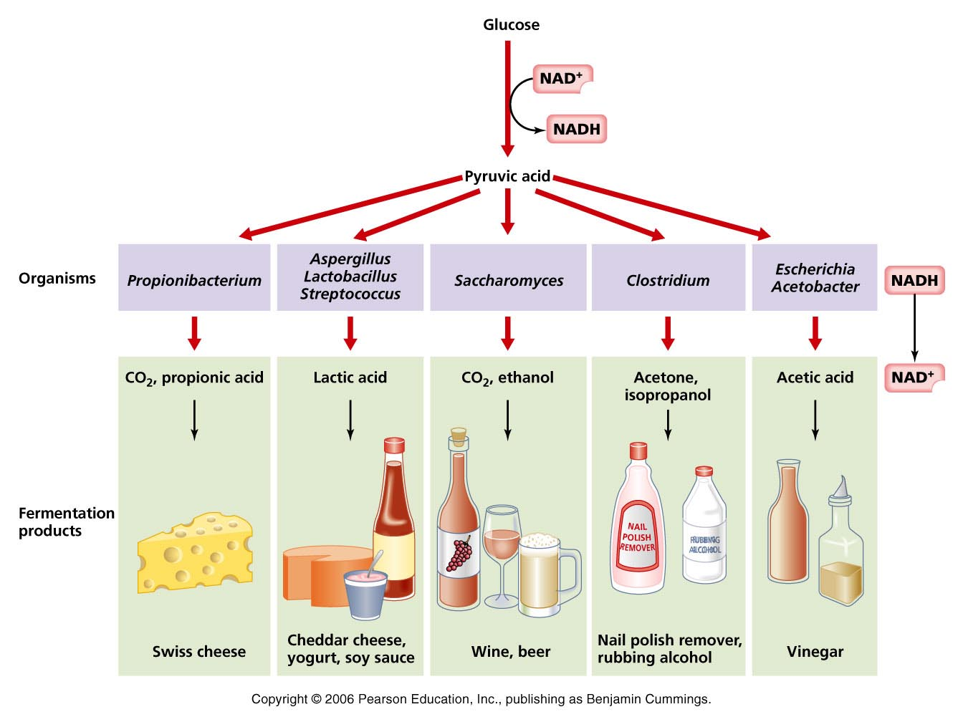

Slide 41
chemoorganotrophy - FERMENTATION
1. LACTIC ACID FERMENTATION
2 ATP
Lactic acid as a final product
Food decaying process
Food production
yoghurt, cottage cheese, cheese
fermented vegetables, cabbage (sauerkraut, kimchi)
fermented mushrooms
2 bacterial genera – Streptococcus, Lactobacillus, some yeasts

Slide 42
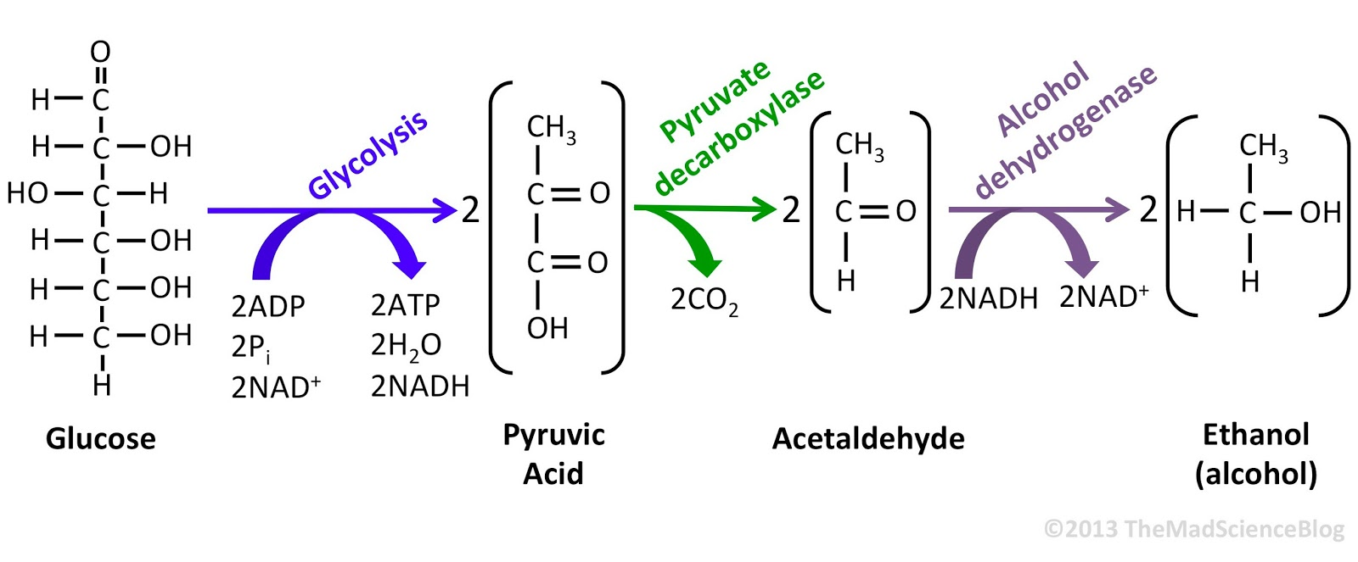
chemoorganotrophy - FERMENTATION
2. ALCOHOLIC (ETHANOL) FERMENTATION
2 ATP
Alcohol and CO₂ as final products
Alcoholic beverages
Rising of the dough
Saccharomyces cerevisiae (bakers yeast)
Zymomonas (bacterium)

Slide 43
chemoorganotrophy - FERMENTATION
3. BUTYRATE FERMENTATION
Products
Butyric acid
CO₂
H₂
Clostridium butyricum, Granulobacter butyricum (butanol)
Flax (linen) processing, wheat starch production, cheese maturation

Slide 44
chemoorganotrophy - FERMENTATION
4. ACETATE FERMENTATION
Aerobic fermentation of alcohol to acetic acid
Acetobacter
vinegar
5. PROPIONATE FERMENTATION
2 ATPs
Products: propionic acid + CO₂
Holes in cheeses – e.g. Ementaaler type
Propionibacterium

Slide 45
CHEMOLITHOTROPHY
Energy from inorganic compounds (H₂S, H₂, Fe^{2+,} NH₃), enters the respiratory chain and is oxidized
CO₂ as a carbon source (autotrophy)
Nitrosomonas (nitrification bact.) NH₄₊ → NO₂
Thiobacillus (sulphur bacteria) SO₃²⁻ → SO₄²⁻
Thiobacillus ferrooxidans (ferric b.) Fe²⁺ → Fe³⁺

Slide 46
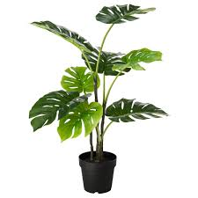
Photosynthesis
Phototrophy
Energy of light transformed to chemical energy
Chemical energy used for the CO₂ to sugar reduction
6 CO₂ + 6 H₂O + sunlight → C₆H₁₂O₆ + 6 O₂
Recyclation and fixation of carbon in environment

Slide 47
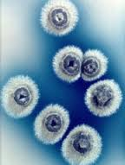
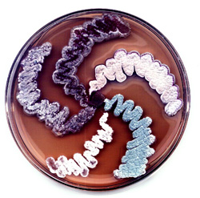
Secondary metabolites
Low molecular weight compounds
Antibiotics
Quorum sensing factors
Microbial hormones
Pigments
Toxins
Effectors of competition and symbiose
Pheromones
Enzyme inhibitors
Immunomodulators
Receptor ligands (antagonists, agonists)
Pesticides
Anticancer agents
Plant and animal growth factors
IMMUNOSUPRESANTS, ANTIHELMINTICS, HERBICIDES, ANTIVIROTICS, ANTIPARASITICS, ANTICANCER DRUGS,
CHOLESTEROL LOWERING DRUGS…
Inhibition zone
Streptomyces
Candida

Slide 48
4. Bacterial growth

Slide 49
BACTERIAL GROWTH and MULTIPLICATION
GROWTH CURVE

Slide 50
BACTERIAL GROWTH and MULTIPLICATION
GROWTH CURVE – LAG PHASE
Preparation for growth and cell division in the new environment
New enzymes synthesis

Slide 51
BACTERIAL GROWTH and MULTIPLICATION
GROWTH CURVE – EXPONENTIAL LOG PHASE
Cell division: 1→2 →4 →8 … →X X=X₀ . 2^{n}
n… generations, n = c.t (c … division speed, t … time)
GROWTH SPEED – change of biomass / time
GENERATION TIME –time for generation of two cells from single
DOUBLING TIME – time to double the number of cells in population (average of generation time)
Doubling time may be shorter than DNA replication time (a new replication starts before the end of the previous)

Slide 52
BACTERIAL GROWTH and MULTIPLICATION
GROWTH CURVE – STATIONARY PHASE
Lack of nutrients
Accumulation of toxic metabolic products
Time for the secondary metabolism

Slide 53
BACTERIAL GROWTH and MULTIPLICATION
GROWTH CURVE – DEATH (DECLINE) PHASE
Cell death
Cell lysis

Slide 54
Continuous cultivation
Chemostat
Steady state growth

Slide 55
Diauxic growth
Two energy sources in the media
Easily-metabolized source used first
Caused by catabolic repression – presence of the better energy source (glucose) blocks biosynthesis of enzymes for utilization of the other (lactose)
Once the first is exhausted, the growth stops and bacteria induce new enzymes to catabolize the other (β-galactosidase)

Slide 56
Environmental growth factors
TEMPERATURE – psychrophile x thermophile
pH: acidophile x alcaliphile
Osmotic pressure - Halophile (sea water)
Osmophile (sugars)
Xerophile (drought)
Bactericidal
vs. bacteriostatic
compounds

Slide 57
5. Bacterial Genetics

Slide 58
Bacterial genome
CHROMOSOME
(nucleoid)
dsDNA (3-8 Mbp, 0,1-15 in extremes)
Essential genes
Typically circular and haploid, supercoiled
E. coli – DNA strand 2 nm x 2 mm
cca 4,5 Mbp
ANTIBIOTICS ACTING ON THE GENETIC INFORMATION MANAGEMENT
REPLICATION - quinolones (nalidixic acid)
TRANSCRIPTION - rifampicin, actinomycin D
TRANSLATION - chloramphenicol, erythromycin, puromycin, streptomycin,
tetracycline

Slide 59
DNA REPLICATION
5‘ to 3‘ direction ALWAYS
Bidirectional
1. Leading strand
2. Lagging strand – (Okazaki fragments)

Slide 60
Bacterial genome – extrachromosomal elements
1. Bacteriophages - Bacterial viruses, RNA or DNA
Host-specificity: Phagotyping of bacteria
→ Salmonella, Shigella, Staphylococcus
classification of the strains based on their susceptibility to different phages
2. PLASMIDS
Circular dsDNA (or linear), more copies, more types in a single cell
Independent replication regulation
Carry 5 - 100 genes:
Replication and copy number control
Horizontal gene transfer – F – fertility factor → conjugation sex pili
May carry antibiotic resistance – R factor
Bacteriocidal proteins / bacteriocin Col (colicin)
Virulence factors Ent enterotoxin
Hly hemolysin
CFA-I, CFA-II adhesins
Cryptic – do not change the host phenotype

Slide 61
Transfer of genetic information
Vertical vs. horizontal
VERTICAL – from mother to daughter cell
HORIZONTAL – from non-related cells, even phylogenetically distant
Horizontal gene transfer, HGT
conjugation
transduction
transformation

Slide 62
Horizontal gene transfer

Slide 63
Horizontal gene transfer
CONJUGATION
conjugative plasmids and some transposons
Gram⁻ conjugation sex pili (F-pili)
Gram⁺ sex pheromone, chemotaxis → contact
May cause integration of new genes in chromosomes (also as a laboratory technique)
The recipient – TRANSCONJUGANT
TRANSDUCTION
Fragment of donor genes transferred inside the phage particle
The recipient – TRANSDUCTANT
TRANSFORMATION
Transfer of DNA only into the cell, integration into the genome
Natural transformation is active and controlled process
The recipient = TRANSFORMANT

Slide 64
1. CONJUGATION
Cell contact, big pieces of DNA might be transferred
Huge impact
Genetic diversity, parallel to sexual reproduction
Used for pilot gene mapping in bacteria chromosomes
Easy tool to transfer genes in a laboratory
Specific type of replication – rolling-cycle replication
CONJUGATIVE PLASMIDS
CONJUGATIVE TRANSPOSONS
May mobilize the entire chromosomes

Slide 65
1. CONJUGATION - Rolling-circle replication
Conjugative plasmids and
transposons
Some viruses

Slide 66
1. CONJUGATION
Lederberg and Tatum, 1946
Fertility factor –F plasmid – 100 genes
tra transfer operon
Replication
F-pili
Transfer of a copy of F-prime to a recipient
(F⁺ =donor, F⁻ = recipient)
Contact of two F⁺ inhibited
Sometimes integrates into chromosome, may transfer chromosomal genes
DNA transferred not via the F-pili, independent channel is formed

Slide 67
1. CONJUGATION: Historically the first tool to map bacterial chromosomes
Hfr strains – F-plasmids integrated into chromosome, may mobilize entire chromosome, show higher frequency of recombination
E.g. 100 min map of E.coli chromosome

Slide 68
2. TRANSDUCTION
BACTERIOPHAGES
Lysogenic conversion
integration of a prophage provides the host with novel characteristics
toxigenic (tox+) strain of Corynebacterium diphtheriae
pyrogenic exotoxin of Streptococcus pyogenes – scarlet fever
botulotoxin of Clostridium botulinum

Slide 69
2. TRANSDUCTION
GENERALIZED
= any part of chromosome packed into the capsid and transferred
SPECIALIZED
= due to the prophage integration and improper excision – only specific genes (lambda of E. coli)
IMPACTS:
Transfer of genetic material
Evolution of bacteriophages
Study of gene linkage

Slide 70
3. TRANSFORMATION
Vibrio cholerae hunting for DNA
“naked” DNA
Natural: naturally competent cells:
controlled and active - Import DNA
Secrete a competence factor
Secrete autolysins
Encodes self-immunity to autolysins
Imported DNA: degraded or adopted (recombination)
Artificial
heat shock, electroporation,protoplast transformation
recombinant DNA technology
TRANSFECTION – transformation of purified phage DNA into the host cell (causes infection)
ANY DNA!

Slide 71
Horizontal gene transfer
Conjugative plasmids (and transposons)
Bacteriophages
DNA of any origin by natural transfomation
4. Mobile genetic elements
1. INSERTION SEQUENCES, IS
Small (1 kbp), surrounded by inverted repeats
Transposase gene, control of frequency transposition
Insertion inactivation of genes, operons, deletions, inversions (mutagenic)
2. TRANSPOSONS, transposable elements, Tn
Bigger, several kbp
Essential genes as IS + adaptive genes – antibiotic resistence, aminoacid biosynthesis, sugar utilization, enterotoxins, adhesive fimbriae and other virulence factors
INTEGRONS
Tn with site-specific integration – often transfer antibiotic resistance
CONSTINS – CONjugative Self-Transmissible INtegrating
Gram negatives, e.g. STX elements of Vibrio cholerae
Conjugation, phage-type integrase, huge, about 70 genes – atb resistance
Present in the epidemic strain El Tor

Slide 72
CHANGES in genomes - evolution
RECOMBINATION MUTATION
1. RECOMBINATION
newly acquirred DNA recombines with the old one
Exchange of parts, or new spatial organisation
Homologous, legitimate → between homologous DNA sequences
host enzyme systems (rec genes for recombination repair of damaged DNA)
Non-homologous, illegitimate
site-specific recombinases, encoded by Tn, IS, bacteriophages

Slide 73
CHANGES in genomes
2. MUTATION
Stable, hereditary DNA changes
Classification:
vital x lethal
spontaneus x induced by mutagens
physical – X ray, UV (T-T dimers, radioactive)
chemical – bromouracyl, HNO₂, EtBr, nitroguanidine, acridines, aktinomycin D
biological – Tn, IS
Point x segment: Insertion x Deletion
REPAIR SYSTEMS
DIRECT REPAIR – e.g. Repair of a base or sugar methylation (alkylation)
EXCISION REPAIR – short part of mutated strand cut out and repaired based on the complementary strand
RECOMBINATION REPAIR – in diploids, homologous region needed
by recombination enzymes
SOS repair – leaves errors, recovers essential processes (replication)
reaction to serious, life-threatening damage

Slide 74
GENETIC ENGINEERING
techniques from recombinant DNA to transformation of cells, organisms
AIMS
Production of:
Medically-attractive proteins
insulin, growth hormone, interferrons, interleukins
Bioactive compounds
antibiotics, chemotherapeutics, immunomodulators, etc.
Recombinant vaccines (hepatitis B)
Gene therapy (a defective gene replaced by an intact)
Genetic defects detection
TOOLS
Cloning vectors to deliver the DNA to the target cell
Plasmids – smaller fragments <20kbp
Bacteriophages <25 kbp
Cosmids (combine features of plasmids and phages) <45 kbp, genomic libraries
Bacterial or yeast artificial chromosomes <200 kbp
Viruses (pox vaccines)
Restriction endonucleases for defined cleavage of DNA
DNA ligases to link the DNA fragments
Now – novel recombination based technologies, CRISPR/Cas9 based technologies

Slide 75
GENE CLONING
Plasmid vectors
easy to work with, small, high copy-number, encode their replication
Selection markers – antibiotic resistence
Restriction endonuclease (RE) cleavage sites to insert the DNA
HOW TO DO:
Isolate DNA of interest (e.g. PCR)
Modify the fragment (RE sites for insertion)
Cleave the vector by the same RE
Ligate both molecules
Transfer the recombinant DNA to the host
Select the transformed clone (antibiotic resistence)

Slide 76
Novel technologies used for the gene-editing –CRISPR/Cas9
A system of adaptive immunity of bacteria / resistance to foreign DNA (to bacteriopages) – degradation of foreign DNA
Form a specific crRNA-Cas9 nuclease complex able to specifically cleave the foreign DNA

Slide 77
Do not underestimate them!
They are clever, highly-efficient, they communicate and cooperate!!!
Myxobacteria cooperatively hunting their prey, Escherichia coli…

Slide 78
Do not underestimate them!
They are clever, highly-efficient, they communicate and cooperate!!!
Myxobacteria cooperatively hunting their prey, Escherichia coli…

