Slide 1
Basics in Molecular Modelling of Drugs
Pharmacy – 4th section of study
Specialization: Pharmaceutical Chemistry
4th Lecture
Topics: Survey of molecular docking methods, rigid docking, flexible docking. Searching function, algorithm for conformers searching, scoring functions. Survey and comparison of programs for molecular docking. Free available software (AutoDock Vina, DOCK), commercially available software, on-line docking possibilities (servers). Critical evaluation of molecular docking results. Usage of molecular docking – virtual screening (HTVS), ligand modification (ligand growth).

Slide 2
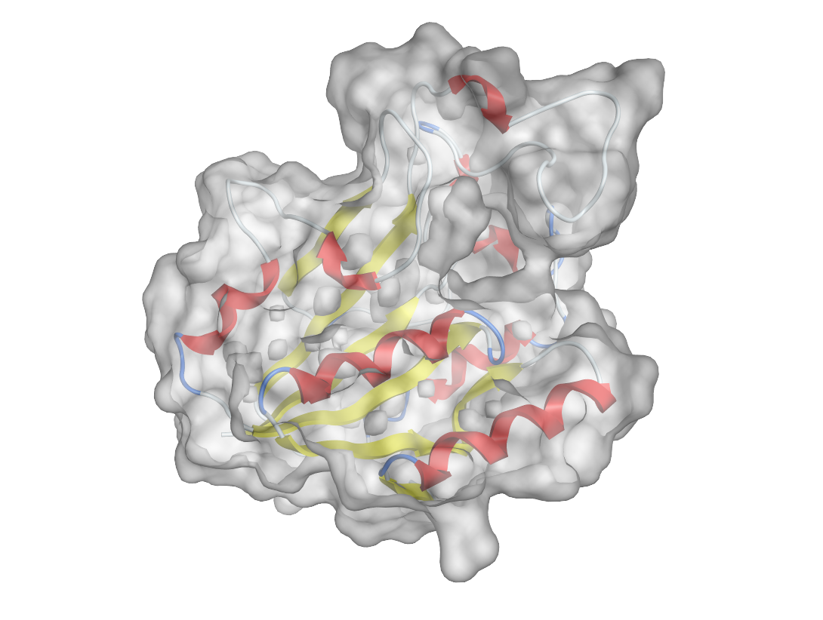
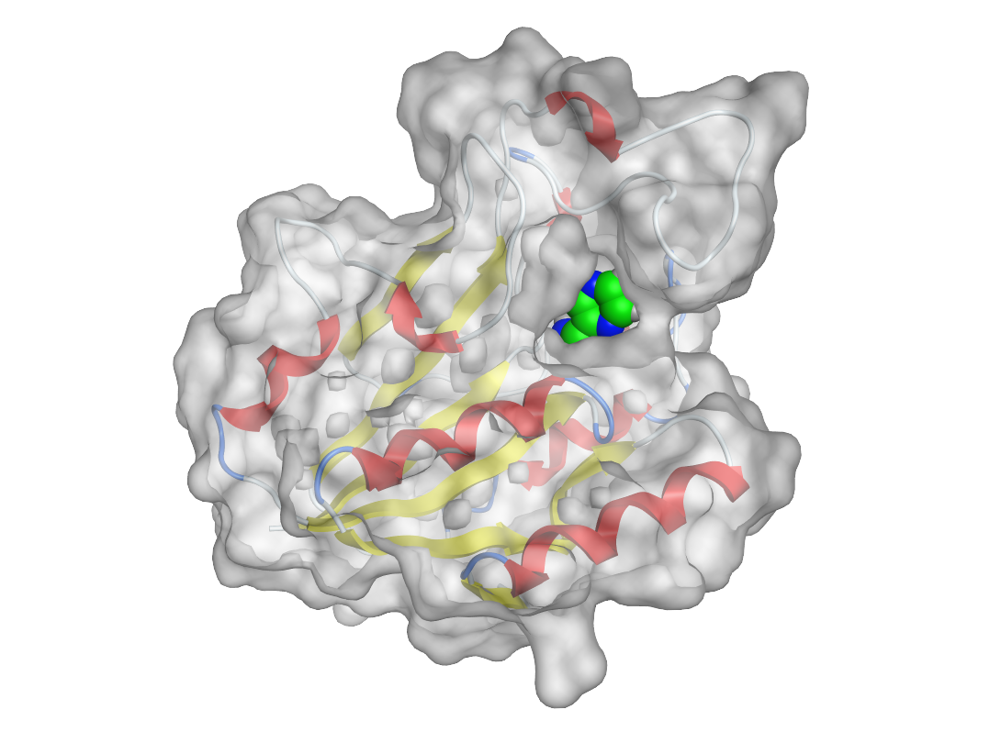
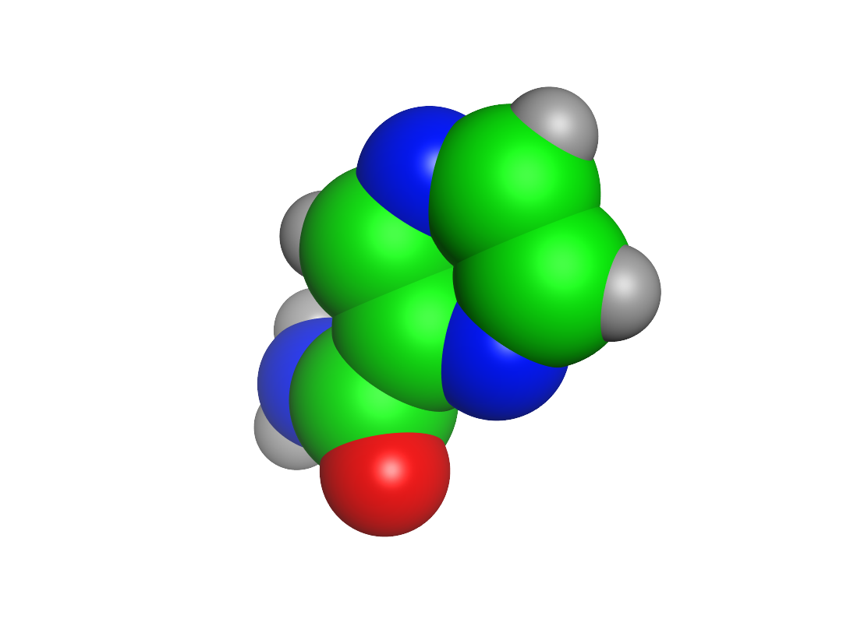
Molecular docking
ligand
receptor
complex
computational method for prediction of energeticaly most convenient mutual position of ligand in receptor (pose)
not a simulation of the binding process
position = translation + orientation + conformation
Stages of docking:
Search function
Scoring function
Notes:
goal -> find all possible positions of ligand in the defined site of the receptor
sampling of the conformational space

Slide 3
Docking - terminology
Term | Definition
Receptor | The "receiving" molecule, most commonly a protein or other biopolymer.
Ligand | The complementary partner molecule which binds to the receptor. Ligands are most often small molecules but could also be another biopolymer
Pose | A candidate binding mode
Binding mode | The orientation of the ligand relative to the receptor as well as the conformation of the ligand and receptor when bound to each other.
Scoring | The process of evaluating a particular pose by scoring function.
Ranking | The process of classifying which ligands are most likely to interact favorably to a particular receptor based on the docking score.
Docking assessment | Procedure to quantify the predictive capability of a docking protocol

Slide 4
Docking - workflow
Protein selection & preparation
Ligand selection & preparation
(Grid generation)
Docking
(Refinement of ligand-receptor complexes)
Analysis of binding modes and important ligand-receptor interactions

Slide 5
Use of Grids (Grid Potentials) in Docking Programs - DOCK, AutoDock
placing a molecule into a 3D lattice or grid, intersections are grid points
different properties (steric, electrostatic) can be measured, tabulated at each point and shown as a field (by connecting points with the same value
in docking, interactions (HB, vdW, ionic) with amino acid are measured and stored in tables for every atom of the ligand
Fig. 17.14 Measuring fields around a molecule by placing a probe atom at grid points
Patrick GL: An Introduction to Medicinal Chemistry, Oxford University Press, New York 2009, 4th Ed.

Slide 6
Use of Grids (Grid Potentials) in Docking Programs

Slide 7
Search function
goal -> find all possible positions of ligand in the defined site of the receptor
sampling of the conformational space
position = translation + orientation + conformation

Slide 8
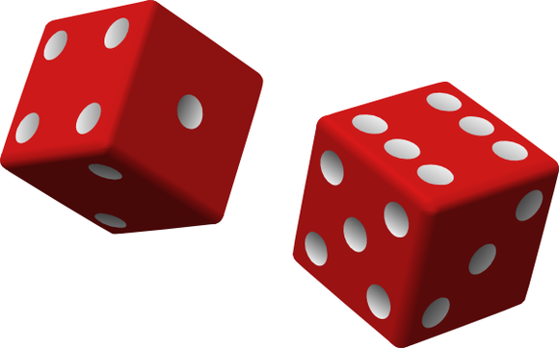
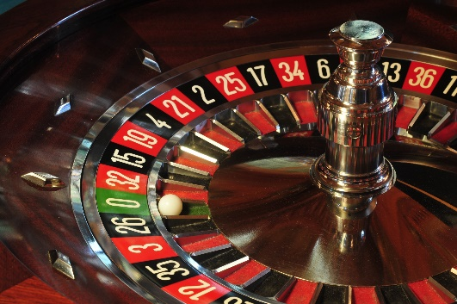
Search Algorithms
Monte Carlo
based on random number generator
translation + orientation + conformation generated randomly
+ thorough search of conformational space
- high CPU time

Slide 9
Search Algorithms
Tabu Search
modified Monte Carlo
keeps track of what positions have already been sampled (no duplication)
Simulated Annealing
no duplication
positions around well scoring positions are sampled more thoroughly
positions around low scoring positions are sampled less thoroughly
+ similar effectiveness to Monte Carlo in significantly reduced time
no duplications
- higher memory usage

Slide 10
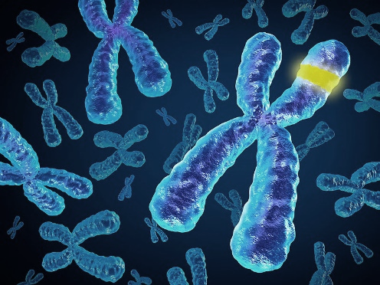
Search Algorithms
Genetic Algorithms
based on Darwin genetics
translation + orientation + conformation is transformed into GENES
combination of genes with favourable interactions gives rise to 2nd generation
random mutation to genes

Slide 11
Scoring functions
goal -> estimate ligand-target binding energy (affinity); i.e. score the positions obtained by search algorithm
crucial phase of docking – source of failures

Slide 12
Scoring functions
Shape based
MM Force field based - van der Waals interactions, electrostatic interactions, strain energy, desolvation energy
Empirical - hydrophobic-hydrophobic contacts, hydrophobic-hydrophilic contacts, number oh H-bonds
Knowledge-based - statistical observations of intermolecular close contacts in large 3D databases

Slide 13
Scoring functions
scoring operation takes into account
steric interactions
HB interactions
other types of intermolecular interactions
desolvation
difference in energy between a ligand´s different conformation
decrease in energy resulting from a flexible molecule being bound in a fixed conformation

Slide 14
Docking – Flexibility
LIGAND – usually treated as flexible, all rotatable bonds allowed to rotate
RECEPTOR (active site)
Rigid
Partially flexible
The more rotatable bonds, the more CPU time you need to dock. EXPONENTIALLY.
RIGID DOCKING = rigid ligand & rigid receptor (known conformations or rigid structures)
2. flexible ligand & rigid receptor
3. INDUCED-FIT DOCKING flexible ligand & flexible receptor
Flexibility of receptor simulates induced-fit.
Notes:
talk about cis/trans amidic bond
elimination of ligands with high number of rotatable bonds from HTVS

Slide 15
Docking – Flexibility
flexibility of receptor might be introduced by several approaches
rotamer library of hydroxyls, thiols and other groups important for H-bonds (Schrödinger Glide)
rotamer library of AA’s side-chains
selected AA side-chains are fully rotatable exactly in the same way as ligand (AutoDock Vina)
induced fit is simulated by MM minimization step after docking (MOE)

Slide 16
Docking software
AutoDock 4.0 - open-source, The Scripps Research Institute
AutoDock Vina – open-source program for molecular docking. Designed and implemented by Dr. Oleg Trott in the Molecular Graphics Lab at The Scripps Research Institute. Video tutorial.
DOCK - University of California San Francisco
Glide – Schrodinger
FlexX – BioSolveIT GmbH
MOE - Chemical Computing Group
GOLD - ​​The Cambridge Crystallographic Data Centre (CCDC)
https://en.wikipedia.org/wiki/Docking_(molecular)#List_of_protein-ligand_docking_software
https://www.click2drug.org/index.html#Docking

Slide 17
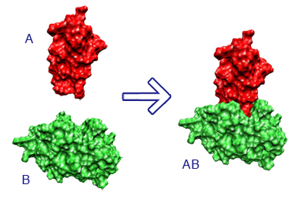
Special applications of docking
Consensus docking = use of several docking engines, then compare results
Consensus scoring = poses generated by one docking engine are scored also by other scoring functions; the final score is a consensus
Ensemble docking = multiple structures of the protein target (different pdbs) are used; simulation of protein flexibility
Blind docking = binding site is not known, the docking is focused on the whole target
Covalent docking = during docking, a defined ligand-receptor covalent bond is created
Protein-protein docking = both ligand and receptor are proteins
HTVS = High Throughput Virtual Screening – based on docking, but may include other CADD techniques (e.g. descriptor filters, pharmacophore models, etc.)

Slide 18
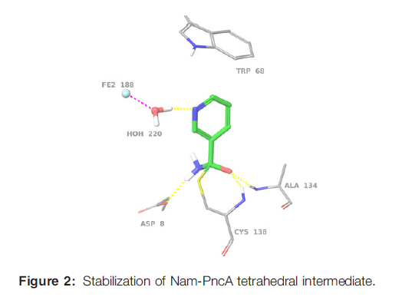
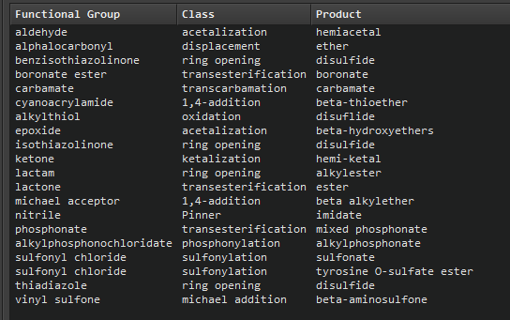
Covalent docking
simulation of covalent complex of ligand-receptor
covalent (suicide inhibitors)
substrates of metabolizing enzymes

Slide 19
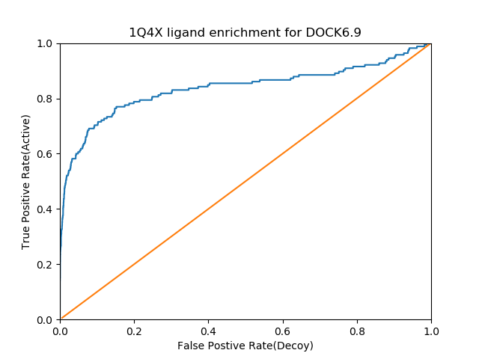
Critical assessment of docking results
RMSD to original ligand (redocking)
docking score, often in comparison with original ligand
ligand efficiency LE = S/n(heavy atoms)
critical inspection of ligand-receptor interactions
enrichment factor (ROC)
comparison with experiment

Slide 20
Virtual Screening by docking - HTVS
complementary to biological screening (HTS)
aimed at identifying new lead compound
priority for biological screening can be given to the structures from a chemical library binding to the target in silico
Find weak binders in pool of non-binders
Many false positives (96-100%)
Consensus Scoring reduces rate of false positives
able to process large number of ligands usually from 10.000 to millions

Slide 21
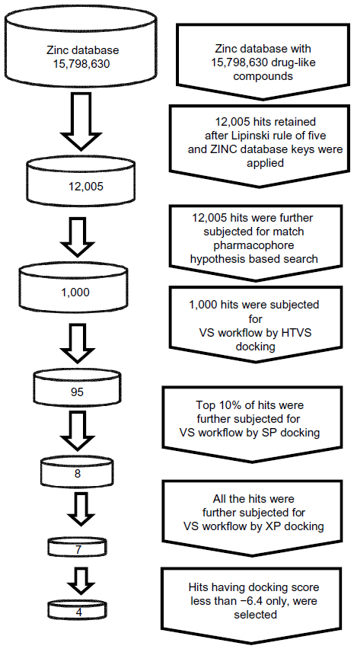
HTVS - workflow
in this case combined with pharmacophore model
Bhansali SG, Kulkarni VM
http://dx.doi.org/10.2147/RRMC.S50738

Slide 22
De novo Design
based on the knowledge of target structure, from the complex target-ligand, ligand must be removed
from identification of amino acids in the binding site is possible to predict binding interactions
must be considered
flexible molecules are better to bind
prediction of synthesizable molecules
energy losses due to desolvation
advantage: novelty of lead compounds, however no clinically used drug has been yet designed de novo
Patrick GL: An Introduction to Medicinal Chemistry, Oxford University Press, New York 2009, 4th Ed.

Slide 23
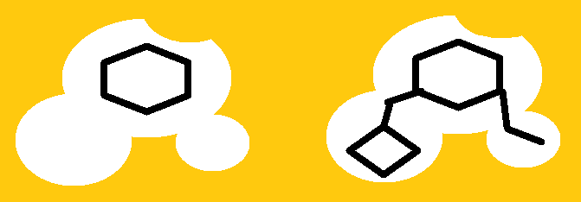
Fragment linking and Ligand growing
Rees D.C. et al. Nature Reviews Drug Discovery, 2004, 3, 660-672
Depends on pre-prepared libraries of LINKERS, FRAGMENTS

Slide 24
Fragment growing - example
PDE10A: growing potency and selectivity
J. Med. Chem., 2015, 58 (19), pp 7888–7894

Slide 25
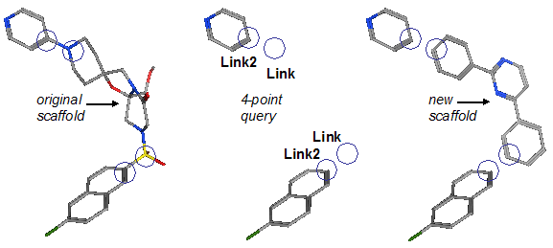
Scaffold hopping (replacement)
functional moieties with important interactions with receptor are preserved
the ‘indifferent’ scaffold is replaced from a library of scaffolds

Slide 26
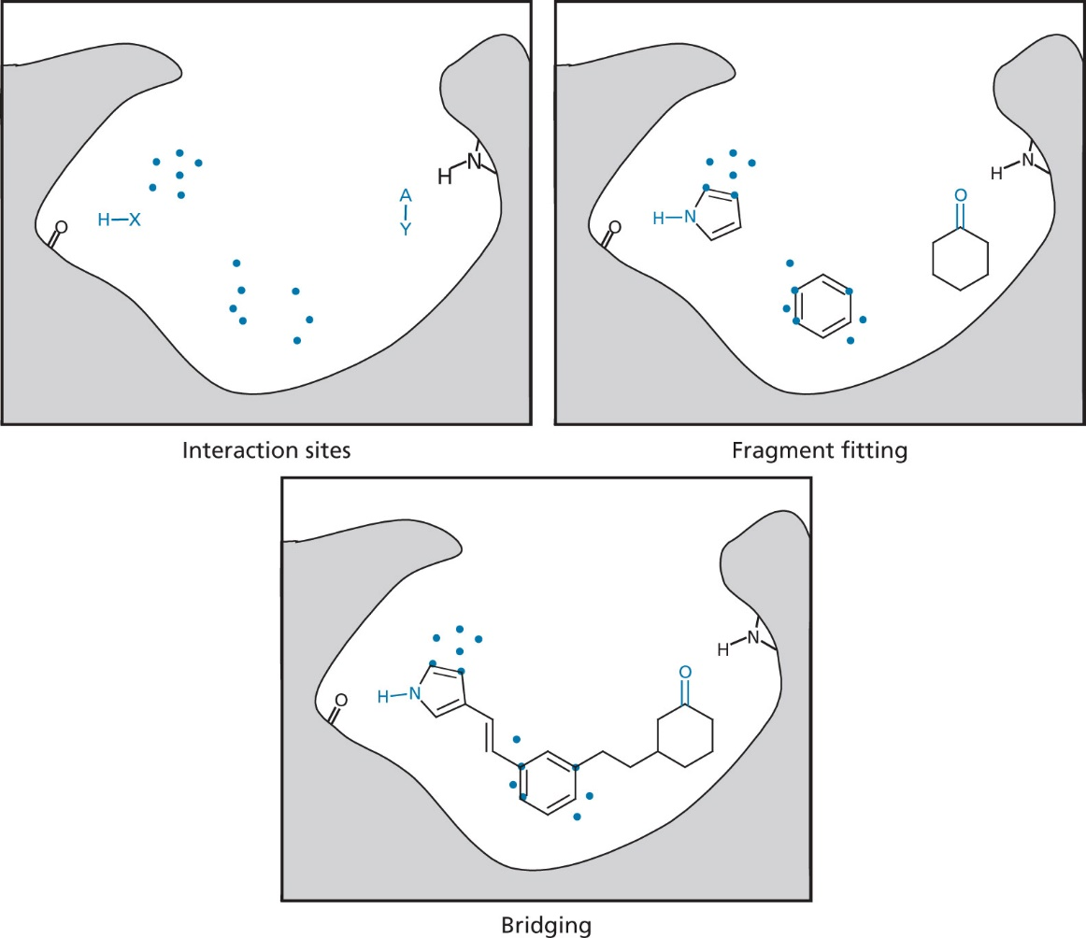
Automated Software for De novo Design
LUDI – works in three steps:
identification of interaction sites (HB, vdW)
fitting molecular fragments (usually rigid)
fragment bridging (linking)
Fig. 17.47 Identification of aliphatic interaction site round a methyl group (LUDI).
Fig. 17.46 Stages involved in automated de novo drug design using LUDI.
HX, HBD interaction, X-Y, HBA interaction site.
The dots indicate aromatic interaction sites.
Fig. 17.48 The interaction sites for a HBD, represented by H-X (LUDI)
Patrick GL: An Introduction to Medicinal Chemistry, Oxford University Press, New York 2009, 4th Ed.

