Slide 1
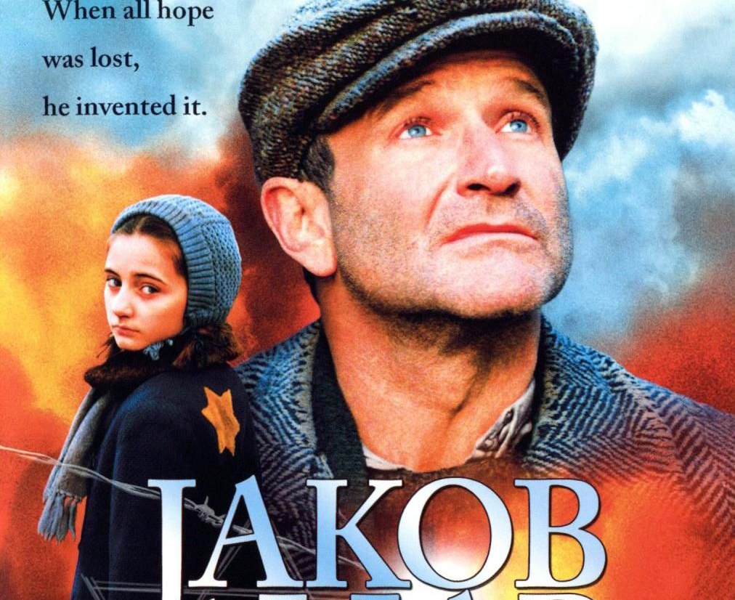
JAKOB THE LIAR
Víctor Domínguez Olalla
Raúl de la Torre Cougil

Slide 2
The book

Slide 3
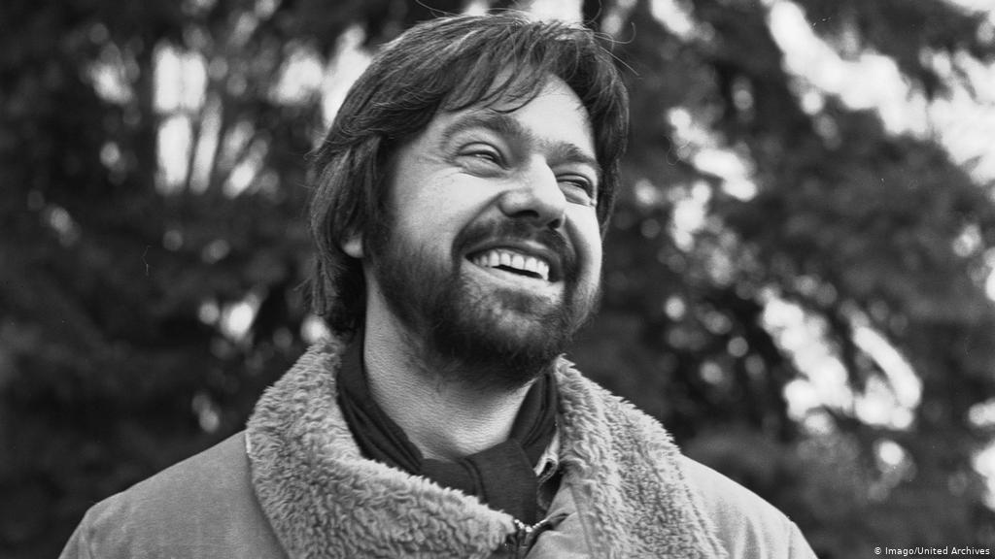
Author: Jurek BECKER
30 September 1937 in Poland - 14 March 1997
German and Poland
Holocaust survivor
His mother died in a concentration camp, but his father survived, and they WERE reunited after war
Becker died in 1997 of colon cancer that was diagnosed in December 1995

Slide 4
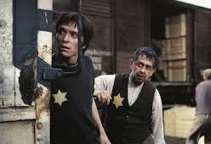
Name in german: Jakob der Lügner
The novel has two different versions: Jacob the Liar (1975) by Frank Beyer, which was nominated for Best foreign language film at the Academy Awards, and Jakob the Liar (1999), starring Robin Williams.

Slide 5
Plot of the story
In Poland, in early 1944 a Polish Jewish named Jakob HEYM is summoned to the German headquarters after being falsely accused of being away after the curfew. As the commander makes him wait for the curfew to later send him home, Jakob listens to a German radio show that talks about the Soviet offensives. When he returns to the ghetto, he shares that information with a friend of his, Mischa, and thereafter a strong rumor is created that there is a secret radio hidden in the ghetto. After doubting a lot about the matter, Jakob decides to take the opportunity to spread hope throughout the ghetto by telling fantastic and optimistic stories, which he allegedly heard from "his secret radio", his lies keep hope and rekindle the humor among the isolated inhabitants .
In addition to the lies he has a real secret, in his home he hides a young Jewish eight year old girl who escaped from a deportation train that was heading to the death camp. Somehow The Gestapo finds out about the rumor and sends for the hero of the resistance who dared to make it work. Jakob surrenders to the Germans after they threatened to assassinate several people if the person responsible was not found.
During the interrogation to which he is subjected, he confesses that the little information he obtained was thanks to the radio of the same commander, who did not realize that at the time. He is ordered to publicly announce that it was all a lie, so that the liquidation of the ghetto proceeds in an orderly manner. When he appears before the public, beaten and barely standing, he refuses to tell the truth but is killed before he can make his own speech.

Slide 6
Differences between the novel and the movieS
Lina (the young woman who escaped the deportation train) is not living with Jakob from the beginning but meets her on her way home from the Gestapo station at the beginning of the film
The radio news is first told to Mischa to prevent him from trying to steal potatoes out of a German military train
Jakob is never captured and interrogated but is deported along with the rest of the Jews and presumably dies in an extermination camp
In the alternate ending of the film Jakob is killed in front of the ghetto, however in the alternate ending of the book, he is killed in an escape attempt

Slide 7
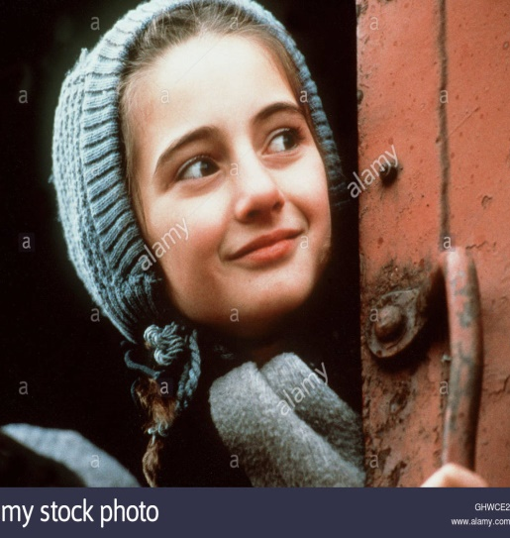
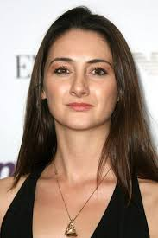
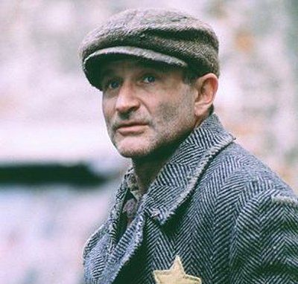
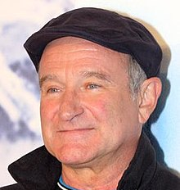
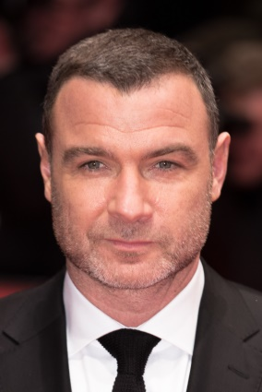
JAKOB THE LIAR (1999) main characters and their actors
Lina (hanna taylor gordon)
Jakob heym (robin Williams)
Mischa (Liev Schreiber)

Slide 8
CLIPS FROM THE MOVIE (1999)

Slide 14
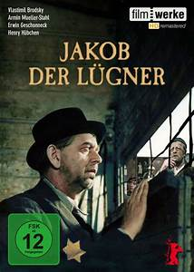
JAKOB DER LÜGNER (1975)

Slide 15
Action JAKOB DER LÜGNER
In the novel "Jakob the Liar", the life of the Jews in a ghetto for the last few weeks before their eviction is described mainly from an authoritative narrative perspective. First, however, the narrator explains his own situation and remembers the "trees" that become an important object for him personally; for example, trees are prohibited in the ghetto, his wife Chana died under a tree, etc.
The real "story" begins with an incident in which a guard orders the main character Jakob Heym to report to the German police station because he ignored the curfew. There he hears on a radio that the Red Army has already advanced to the city of Bezanika and is released by the guard who has to inform him. A ghetto resident never returned after being in the area. Jakob was the first to be released.
Jakob works with other ghetto residents in a cargo yard. When his colleague Mischa tries to steal potatoes that are stored in a container at the station due to hunger, Jakob tries to stop him because he knows that Mischa could be discovered. At first, Jakob tries to tell Misha the truth, but pays no attention to Jakob and remains determined to steal the potatoes. At the last minute, Jakob prevents him from lying that he has a radio. However, he only tells this lie because he believes that no one would believe he left the area. Mischa believes in this lie and refrains from stealing the potatoes.

Slide 16
Action JAKOB DER LÜGNER
Although Jakob probably saved his friend's life with this white lie, he is also taking an unpredictable risk, because possession of a radio is prohibited for Jews in the ghetto if they are sentenced to death. Mischa cannot keep the news to himself. Already in the morning, the news spreads among the workers, so Kowalski, an old friend, talks to Jakob during lunch.
In the evening, Jakob visits Lina, an orphan whose parents had been picked up by the Gestapo when, as the narrator suspects, she was playing in the backyard. Jakob, who takes care of her, decides to adopt her after spending time in the ghetto. Lina suffers from whooping cough and is treated by Prof. Kirschbaum, a cardiologist.
in her euphoria, Mischa also visits his girlfriend Rosa Frankfurter to tell her and her family the good news. To convince his skeptical parents, who fell into torpor due to the desperate situation in the ghetto, he proposes to Rosa and tells her that Jakob has a radio and that the Russians have advanced to Bezanika. The news spreads like a forest fire. Rosa's father, Felix Frankfurter, was an actor in a theater before the war. When he learns of the danger from Jakob's radio, he destroys his, which was stored in the basement, for fear that the Germans might find it when they search it.

Slide 17
Action JAKOB DER LÜGNER
The lie about radio brings advantages and disadvantages for Jakob himself. Although popular in the ghetto, he always has a strong friend by his side during physically difficult work; On the other hand, other residents, such as the pious Herschel Schtamm, consider radio to be dangerous because they suspect that the SS might find out about the radio and search the entire ghetto. Jakob, which is very exhausting, has to invent new information about the advance of the Russians. He does this because he notices the effects of his lie; it becomes the central content and determining hope of the life of the ghetto residents. They begin to forget the present and to believe that conditions will change soon. They also think of a future outside the ghetto: "Old debts begin to play a role," "Daughters become girlfriends," and "Suicide rates drop to zero."
A power outage gives Jakob a short break, but after power is restored, he feels pressure from the ghetto residents to use his radio again. For more "real" information, Jakob steals a torn toilet paper newspaper from a toilet reserved for German guards. Being trapped means certain death, and Jakob only escapes for the amusement of his friend Kowalski. But the informational content of the newspaper clippings is very poor. He decides to let his radio "die" and claims that his radio has suddenly broken. In the afternoon of the same day, Kowalski, who suffered injuries due to amusement, visited him. Jakob tries to avoid Kowalski's thirst for information, but Kowalski heads directly to the radio. Lina captures this conversation and learns from the radio; she urges to watch the radio.

Slide 18
Action JAKOB DER LÜGNER
While working at the charging station the next day, Herschel Schtamm hears the voices of a wagon containing people who are apparently to be transported to an extermination camp. The otherwise scared tribe goes to the car and asks the death row inmates to wait for an alleged imminent release. A guard shoots him. "He wanted to continue the hope and he died of it." Jakob feels responsible for Schtamm's death because it led to heroism with his "radio lie". When Jakob comes home, he catches Lina searching for the radio in her room. The situation comes to a head when Kowalski convinces a radio mechanic to fix the radio. In this emergency, Jakob unceremoniously claims that the radio is fine again and begins to lie more generously from now on in order to maintain the hope of the ghetto residents.
But the lie on the radio begins to weigh more and more on Jakob. Jakob takes the curious Lina to the basement to "show her" the radio, but she doesn't see her, she just listens to her. Jakob organizes an interview with Winston Churchill and tells the story of a sick princess. Later he learns how Lina carelessly tells this story.
Professor Kirschbaum visits Jakob and confronts him with the dangers of radio. Jakob defends himself, noting that since the radio has been broadcasting, no one has committed suicide in the ghetto. Cherry will be picked up shortly after, that Sturmbannführer treated Hardtloff, the idyllic lives outside the ghetto. Cherry is poisoned on the car ride, so she doesn't have to help Hardtloff.
When Jakob, after the deportation of Rosa's parents, Linas' defense against Rosa lies and the deportation of Elisa Kirschbaum, the sister of Professor Kirschbaum, is emotionally bad and Kowalski confesses the radio lie, Kowalski hangs himself . Jakob realizes how much depends on his existence or failure. His conscience and guilt over Kowalski's death motivated him to invent more lies and give hope.

Slide 19
Action JAKOB DER LÜGNER
When residents of some ghetto streets are already being deported to death camps, the end of the camp looms. The narrator offers two different endings:
At the "real" end, which considers historical facts, Kowalski hangs himself and Jakob is deported along with the other ghetto residents. On the train, the narrator Lina explains what the clouds are made of and approaches Jakob in this way. The narrator, who is one of the few who will survive the war with this transport, suspects that this is one of the reasons why Jakob told him his story. After the war, the narrator did an investigation into Jakob's story and continued to tell it. In contrast, Jakob is shot in the "dummy" end during an attempt to escape. At the same moment, you can hear thunder from Red Army weapons. The ghetto will be released in time.

Slide 20
TOPIC TO BE MENTIONED: THE REASON FOR THE TREES
Trees can be found throughout the novel as a leitmotif. The narrator combines numerous memories with trees, that his desire to become a violinist was prevented by falling from a tree, that he "became a man" under a tree, and that his wife was shot under a tree. The tree motif, often with the meaning of life connotes, but is also opposed to the symbol used for death. As a design element, it contrasts strands of time and stories, especially since there is a tree ban in the ghetto, a place of death. At the end of the book, the narrator looks at the passing trees. Here the trees represent the hope that the terrible moment will pass (winter → spring), but also the naturalness that the ghetto lacks.

Slide 21
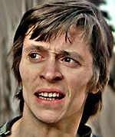
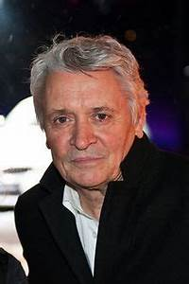
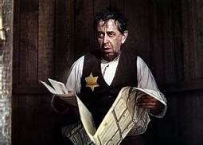
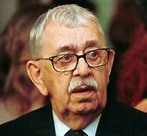
JAKOB THE LIAR (1975) main characters and their actors. By frank beyer
MISCHA
JAKOB HEYM
LINA
VLASTIMIL BRODSKÝ
HENRY HÜBCHEN
MANUELA SIMON

Slide 22
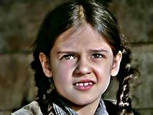
LINA
LINA is an extraordinarily beautiful eight-year-old girl. She has black hair and brown eyes. Lina is a very kind girl who should be in first grade next year. The narrator thinks this is "ridiculous, a nine-year-old girl in the first class." However, one could teach something before school, "at least read and a bit of arithmetic." Everyone can have a good time with Lina because she is "a conversation teacher". Jakob is attracted to her because she never had children of his own. She has no "parents for two years". One day her father forgot to put his Jewish star on his jacket. Then he and a woman were arrested and deported. Lina could only avoid deportation because she did not play in front of the house because her parents had always forbidden her to do so.

Slide 23
JAKOB
Is the main character . He is the discreet, attentive, initially conscientious and hopeful main character of the novel. He becomes a liar because he initially saves his friend Mischa by lying to him that he owns a radio. Eventually, he must continue to lie to hope that his lie has been generated through fictitious radio news. Towards the end, he admits the lie to Kowalski.

Slide 24
MISHA
He is a young and former amateur boxer. It is Jakob's colleague carrying boxes at the train station. He reveals Jakob saying that he has a radio. He is the trigger for the white lie.

Slide 25
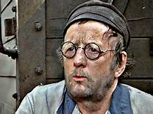
KOWALSKI
he is a "former friend" of Jacob. He reappears in his life when he learns that Jakob has a radio. Before the war, when the Nazis had not yet occupied Poland, they had reached an agreement: Kowalski was allowed to eat free in Jakob's salon and Jakob was free to go to Kowalski's barbershop. The "friendship" between the two is rather superficial, since material interests are the main focus. He is gossipy and cunning, but he saves the life of Jacob in the course of the plot. Later he hangs himself when he finds out that the radio doesn't exist.

Slide 26
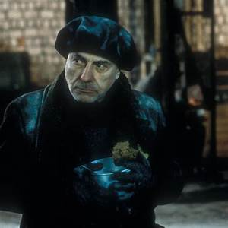
Prof. Kirschbaum
He is a teacher and a heart specialist. As a respected person, she also cares for Lina for z. B. sacrifice your food stamps for them. He accuses Jakob of spreading false news in the ghetto, but he also sees that the news brings hope to people. One day he is asked to treat the seriously ill German commander in chief over the ghetto, Hardtloff, with medical treatment. He commits suicide while driving by taking two pills that are said to relieve heartburn.

Slide 27
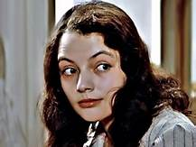
Rosa Frankfurter
She is Misha's friend. She is a sensitive, simple and disinterested girl.

Slide 28
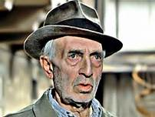
Roman Schtamm
He is Herschel's older brother. After Herschel was killed, it gives Jakob the feeling that he is to blame for his brother's death.

Slide 29
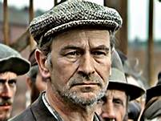
Herschel Schtamm
He is Roman's twin brother. He is an Orthodox Jew who hides his long curly hair from the Germans with a cap every day. Herschel Schtamm believes that radio brings disgrace to the ghetto. They shoot him in the course of the novel because he tries to transmit the news from the "radio" to the deportees in a cart.

Slide 30
MOVIES
FILMS:
The novel became a Frank Beyer film in 1974 (DEFA in cooperation with GDR television) and, as the only film in the GDR, nominated for an Oscar in the Best Foreign Film category (see Jakob the Liar (1974 )).
A new American version was made in 1999 with Robin Williams as Jakob and Armin Mueller-Stahl. The latter already participated in the first film adaptation as Roman Schtamm. In the Hollywood movie, the Nazis are portrayed as inherently evil, as is not the case in the book. The ending was also changed. In the remake, Jakob Heym dies as a martyr after being shot by the Nazis. He does not withdraw his message from the Russians. (see Jacob the liar (1999)

Slide 31
CLIPS FROM THE MOVIE (1975)

Slide 32
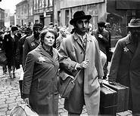
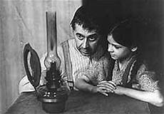

Slide 33
