Slide 1
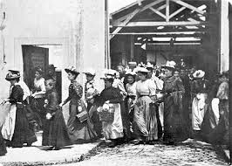
VIZUÁLNÍ KULTURA část FILM/AUDIOVIZE
IKSŽ FSV UK
katedra mediálních studií
prof. MgA. Martin Štoll, Ph.D.

Slide 2
Audiovisual Interpretation of Reality
Department of Media Studies
Charles University Prague
Prof. Martin Štoll, M.A., Ph.D.

Slide 3
I. EXCERPT doing something dumb at 2:13 A.M. author: karina kurzawa © karina,2020 (4,7 milion viewers)

Slide 4
EDITING/CUT AND COMPOSITION

Slide 6
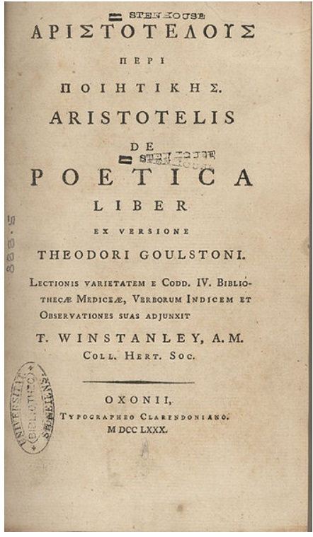
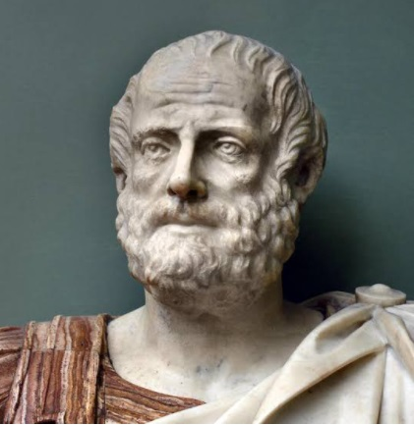
aristotle
„Unity of place, time and action“

Slide 7
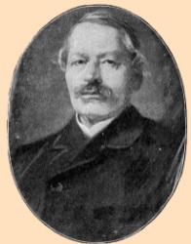
Dr. Gustav Freytag
TECHNIQUE OF THE DRAMA (1894)
(Gustav Freytag)
The intruction and the exciting force moment
The tragic force or incident
Falling action
The force or motive of last suspense
Catastrophe – resolution and purification (catharsis)
„Jednota místa, času a děje“ (Aristoteles)

Slide 8
The composition of the work
COMPOSITION OF SCENES AND THEIR CONNECTIONS
EXPOSURE AND THEIR DEVELOPMENT
CULMINATION POINTS AND IMPORTANTS OF THE END
RELATIONSHIP OF IMAGE AND SOUND

Slide 9
The composition of the work
GENRE AND ITS RULES
Challenge or limitation?
Primary signs
(human speech, facial expressions)
Secondary signs
(clothing, scenery, situation, composition, typicality of relationships… )
Genre is defined by secondary signs.

Slide 10
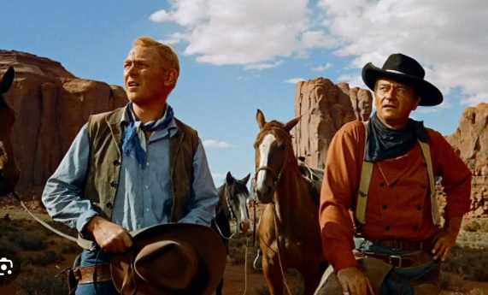

Slide 11
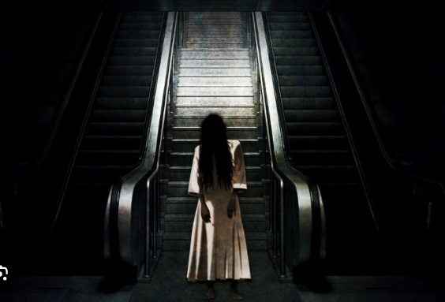

Slide 12
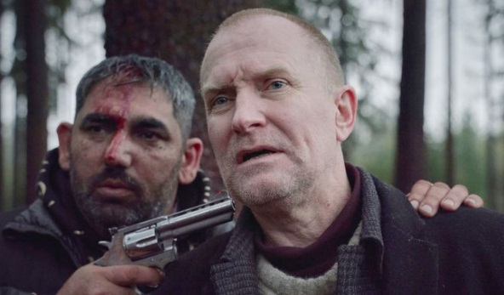

Slide 14
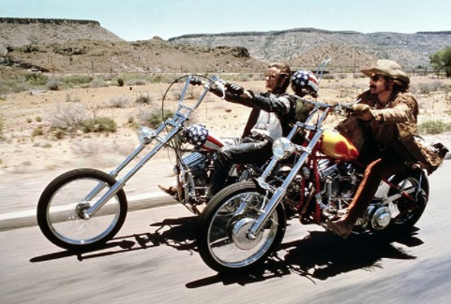

Slide 15
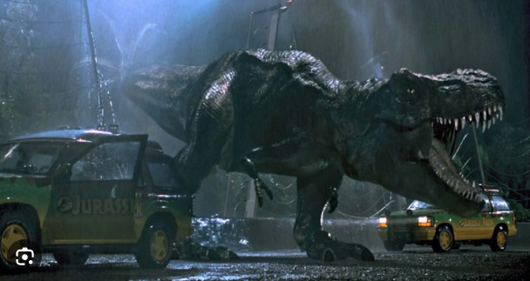

Slide 16
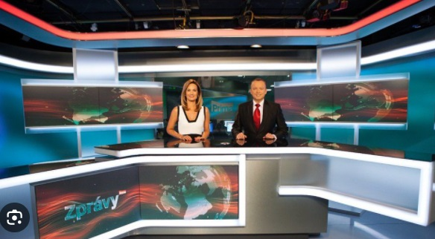
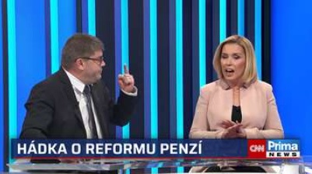
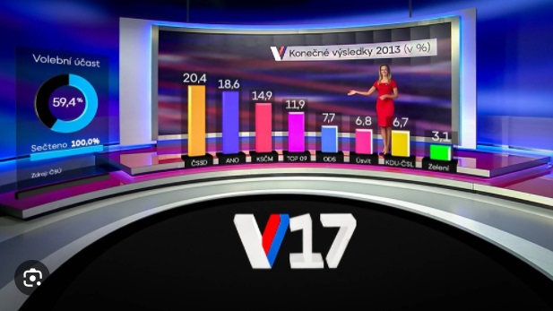

Slide 17
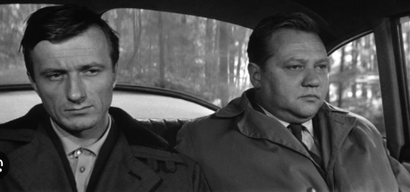

Slide 18
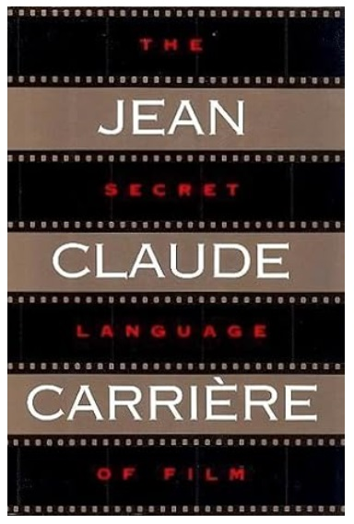
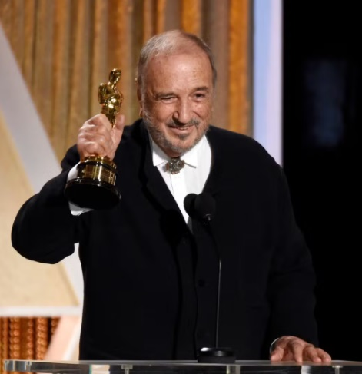
jean-Claude CarriEre
DRAMATURGY

Slide 19
The composition of the work
WHAT
WHY
HOW
FOR WHOM
TELL…

Slide 20
The composition of the work
FEATURE FILM
Bound by plot line and sequels
It cannot (it is taff) be given structure regardless of how it was shot.
DOCUMENTARY
Much more freedom

Slide 21
The composition of the work
KEY PROFESSION
Cutter/editor
The difference between film editing and TV editing.
TV editor slightly different skills than film editor (e.g. promptness)

Slide 22
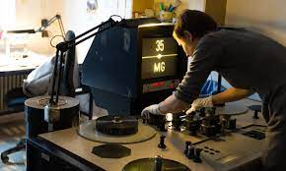
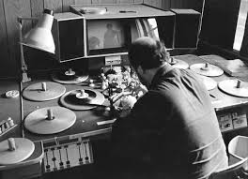
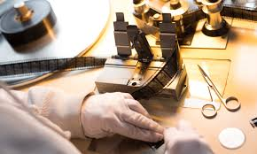

Slide 23
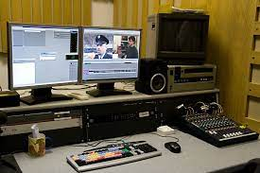
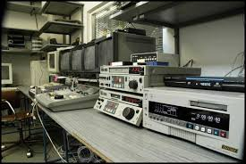

Slide 24
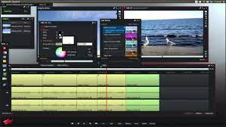

Slide 25
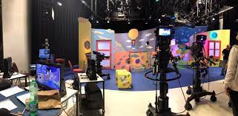
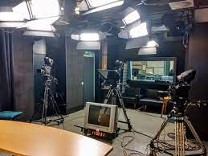
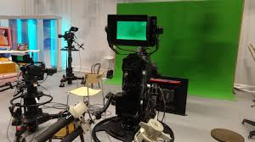

Slide 26
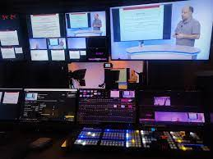
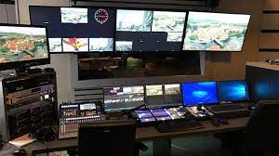

Slide 27
editing
- It can be only a mechanical shortening
(I recommend if for home videos)
- It can be a technical composition of the filmed plot
(the first version of the film or live TV broadcast)
- It can be a creative storytelling tool, or expressing an idea

Slide 28
editing
THEY ARE CREATED BY CUTTING RELATIONSHIPS BETWEEN SHOTS
(AND BETWEEN THE DISPLAYED FACTS)
e.g. contrapunctical relationship
THE SHOT BECOMES THE FUNDAMENTAL BUILDING STONE OF THE FILM

Slide 29
II. excerpt kuleschov´s efect author: lev kuleschov © twenties of 20. century

Slide 30
III.excerpt bridge author: JORIS IVENS © 1928

Slide 31
IV. excerpt the land is singing author: karel plicka © 1934

Slide 32
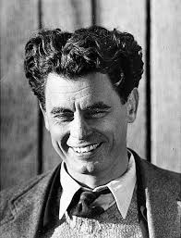
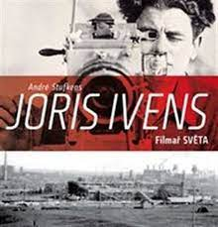
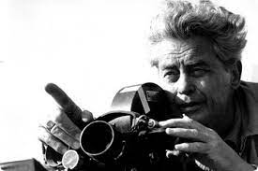

Slide 33
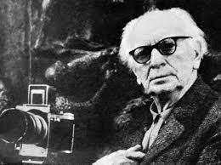
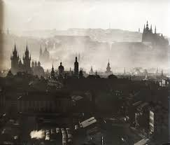
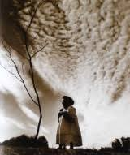

Slide 34
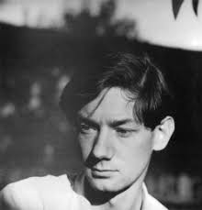

Slide 35
FINALITY OF THE WORK
„The film work is definitive and therefore must be as accurate as possible“
Jan Kučera

Slide 36
Rules of editing
Each shot must be shot in such a way that it not only captures something, but also has an emotional impact and becomes a stimulus for the transition to other shot.

Slide 37
Rules of editing
PARADOX:
Shots must tie and at the same time some change must come with the cut
(shot size, in motion…)

Slide 38
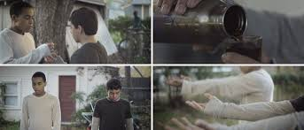
Rules of editing
Oriention in space

Slide 39
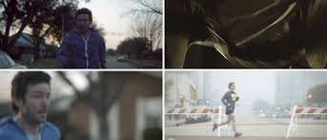
Rules of editing
Continuity of movements and directions

Slide 40
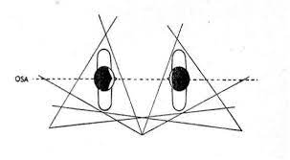
Rules of editing
AXIS RULE

Slide 41
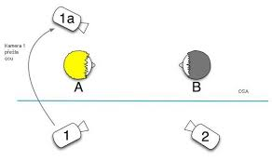
Rules of editing
AXIS RULE

Slide 42
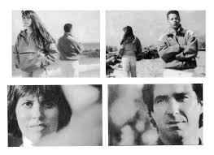
Rules of editing

Slide 43
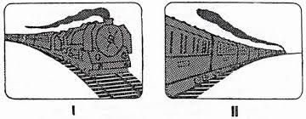
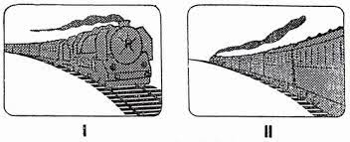
Rules of editing

Slide 44
V. excerpt battleship potemkin author: sergej ejzenštejn © Mosfilm, 1925

Slide 45
WORK WITH TIME
TIME – REAL
TIME – DRAMATICAL

Slide 46
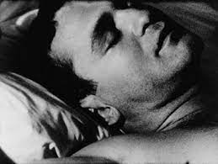
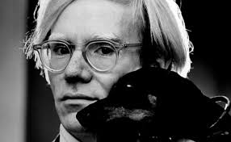
WORK WIT TIME
Andy Warhol
Sleep (1962)
(5 and a half hours)

Slide 47
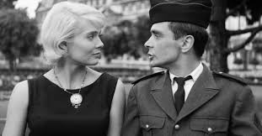
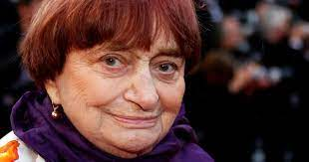
Work with time
Agnès Varda
Cléo de 5 à 7 (1962)

Slide 48
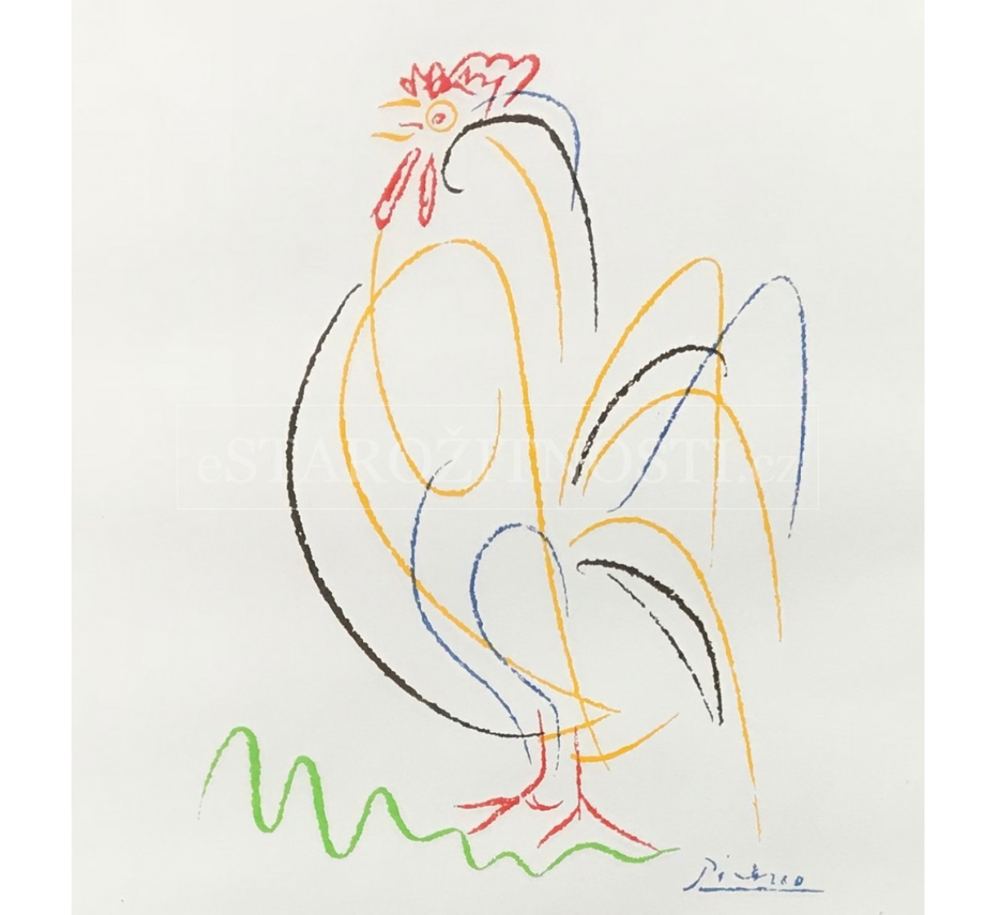
Work with time
Art shortening basic means of expression in the relationship between dramatic and real time
Art shortening is a principle of art.

Slide 49
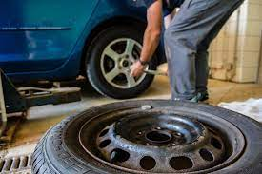
Práce s časem
Filmová zkratka
základní vyjadřovací prostředek ve vztahu dramatického a reálného času
Zkratka je vůbec princip umění.

Slide 50
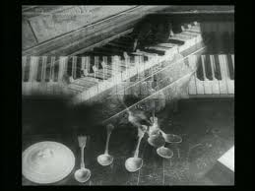
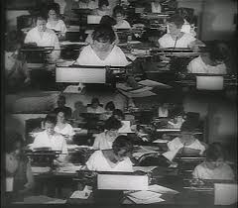
Work with time
Rapidmontage

Slide 51
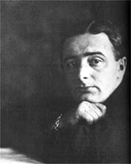
Work with time
Rapidmontage
Man with the movicamera (1929)
Dziga Vertov

Slide 52
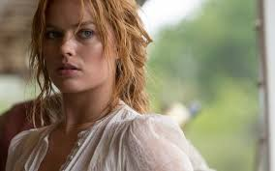
Work with time
Cross-cut

Slide 53
Work with time
Cross-cut

Slide 54
Work with time
Parallel telling
meanwhile

Slide 55
VI. excerpt man with the moviecamera author: dziga vertov © mosfilm, 1929

Slide 56
VII. excerpt man of aran I author: robert flaherty © 1934

Slide 57
VIII. excerpt man of aran II author: robert flaherty © 1934

Slide 58
Conclusion
The editing composition is always dependet on the film material. A feature film is more tied down than a documentary.
The editing composition orients the viewer in the relationships of the acting characters with the environment and with each other.
The editing composition builds a dramatic space, as well as a dramatic time.
Editing is a key tool in the construction of a film.

