Slide 1
Symbolic interactionism

Slide 2
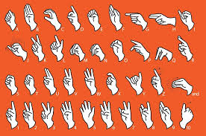
Symbols
Stimuli that is abstract and arbitrary with applied meaning
“arbol” “ki” “arbre” “baum” “pokok” and “shu”
Language as a collection of symbols organised by rules
Roots in pragmatism –activity, processes and dissolving dualisms
Transform structures into processes
Chicago School: George Herbert Mead, Herbert Blumer, Erving Goffman and Harold Garfinkel
Blumer 1937 ‘symbolic interactionism’

Slide 3
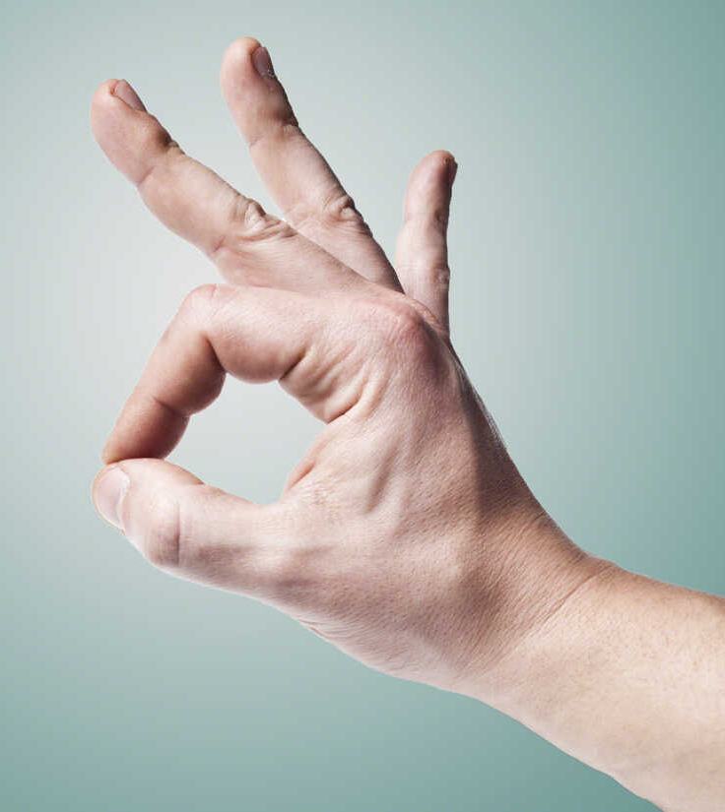
Herbert Mead
Self image from interaction with others, societies from interactions between people’s selves
Behaviourism – behaviour as responses to stimuli
Gestures as unintentional acts without meaning evoking responses
Sign as stimulus with fixed meanings regardless of context
Expansion of sign to a symbol or ‘significant gesture’
Pragmatists- humans interpret their environment through symbols
Symbols created in a society and people acquire them

Slide 4
Symbolic Interaction
Acquiring symbols empowers us to interact with others
“…a process in which humans interact with symbols to construct meanings. Through symbolic interactions we acquire information and ideas, understand our own experiences and those of others, share feelings, and come to know other people. Without symbols none of this could happen” Julia Wood (1992)
Constantly acting and reacting symbolically
We consider, interpret, and adapt to other people’s acts
Our symbolic interactions connect us to the society, connect the society to us, and reflect the society in which we are acting.

Slide 5
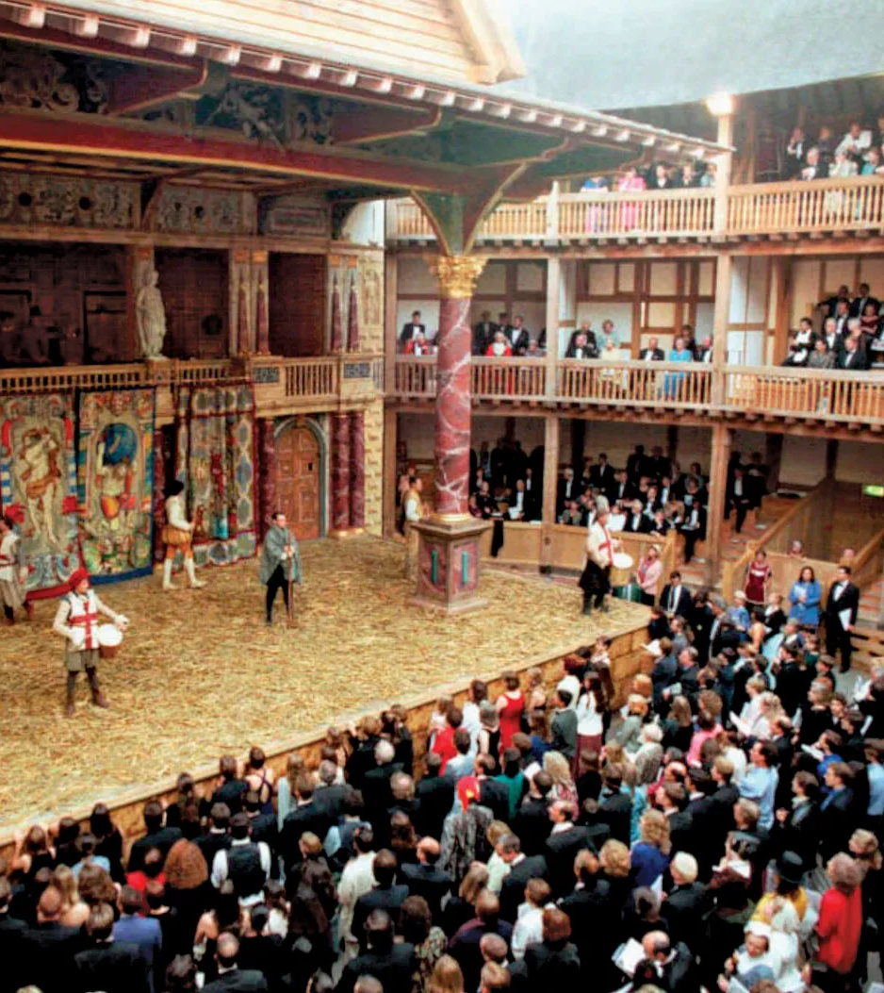
Erving Goffman
The presentation of the self in everyday life
‘On stage’ in everyday life –moving between ‘front stage’ and ‘back stage’
Constant interaction rituals
Managing impressions of ourselves in social interactions
Use narratological and symbolic mechanism to shape perception
Impressions we actively make and passively create
Social interaction is negotiation
Everyone has certain social characteristics

Slide 6
Goffman – Frame analysis
‘Frame clues’ and ‘frame conventions’
Choose between alternative perspectives
Ethnographic research into chunks of social behaviour
Uses in social movement research and mass communication
‘primary frameworks’ or ‘transformations’
Relevance to politics: intentional deployment
Frame alignment as legitimate organization
Interpretation through frames in the mass media

Slide 7
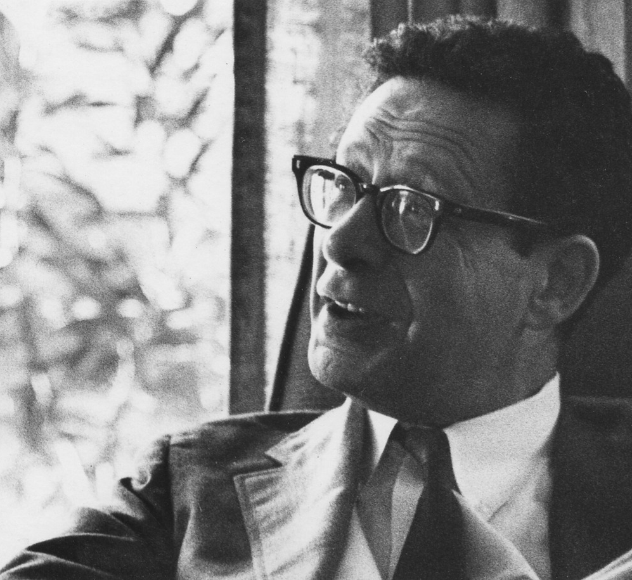
Harold Garfinkel -Ethnomethodology
Conditions of successful Degradation Ceremonies (1956)
1) Reasoning process for defining situations
2) Maintenance of order in microcosmic interactions
3) The rules of social interaction
Ethnomethodology to describe the reasoning process
Much short-hand in interactions only useful with context
Experiments in subversion

Slide 8
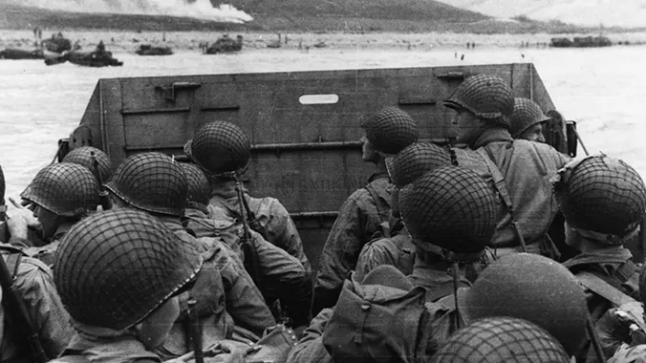
Edward Hall
WWII – failures in intercultural communication
Context and meaning are interrelated
High context cultures – do not rely on verbal communication
Low context cultures – rely heavily on verbal communication
Culture as communication and communication as culture

Slide 9
Questions- Perspective and Method, Blumer
What are two forms of Mead´s social interaction analysis? How does he identify them?
How does Blumer explain the concept of attitudes? For what type of research is it suitable?

Slide 10
Questions – Body Embodiment, Waskul and Vannini
For Huggins, what is the cultural significance of drug use?
How does he approach research on the representation of drug use through discourses and images of the addict’s body in popular media?
1. How does class play a role in reflexivity according to Bourdieu? Does he believe this is instinctive? How would this theory hold up in this day and age?
2. What does Mead mean when he talks about vantage point in regards to reflexivity?

