Slide 1
Encouraging Creative and Innovative Thinking in Schools
Petra Vallin

Slide 2
Program
What makes me me – getting to know your teacher
Ladybird – getting to know each other
Definition of creativity and why it is important
Components of creativity
Tests of creativity

Slide 3
Task 1:
Take a small piece of paper and write answers to the following questions:
1. What does creativity mean to me?
2. Why is it so important in the 21st century?

Slide 4
What is creativity?
„Creativity is the act of turning new and imaginative ideas into reality. Creativity is characterized by the ability to perceive the world in new ways, to find hidden patterns, to make connections between seemingly unrelated phenomena, and to generate solutions.
Creativity involves two processes: thinking, then producing. If you have ideas but don’t act on them, you are imaginative but not creative.“
http://www.creativityatwork.com/2014/02/17/what-is-creativity/

Slide 5
Creative learning – why now?
50s – stated it should be prioritized
90s – gradually starts to be placed into practice
Educational system was designed during 1st industrial revolution – to train good workers
Agricultural age (farmers)
Industrial age (factory workers)
Information age (knowledge workers)
Conceptual age (creators)

Slide 6
Creative learning - Why now?
K. Robinson (2011) says: „Creativity in education is crucial to prepare children for a world we cannot envisage – instead of remembering and following instructions, they choose instead to think.“
The Sutton Trust (2017) warns that 15 million jobs in the UK could disappear due to technologiy (robotics).
Be Open (2017) mentions that „creative capacity is far more important than academic knowledge“.
R. Mohammed (2018, s. 20) says that: „It is agreed that we no longer live in a worldwhere relying solely on logic, analysis, and problem-solving skills is sufficient. In today`s rapidly changing environment, children need a new set of skills to cope with uncertainty and complexity, and creativity is very much a part of it.“
Mohammed, R. (2018). Creative Learning in the Early Years: Nurturing the characteristics of creativity. Routledge.

Slide 7
But…
…teachers know creativity is important but they do not have the time to incorporate it into their work or they are not sure how to do it.

Slide 8
Myths about creativity
It`s something you are born with.
It`s for right-brained people.
You`ve to be a little weird and crazy.
It`s only for people like Mozart or Einstein.

Slide 9
Why creative learning in the early years?
Research has found that if creativity is not engaged with during the naturally creative childhood years, it is not something that can be developed in later life (Marzollo, Lloyd 1974).

Slide 10
Creativity tests to unlock your imagination (e.g. alternative uses)
Developed by J.P. Guilford in 1967, the Alternative Uses Test stretches your creativity by giving you two minutes to think of as many uses as possible for an everyday object like a chair, coffee mug, or brick. Here’s a sample brainstorm for “paper clip” uses:
Hold papers together
Cufflinks
Earrings
Imitation mini-trombone
Thing you use to push that emergency restart button on your router
Keeping headphones from getting tangled up
Bookmark
https://99u.adobe.com/articles/7160/test-your-creativity-5-classic-creative-challenges

Slide 12
Alternative uses (a glass)
To drink
To store pencils
To make cookies
To roll the dough
As an aquarium
For a candle
To make your music louder
To water flowers
To serve soup
To teach geometry
As a vase
As a flower pot
As a gun
To play dice
To watch a video
As a holder for a book
As a stamp
Paper weight
To measure quantity
To make a fire
To build a tower
To make cupcakes
As a target
To catch insect
To catch a fish
To beg money
To wash hair
To take a shower
As glasses
To spy

Slide 13
How is it measured?
The test measures thinking across four sub-categories:
Fluency – how many uses you can come up with
Originality – how uncommon those uses are (e.g. “router restarter” is more uncommon than “holding papers together”)
Flexibility – how many areas your answers cover (e.g. cufflinks and earrings are both accessories)
Elaboration – level of detail in responses; “keeping headphones from getting tangled up” would be worth more than “bookmark”
https://99u.adobe.com/articles/7160/test-your-creativity-5-classic-creative-challenges

Slide 14
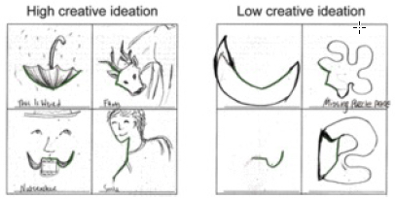
Creativity tests: Incomplete Figures
Developed in the ’60s by psychologist Ellis Paul Torrance, the Torrance Test of Creative Thinking (TTCT) sought to identify a creativity-oriented alternative to IQ testing. One of the most iconic elements of the TTCT was the Incomplete Figure test. You’re given a shape like the below, and then asked to complete the image.
http://www.kurzweilai.net/alpha-rhythm-brain-stimulation-shown-to-boost-creativity

Slide 15
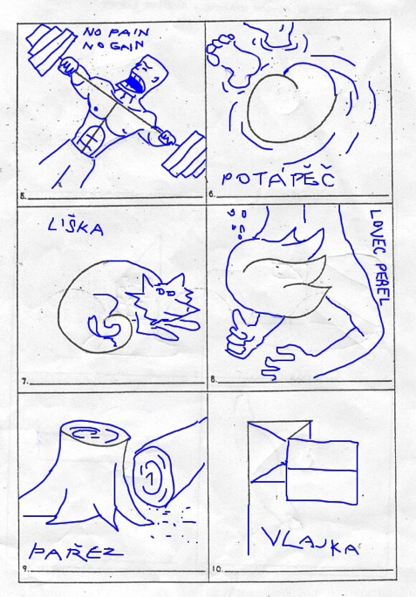

Slide 17
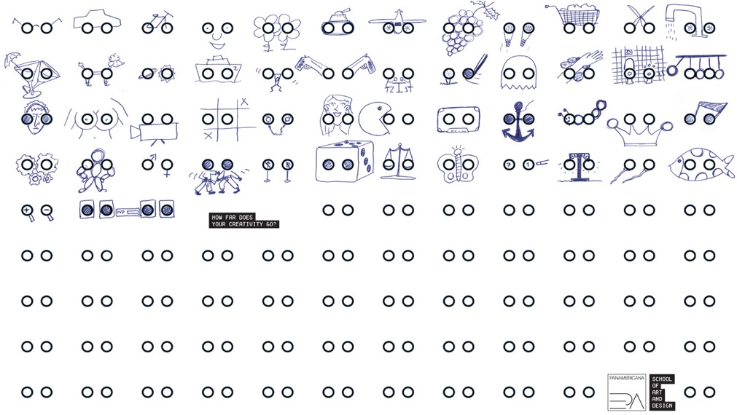
http://theinspirationroom.com/daily/2009/panamericana-creativity-tests/
http://www.kon.org/urc/v13/kissler.html

Slide 18
The newest test of creativity
You can try it right here (it is worth trying twice): https://www.datcreativity.com

Slide 19
What are these tests useful for in a class?
To stimulate students‘ brain
To boost their imagination and creativity
To free their mind
To help them to think out of the box
To look at things from many different perspectives
As a warm-up or a brain breaker

Slide 20
Components of creativity
Creativity, Culture and Education (2011), an international foundation for creative learning, developed a framework identifying creative skills and behaviours in children aged 5 years and up.
It is advised to use this Framework in the planning and development of any teaching and learning approaches with the aim of unlocking the creativity of children and young people.
These skills and behaviours were defined as: …

Slide 21
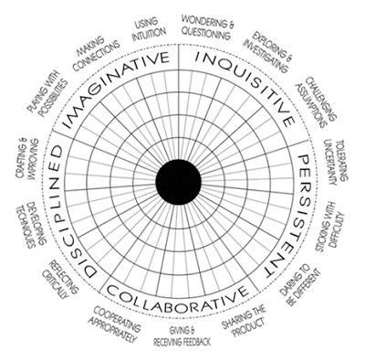
http://www.creativetallis.com/creative-learning-development-fund.html

Slide 22
CREDIT REQUIREMENTS
max. 20% absence (which means 1 whole session)
completed outdoor group activity (31st October)
regular assignments after each session
NO EXAM OR FINAL PROJECT AT THE END!

Slide 23
Petra Vallin
PhDr. Petra Vallin, Ph.D.
Department of Preprimary and Primary Education
Faculty of Education, Charles University in Prague
Contact: petra.vallin@pedf.cuni.cz

