Slide 1
Contemporary Theories of Consciousness
6
Mysterianism

Slide 2
Today
Mysterianism and its historical background
A modular theory of mind
‘The hard problem’ and cognitive closure
Critical perspectives

Slide 3
1. Mysterianism and its historical Background

Slide 4
Intellect as image of God
‘Since human beings as made in the image of God in virtue of their having a nature that includes an intellect, such a nature is most in the image of God.’
Thomas Aquinas, Summa teologica, I. q. 93, a. 4.
‘For it is clear that by means of the intellect man can have knowledge of the nature of all corporeal things.’ Manifestum est enim quod homo per intellectum cognoscere potest naturas omnium corporum.
Thomas Aquinas, Summa teologica, I. q. 75, a. 2

Slide 5
‘Universal instrument’
‘Reason is a universal instrument which can be used in all kinds of situations.’
‘La raison est un instrument universel, qui peut server en toutes sortes de rencontres’
Descartes, Discourse on the Method, Part 5

Slide 6
Universal instrument in contemporary philosophy
‘Science’s understanding of the world is correct in its fundamentals [and] when complete, what science tells us will not be surprisingly different from what science tells us today.’
Alex Rosenberg, The Atheist’s Guide to Reality, 2012, chap. 1.

Slide 7
An alternative, critical, starting point
John Locke:
‘… before we set our selves upon Enquiries of that Nature, it was necessary to examine our own Abilities, and see, what Objects our Understandings were, or were not fitted to deal with.’
Essay concerning Human Understanding, Epistle to the Reader
Immanuel Kant:
‘Dogmatism is the dogmatic procedure of pure reason, without previous criticism of its own powers. [Instead it is necessary] to prepare the ground beforehand by a critique of the organ, that is of pure reason itself.’
Critique of Pure Reason, Preface to the Second Edition, 1787, Bxxxv-xxxvi

Slide 8
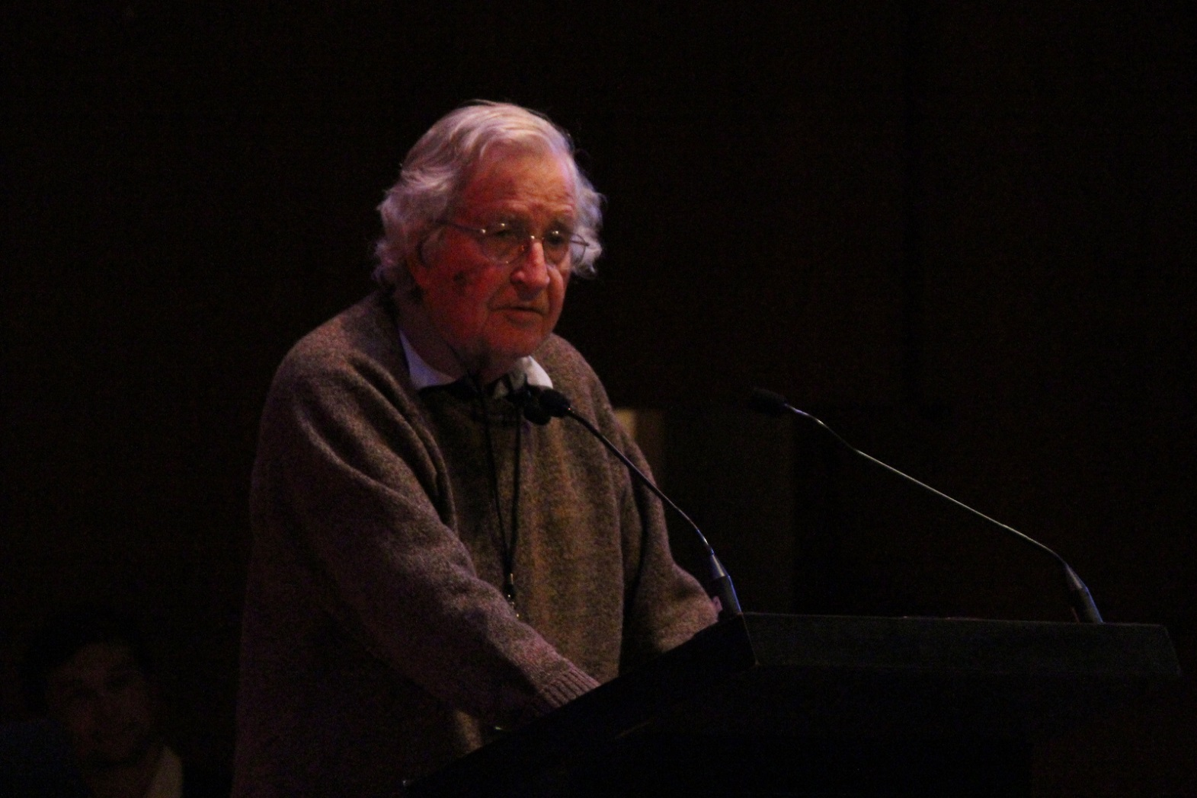
Contemporary critical philosophers or ‘mysterians’
Noam Chomsky
Jerry Fodor
Thomas Nagel
Colin McGinn
Steven Pinker

Slide 9
2. A Modular Theory of Mind

Slide 10
Modularity of the mind
‘Every complex biological system we know is highly modular in its internal structure. It should not be a terrible surprise to discover that [the mind] is just like other complex biological systems: that it is composed of interacting sub-systems with their specific properties and character and with specific modes of interaction amongst the various parts.’
Noam Chomsky, Modular Approaches to the Study of Mind, 1984, p. 16

Slide 11
Mind is modular: like a system of organs
‘The mind is a complex system of faculties which do not develop according to some unified principles of general intelligence; the mind has “mental organs”, which are just as specialised and distinctive as organs in the rest of the body.’
Chomsky, ‘Language and Nature’, 1995

Slide 12
The modules of our minds have focal points and limited scope

Slide 13
Chomsky on the Language Module
Biological linguistic organ (LAD) with preprogrammed development that has an innate understanding of the principles of universal human grammar
Our language organ would not be helpful for languages with a non-human syntactical or grammatical foundation (Martian languages)

Slide 14
Prosopagnosia
Face Blindness

Slide 15
Face Blindness (Prosopagnosia)

Slide 16
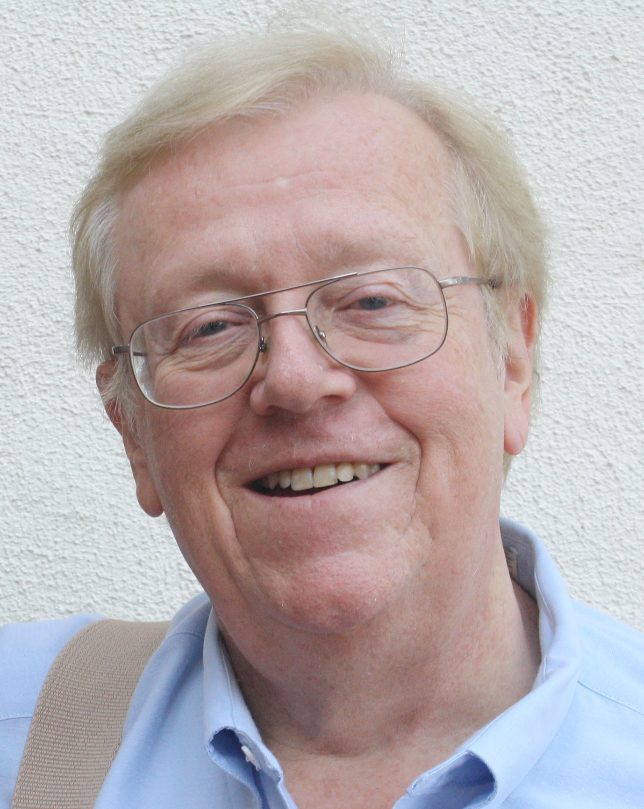
Our modern skulls house a stone age mind
“Stone age priorities produced a brain far better at solving some problems than others. For example, it is easier for us to deal with small, hunter-gatherer-band sized groups of people than with crowds of thousands; it is easier for us to learn to fear snakes than electric sockets, even though electric sockets pose a larger threat than snakes do in most American communities. In many cases, our brains are better at solving the kinds of problems our ancestors faced on the African savannahs than they are at solving the more familiar tasks we face in a college classroom or a modern city. In saying that our modern skulls house a stone age mind, we do not mean to imply that our minds are unsophisticated. Quite the contrary: they are very sophisticated computers, whose circuits are elegantly designed to solve the kinds of problems our ancestors routinely faced.”
Leda Cosmides and John Tooby, Evolutionary Psychology, 1997

Slide 17
3. ‘The hard problem’ and cognitive closure

Slide 18
Problem vs mystery

Slide 19
Problem/Puzzle
Lies within our competence, though its solution may be very difficult.
Mystery
Lies outside our competence.

Slide 20
Cognitive limits
“If we are biological organisms, not angels, much of what we seek to understand might lie beyond our cognitive limits―maybe a true understanding of anything, as Galileo concluded, and Newton in a certain sense demonstrated. That cognitive reach has limits is not only a truism, but also a fortunate one: if there were no limits to human intelligence, it would lack internal structure, and would therefore have no scope: we could achieve nothing by enquiry.”
Chomsky, “The Mysteries of Nature”, p. 184

Slide 21
Cognitive closure
Conceiving minds come in different kinds, equipped with varying powers and limitations, biases and blindspots, so that properties (or theories) may be accessible to some minds but not to others. What is closed to the mind of a rat may be open to the mind of a monkey, and what is open to us may be closed to the monkey. Representational power is not all or nothing. Minds are biological products like bodies, and like bodies they come in different shapes and sizes, more or less capacious, more or less suited to certain cognitive tasks.
Colin McGinn, ‘Can We Solve the Mind-Body Problem? Mind 98 (391), 1989

Slide 22
Hypotheses non fingo
‘While Newton seemed to draw off the veil from some of the mysteries of nature, he shewed at the same time the imperfections of the mechanical philosophy; and thereby restored [nature’s] ultimate secrets to that obscurity, in which they ever did and ever will remain.’
David Hume, History of England, 1756

Slide 23
Matter is an ‘honorific designation’
“The notions of body, material, physical are hardly more than honorific designations for what is more or less understood at some particular moment in time, with flexible boundaries and no guarantee that there will not be radical revision ahead, even at its core.”
Chomsky, ‘‘The Mysteries of Nature: How Deeply Hidden’, p. 180

Slide 24
CALM
‘Combinatorial Atomism with Lawlike Mappings’
Colin McGinn, Problems in Philosophy: The Limits of Enquiry, 1993

Slide 25
Brain Science is inherently spatial
‘There the brain is, an object of perception, laid out in space, containing spatially distributed processes; but consciousness defies explanation in such terms. Consciousness does not seem made up out of smaller spatial processes; yet perception of the brain seems limited to revealing such processes.’
Colin McGinn, ‘Can We Solve the Mind-Body Problem’

Slide 26
McGinn’s ‘transcendental naturalism’
We are missing the connexion between consciousness known by introspection and the spatial data of neuroscience known to perception.
The nature of consciousness belongs to natural science.
The science in question transcends our limited conceptual abilities.

Slide 27
4. Critical Perspectives

Slide 28
Three critical perspectives
Pragmatic. ‘Counsel of despair’
Can we make sense of a science that transcends our conceptual reach?
What about cultural evolution and the strengths of the community of scientists?

Slide 29
Next Time
13.4.2023: Emergentism
20.4.2023: No class

