Slide 1
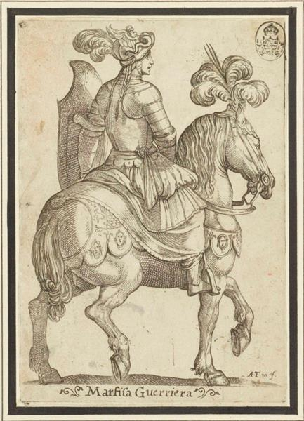
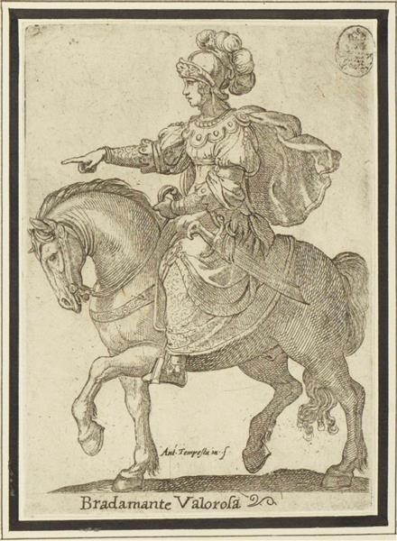
Ludovico Ariosto
Zuřivý Roland
(Orlando furioso – Raging Orlando)
Women in the
Orlando Furioso

Slide 2
Three aspects

Slide 3
Three aspects
Criticism of (social) inequality/treatment of men and women

Slide 4
Three aspects
Criticism of (social) inequality/treatment of men and women
Criticism of men’s violence against women

Slide 5
Three aspects
Criticism of (social) inequality/treatment of men and women
Criticism of men’s violence against women
The active function/role of women (beyond the tradition)

Slide 6
Social Inequality

Slide 7
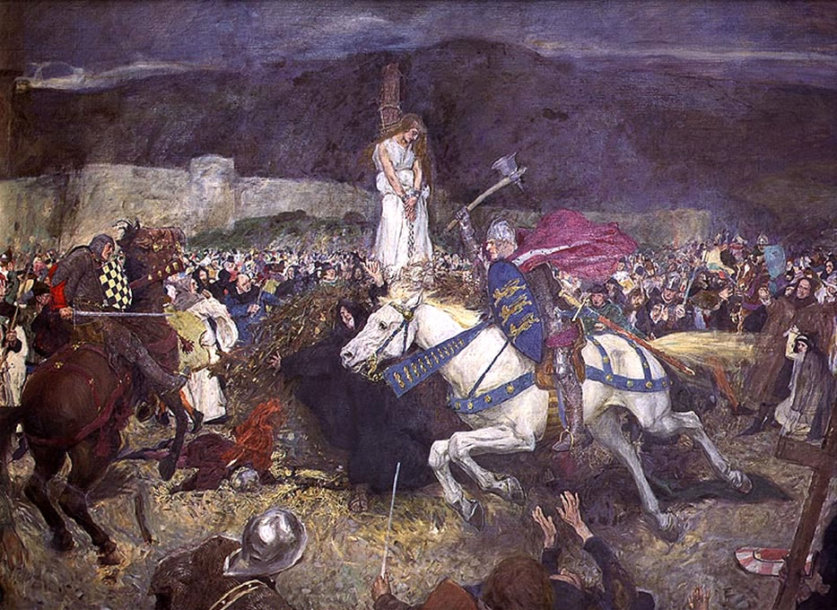
Social Inequality
Canto IV→ The Story of Ginevra

Slide 8
Social Inequality
Canto IV→ The Story of Ginevra
During one of his adventures, Rinaldo arrives in
Scotland
According to the law of Scotland, women who give
themselves to men without being married to them
are liable to death sentence

Slide 9
Social Inequality
Canto IV→ The Story of Ginevra
During one of his adventures, Rinaldo arrives in an
Scotland
According to the law of Scotland, women who give
themselves to men without being married to them
are liable to death sentence
- Upon his arrival, Rinaldo learns that Ginevra, the King’s daughter has been accused by a local Baron, Lurcanio (who is indeed in love with her), of having slept with a man to whom she is not married

Slide 10
“The daughter of our monarch is oppressed.
In need of help, she knows not what to do.
An evil lord, Lurcanio by name,
Intends that she shall die a death of shame.
Lurcanio has reported to the king
(Inspired perhaps by hatred more than right)
That by a secret rope he saw her bring
Her lover to her balcony at night.
By law she is condemned for such a thing
To death by burning. Such, then, is her plight,
Unless within a month – and time is short –
A knight arrives to challenge the report”
(IV, 57-58)

Slide 11
Rinaldo’s Reaction to the law of Scotland
“Rinaldo thought a while and then he said
‘A damsel is condemned to death because
She gave her lover solace in her bed
Who with desire for her tormented was?
A curse upon the legislator’s head!
And cursed be all who tolerate such laws!”

Slide 12
Rinaldo’s Reaction to the law of Scotland
“Rinaldo thought a while and then he said
‘A damsel is condemned to death because
She gave her lover solace in her bed
Who with desire for her tormented was?
A curse upon the legislator’s head!
And cursed be all who tolerate such laws!
[…]
And in my view it makes no difference
If the report is false or if it’s true,
For this does not affect her innocence
(I’d praise her anyway, if no one knew).”
I know just what to say in her defense.
So now a trusty guide I ask of you
To lead me to the accuser. I’ll not waver,
For, as God is my help, I hope to save her” (IV, 63-64)

Slide 13
Ariosto’s Re-elaboration of a traditional epic topic

Slide 14
Ariosto’s Re-elaboration of a traditional epic topic
An (innocent) woman is accused of something

Slide 15
Ariosto’s Re-elaboration of a traditional epic topic
An (innocent) woman is accused of something
A man (a knight, a warrior) is needed to defend her and prove her innocence

Slide 16
Ariosto’s Re-elaboration of a traditional epic topic
An (innocent) woman is accused of something
A man (a knight, a warrior) is needed to defend her and prove her innocence
By winning a death duel (against the accuser), the defender proves her innocence (= judicial duel)

Slide 17
An example…

Slide 18
An example…
A real story:
The story of the last “judicial duel” organized in France in 1386 between Jean de Carrouges (Matt Damon) and Jacques Le Gris (Adam Driver)
Jacques is accused by Jean’s wife of having raped her – but Jacques accuses her of slander
Jean kills Jacques in a judicial duel, thereby proving his wife’s innocence (had he lost the duel, his wife would have been burnt alive)

Slide 19
Ariosto’s Re-elaboration of a traditional epic topic
A woman is accused of… x

Slide 20
Ariosto’s Re-elaboration of a traditional epic topic
A woman is accused of… x
Rinaldo does not know and is not interested in knowing whether she is innocent
“And in my view it makes no difference
If the report is false or if it’s true,
For this does not affect her innocence
(I’d praise her anyway, if no one knew)”

Slide 21
Ariosto’s Re-elaboration of a traditional epic topic
A woman is accused of… x
Rinaldo does not know and is not interested in knowing whether she is innocent
Rinaldo is willing to fight for her in a judicial duel to prove that the law itself is unjust

Slide 22
Rinaldo against the inequality of the Law
“‘I will not say she did not do this deed.
Lest I am wrong, it would be ill-advised;
But I will say that even if she did,
She does not merit to be thus chastised.
And I will say that mad and bad indeed
He was who first this evil law devised,
Which from the statue-book should be erased
And by a wiser measure be replaced’”

Slide 23
The Same desire cannot be punished differently
“‘If the same ardour, if an equal fire
Draws and compels two people ever more
To the sweet consummation of desire
(which many ignoramuses deplore),
Why should a woman by a fate so dire
Be punished who has done what men a score
Of times will do and never will be blamed,
Nay, rather, will be praised for it and famed?
This inequality in law much wrong
Has done to women. With God’s help, I mean
To show that to have suffered it so long
The greatest of iniquities has been’
Rinaldo’s logic carried them along.
The ancient forefathers were justly seen
To be unjust to have consented to it;
Also the king, who could and should undo it” (IV, 65-67)

Slide 24
“Rinaldo’s logic carried them along”

Slide 25
“Rinaldo’s logic carried them along”
By nature, men and women are equal →

Slide 26
“Rinaldo’s logic carried them along”
By nature, men and women are equal →
By nature, they have and are driven by the same desires

Slide 27
“Rinaldo’s logic carried them along”
By nature, men and women are equal →
By nature, they have and are driven by the same desires
And yet, women are punished by the law while men are praised

Slide 28
Ariosto’s Critique of Men’s Violence against Women (Canto V)

Slide 29
Ariosto’s Critique of Men’s Violence against Women (Canto V)
“No creatures on earth, no matter whether
Of peaceful disposition, mild and kind,
Or fierce and merciless as wintry weather,
Are hostile to the females of their kind.
The she-bear and her mate in sport together,
The lion and the lioness, we find;
The she-wolf and the wolf at peace appear;
The heifer from the bull has naught to fear”

Slide 30
Ariosto’s Critique of Men’s Violence against Women (Canto V)
“No creatures on earth, no matter whether
Of peaceful disposition, mild and kind,
Or fierce and merciless as wintry weather,
Are hostile to the females of their kind.
The she-bear and her mate in sport together,
The lion and the lioness, we find;
The she-wolf and the wolf at peace appear;
The heifer from the bull has naught to fear
What dreadful plague, what fury of despair
In our tormented bosoms now holds sway,
That wives and husbands constantly we hear
Wounding each other with the things they say?
With scratching, bruising, tearing out of hair,
Assault and battery, in bitter fray
They drench with scalding tears the marriage-bed,
And not tears only; sometimes blood is shed”

Slide 31
Ariosto’s Critique of Men’s Violence against Women (Canto V)
“Not only a great wrong, but in God’s sight
An outrage against Nature he commits
Who with his gentle helpmeet stoops to fight,
Or in her face a lovely woman hits,
Or harms a hair upon her head; but quite
Inhuman is the man who her throat slits,
Or chocks or poisons her; he, in my eyes,
Is not a man, but fiend in human guise” (V, 1-3)

Slide 32
Differences
Animals
Humans

Slide 33
Differences
Animals
Humans
“The she-wolf and the wolf at peace appear”
- “That wives and husbands constantly we hear
Wounding each other with the things they say?”

Slide 34
Differences
Animals
Humans
“The she-wolf and the wolf at peace appear”
“The heifer from the bull has naught to fear”
- “That wives and husbands constantly we hear
Wounding each other with the things they say?”
- “Inhuman is the man who her throat slits,
Or chocks or poisons her; he, in my eyes,
Is not a man, but fiend in human guise”

Slide 35
Differences
Animals
Humans
“The she-wolf and the wolf at peace appear”
“The heifer from the bull has naught to fear”
- “The she-bear and her mate in sport together,
The lion and the lioness, we find”
- “That wives and husbands constantly we hear
Wounding each other with the things they say?”
- “Inhuman is the man who her throat slits,
Or chocks or poisons her; he, in my eyes,
Is not a man, but fiend in human guise”
- “No creatures on earth, no matter whether
Of peaceful disposition, mild and kind,
Or fierce and merciless as wintry weather,
Are hostile to the females of their kind”

Slide 36
Differences
Animals
Humans
“The she-wolf and the wolf at peace appear”
“The heifer from the bull has naught to fear”
- “The she-bear and her mate in sport together,
The lion and the lioness, we find”
They do things together / Same activities
- “That wives and husbands constantly we hear
Wounding each other with the things they say?”
- “Inhuman is the man who her throat slits,
Or chocks or poisons her; he, in my eyes,
Is not a man, but fiend in human guise”
- “No creatures on earth, no matter whether
Of peaceful disposition, mild and kind,
Or fierce and merciless as wintry weather,
Are hostile to the females of their kind”

Slide 37
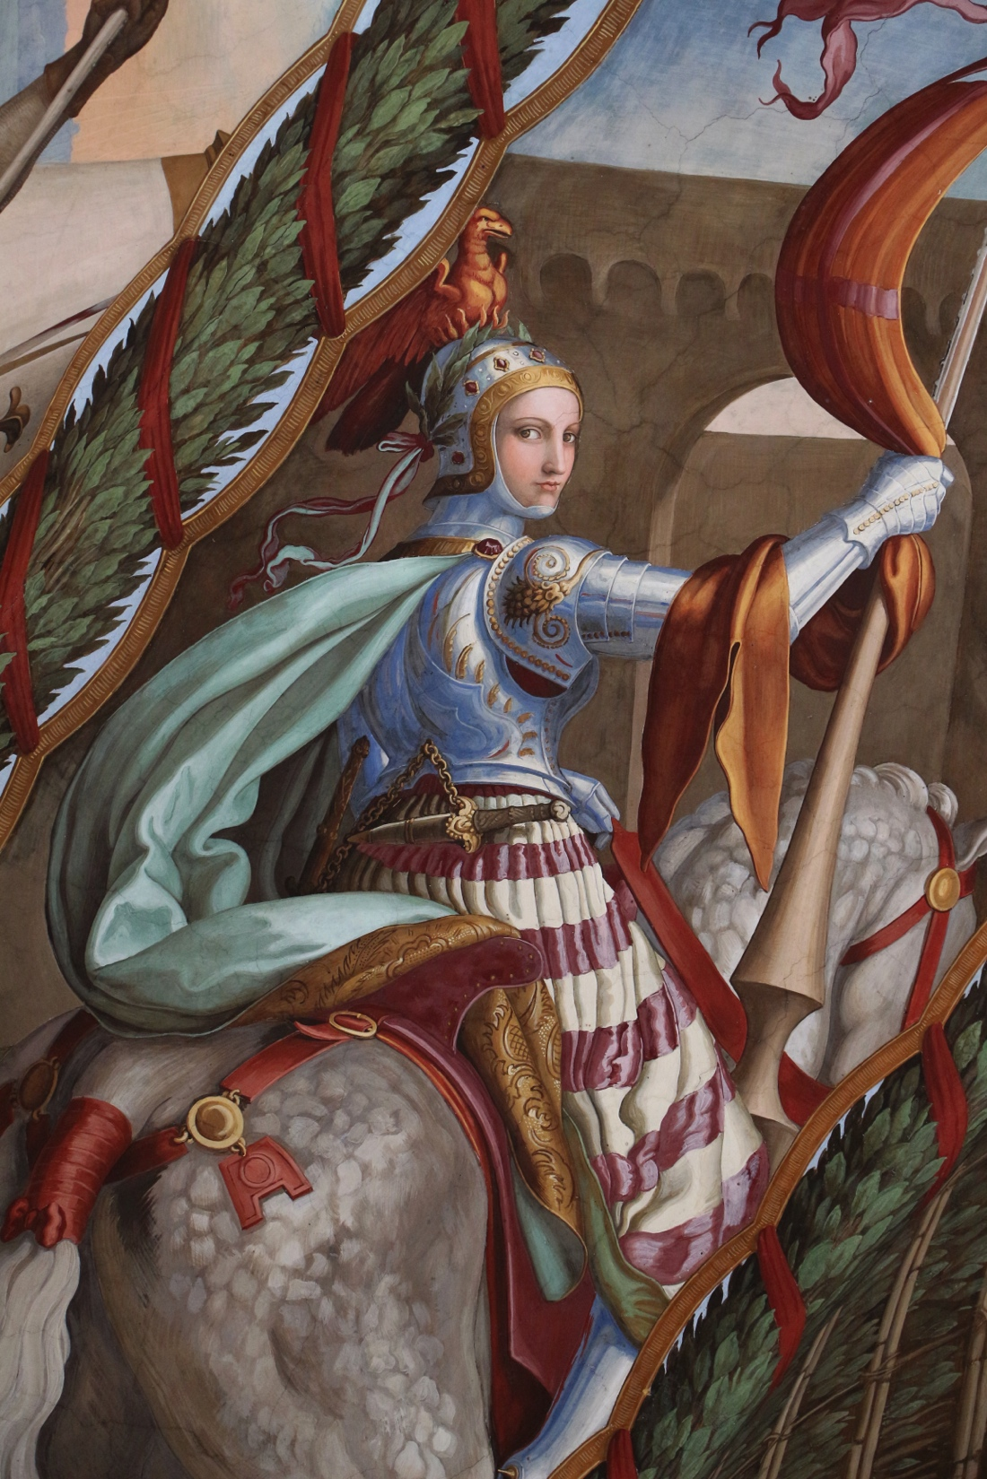
Marfisa
Julius Schnorr von Carolsfeld, Ariosto Room (Casino Massimo, Rome)

Slide 38
The Traditional View…

Slide 39
The Traditional View…
In traditional epic, women tended to become warriors/knights for several reasons:

Slide 40
The Traditional View…
In traditional epic, women tended to become warriors/knights for several reasons:
To escape a danger
To follow a lover
To save personal honor
To amuse the reader by providing comic relief

Slide 41
The Traditional View…
In traditional epic, women tended to become warriors/knights for several reasons:
To escape a danger
To follow a lover
To save personal honor
To amuse the reader by providing comic relief
They usually end up:
Marrying men
Killed by men
Transformed into men

Slide 42
Marfisa
Break with the tradition
- Marisa’s identity as a warrior is not something temporary
It is not just a masquerade
She dresses up like a knight because this is how she sees herself and how she wants to be seen by the other
At the end of the poem, she is unmarried and undefeated
She makes a name for herself, and Charlemagne accepts her among his own army as a most important champion

Slide 43
Marfisa
“Marfisa is this warrior-maiden’s name.
So mighty was her strength that, sword in hand,
She’d made Orlando sweat (and non can blame
Him) and Rinaldo too, I understand.
She went in search of glory and of fame,
In armour day and night she hoped to meet
Knights-errant to combat and to defeat”
(XVIII, 99)

Slide 44
Marfisa
“Then, since there is no other cavalier,
The pagan thinks that he has won the joust,
And to the fountain goes on to claim the fair
Young damsel, and he says: ‘Lady, you must
Concede that you are ours, since it is clear
No one is left to champion you. I trust
You’ll not demur or make excuse, for
This custom has been long observed in war’”

Slide 45
Marfisa
“Then, since there is no other cavalier,
The pagan thinks that he has won the joust,
And to the fountain goes on to claim the fair
Young damsel, and he says: ‘Lady, you must
Concede that you are ours, since it is clear
No one is left to champion you. I trust
You’ll not demur or make excuse, for
This custom has been long observed in war’
Raising a haughty face, Marfisa said,
‘The premises of your remarks are wrong.
Right would be on your side, I will concede,
And you could justly claim me, if among
These cavaliers, who on the ground lie spread,
To no one but myself; and so you see,
Who wants me must do battle first with me” (XXVI, 79)

Slide 46
Ariosto’s views
Women should be judged based on their actions (what they can
do) rather than what society established about their role
- Criticism of all the poets of the past, who have never written their lives and stories

Slide 47
“As to perfect some precious gift or bent
Which Nature without toil cannot bestow,
Women have labored, day and night intent,
And well-earned recognition sometimes know,
Would that they chose to be as diligent
And a like dedicated care would show
In studies more esteemed and highly prized,
Whence mortal virtues are immortalized
And would they might their powers then devote
To women’s own commemorative praise,
Rather than look to men to sound this note,
Whose envious spite their judgment overlays,
For Woman’s merits many a man will not
Proclaim, though gladly ill of her he says.
By women, women’s fame could reach the skies,
Higher perhaps than men’s renown could rise”

Slide 48
“And often men are not content to sing
In praise of each other’s world renown,
But all their efforts they apply to bring
To light why purists should on women frown.
Unwilling they should rise in anything,
They do the best they can to keep them down
(I speak here of the past), as if the fame
Of women would dissolve or dim their name”
(XXXVII, 1-3)
“So, ladies, I conclude: in every age
There have been women worthy of renown;
But envious writers have left blank the page
Which after death should make your glory known.
This will no longer be: you must engage
To make yourselves immortal from now on”
(XXXVII, 23)

Slide 49
Gender as a Performance

Slide 50
Gender as a Performance
- Gender is not to be identified with the biological sex
Gender is expressed by the appearance (what I want to look like and what I want to be seen like by the other)
Gender is expressed by one’s behavior

Slide 51
Gender as a Performance
Canto XXVI
“Now with the Clairmonts, as you are aware,
Ruggiero rode; […]
Across the plain they’d seen a cavalier
Approach – an arrogant and haughty knight,
Flaunting the bird which rises from the flame
Renewed, unique and of undying fame.
[…]
‘I hoped I might exchange a blow or two,
To test your valour and your expertise;
But if your skill you are prepared to show
At someone else’s cost, then, as you please.
I only ask that I may fight your foe’,
and with a shield and helmet such as these,
If you accept, I hope to demonstrate
That no unworthy ally you have met’”

Slide 52
Gender as a Performance
Canto XXVI
“Someone, I think, would like to know the name
Of him who offers to assist the three
Who to the rescue of the brothers came,
So I will say the cavalier is she
(Not he or him henceforth), that very same
Marfisa, who a toll of chivalry
Exacted from Zerbino, binding him
To do the vile Gabrina’s every whim
The Clairmont cousins and the good Ruggiero
Welcomed Marfisa gladly as a fourth,
For they believed she was a cavalier,
Not knowing her true sex nor her true worth (8-9)”

Slide 53
Gender as a Performance
Canto XXVI
“She marvelled a Ruggiero’s deadly blows,
She marvelled, too, at their unerring aim.
When Balisard struck, you would suppose
That iron, paper suddenly became.
However tick the armour of the foes,
In twain the weapon sliced them just as the same,
Down to their very steeds, and sent them flying
Till here, there, everywhere the dead were lying.
[…]
Almost as though Marfisa’s enemies
Were ice, they melt as, like a torch, she weaves
Among their ranks, causing no less surprise
Then he on whom she turns astonished eyes” (21-23)

Slide 54
Gender as a Performance
Canto XXVI
“When all have drawn their helmets off, the three
Observe to whom they owe such timely aid:
The golden, curling tresses they now see,
And the fair features, of a lovely maid.
They greatly honour her and beg that she
Will not conceal their name, which she has made
Deserving of such glory; she replied
With courtesy and with their wish complied” (28)

Slide 55
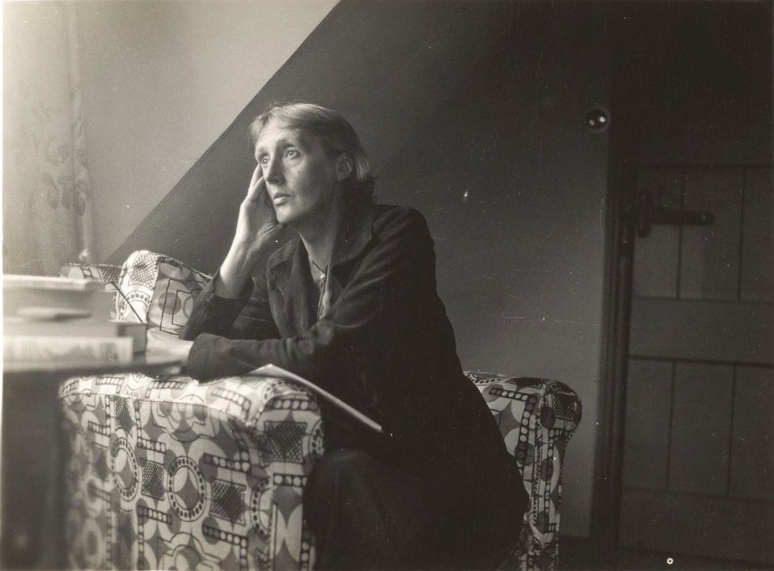
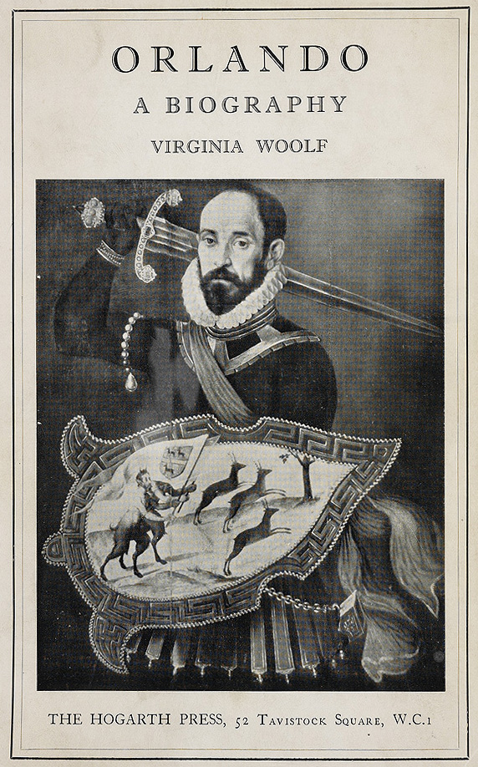
Virginia Woolf’s Orlando
Orlando. A Biography (1928)

Slide 56
Virginia Woolf’s Orlando
Orlando. A Biography (1928)
The adventures of an English nobleman during the reign of Elizabeth I (1533-1603)
Then, at the age of 30 Orlando undergoes a mysterious change of sex and becomes a woman and lives for 300 years

Slide 57
Virginia Woolf’s Orlando
Orlando. A Biography (1928)
→ From performance-identity to identity-change
“The difference between the sexes is, happily, one of great profundity. Clothes are but a symbol of something hid deep beneath. It was a change in Orlando herself that dictated her choice of a woman’s dress and of a woman’s sex. And perhaps in this she was only expressing rather more openly than usual […] something that happens to most people without being thus plainly expressed. For here again, we come to a dilemma. Different though the sexes are, they intermix. In every human being a vacillation from one sex to the other takes place, and often it is only the clothes that keep the male or female likeness, while underneath the sex is the very opposite of what is above. Of the complications and confusions which thus result everyone has had experience” (Chapter IV)

