Slide 1
TALMUD AND PHILOSOPHY
THE CONTROVERSY

Slide 2
Three Big questions
The position of philosophy within Judaism
The actual controversy
Geographical and historical context (and their possible transcendency)

Slide 3
Talmud as a start position
Authority of the „Oral Torah“
https://halakhah.com
Name from the Hebrew root למד LMD (learn)

Slide 4
Talmud as a start position
Ben Dama, son of Rabbi Yishmael’s sister, asked Rabbi Yishmael: In the case of one such as I, who has learned the entire Torah, what is the halakha with regard to studying Greek wisdom? Rabbi Yishmael recited this verse about him: “This Torah scroll shall not depart from your mouth, and you shall contemplate in it day and night.” Go and search for an hour that is neither part of the day nor part of the night, and learn Greek wisdom in it.
A certain elderly man was there, in Jerusalem, who was familiar with Greek wisdom. He communicated to those on the outside by using words understood only by those proficient in Greek wisdom. The elderly man said to them: As long as they are engaged with the Temple service, they will not be delivered into your hands. Upon hearing this, on the following day, when they lowered dinars in a box, they sent up a pig to them. Once the pig reached halfway up the wall, it inserted its hooves into the wall and Eretz Yisrael shuddered four hundred parasangs by four hundred parasangs.
When the Sages saw this, they said at that time: Cursed is he who raises pigs, and cursed is he who teaches his son Greek wisdom

Slide 5
Salome Alexandra (mother)
/// \\\
Hyrcanus vs. Aristobulos (brothers)
Siege of Jerusalem and fall of Jerusalem – the loss of autonomy of Judea in 64 BCE

Slide 6
Hokhma yevanit
חכמה עיוניתHOKHMA YEVANIT
Noun + Adjective = greek wisdom
חכמת עיוניתHOKHMAT YEVANIT
Noun + Noun = wisdom of the Greek

Slide 7
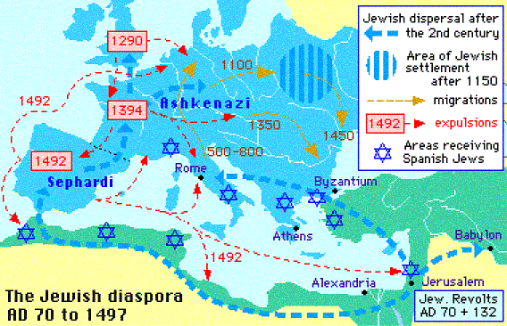
Maimonidean controversy
Internal causes: Maimonides
External causes: Geography

Slide 8
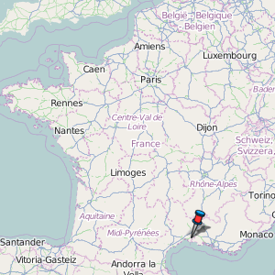
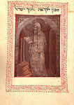
Phases of the maimonidean Controversy
1. phase – 1180 – 1204, Meir ben Todros Ha-Levi Abulafia versus Lunel
Problem of the afterlife (olam ha-ba)

Slide 9
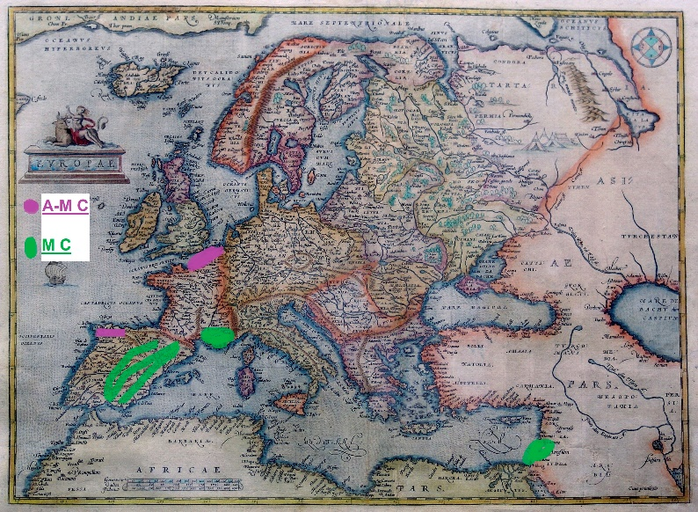
2. phase – 1230 – 1240
Europe:
Maimonidean camp (= David Kimhi /Radak/, Ibn Tibbon family, various scholars of Provence and Spain)
Anti-Maimonidean camp (= Solomon ben Abraham of Montpellier, David ben Saul, Jonah ben Abraham Gerondi, Nachmanides /Ramban/, rabbis of Northen France)
The conclusion: ban of Maimonides‘s books and studying of philosophy (and those whose study them), burning of Maimonides books X ban of the previous ban and of the actors of the previous ban.
Ended with the public burning of Talmud (1232)
B. Middle East:
Abraham ben Moses ben Maimon.
Ended with the public burning of Talmud and with the desecration od Maimonides‘ tomb.

Slide 10
3. phase: 1288 – 1290
Solomon Petit – from France and Germany to Acre (Akko, northen Israel) – anti-maimonidean sentiment. Support in Europe (but opposition in the Shem Tov ibn Falaquera and his strict rationalism) x opposition in East.
4. phase: 1300 – 1306
Rationalistic camp led by Abby Mari of Lunel – ban to study philosophy under the age of 25 X opposition led by Menahem ben Solomon Meiri counter-ban X Jedaiah ben Abraham attack on anti-rational camp. Ended with Philil IV‘s expulsion of the Jews from France in 1306.

Slide 11
Letter against philosophy, ms opp. 585, 78v – 81r

Slide 12
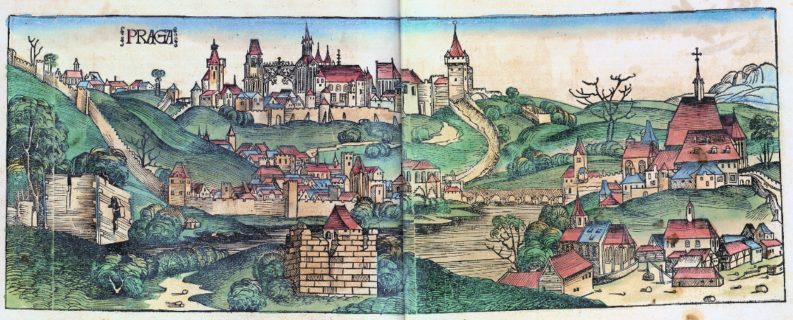
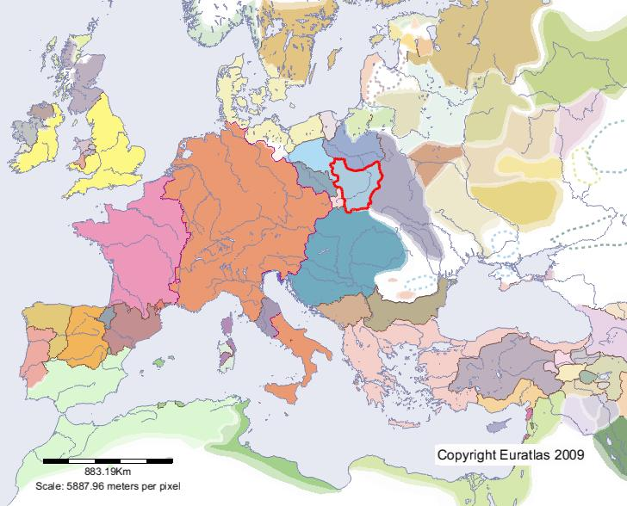
Letter against philosophy, ms opp. 585, 78v – 81r
probably after 1450, not later than 1467 ( – at that time was created copy of the letter)
anonymous author either from Prague or from Lesser Poland

