Slide 1
Photography

Slide 2
Born of the photography
Term from the Greek, means „drawing with light“
„invented“ in 1839
Louis Jaques Daguerre and William Fox Talbot, both in the same time
Consider as more accurate picture of reality – crisis for art (and stimulus for its turn to abstraction)

Slide 3
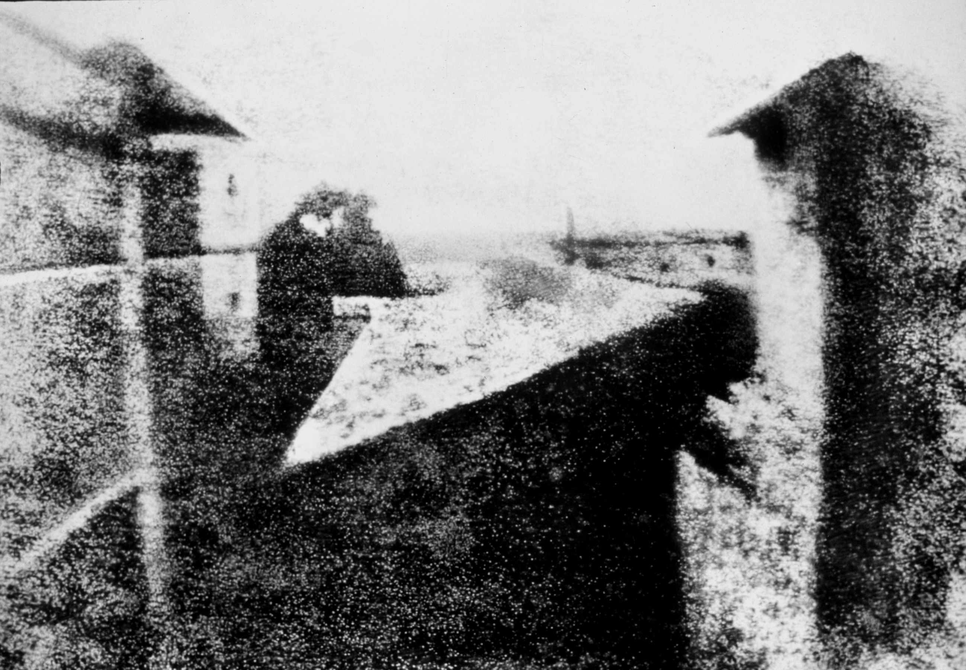
Nicéphore Niépce – View from the Window at Le Gras (1826/1827)

Slide 4
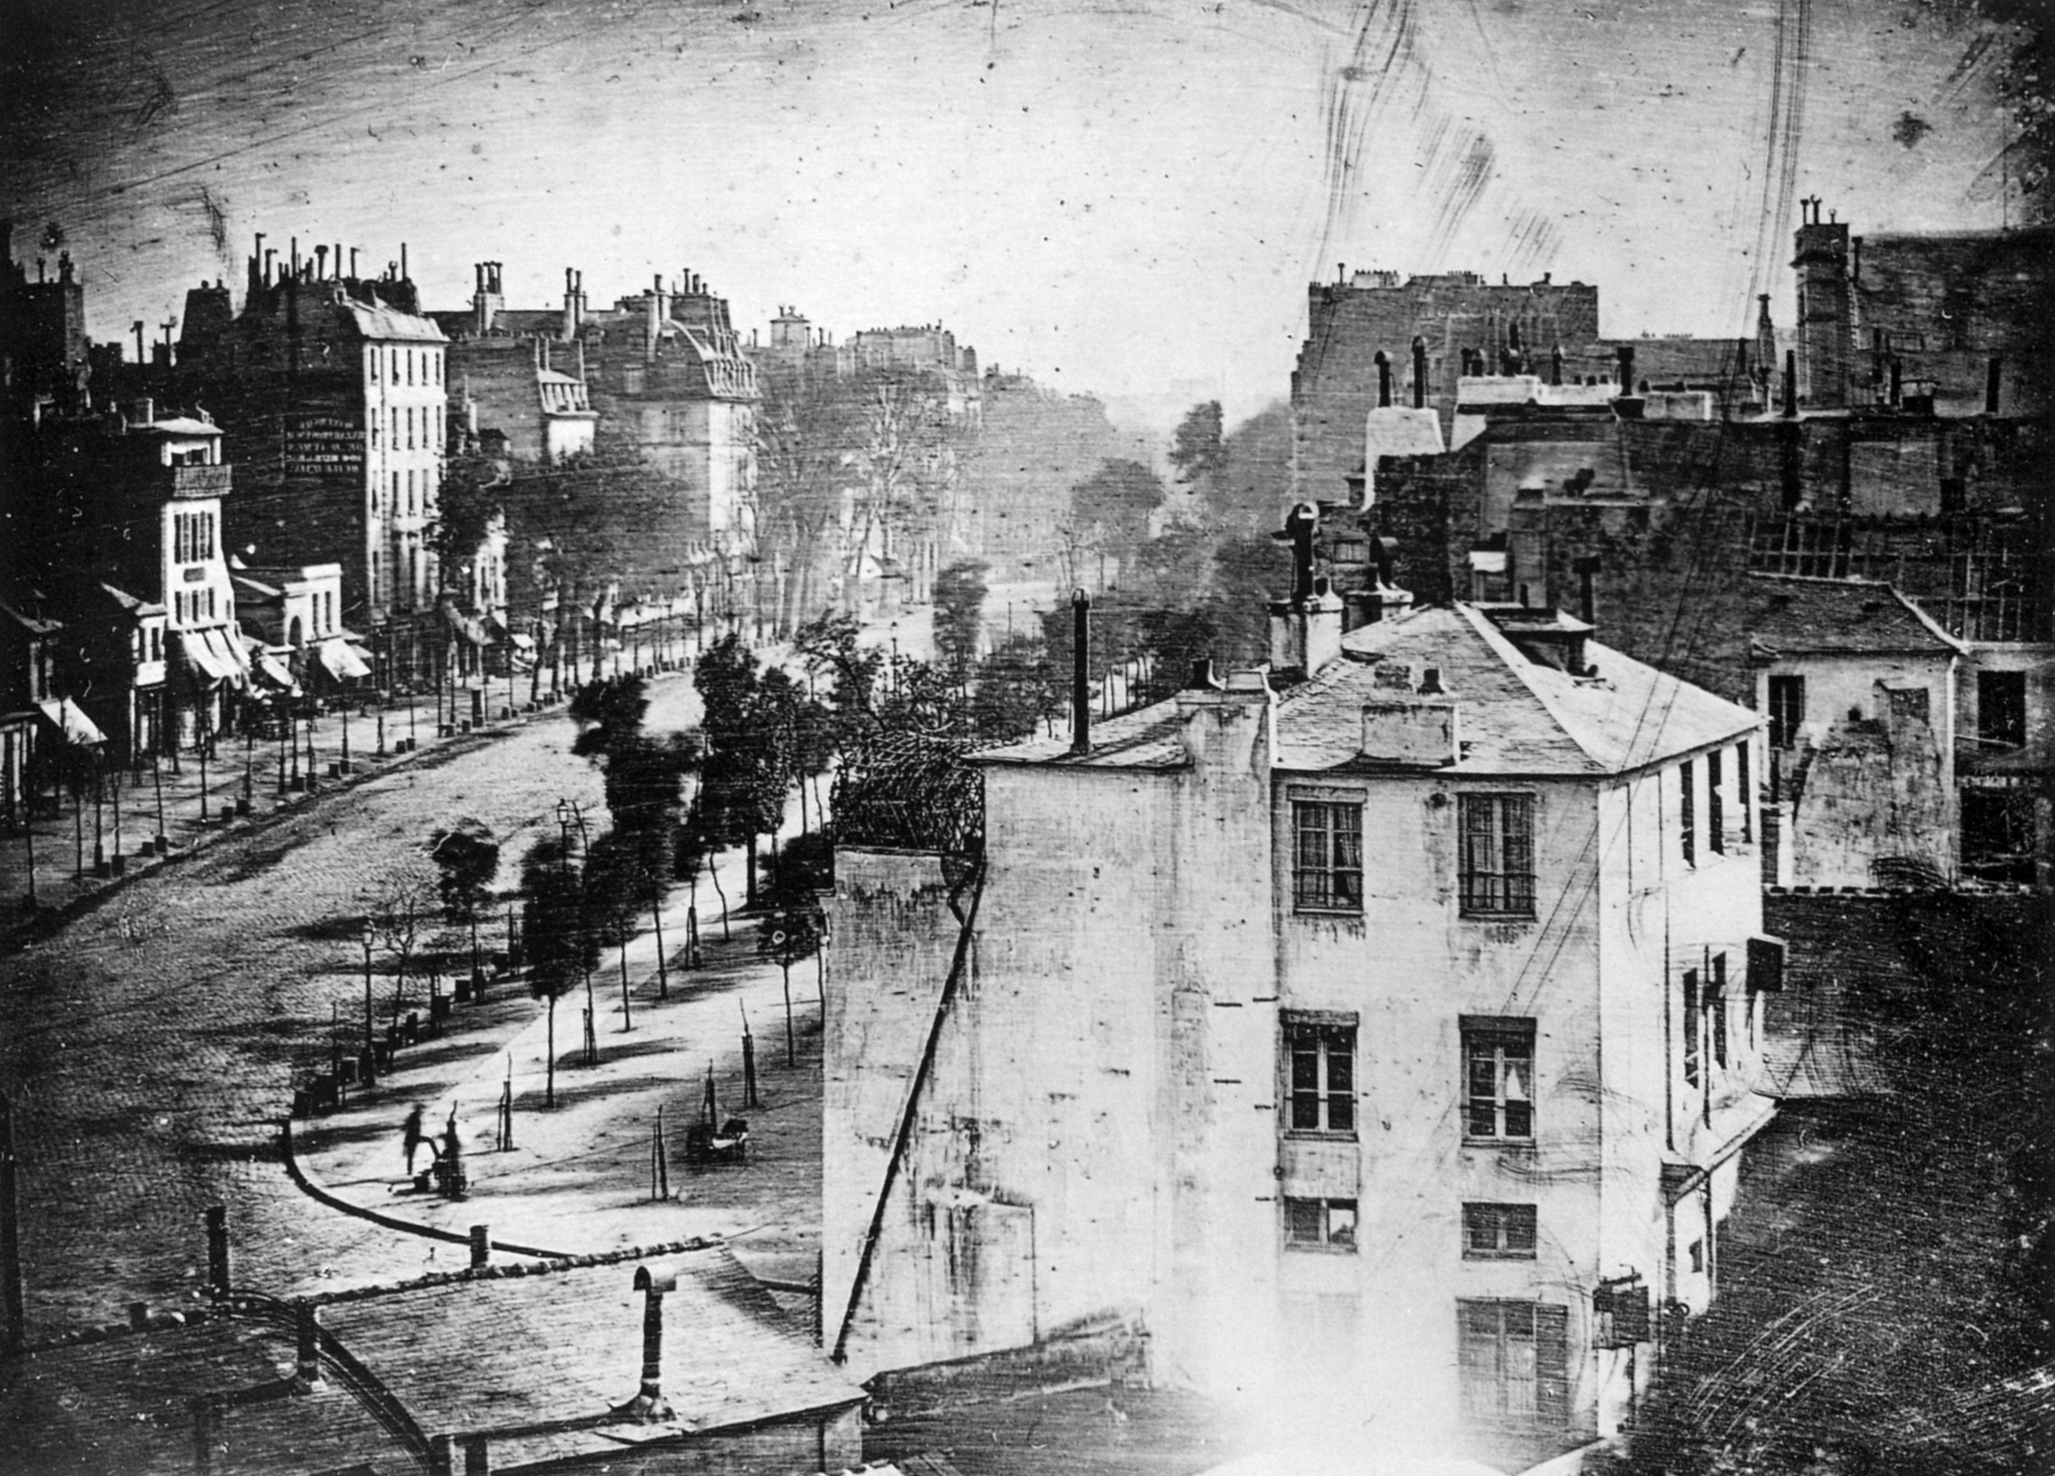
Louis Jacques Mandé Daguerre – Le Boulevard du Temple (1838/1839)

Slide 5
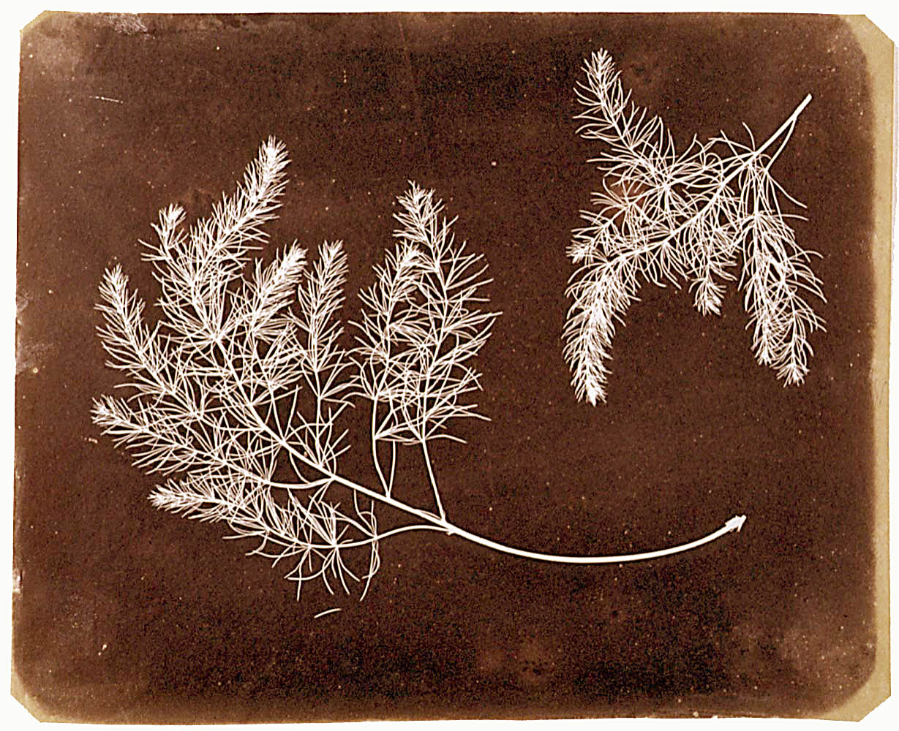
William Fox Talbot (cca late 1830s)

Slide 6
Trends
Portraits – everlasting
Landscapes and architecture – similar to trends of art in the first half of 19th century, connected to tourism (from the start of the photographic age)
Etnographocal pictures – scientical
Photographs with social context – the end of the 19th century

Slide 7
Characteristic
Static photograps – because of long expostion (minutes, later seconds)
„ghost“ effect – just because of moving during of object
Non abstract – photographers start to be bored of realism at the turn of 19th and 20th century
… (I have no other idea now ☺)

Slide 8
Objectivity?
Unshakable faith even until the 20th century
But every picture is always a copy, only reflextion of reality
One of the first doubts – photographies from the Paris Commune showing violence of communards
A tool of (state) propaganda – royal dynasty, war, industrialization and modernity, imperialism,…

Slide 9
Interpretation
The intention of photographer
Used technique (type of camera, coloring,…)
Social, political etc. context
Randomness, a strange character of camera, nobody can influence it

Slide 10
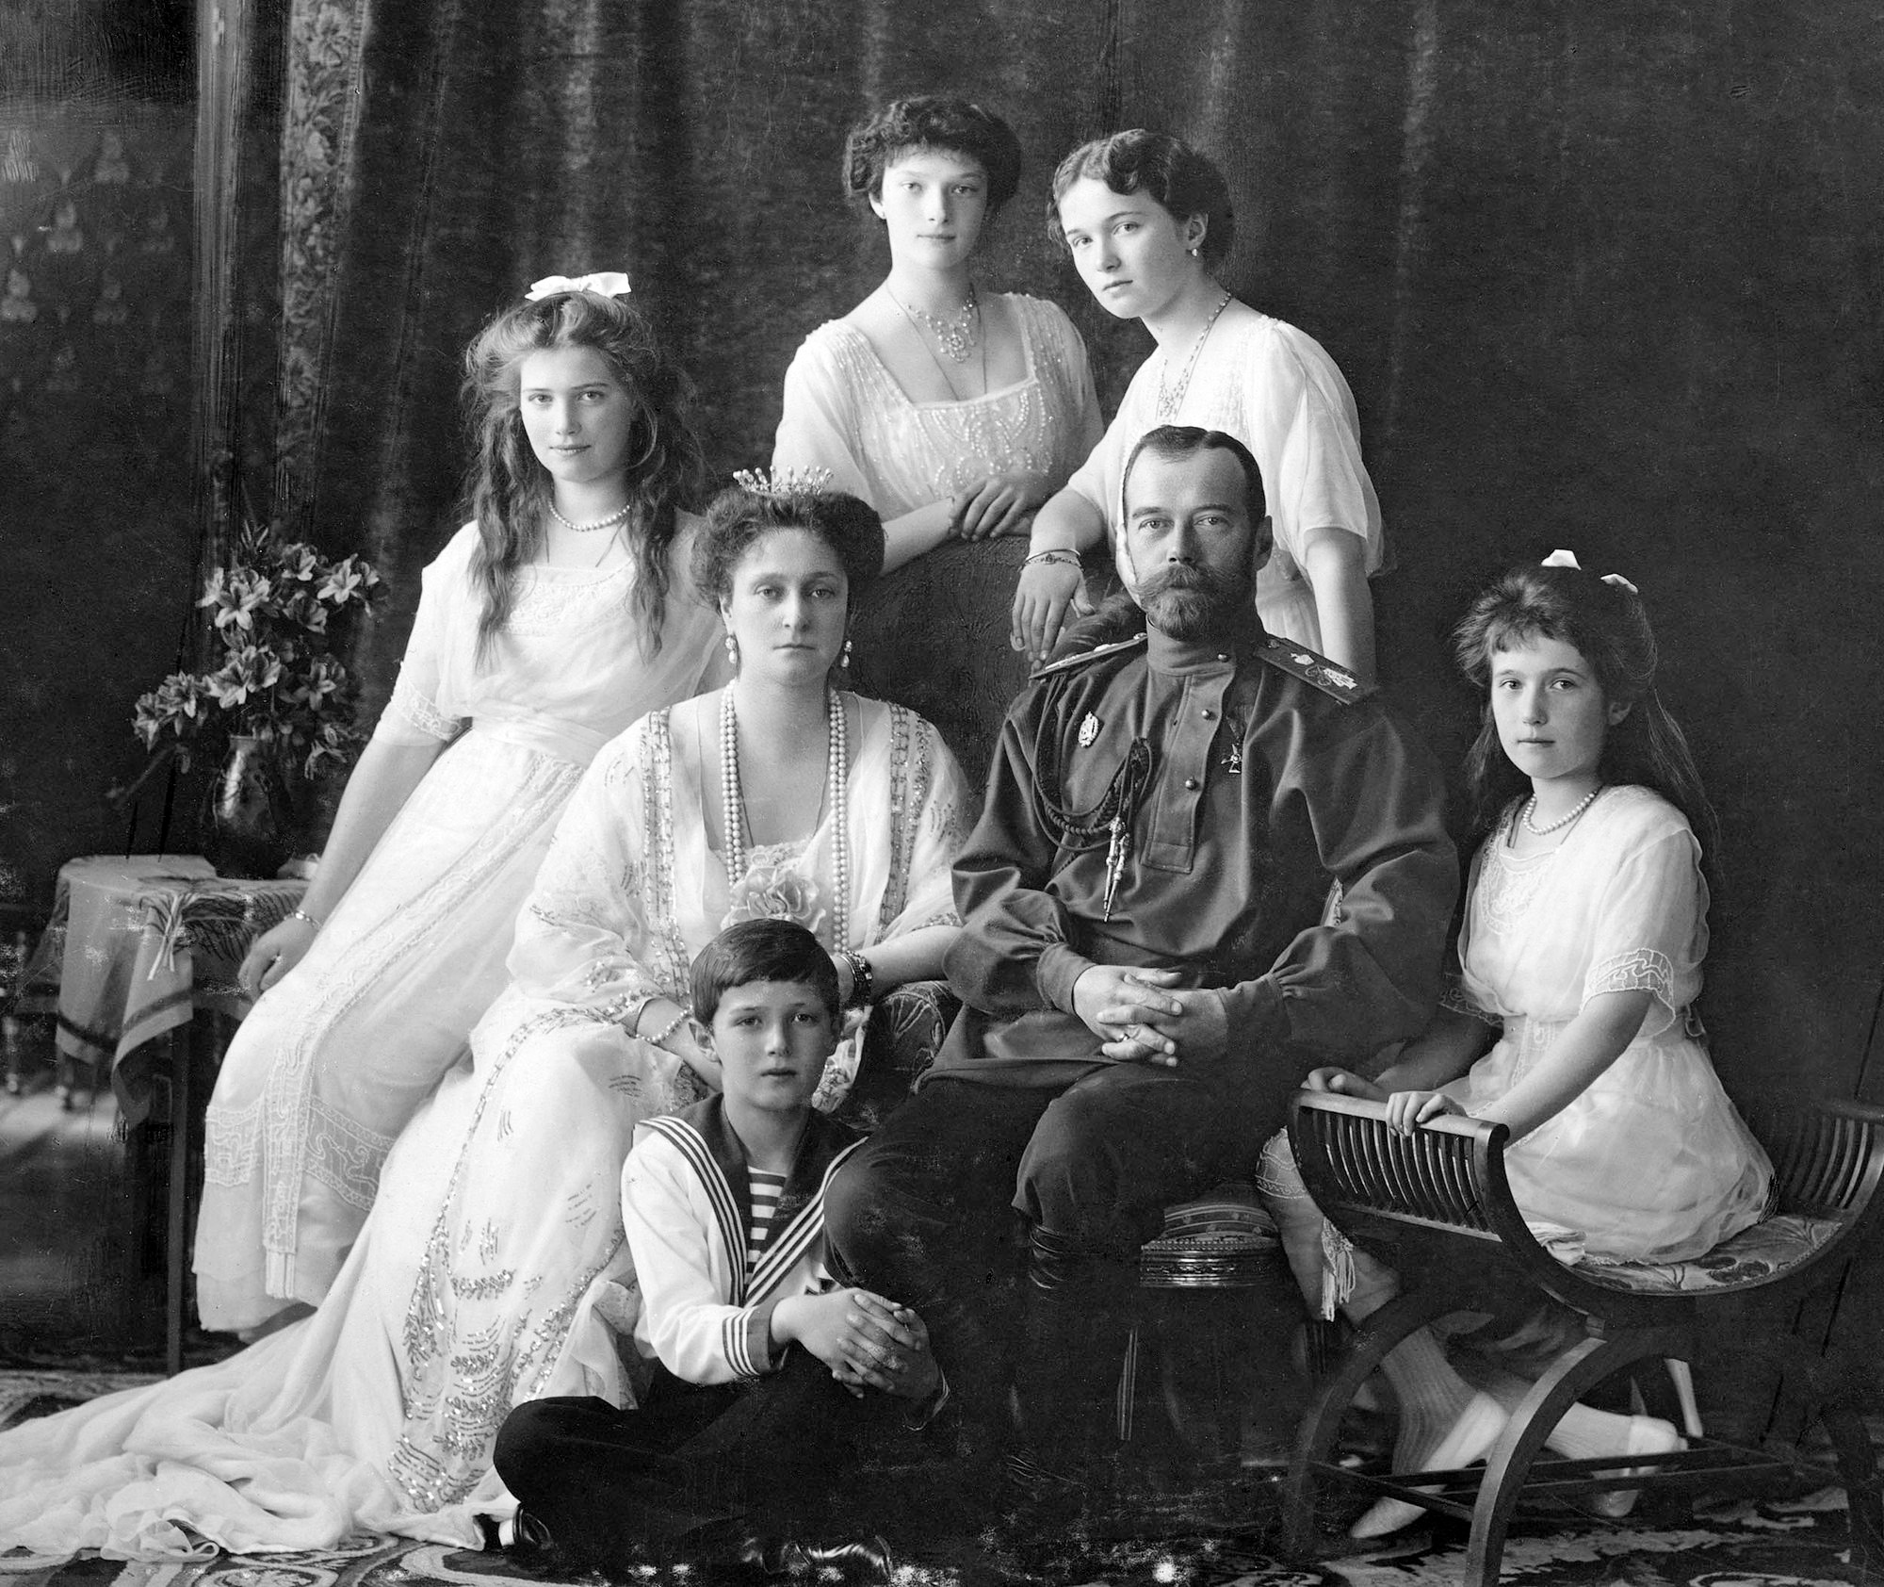
Nicholas II of Russia with his family (1913/1914)

Slide 11
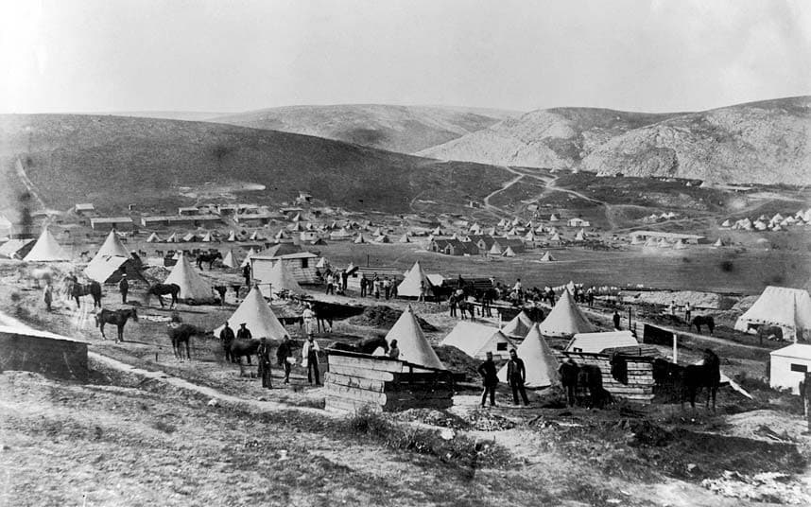
Roger Fenton, from the Crimean War (1855)

Slide 12
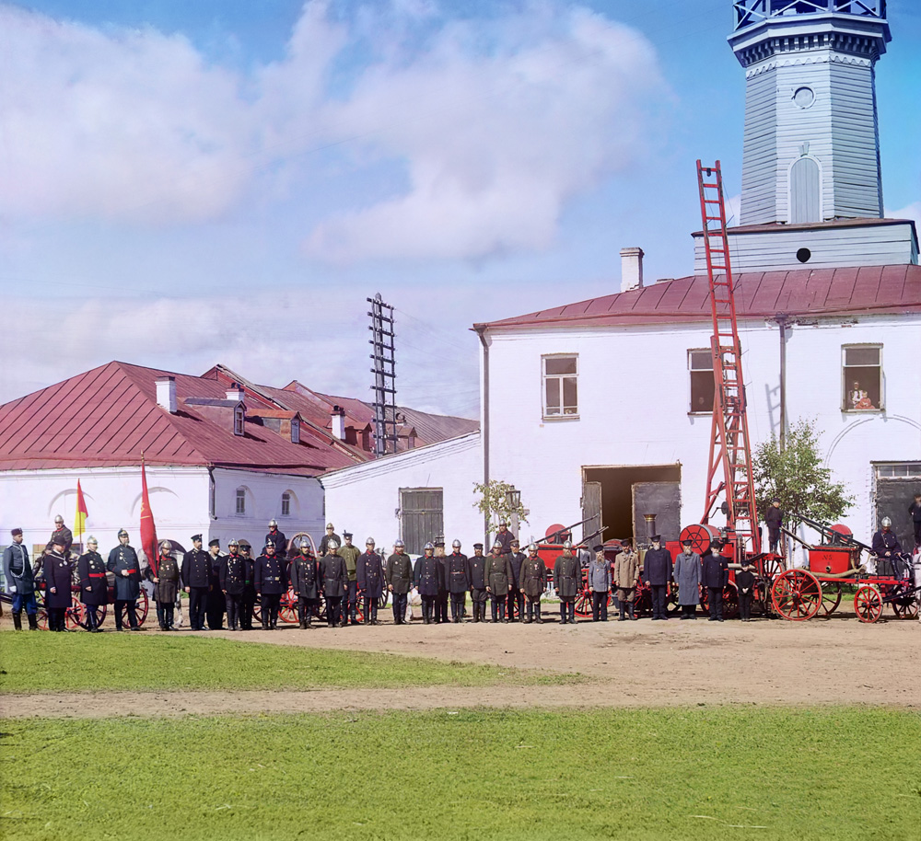
Sergej Michajlovič Prokudin-Gorskij – Fire Brigade in the town of Vytegra (?)

Slide 13
Sergej Michajlovič Prokudin-Gorskij– Fire Brigade in the town of Vytegra (1909)

Slide 14
Document or Art?
Very hard to differentiate
We cannot speak about photography as art for almost all 19th century. Photography was „cought in its ‚objectivity‘ “
Depends on the intention of a photographer, the mentality of that time,…

Slide 15
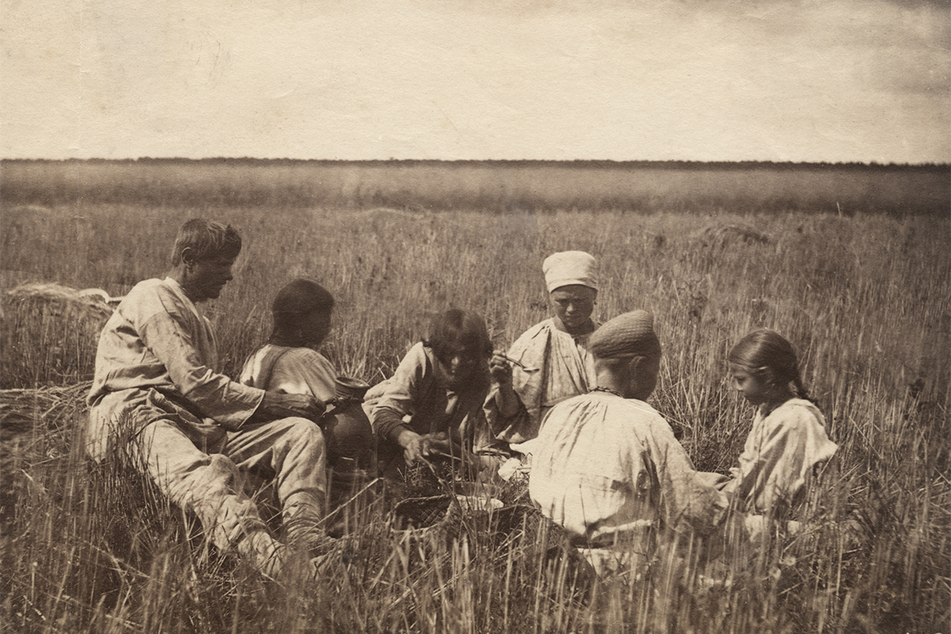
William Carrick

Slide 16
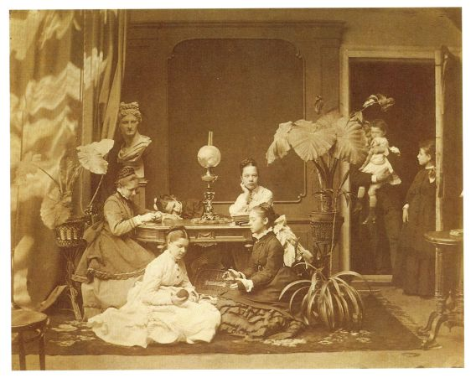
Andrej Osipovič Karelin

Slide 17
William Carrick
Andrej Osipovič Karelin

Slide 18
That‘s all. Thank yoooou for your attention!
Lucie Uriková

Slide 19
Sources
ALLSHOUSE, Robert A. (eds.), Photographs for the Tsar: The pioneering color photography of Sergei Prokudin-Gorskii commissioned by Tsar Nicholas II, New York 1980.
BARCHATOVA, Jelena Valentinovna, Russkaja svetopis: Pervyj vek fotoisskusstva 1839–1914, Petrohrad 2009.
FLUSSER, Vilém, Za filosofii fotografie, 2. vyd., Praha 2013.
GERNSHEIM, Helmut, GERNSHEIM, Alison, A Concise History of Photography, 2. vyd., Londýn 1971.
HANNAVY, John (eds.), Encyclopedia of Nineteenth-Century Photography, New York 2008.
MULLIGAN, Therese, WOOTERS, David (eds.), Dějiny fotografie: Od roku 1839 až do současnosti, Praha 2010.
ROSENBLUM, Naomi, A World History of Photography, 4. vyd., New York 2007.

