Slide 1
THERMAL INJURIES

Slide 2
THERMAL INJURIES
Caused by heat:
burns
hyperthermia (heat illness)
Caused by cold:
frostbites
hypothermia
Thermal injuries with systemic effects:
hyperthermia
hypothermia
Thermal injuries with local effects:
burns
frostbites

Slide 3
BURNS
- injuries caused by dry heat, wet heat, radiation, friction, electricity, chemicals
Seriousness of burns:
Size (rule of nines)
Depth (degree of burn)
Location (hands, face, feet, genitals, trunk, extremities)
Age (under 18 months, above 65 years)
Complications of burns :
Infection
Shock (loss of fluids)
children under 2 years - up to 2-5% of body surface
children under 10 years - up to 10% of body surface
adults - up to 20% of body surface
Hypothermia

Slide 4
SIGNS AND SYMPTOMS:
redness
swelling
blisters
white, black, charred skin
severe pain or painless (depending on degree of burn)
shock

Slide 5
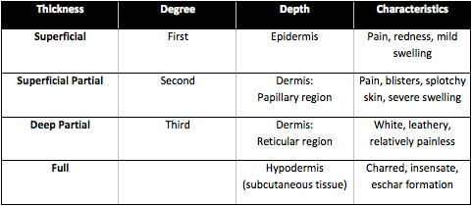
DEGREE OF BURN

Slide 6
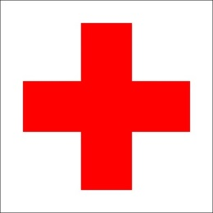
FIRST AID
technical FA
cool burn for at least 10-20 minutes, if up to 5% of body surface
remove any constrictive items (ring, watch, jewellery, belt)
cover the burn with sterile, clean, nonadhesive dressing
immobilize injured limb
shock treatment
DO NOT remove stuck clothing!
DO NOT apply ice directly to skin!
DO NOT break blisters!
DO NOT apply any creams, ointments, lotions, butter!
Call EMS if burn is more than 10% of body surface.
See a doctor if burn is more than 1% of body surface and is on hands, face, feet, genitals and is 2nd and higher degree.
https://www.youtube.com/watch?v=2pVGG09VmfQ

Slide 7
HYPERTHERMIA
- condition in which body temperature is higher than normal
- failure of thermoregulation, usually due to prolonged exposure to heat
Risk factors:
physical activity in hot and humid environment
unsuitable clothing
age (infants, young and elderly)
lack of liquids
Heat exhaustion
Heat stroke
Heat stroke is a life threatening condition where body temperature will continue to rise and can cause brain damage, coma and death.

Slide 8
SIGNS AND SYMPTOPMS
HEAT EXHAUSTION
exhaustion and headache
nausea and vomiting
muscle and stomach cramps
sweating
dizziness and faintness
HEAT STROKE:
as per heat exhaustion +
dry red hot skin (no sweating)
fever (temperature above 40°C)
seizures
rapid pulse, rapid breathing
confusion and disorientation
unconsciousness

Slide 9
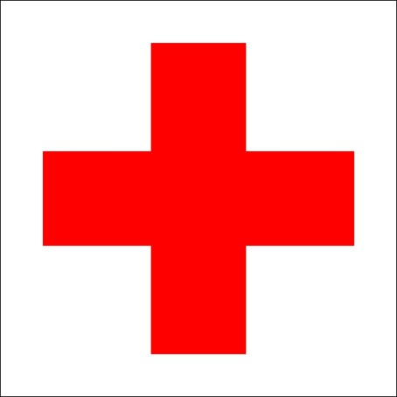
FIRST AID
move to cool and ventilated place
lay down
remove excess or tight clothing
cool with cold water (sponge, spray, wet towels, shower, bath)
apply ice packs to neck, armpits, groins
give cool liquids (+ 1 teaspoon of salt disolved in 0.5 l)
use recovery position if unconscious
check vital sings
call EMS

Slide 10
https://www.youtube.com/watch?v=1U7upbieQLk

Slide 11
2015 FIRST AID GUIDELINES
BURNS
Actively cool thermal burns as soon as possible for a minimum of 10 minutes duration using water.
Subsequent to cooling, burns should be dressed with a loose sterile dressing.
For an eye injury due to exposure to a chemical substance, take an immediate action by irrigating the eye using continuous, large volumes of clean water.

Slide 12
SUN STROKE FIRST AID
move to cool and ventileted place
lay down
give cold liquids
give medicaments

Slide 13
HYPOTHERMIA
- abnormal low body temperature
- occurs when body loses heat usually due to prolonged exposure to cold environment
Life threatening - body temperature below 35°C
Unconsciousness - body temperature below 30°C
Death - body temperature below 26-29°C

Slide 14
SIGNS AND SYMPTOMS
Mild hypothermia:
constant shivering
tiredness
cold a pale skin
fast breathing
Moderate hypothermia:
no shivering
exhaustion
difficulty moving
slurred speach
loss of coordination
loss of judgement and reasoning
confusion
slow shallow breathing
Severe hypothermia
unconsciousness
shallow or no breathing
weak or no pulse

Slide 15
FIRST AID
if unconscious check for breathing
start CPR (at least 60 minutes)
avoid active movement
avoid pasive movement
move indoors
remove wet clothing
rewarm slowly (blankets, your own body)
give warm and sweet liquids
give warm food
DO NOT use direct heat (hot water, heat lamp)!
DO NOT give alcohol!

Slide 16
FROSTBITES
- condition when localized damage is caused to skin and other tissues due to freezing
SIGNS AND SYMPTOMS
1st degree
white, red, violet skin
pain, itching
lack of feeling
2nd degree
yellow skin
numbness
blisters (1-2days after)
3rd degree
grey or black skin
loss of sensitivity
necrosis

Slide 17
FIRST AID
keep warm
remove wet clothing
slowly warm affected areas (luke warm water)
sterile dressing
immobilise and elevate
see doctor if 2-3 degree frostbite
DO NOT rub skin!
DO NOT use dry heat (fireplace, oven)!
DO NOT break blisters!

Slide 18
CHEMICAL BURNS
SIGNS AND SYMPTOMS:
irritation and redness of skin
blackened or dead skin
severe pain or numbness
FIRST AID
protect yourself
remove contaminated clothing, jewelry
rinse skin under running water (10-20 minutes)
sterile dressing
shock treatment
DO NOT touch burn without protecting yourself!
DO NOT try to neutralize chemicals!

Slide 19
ELECTRICAL INJURIES
- cardiac arrest due to electrical effect on heart
- muscle, nerve and tissue destruction from current passing through body
- thermal burns from contact with electric source
SIGNS AND SYMPTOMS:
changes of consciousness
heart problems (from irregular heartbeat to cardiac arrest)
breathing problems
muscle spasm and pain
seisures
numbness or tingling
skin burn

Slide 20
FIRST AID
technical FA
CPR
FA for burns
shock treatment
DO NOT touch „electrified person“!

