Slide 1
The Recession of European Democracy: from Democratic Consolidation to Backsliding?
Thareerat Laohabut
Chair of Comparative Political Science
Geschwister Scholl Institute of Political Science (GSI) LMU Munich
EPS programme at Charles University 3 November 2023
Contact: Thareerat.Laohabut@gsi.uni-muenchen.de

Slide 2
INTRODUCTION - WHO I AM?
Doctoral researcher at the Chair of Comparative Political Science, GSI, LMU Munich, Germany
Since April 2022
Teaching BA courses in Democratic Consolidation and Backsliding (2022), Party Politics and Party System in Germany (2023 & 2024), and Comparative Politics in Authoritarian Regime (schedule for summer 2024)
Guest lecturer at Department of Governance, Faculty of Political Science, Chulalongkorn University, Thailand
September 2023
Teaching BA and MA courses in Comparative Democracy in Europe and Comparative Party Politics in Europe, as well as leading a PhD seminar in Political Parties in Western Europe
Visiting researcher at Department of Comparative Politics, University of Bergen, Norway
March-April 2023
The Centre on Regional Democratic Governance (CREDGOV)
Paid trainee (Schuman Traineeship programme) at the European Parliament, Brussels, Belgium
October 2021-February 2022
Unit for Asia, Australia, and New Zealand, Directorate-General for External Policies of the Union (DG-EXPO)
Joint Master of Arts in European Politics and Society (EPS) with Erasmus Mundus Scholarship
October 2019-September 2021 (graduated with distinction)
Research track: Charles University, Leiden University, and Pompeu Fabra University (UPF)
Thesis: Assessing polarisation and party system deinstitutionalisation in multiparty Western Europe between 1998 and 2018 (9.2 out of 10)

Slide 3
OVERVIEW
Typology: What is Democracy?
Democratic Consolidation
Democratic Backsliding: How Democracy Backslides?
Evaluating European Democracies: Are They Backsliding?
Summary

Slide 4
What is democracy?
1/22

Slide 5
1. Typology: what Is democracy wise 2023/2024
The public realm & collective norms
Citizens
Representative
Cooperation & Collective decisions
Competition
What Democracy is .. and is not published by Smitter & Karl in 1991
2/22

Slide 6
1. Typology: what Is democracy wise 2023/2024
THE PUBLIC REALM & COLLECTIVE NORMS
Satisfactory collective norms and choices, binding on the society and supported by state coercion, varies and depends on pre-existing factors in different society
The public realm & collective norms
Citizens
Representative
Cooperation & Collective decisions
Competition
What Democracy is .. and is not published by Smitter & Karl in 1991
3/22

Slide 7
1. Typology: what Is democracy wise 2023/2024
THE PUBLIC REALM & COLLECTIVE NORMS
Satisfactory collective norms and choices, binding on the society and supported by state coercion, varies and depends on pre-existing factors in different society
CITIZENS
“All regimes have rulers and a public realm, but only to the extent that they are democratic do they have citizen” (Schmitter & Karl, 1991, p.77)
Universal suffrage
Eligibility for running for the office
The public realm & collective norms
Citizens
Representative
Cooperation & Collective decisions
Competition
What Democracy is .. and is not published by Smitter & Karl in 1991
4/22

Slide 8
1. Typology: what Is democracy wise 2023/2024
THE PUBLIC REALM & COLLECTIVE NORMS
Satisfactory collective norms and choices, binding on the society and supported by state coercion, varies and depends on pre-existing factors in different society
CITIZENS
“All regimes have rulers and a public realm, but only to the extent that they are democratic do they have citizen” (Schmitter & Karl, 1991, p.77)
Universal suffrage
Eligibility for running for the office
REPRESENTATIVES
Modern Democracy relies on the work of representatives
To make representative system function depends on how the representatives are chosen and held accountable for their actions (Schmitter & Karl, 1991, p.80)
The public realm & collective norms
Citizens
Representative
Cooperation & Collective decisions
Competition
What Democracy is .. and is not published by Smitter & Karl in 1991
5/22

Slide 9
1. Typology: what Is democracy wise 2023/2024
COOPERATION & COLLECTIVE DECISIONS
Collective decision is a central feature of democracy
Actors must act collectively through several platforms, such as parties, associations, and movements to vote and select candidates, petition authorities, and influence policies
The phenomenon of cooperation and deliberation via autonomous group activities can go under the mechanism of civil society
The role of civil society as diverse unites of social identity and interest can remain their independency from the state and can play a role in restraining the arbitrary actions of rulers
"Civil society, as an intermediary, provides an intermediate layer of governance between the individual and the state" (Schmitter & Karl, 1991, p.80)
The public realm & collective norms
Citizens
Representative
Cooperation & Collective decisions
Competition
What Democracy is .. and is not published by Smitter & Karl in 1991
6/22

Slide 10
1. Typology: what Is democracy wise 2023/2024
COOPERATION & COLLECTIVE DECISIONS
Collective decision is a central feature of democracy
Actors must act collectively through several platforms, such as parties, associations, and movements to vote and select candidates, petition authorities, and influence policies
The phenomenon of cooperation and deliberation via autonomous group activities can go under the mechanism of civil society
The role of civil society as diverse unites of social identity and interest can remain their independency from the state and can play a role in restraining the arbitrary actions of rulers
"Civil society, as an intermediary, provides an intermediate layer of governance between the individual and the state" (Schmitter & Karl, 1991, p.80)
COMPETITION
People participation in politics both at election and non-election time
“Modern democracy offers a variety of competitive processes and channels for the expression of interests and values – partisan, functional as well as territorial” (Schmitter & Karl, 1991, p.78)
Civil forms of action reflects different intensities of preference that exists in the society and can bring them to bear on democratically elected decision-making process
The public realm & collective norms
Citizens
Representative
Cooperation & Collective decisions
Competition
What Democracy is .. and is not published by Smitter & Karl in 1991
7/22

Slide 11
1. Typology: what Is democracy wise 2023/2024
Polyarchy (Dahl, 1971) is collectively defined by the combination of seven attributions and is considered the procedural conditions as the requirement of the presence of modern democracy.
These seven attributions are:
8/22

Slide 12
1. Typology: what Is democracy wise 2023/2024
Polyarchy (Dahl, 1971) is collectively defined by the combination of seven attributions and is considered the procedural conditions as the requirement of the presence of modern democracy.
These seven attributions are:
Free and fairly conducted elections
Universal Suffrage and rights to run for public office
Freedom of expression and speech
Freedom of media and press with ability to access alternative sources of information
Accountability of government (and parties) to election outcomes and government
Responsiveness of government (and parties) to voters
9/22

Slide 13
1. Typology: what Is democracy wise 2023/2024
Polyarchy (Dahl, 1971) is collectively defined by the combination of seven attributions and is considered the procedural conditions as the requirement of the presence of modern democracy.
These seven attributions are:
Free and fairly conducted elections = COMPETITION
Universal Suffrage and rights to run for public office = CITIZEN
Freedom of expression and speech = THE PUBLIC REALM AND COLLECTIVE NORMS
Freedom of media and press with ability to access alternative sources of information = THE PUBLIC REALM AND COLLECTIVE NORMS
Accountability of government (and parties) to election outcomes and government = REPRESENTATIVES
Responsiveness of government (and parties) to voters = COOPERATION & COLLECTIVE DECISION
10/22

Slide 14
1. Typology: what Is democracy wise 2023/2024
Polyarchy (Dahl, 1971) is collectively defined by the combination of seven attributions and is considered the procedural conditions as the requirement of the presence of modern democracy.
These seven attributions are:
Free and fairly conducted elections = COMPETITION
Universal Suffrage and rights to run for public office = CITIZEN
Freedom of expression and speech = THE PUBLIC REALM AND COLLECTIVE NORMS
Freedom of media and press with ability to access alternative sources of information = THE PUBLIC REALM AND COLLECTIVE NORMS
Accountability of government (and parties) to election outcomes and government = REPRESENTATIVES
Responsiveness of government (and parties) to voters = COOPERATION & COLLECTIVE DECISION
Schmitter and Karl (1991) argued that the seven attributions might capture the essence of procedural of democracy but fail to capture some contemporary elements, thereby adding that two additional attributions.
“Polyarchy plus” (p.81) consists of seven classic attributes with two additional elements
Ability of popularly elected officials to exercise their constitutional power without being subjected to overriding opposition from unelected officials
Self-governing polity, acting independently of constrains imposed by overarching political system
11/22

Slide 15
10-minute group discussion (pre-class activity)
What is democratic consolidation?
What is democratic backsliding?
12/22

Slide 16
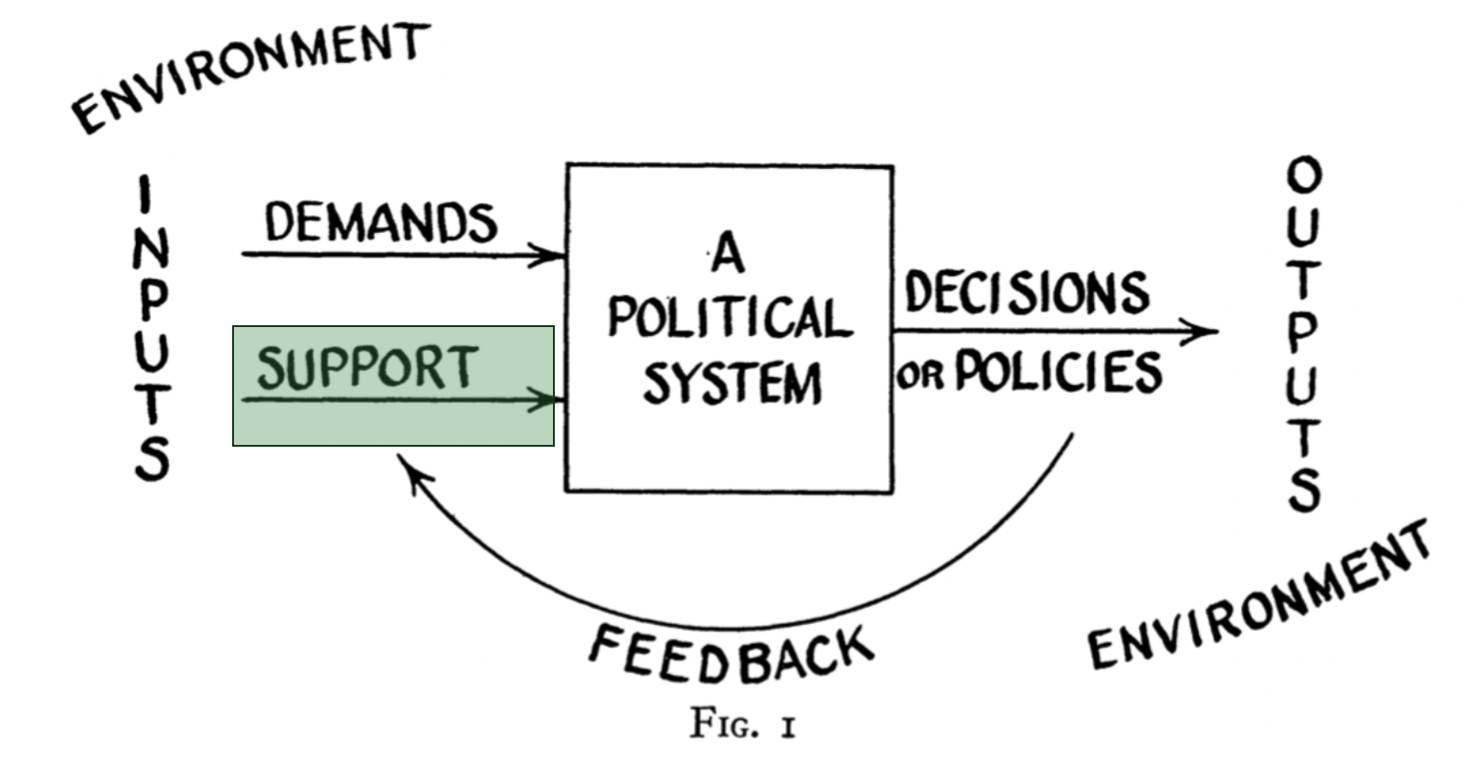
2. democratic consolidation wise 2023/2024
Democracy Consolidation means democracy has become “the only game in town” (Linz & Stepan, 1996)
Government
Regime
Community
Supports
Support is fed through three domains: community, government, and regime
Community = collectivity; Regime = rules of the game; Government = policies
13/22

Slide 17
2. democratic consolidation wise 2023/2024
To maintain democracy the only game in town depends on three dimensions (Linz & Stepan, 1996)
Behavioural dimension = Behavioural elements
No significant political group seriously attempts to overthrow the democratic regime or to promote domestic or international violence in order to secede from the state
Attitudinal dimension = Cultural elements
Even under critical time with severe political and economic crisis, the overwhelming majority of the people believe that any further political change must emerge from within the parameters of democratic procedures
Constitutional dimension = Constitutional elements
All of the actors in the polity become habituated to the fact that political conflict within the state will be resolved according to established norms, and the violation of these norms are likely to be ineffective and costly
The consolidation of democracies refers to “a mature stage when regimes prove resilient even under periods of severe crisis and electoral turbulence” (Norris, 2017)
14/22

Slide 18
3. Democratic backsliding: HOW democracy backslides? wise 2023/2024
Norris (2017) questions whether Western democracies are in danger of backsliding. Do they come to resemble hybrid regimes like Turkey, Thailand, the Philippines, and Venezuela?
Hybrid regimes are characterised by:
weak checks and balances on executive powers
flawed or even suspended elections
fragmented opposition forces
state restrictions on media freedoms, intellectuals, and civil society organizations
curbs on the independence of the judiciary and disregard for rule of law
the abuse of human rights by the security forces; and
tolerance of authoritarian values
Her findings shed light on the contemporary states of Linz and Stepan’s conditions in Western Democracies
15/22

Slide 19
3. Democratic backsliding: HOW democracy backslides? wise 2023/2024
Democratic Backsliding means a deliberate turning away from an ideal form of democracy (Bermeo, 2016)
Forms of backsliding change and vary over time and contexts, but are usually legitimated through democratic institution
“Backsliding can take us to different endpoints at different speeds” (p.6), covering both forms of rapid and radical change to gradual transformation
Although military coups and other violent seizure of power are rare, democracies still die through different means" (Levitsky and Ziblatt, 2018, p.10)
"Backsliding today begins at the ballot box” (p.10) and can be led by electoral officials not generals.
“Backsliding is neither inevitable nor irreversible”, the phenomenon is dynamic - not a one way no return
The process of democratic backsliding is how elected autocrats subtly undermine institutions (imagine in a soccer game)
The subversion of democratic institutions are proceeded through sidelining the referees, rewriting the rules of the game, and tilting the playing field to rule out opponents (Levitsky and Ziblatt, 2018)
A symptom of democratic backsliding is a situation where "leaders with autocratic tendencies are coming to power through democratic elections and attacking norms and institutions from within, typically with support from some portion of the electorate" (Haggard and Kaufman, 2021, p.27)
16/22

Slide 20
3. Democratic backsliding: HOW democracy backslides? wise 2023/2024
According to Bermeo (2016)'s concept, she does not clearly specify how democracy backslides.
She leaves the question of how democracy backslides "a widely open question" by stating that backsliding in her definition can be in a form ranging from rapid change to incremental transformation. However, she emphasised three contemporary forms of backsliding
i) promissory coup; ii) executive aggrandisement; and iii) manipulating elections strategically
According to Levitsky and Ziblatt (2018)'s concept, democracies can die at the ballot box.
The tragic paradox of the electoral route to authoritarianism is that democracy’s assassins use the very institutions of democracy—gradually, subtly, and even legally—to kill it.
According to Waldner and Lust (2018)'s concept, democratic backsliding can potentially occur through "a discontinuous series of incremental actions" (p.95) by making election less competitive, restricting political participation, and weakening accountability mechanism.
According to Haggard and Kaufman (2021)'s concept, a key process of democratic backsliding can be called as "collapse of the separation of powers" (p.36) through assaults on the independence of the judiciary and other institutions serving to limit executive discretion.
17/22

Slide 21
10-minute group discussion
Are European Democracies Backsliding?
If yes or no, please discuss and explain your reasons with empirical examples
18/22

Slide 22
4. evaluating European democracies: are they backsliding? wise 2023/2024
Democratic Consolidation means democracy has become “the only game in town” (Linz & Stepan, 1996)
The consolidation of democracies refers to “a mature stage when regimes prove resilient even under periods of severe crisis and electoral turbulence” (Norris, 2017)
Norris (2017) questions whether Western democracies are in danger of backsliding. Do they come to resemble hybrid regimes like Turkey, Thailand, the Philippines, and Venezuela?
Her findings shed light on the contemporary states of Linz and Stepan’s conditions in Western Democracies by showing that
Norris (2017) did not clearly point out and answer to the question she asked, “Is Western democracy backsliding?” but only identified and showed her findings identifying risks
Instead of answering YES or NO, why did she leave it an open-end question?
19/22

Slide 23
4. evaluating European democracies: are they backsliding? wise 2023/2024
CHALLENGES IN EVALUATING EUROPEAN DEMOCRACIES: ARE THEY BACKSLIDING
Ongoing academic debates on the operationalisation of democratic backsliding
Democratic backsliding is “the term that has not been used consistently and has not been properly operationalised how to measure the phenomenon” (Waldner and Lust, 2018, p.95)
Arbitrary threshold?
Endless debates and criticism on the reliability of cross-national indices on elements related to the quality of democracy produced by Freedom House, V-Dem, and so on
Major concerns is due to their secondary sources based on individual country expert survey
Various typologies developed based on different conceptualization
Democractic Erosion, Democratic Backsliding, Democratic Recession, Autocratisation, etc.
Building on different framework leads to different result?
What is the difference between autocratisation and democratic backsliding?
20/22

Slide 24
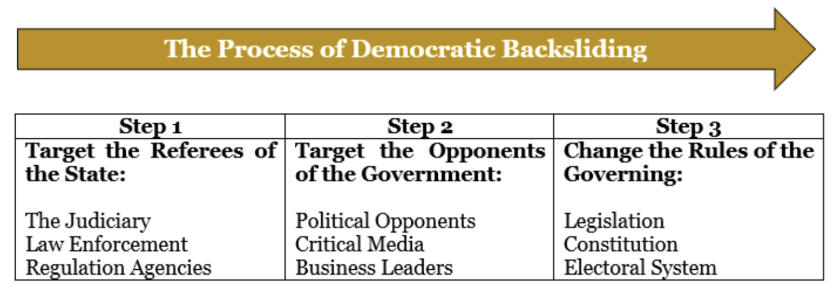
4. evaluating European democracies: are they backsliding? wise 2023/2024
How democracies die published by Levitsky & Ziblatt in 2018
A third wave of autocratization is here: what is new about it? published by Lührmann & Lindberg in 2019
21/22

Slide 25
5. summary wise 2023/2024
This session systemically delved into understanding two democracy-related phenomena: democratic consolidation and backsliding based on two main findings, Norris (2017) and (Linz & Stepan, 1996)
This session provided a systemic understanding of the how to define and understand the two phenomena by revisiting the typology of democracy
This session explored and summarised complexities and difficulties why it is problematic to come up with consensual points with regard to the evaluation of the state of democracy
This session introduced important existing theoretical frameworks that have been used to analyse and explain the phenomenon indicating the recession of democracy
22/22

Slide 26
Thank you for your attention
Email: Thareerat.Laohabut@gsi.uni-muenchen.de
Webpage: https://cps-lmu.org/people.html https://thareeratlaohabut.wordpress.com

