Slide 1
Review of the Swedish position
By the European Commission

Slide 2
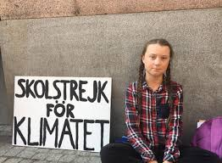
Strengths
Recognition of the need for firm action
Good use of statistics to underpin it
Sweden has already taken a great deal of action
We feel in many ways they can act as an exemplar
Acknowledge obstacles put forward by other countries
Perhaps these contributions can be forwarded into longer term targets

Slide 3
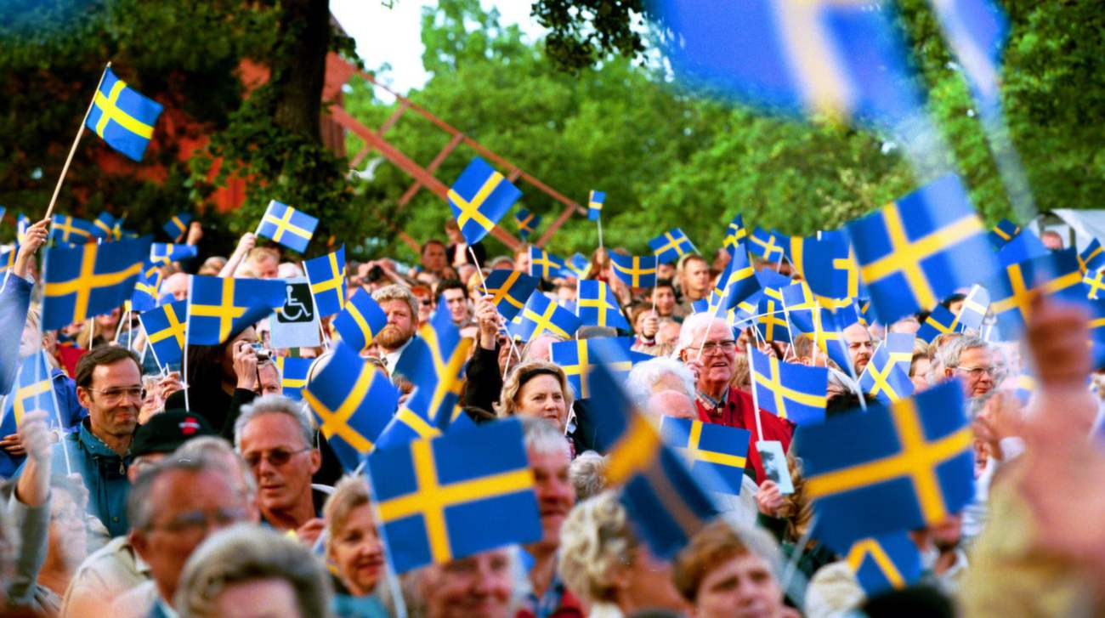
Weaknesses
Proposals are too ambitious
Not applicable to each nation based on circumstance and current disagreement
Need more investment for such speed
Suggest measures that mostly fit Sweden
Early mover advantage
Low willingness to contribute funds to help other countries’ transition
Is Sweden truly committed to collective action?
The EC proposes more funding through JTF and InvestEU in those nations most affected by transition
We need further investment to foster this aim→ Solidarity is Key

Slide 4
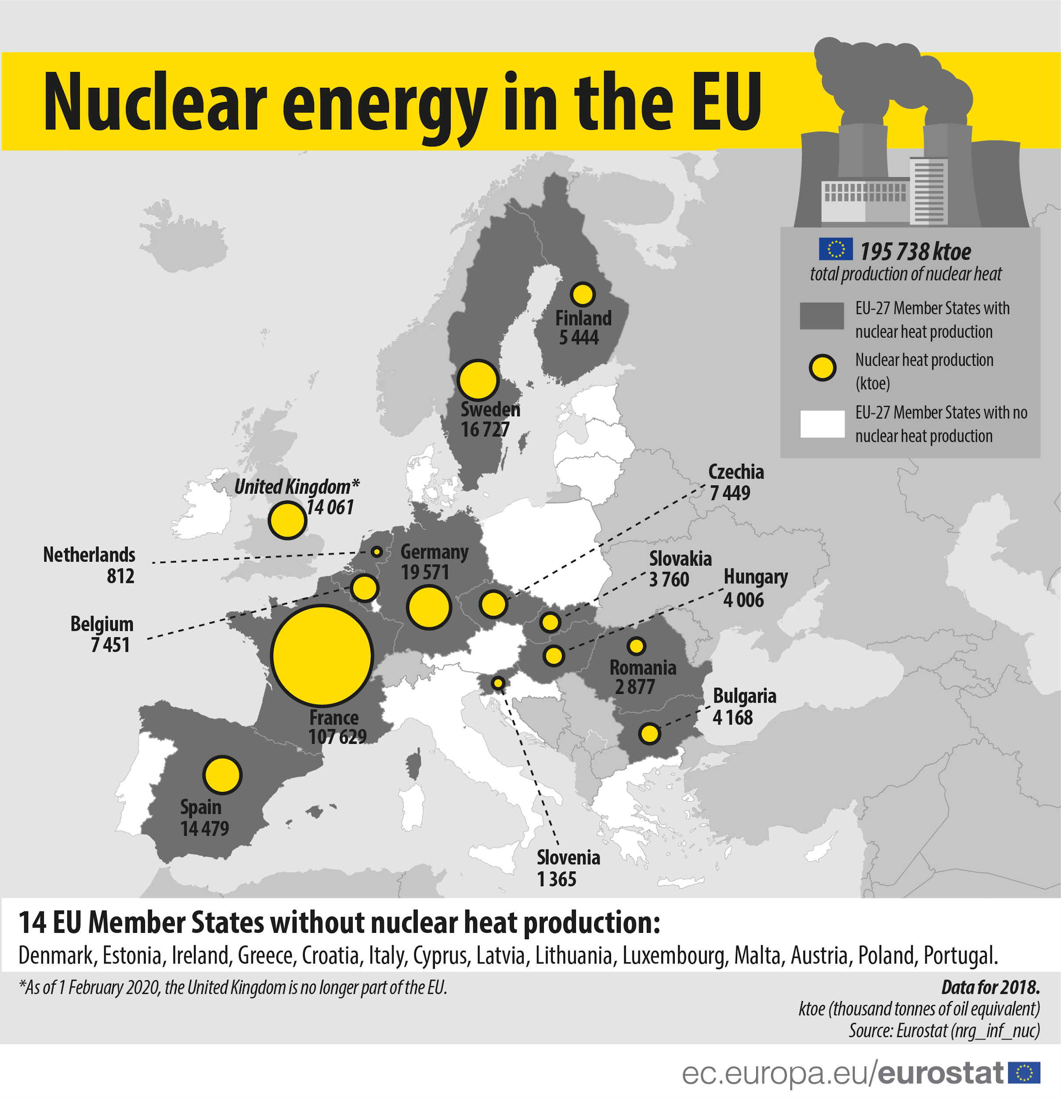
How to Transition?
Sweden fails to identify key factors in its ability to lead clean energy revolution
Low labor effect
Almost all oil and gas (still over ⅕ of energy consumption) is imported through Saudi controlled company Preem
Cheap and not a major source of domestic labor
High reliance on nuclear energy
Over ⅓ of energy supply is nuclear
Should we not aid other countries in attaining this capability?

Slide 5
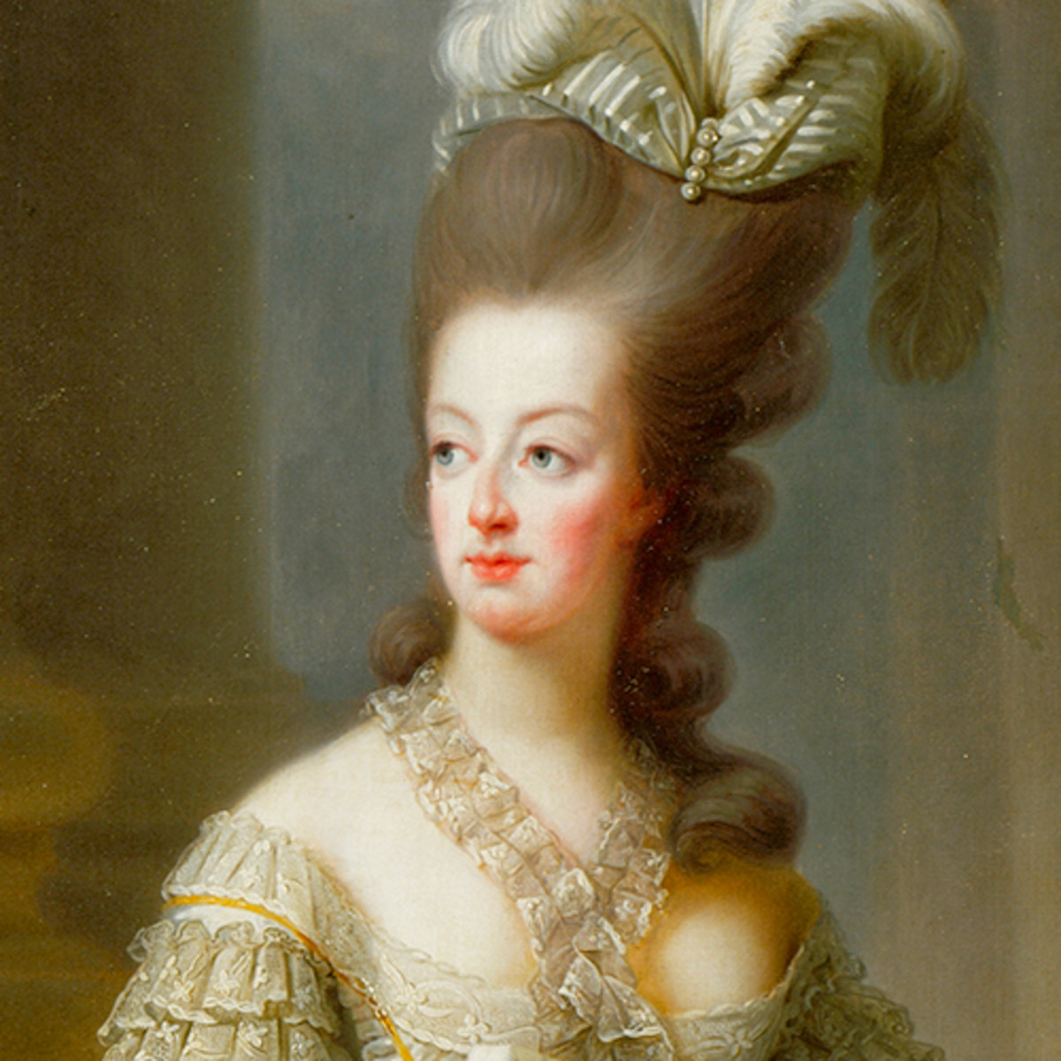
“Let them Eat Cake”
In all, Sweden neglects its co-dependence on other nations
The environment is global, not national
If its position in EU is to be cemented, this is a crucial opportunity to lead. Instead, it looks down upon nations reliant upon these resources at the moment
i.e. Poland, Bulgaria, Czechia,
Focus on budgetary issues shows a severe misalignment of priorities and lack of touch with issues confronting the continent

Slide 6
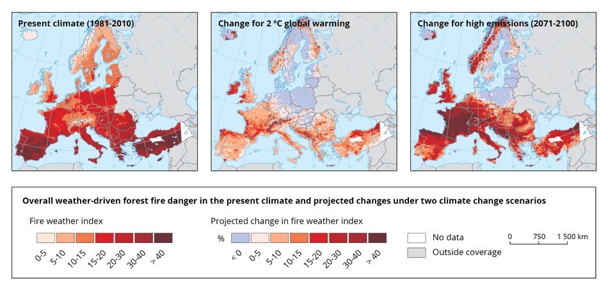
An Appeal to Sweden
One of your citizens has noted, “Our house is on fire.” Is it not an opportune time to pay for an adequate the fire department? What cost is too great?
We all know, proactive measures will be far less costly than reactive
Let’s invest now!

Slide 7
Sources
European Commission (2019). European Union, Trade in good with Saudi Arabia.
Martins, F., Felgueiras, C., & Smitková, M. (2018). Fossil fuel energy consumption in European countries. Energy Procedia, 153, 107-111.
Swedish Ministry of Environment. (2020). Sweden demands that the EU raise the bar ahead of Climate Change Conference in Glasgow.
World Nuclear Association. (2020). Nuclear Power in the European Union.
European Commission (2018) ‘A Clean Planet for all A European strategic long-term vision for a prosperous, modern, competitive and climate neutral economy, COM(2018) 773
European Commission (2018c) ‘A Modern Budget for a Union that Protects, Empowers and Defends The Multiannual Financial Framework for 2021-2027’
Thunberg, G. (2019). Our house is on fire. The Guardian, 20.
European Commission (2018) “Nuclear Energy in the EU”. Eurostat: Nuclear Energy Statistics.
Biography. 2017. Marie Antoinette. [online: www.Biography.com/royalty/Marie-Antoinette]

