Slide 1
Addictions

Slide 2
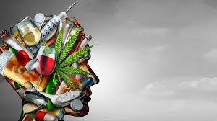
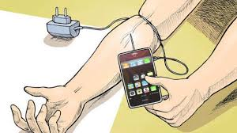
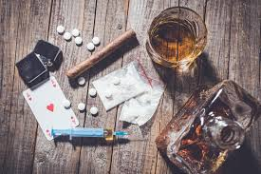

Slide 3
What is addiction?
Addiction is a condition that results when a person ingests a substance (e.g. alcohol, cocaine, nicotine) or engages in an activity (e.g. gambling, sex, shopping, social media etc.) that can be pleasurable but the continued use/act of which becomes compulsive and interferes with ordinary life responsibilities, such as work, relationships or health. Users may not be aware that their behavior is out of control and causing problems for themselves and others.

Slide 4
What is addiction?
The word addiction is used in several different ways. One definition describes physical addiction. This is a biological state in which the body adapts to the presence of a drug so that drug no longer has the same effect, otherwise known as a tolerance. Because of tolerance, the biological reaction of withdrawal occurs the drug is discontinued. Another form of physical addiction is the phenomenon of overreaction by the brain to drugs (or to cues associated with the drugs).

Slide 5
Psychoactive substances
Such substance which changes psychological and on which the addiction can be created
Long history of using and many of different reasons (stimulation, good feeling, experiment, depression, relaxation etc.)
Very different attitude and tolerance in different cultures and regions
International classification – such substances which cause addiction and in the case of their abuse it can lead to a development of mental and behavioral disorders

Slide 6
International classification
Alcohol
Opioids
Canabinoids
Sedatives or hypnotics
Cocain
Stimulants (including coffein)
Hallucinogenic substances
Tobacco
Volative dissolving agents
Other psychoactive substances or using of more substances

Slide 7
What are the signs and symptoms of addiction?
Substance dependence: when a person is addicted to a substance, such as a drug, alcohol etc., they are not able to control the use of that substance. At least one serious attempt was made to give up, but unsuccessfull.
Withdrawal symptoms: when a body levels of that substance go below a certain level the patient has physical and mood-related symptoms. There are cravings, bouts of moodiness, bad temper, poor focus, a feeling of being depressed and empty, frustration, anger, bitterness and resentment.

Slide 8
What are the signs and symptoms of addiction?
Social and recreational sacrifices: some activities are given up because of an addiction to something. For example, a smoker may continue smoking even after a lung or heart condition develops.
Risks: In some cases the addicted individual make take risks to make sure he/she can obtain his/her substance, such as stealing. Under the influence the addict may engage in risky activities such as driving.
Dealing with problems: an addicted person feels that he needs his drug to deal with the problem.

Slide 9
What are the signs and symptoms of addiction?
Denial: a significant number of people who are addicted to a substance are in denial. They are not aware that they have a problem.
Dropping hobbies and activities: as the addiction progresses the individual may stop doing things he used to enjoy a lot.

Slide 10
Risk Factors
Genetics (family history): anybody who has a close relative with an addiction problem has a higher risk of eventually having one themselves.
Gender: a significantly higher percentage of people addicted to a substance are male.
Having a mental illness/condition: people with depression, ADHD and etc have a higher risk of eventually becoming addicted to drugs, alcohol or nicotine.

Slide 11
Risk Factors
Family behavior: young people who do not have a strong attachment to their parents and sibling have a higher risk of becoming addicted .
Stress: if a person’s stress levels are high there is a greater chance to try any substance.
How the body metabolizes the substance: in cases of alcohol for example individuals who need a higher dose to achieve an effect have a higher risk of eventually becoming addicted.

Slide 12
Formation and development of an addiction on alcohol
4 main stages:
Initial, prealcoholic (human realizes that he/she drinks more than others, alcohol brings relief/easement form solving the problems =) a frequency as well as amount is rising)
Prodromal, warning (habit, rising consumption, disrupted control of drinking, sometimes a feeling of a shame, first blackouts, than pangs of conscience, rationalisation of drinking)
Decisive, crucial (rising tolerance to alcohol, increase of conflicts, , missing self-control, frequent blackouts, daily need of alcohol, need of a smae company, change of personality traits, values, decline of other interests, disintegration of interpersonal relationships)
Terminal, final (a tolerance is rapidly going down, de facto non-stop consumption, somatical as well as psychic disorders, deep disruption of a social interaction, a company consists from only addicted, probelms when dringing as well as when not drinking, finally total helplessness and deterioration

Slide 13
Drugs affect on the brain
Drugs are chemicals that tap into the brain’s communication system and disrupt the way nerve cells normally send, receive and process information.
Some drugs like marijuana and heroin have a similar structure to chemical messengers which are naturally produced by the brain (neurotransmitters). These drugs are able to ‘’fool’’ the brain’s receptors and activate nerve cells to send abnormal messages.
Other drugs, such as cocaine or methamphetamine, can cause the nerve cells to release abnormally large amounts of natural neurotransmitters, or prevent the normal recycling of these brain chemicals. This disruption produces a grantly amplified message that ultimately disrupts normal communication patterns.

Slide 14
Drugs affect the brain
Nearly all drugs, directly or indirectly, target the brain’s reward system by flooding the circuit with dopamine. Dopamine is a neurotransmitter present in regions of the brain that control movement, emotion, motivation and feelings of pleasure. The overstimulation of this system produces euphoric effects in response to the drugs.
Long-term drug abuse causes changes in other brain chemical systems and circuits, as well. Brain imaging studies of drug-addicted individuals show changes in areas of the brain that are critical to judgment, decision-making, learning and memory, and behavior control.

Slide 15
Treatment options for addiction
Treatment options for addiction depend on several factors, including what type of substance it is and how it affects the patients.
Treatment programs: these typically focus on getting sober and preventing relapses. Individual, group and family sessions may form part of the program
Psychotherapy: there may be one-to-one or family sessions with a specialist.
Self-help groups: these may help the patient meet other people with the same problem, which often boosts motivation.

Slide 16
Medications
Opioids: Methadone, buprenorphine and for some individuals, naltrexone are effective medications for the treatment of opiate addiction.
Tobacco: a variety of formulations of nicotine replacement therapies now exist, including the patch, spray, gum. Bupropion and varenicline are prescribed medication for treatment.
Alcohol: There are three medications that have been approved for treating alcohol dependence: naltrexone, acamprosate and disulfiram.

Slide 17
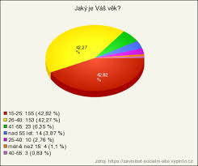
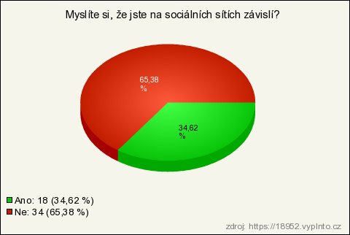
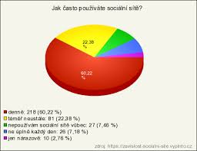
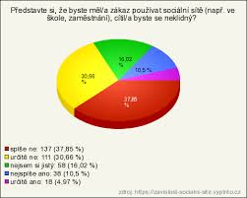
Brief results of an inquiry among Czech people (social media)

Slide 18
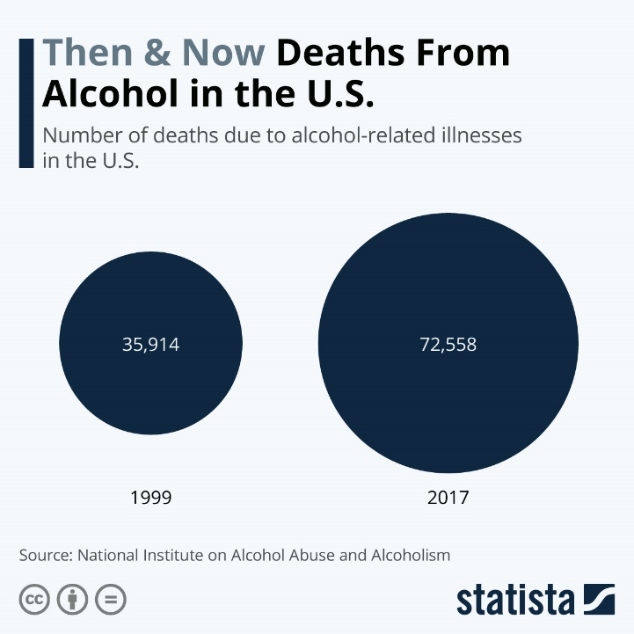
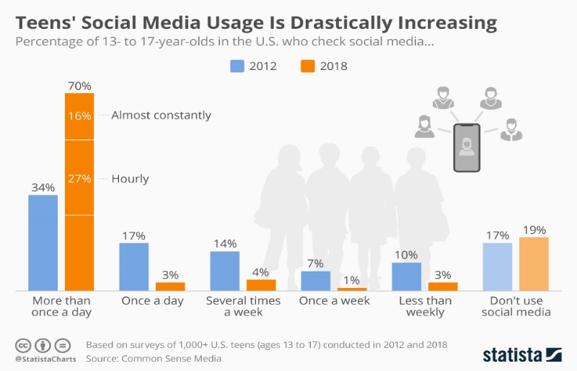

Slide 19
Thank you for your attention!

