Slide 1
International Classification of Functioning, Disability and Health ICF
PhDr. Ivana Vláčilová, Ph.D

Slide 2
Term Rehabilitation Repetition of winter term
This term expresses the regaining of a lost ability
(from Latin RE = repetition of action, habilis = to be capable)
Components of RHB: medical, occupational, social and pedagogical
(Rehabilitation ≠ Physiotherapy)
HISTORY:
The term RHB has been used in the USA since World War 1
(integration of the soldiers back into life)
1918 Soldiers' RHB law (USA),
1920 Citizens' RHB law
CR prof. MUDr. Jedlička - treatment of war invalids, he did not use the term RHB
(the term was spread to Europe after WWII)

Slide 3
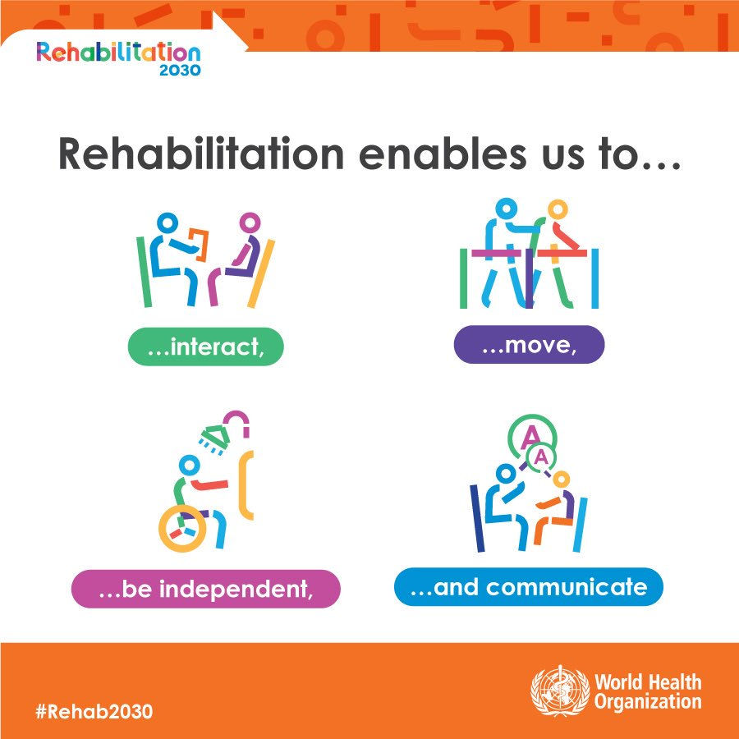
What is rehabilitation?
WHO (1981)
Rehabilitation is defined as “a set of interventions designed to optimize functioning and reduce disability in individuals with health conditions in interaction with their environment”.
Rehabilitation helps a child, adult or older person to be as independent as possible in everyday activities (participation in education, work, recreation and family life).
It does so by improving the way an individual functions in everyday life, supporting them to overcome difficulties with thinking, seeing, hearing, communicating, eating or moving around.

Slide 4
WHO accepts the ICD - Why ICD? To unify the differences between the names of diseases in different countries.
ICD is used globally and provides knowledge of causes and consequences of human disease and death worldwide.
The diseases are coded with the ICD. These codes are the main basis for health records, statistics of diseases as well as for cause of death lists.
These codes support payment in Health Care systems - we have to know the code for payment from health insurance company.
The codes support health services research - the doctors sent these codes to Institusion of healt statistics every year!

Slide 5
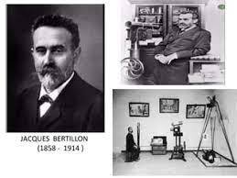
History ICD:
The system was based on the Bertillon Classification of Causes of Death, developed by French demographer Jacques Bertillon.
In 1898 the American Public Health Association recommended that Canada, Mexico, and the United States use that system and that it be revised every decade.
For more than a century, the International Classification of Diseases (ICD) has been the basis for comparable statistics on causes of mortality and morbidity between places and over time.
The latest ICD version – revission ICD11 - came into effect on 1st January 2022.

Slide 6
Classification ICD x ICF
ICD code:
I21. 9 Heart attack
M54.50 Low back pain
M53.0 Cervicocranial syndrome
M53.1 Cervicobrachial syndrome
ICD is based on: etiology – pathology – manifestation
x
ICF is based on: desease – impairment – disabilita – handicap
ICD – is used by doctors in clinical practice, provides a common language for recording, reporting and monitoring diseases.
ICF – is used in medical assessments (doctors, physiotherapy, ergotherapy …)

Slide 7
Reference List for Physiotherapy
Patient + Diagnosis (ICD code)
Healt Insurance Company
Medical procedure code
Name of medical procedure
Medical procedure parameters
Doctor signature
Validity
OR
Doctor write a prescription as a text, where the diagnosis and physiotherapy aim must be writen !!!

Slide 8
The International Classification of Functioning, Disability and Health ICF
ICF is the WHO framework for measuring health and disability at both individual and population levels.
ICF is a classification of health and health-related domains. Function and disability of each person is influenced with environmental factors.
ICF was officially endorsed by all 191 WHO Member States on 22 May 2001 as the international standard to describe and measure health and disability.
ICF is based on the same foundation as ICD and share the same set of codes BUT with more function details.

Slide 9
New terms of modern RHB
Impairment: is an absence of or significant difference in a person’s body structure or function or mental functioning
Disability is any condition of the body or mind (impairment) that makes it more difficult for the person with the condition to do certain activities (activity limitation) and interact with the world around them (participation restrictions).
Handicap is a disadvantage of the disabled person at a social level.

Slide 10
Where can I apply the ICF?
The ICF can be used in various ways across many fields of application:
Clinical tool: evaluating treatment outcomes, communicating with colleagues or the person involved. It provides a common language across clinical disciplines and with patients or clients.
Educational tool: The ICF, as a common language, can assist with integrating perspectives from the child, the family, the school, and service systems.
Statistical tool: management of information system
Research tool: guality of life, enviromental factors
Support services and income support: The ICF can support eligibility assessment, service planning …
Social Policy: The ICF supports clear, conceptual thinking about disability and health related policies at a high level. (Compensation)
Advocacy and Empowerment

Slide 11
Coding rules
The patient profile is coded using codes of functional abilities, disabilities and enviromental factors
Only the information that is important for the specified purpose is coded
Only information related to the health problem is coded
Only directly obtained information is encoded
Functional status in the acute state is coded
Functional status in a stabilized state is coded (max. 1 month retroactively)
In case of uncertain decision between two qualifiers, we prefer the functionally best one
At the basement of known information the coding should be determined at the highest level

Slide 12
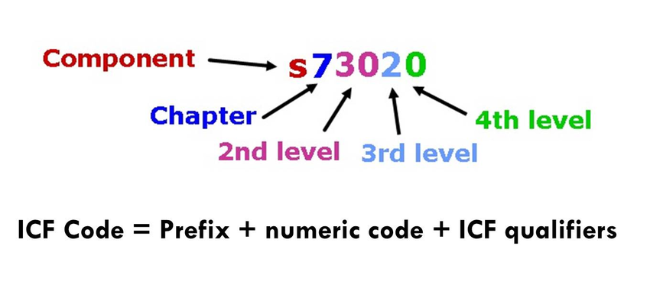
Coding
The healt state could be determined with 4 components:
b - Body Functions
s – body Structures
d - Activities and Participation (at individual and societal levels)
e - Environmental Factors (at a contextual level)
The code is futher accompanied by a qualifier
The qualifier determines the degree of health and its severity
A code is complete only when a qualifier is present, and a minimum of one qualifier must be indicated for each code. Qualifiers are coded as one or more numbers after a decimal point.
Code Qualifier
_XXXX._ _ _

Slide 13
Health-related domains contain:

Slide 14
Qualifiers of Body functions bxxxx._
Range of motion qualifier
None, no problem 0-4%
Mild 5-24%
Moderate 25-49%
Sever 50-95%
Complete 96-100%
Nonspecific
Not applicable

Slide 15
Qualifiers of Body structures sxxxx._ _ _
The First Qualifier - Range of motion qualifier
The second Q - Origin of disorder
The thirt Q - Localisation
No change
Complete lost
Partial lost
Additional part
Disproportion
Continuity failure
Misalignment
Quality changes
Nonspecific
Non applicable
More than one place
Right
Left
Both sides
Frontal
Dorsal
Proximal
Distal
Nonspecific
Non applicable

Slide 16
Qualifiers of Activities and Participation dxxxx._ _
Two Qualifier the same evaluation
Performance difficulties, dependent on the enviroment
Capacity difficulties, independent on the enviroment

Slide 17
Qualifiers of Enviromental factors
Two Qualifier the same evaluation
exxxx._ (barier .)
exxxx+_ (facilitation +)

Slide 18
World Physiotherapy adopted a motion supporting the implementation of the ICF in physiotherapy in 2003.
Physiotherapy respect a ICF model (bio-psycho-social model)
Physiotherapy includes evaluation of pain and disability sources (McKenzie)
More aplications are used in Occupational therapy (Ergotherapy)

Slide 19
Biopsychosocial model according ICF
Our health is affected by 5 factors
The Model Consists of 5 components:
Body Functions and Structures
Activities
Participation
Enviroment factors
Personal factors

Slide 20
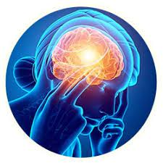
ICF implementation to treatments methods
McKenzie - How to set up right therapy?
- The sources of pain and disability are determined during the assesment
- Biopsychosocial model
Source of PAIN
Nociception
Neuropatic pain Nociplastic pain
Source of Disability
Cognition
Emocional
Comorbidities
Contextual

Slide 21
Disability and Pain Sources according Mc Kenzie
ICF functional abilities are analyzed with the HOLISTIC perspective
- The biological processes (nociception, neuropatic or neuroplastic pain) influences our musculosceletal system and our mind too.
- The Comorbidities limit the healing process !
Pain description depends on the deficit, disfunction and bony structure disorder:
- nociception: actual tissue demage NOT nerve structure, the nociceptors are activated with mechanical, chemical or thermical inputs (stimulies). We can not indentify the pathology or the structure that couses the pain, the nociception appears in inflammation, healing from trauma or after the operation.
- neuropatic pain: arises from peripheral nerve system, (stenosis, lumbar radiculopathy, the pain iradiates into lower extremities plus there are sensitivity changes)

Slide 22
The pain sources complete to each other !
Neuroplastic pain: is given by CNS changes resulting in an amplification of pheripheral input. This pain arises from an altered nociception (there is not acute tissue demage) or from a somatosenzoric system demage/illness. Chronic pain syndrome, hyperalgezia, algodynia.
Nociception
Neuropatic pain
Neuroplastic pain

Slide 23
Pain and Disability Sources
to be divided in factors:
Enviromental Factors – contextual – individual relationships, job enviroment, job attitudes, culture
Personal factors – cognitional – how is the pain and disability individually perceived, pain conviction, individual expectation, catastrophizing, fear and low self-confidence, – in case of misperception the specialist should be in therapy included
- emocional factors – the anger, anxiety, depression affects the pain, the pain goes together with the emotion, the negative emotion has a worse prognosis, that is why we should cooperate with the specialist
- comorbidities – physical and mental (diabetes, migraines, sleep and anxiety disorders, the more comorbidities the worse therapy results

Slide 24
Literature / video
Video: ICF Module 1-5
https://www.physio-pedia.com/International_Classification_of_Functioning,_Disability_and_Health_(ICF)
Literature:
WHO Standards and Classifications ICF, ICD
https://www.who.int/standards/classifications/international-classification-of-functioning-disability-and-health
ICF Owerview
https://www.cdc.gov/nchs/data/icd/icfoverview_finalforwho10sept.pdf
McKenzie manual A Lumbar Spine
https://mckenzieinstitute.org/

