Slide 1
The Shaping of the Puritan Self: Anne Bradstreet and Others
Calvinist Doctrine and Puritan Mind
Calvinism: a major branch of Protestantism following the doctrine of John Calvin (Jehan Cauvin, 1509-64), a French religious reformer who lived in Geneva. Calvinism became a basis of the theological doctrines and religious communities of English, Scottish and American Puritans.
Predestination: Following the Epistles of St Paul in the New Testament and St Augustine, Calvinism taught that all events have been predestined in the Divine Mind, and God knows everything that will happen in future. The Puritans believed that some individuals are predestined for salvation and others for damnation.
God‘s Grace and Will were able to change the predestination. If a repentant sinner deserved God‘s grace, he could be saved; but Divine Will could also change the predestination to salvation to that to damnation. Divine Will was believed to be an absolute power which humans could not influence.
Anxiety and Introspection: The doctrines of Predestination and Divine Will made people extremely anxious about their uncertain future. The Puritans were told to introspect their minds and look for the signs of God‘s favour or disfavour. These signs would indicate what their future fate may be.
Regeneration: To reaffirm their faith and alleviate their anxieties, the believers were encouraged to embark on the process of spiritual regeneration which had two phases: justification of the sinner before God and the congregation, and the spiritual revival called vivification, after which the individual could even become a saint. The decision whether the sinner was regenerated was made by the Council of a Puritan congregation (called the Church) composed of the Church Elders.
Michael Wigglesworth‘s The Day
of Doom (1662) was the bestselling
book in the Puritan colonies.

Slide 2
Anne Bradstreet (1612-72): the First Poetess of the Colonial Era
Life
Bradstreet came to America in 1630, when she was 18, with John Winthrop‘s expedition, which founded the Massachusetts Bay colony (today‘s Greater Boston area). The expedition was financed by the Earl of Lincoln, who supported the Puritans. Bradstreet‘s father, Thomas Dudley, was a steward of the Earl of Lincoln; her husband Simon, whom she married at the age of 16, was a colonial businessman, magistrate, diplomat, and the last governor of the Massachusetts Bay colony (before it was integrated into the colony of Massachusetts).
Anne Bradstreet‘s health was infirm, she had suffered of smallpox, rheumatic fever, later of paralysis and tuberculosis (of which she died). In spite of this, she had to bear and raise eight children between 1633 (when she was 21) and 1652 (40). Her husband was mostly away from home on business and she had to take care of the whole house. Because of famine and illnesses the family had to move six times; the relocation from Ipswich to Andover in 1643 was the worst one, since Bradstreet was in an advanced stage of pregnancy.
Though she had been very religious and given to introspection since her early childhood, she could not easily get used to the “new manners” of the Puritan community and to the different conditions of life. In her own words, her “heart rose,” when she had to join “the church”(Puritan congregation) in Boston. Unfortunately, she had no other choice than to accept Puritan habits and discipline, and she became an exemplary wife and mother.
An imaginary portrait (1897). No portrait
of Anne Bradstreet has been preserved.

Slide 3
Anne Bradstreet‘s Poetry: an Introduction
Bradstreet‘s major work is a collection of poems The Tenth Muse Lately Sprung up in America (1650) published for the first time anonymously (the author is called “a Gentlewoman”) by her brother-in-law, John Woodbridge. He introduces the author as “a Woman, honored and esteemed where she lives” and adds that her poetry is not a product of leisure but had been written along with her household work: “these poems are the fruit but of some few hours, curtailed from sleep and other refreshments.”
Bradstreet presents herself as an educated poet influenced by the French Hugenot (Calvinist) poet Guillaume Salluste du Bartas (1544-90), whose epic poems La Semaine, ou Creation du monde (1578, The Week or the Creation of the World) and La Seconde Semaine (1584-1603, The Second Week) she was reading since her youth. She also praises the English Renaissance poet, Sir Philip Sidney (1554-86).
Although she is self-critical, attributing the faults of her writing to the imperfection of women and their social position, she also criticizes contemporary readers for their denigration of women authors and uses the example of Ancient Greeks, who celebrated women poets, such as Sappho. In her criticism she appeals to the royal authority of Queen Elizabeth I (a poem “In Honor of that High and Mighty Princess Queen Elizabeth of Happy Memory”), whom she praises for her leadership qualities: “She has wip'd off th' aspersion of her Sex,/ That women wisdome lack to play the Rex.”

Slide 4
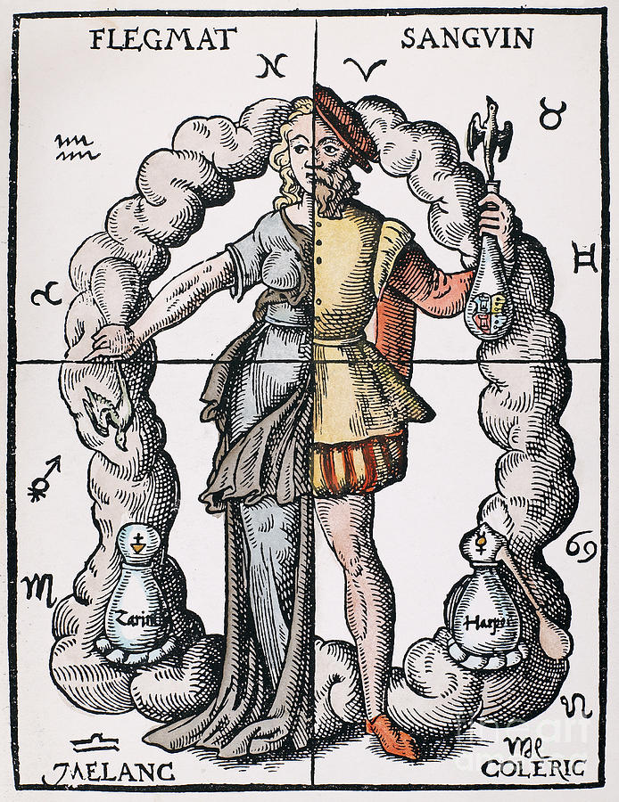
The Tenth Muse: Education and Experience
The Tenth Muse… is a carefully composed book of poetry which displays Bradstreet‘s extraordinary learning. It is constructed on the cyclical model of the Renaissance macrocosm and microcosm based om four groups, each including four components.
The first section includes four long poems (called Quaternions) dealing with "The Four Elements" (water, fire, earth, air), "The Four Humours of Man“ (blood, bile, phlegm, black bile) “The Four Ages of Man” (childhood, youth, mature age, old age) and "The Four Seasons." All those poems demonstrate Bradstreet‘s learning in anatomy, physiology, medieval and Renaissance cosmology. Although she draws from the works of diverse scholars, her poems are more dramatic than contemporary didactic poetry. They are based on personal experience of hard life of the settlers full of diseases and death, which Bradstreet also sees in the life of her children.
What gripes of wind my infancy did pain, What tortures I in breeding teeth sustain? What crudities my stomach cold has bred, Whence vomits, flux, and worms have issued?
The second part of the book deals with the cycles of universal history. The epic poem "The Four Monarchies" (Assyrian, Persian, Grecian, and Roman) describes the rise and dissolution of empires and is inspired by Walter Raleigh's History of the World (1614). The destruction of the empires is seen as the outcome of predestination, God‘s plan of world history.
The third part of the book is an elegy on the fate of England during the Civil War (1642-60), which at that time has reached its peak. While Bradstreet as a Puritan defends the rebels‘ cause, she bewails the destruction of the country, lending her own voice to it:
O pity me in this sad perturbation, My plundered Towers, my houses devastation, My weeping Virgins and my young men slain; My wealthy trading fall'n, my dearth of grain
The Four Elements (above); The Four Humours (below)

Slide 5
The Tenth Muse: Woman‘s Life – Patriarchy and Sin
1. Patriarchy: Submission and Self-debasement:
Cosmic Hierarchy Reflected in Marriage: “Letter to Her Husband”
Compares herself to the Earth mourning when the Sun does not heat her Tropic of Cancer, and reviving with the return of her Sun-husband. The unity of a husband and a wife is sacred: established by God’s creation.
Bad Investment: “To Her Father with Some Verses”
Bradstreet compares her own life to a mismanaged fortune (she expressly mentions capital—or “principal” as it was called these days). Her way of life brought to her father nothing but losses. She made a debt she will not be able to repay. With respect both to the spiritual and to the financial world of the Puritans, the self of Bradstreet’s poems is marked by tragic insufficiency.
2. Original Sin and Predestination
Beauty of Nature and Human Sin: “Contemplations”
To celebrate God‘s greatness, as it appears in nature and its autumnal beauties, is impossible, since Bradstreet is weak in her own body and soul. Human history is a tale of corruption (of Adam’s sin and Cain’s murder of Abel) and of decay without hope of renewal by natural power and energy. Moreover, humans do not realize the value of salvation through Christ.

Slide 6
The Tenth Muse: Bradstreet as a Mother and Author
1. Mother‘s Anxieties
“Before the Birth of One of Her Children”
Mother’s love for her child is threatened by the imminent danger of death during childbirth. The natural bond between mother and child is broken at
the moment of birth: “I may seem thine, who in effect am none”. The further fate of the child is decided only by its father. The dead mother may be replaced by a stepmother and children may forget her.
“In Memory of My Dear Grandchild Elizabeth”
God‘s Will works against nature and is even responsible for the death of newly born babies (metaphors of new plants, buds).
“But plants new set to be eradicate, /And buds new blown to have so short a date, /Is by His hand that guides nature and fate.”
2. Authoring as Mothering “The Author to Her Book”
The poem, written for the second edition of The Tenth Muse…, published posthumously in 1678, compares her book to a deformed and stolen fatherless child who can bring her only shame and will never be reformed. Apart from self-debasement (see the previous slide), the poem undermines traditional notions of authorship, based on the metaphor of fathering.
3. Bradstreet‘s Prose Meditations Divine and Moral (1664)
Didactic, based on Puritan theology. Explaining introspection and the interpretation of all events in life as signs of Divine Will. This cannot be achieved by our imperfect senses, only by contemplating Divine perfection.
A comics published after a gate at Harvard
University had been dedicated to
Anne Bradstreet in 1997

Slide 7
Other 17th Century Puritan Writers
Edward Taylor (c. 1642-1729)
After late studies at Harvard (enrolled at 29) he became a minister (priest) in Westfield, MA, which was a frontier town at that time. He was a conservative, defending Puritan theocracy (the government influenced by the representatives of the church). His Preparatory Meditations were never published in his lifetime (the manuscript was discovered in the 1930s). Most poems were written during his preparations for Sunday sermons (Puritan sermons were very long and often read monotonously). In contrast to the dullness of his sermons the poems display bold imagination and powerful as well as playful Baroque figurative language, which creates “reversible” metaphors pointing to high and low things at the same time:
In “Meditation 8” about the Holy Communion, the whole universe is transformed into a kneading bowl, in which the precious spiritual bread (symbolic of Christ’s transfigured body), is made of the “streams of grace” running out of God’s bowels. The poem boldly combines spiritual and scatological (obscene) meanings - bowels as a seat of compassion, but also as a place where excrement is formed.
Cotton Mather (1663-1728)
The corresponding member of the Royal Society (one of the first scientific bodies) became famous for his participation in the Puritan witch trials, which he defended in his treatise Wonders of the Invisible World (1693) as a necessary fight against the snares of the Devil, who had decided to mar the spiritual rebirth of Christianity in the New World. This rebirth, he argued in his “ecclesiastical history of New England,” Magnalia Christi Americana (1702), was accomplished by the work of Christ through many of Puritan “saints” - leaders like William Bradford and John Winthrop. In contrast to the poetry of Anne Bradstreet, in the works of Taylor and Cotton Mather, Puritan spirituality often becomes hysterical, prompted by the anxiety of demonic forces working from inside Puritan churches. This explains the violent treatment of the people (both women and men) accused of witchcraft.
A Narrative of the Captivity and Restoration of Mrs. Mary Rowlandson (1682)
One of many accounts about the captivity of the colonists by Native Americans during the so-called King Philip Wars. Includes a moving description of the death of the writer‘s baby in Indian captivity and the mother‘s search for consolation in the Bible.

