Slide 1
Phenomenology

Slide 2
What is phenomenology?
Qualitative method reflecting on pre-reflective human experience
Social phenomenology – human awareness in social action, situations and worlds
Methods: meanings shaped by consciousness, language, our cognitive and noncognitive sensibilities, and our personal, social, and cultural preunderstandings.
Subjective understandings of individual practitioners

Slide 3
Foundations
Edmund Husserl early 1900s – sources of reality in social consciousness
Alfred Schutz 1960s – subjective meanings give rise to objective social worlds
Language and ‘stock of knowledge’ enable social interaction
Explain reciprocal interactions which take place during human action, situational structuring and reality construction

Slide 4
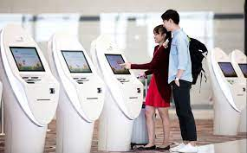
In everyday life
“The reality of everyday life is taken-for-granted as reality. It does not require additional verification over and beyond its simple presence. It is simply there, as self-evident and compelling facticity. I know that it is real. While I am capable of engaging in doubts about its reality, I am obliged to suspend such doubt as I routinely exist in everyday life.” – Berger and Luckman (1966)
Performance of self as automatic and semiconscious
Agnes Heller – impossible to be critically self-reflective of all aspects of life
Depend on routine and habit but leads to complacency
Habit as enemy of an authentic life

Slide 5
Alfred Schutz
The Meaningful Constitution of the Social World (1932)
Intersubjectivity of individuals
‘Lifeworld’ Edmund Husserl
Common-sense perception before it is subjected to theoretical analysis/typifications
The Stranger – not at home
Critique Parsons for neglecting social theory in the subjective point of view

Slide 6
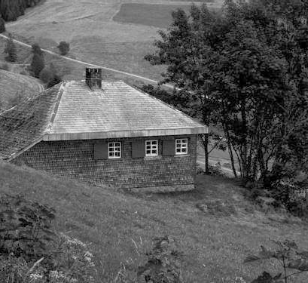
Phenomenology of Architecture
Emphasis on human experience, background, intention and historical reflection, interpretation and poetic and ethical considerations
Martin Heidegger- Building, Dwelling, Thinking
Relation between buildings and dwelling –negative severance
Dwelling as an extension of identity
Modern confusion

Slide 7
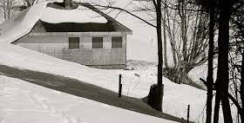
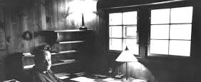
Heidegger cont.
"the basic character of dwelling is to spare, to preserve… dwelling itself is always a staying with things. Dwelling, as preserving, keeps the fourfold in that with which mortals stay: in things"
Fourfold: Earth (supporting and nurturing ground), Sky (human gaze and spiritual eternity), Mortals (people as finite) and Divinities (God as anonymous creator)
Sense of space
Space (created) differs from place

Slide 8
Berger and Kellner -Marriage
Marriage = two lifeworlds in communication
New social reality through private conversation
Strengthened through couples external interactions
Dramatic act –internally anticipated and socially legitimated
Divorce – no tolerance for less than completely successful marital arrangements

Slide 9
Questions – Heideggar’s Hut
What are the phenomenological practices adopted by the authors in this article and what information does that reveal about Heideggar?
How does Heideggar’s hut reflect the relationship between building and dwelling?

Slide 10
Questions – Berger and Kellner
How does an individual’s perception of the world become validated and why is this important?
Do the concepts outlined in the article still apply to modern marriages/relationships ?

