Slide 1
Theory Construction
3. Creative theorising II
The case of depression
Working seminar

Slide 2
Starting point: everyday observation, news paper articles
Antidepressants among best sold pharmaceutical drugs world-wide (NYT, 2009): 3 out of 7 best sold drugs worldwide are antidepressants (Prozac, Paxil and Zoloft)
For instance, Belgium, 2008: 13% of the adult population received at least one doctor prescription for antidepressants
Notes:
Explain: is about “depression”…
Just trying to generate ideas and theories, to apply these heuristics to this phenomenon, try to think about depression differently…

Slide 3
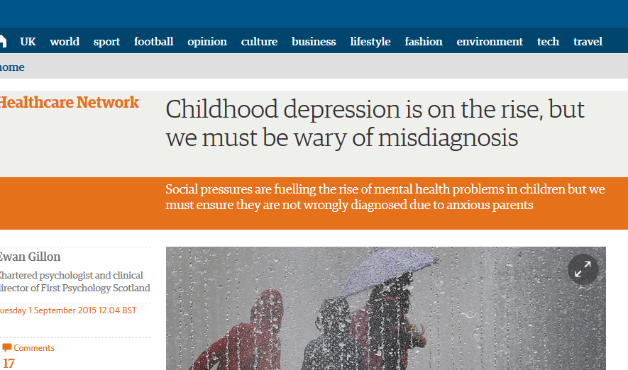
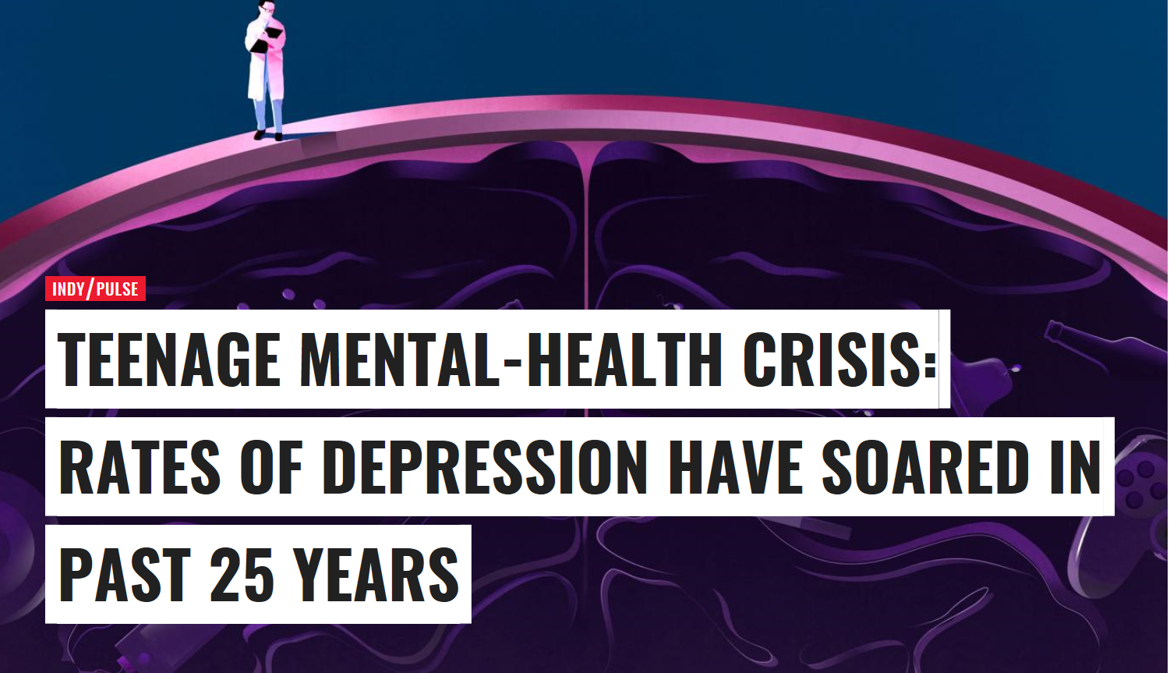
Why is depression increasingly prevalent?
Why these categories?
What is social about it?
What are its (social) causes and effects?
Notes:
Why social fact? Is relevant to a lot of people. Has social consequences (e.g. social networks, social professions,…). And it probably has structural social causes…

Slide 4
Causes?
‘Cancer patients with depression 'are being overlooked' (BBC, 28/08/2014)
Three-quarters of cancer patients who are clinically depressed do not get the psychological therapy they need, according to research in the Lancet.
This "huge unmet need" is partly due to a focus on physical symptoms at the expense of good mental healthcare, researchers say.
They argue depression is often overlooked but could be treated at a fraction of the cost of cancer drugs
One in three suicide attempts among men "work-related"
"When will company managers finally adopt a more human attitude?" (Standard, 19/10/2013) |
Yes, there is a connection between the closure of companies and the rise in suicide attempts. This is not only said by professor Kees van Heeringen, but also by trade unionists who experienced a clean-up or closure - at Sabena or Ford - or people who followed a professional group in crisis

Slide 5
Treatments?
Physical activity
Prevent depression? Come off that bank!
Scientias.nl (3/10/17)
"We have known for a while that exercise can play a role in treating symptoms of depression," says researcher Samuel Harvey. But now it appears that exercise can also prevent people from becoming depressed. And researchers have even succeeded in making it very specific how often you have to move to benefit from the anti-depression effect of exercise. "The results are exciting because they show that relatively little exercise - one hour a week - can already offer significant protection against depression."
Pills or therapy?
(Standaard, 26/09/2013)
What helps best against depression: medication or psychotherapy? "The most important question is: what does the patient want," says Koen Demyttenaere, professor of psychology at KU Leuven. "If you ask them, more than half say they want psychotherapy. So rather talk than pills. A study was conducted in which patients were allowed to indicate their preference. They got what they wanted. Another group of patients just did not get what they wanted. It was clear that those who get what they want achieved much better results than those who did not get what they wanted. "

Slide 6
Effects?
WEBmd (17/08/17)
Untreated clinical depression is a serious problem. Untreated depression increases the chance of risky behaviors such as drug or alcohol addiction. It also can ruin relationships, cause problems at work, and make it difficult to overcome serious illnesses.
Clinical depression, also known as major depression, is an illness that involves the body, mood, and thoughts. Clinical depression affects the way you eat and sleep. It affects the way you feel about yourself and those around you. It even affects your thoughts.
A.o. increases risk of heart diseases, insomnia, weight gain/loss, alcohol and drug abuse, headaches, chronic pain, digestive problems, suicide,…
Depression risk 'starts in the womb‘ (BBC, 13/10/2013)
Depression in pregnancy can have long-lasting effects
Children whose mothers are depressed during pregnancy have a small increased risk of depression in adulthood, according to a UK study.
The study followed the offspring of more than 8,000 mothers who had postnatal or antenatal depression.
The risk is around 1.3 times higher than normal at age 18, it found

Slide 7
Creative heuristics
Observe: assemble information!
Associations (theorise wildly!)
Who? What? When ? Where? How?
Why? What are the causes?
What are the consequences?
Facts?
Notes:
Starting from here we will do creative heuristics
In and out of your comfortzone, Use a metaphor/analogy, Problematising the obvious, Reversing theories or concepts, Describe your phenomenon differently, Static and dynamic, Study the literature, Reframe your phenomenon (Fame by case, Framing by Aspect)
And each of these requires a different way of thinking, a different way of approaching your topic (focussing on political movements, focussing on an everyday culture and sense-making, focussing on relative deprivation…)

Slide 8
1. Observe
Get in and out of your comfort zone!
Try to assemble knowledge/interpretations of related social participants: family members, friends, doctors, experts, health insurance officials, spokesmen of pharmaceutical companies, etc.
Is ‘role playing’ possible in this case? ‘What would I do if I would be depressed?’ Or if a friend would become depressed?
What social implications would that have? How would I behave? What would cause me to be depressed?
What is “depression”, from a social point of view?

Slide 9
2. Problematise the obvious (what is depression, really?)
Have there been changes in the definition and interpretation of depression?
E.g. 15th and 16th century: melancholy was seen as something good: related to a good relation with God, being creative, being contemplative and wise…
It is only in last 20 years that the label of “depression” has become so dominant
In other words, what counts as “depression” is socially constructed, and thus differs across time and space
When and why would a common feeling of sadness transform into a widespread diagnosis of “depression”?
What kind of “social work” does a diagnosis of depression require?
E.g. which professions, medications, interactions, social categories do you need?

Slide 10
2. Problematise the obvious (what is depression, really?)
What is actually common to all those phenomena that are grouped together under the label “depressed”? (Lumping/splitting)
Depression provides a clearcut label for a range of diffuse negative feelings, with subtle differences (sadness, loneliness, loss, mourning, melancholic, emptiness, pessimism, fatalism,…).
So when you experience negative feelings, “depression” has become a socially accepted way of disscussing all these negative feelings at once. It clarifies a diffuse set of feelings for everyone (“this is what you feel”)
In other words, a lot of “social work” is needed to create the diagnosis of depression
Notes:
Canon: study the sociological reality of the phenomenon, study the phenomenon in a sociological way.

Slide 11
2. Problematise the obvious (what is depression, really?)
Is depression something individual, or is it something collective?
E.g. Wolfgang Lepenies, Melancholy and society:
Describes melancholy as a collective characteristic of the German bourgeoisie in the 19th century: a great political will and collective self-conssciousness, but little power… This collective attitude feeds into idealism and a strong nationalism…

Slide 12
3. Changing context (foreground/background) or levels of analysis
Level of analysis: individual odds to become depressed are co-determined by:
Your position within the social network or group (e.g. peripheral position within in social networks)
the level of hierarchy of organization by which one is employed
The country you live in…
In other words: depression is ‘socially produced’.

Slide 13
3. Changing context (foreground/background) or levels of analysis
Level of analysis:
Depression is usually thought of as an individual, psychological problem It is diagnosed by a doctor or a psychiatrist And the solution is usually sought in individual therapy and/or antidepressants
Yet what if the causes (and the solutions) are not psychological (your own environment), but societal?
E.g. individualisation, weak social networks, flexible labour market,…

Slide 14
4. Reversing theories or concepts
Maybe depression does not lead to social isolation, the breaking up of relations, and exclusion from social networks: maybe it is the other way around?
Maybe anti-depressants are not meant to cure diseases but to continue them?
E.g. medical research on addictive nature of antidepressants
Notes:
Trying to stop increases your risks of becoming depressed again, and as the case when you relapse into an addiction, it becomes more intensive after you have tried to stop but failed. So the depression actually gets worse… It started as additive, in which there is a growth of knowledge, then it became accumulative of knowledge

Slide 15
4. Latent or inherent functions?
Supplying patients to psychiaters
Creating a market for antidepressives…
Legitimate form of work absenteeism
Collective response to deregulated, flexible labour market and stress on ‘individual performance’ (demand for re-regulation)?
Collective response to a sense of lacking individual agency?

Slide 16
5. Using a metaphor or making an analogy
Economic depression: can we learn something about the evolution of ‘psychic depression’s from the existing knowledge about the evolution of ‘economic depressions
E.g. cyclical nature
Social life as a theatrical performance:
E.g. depression might be a sign that an actor is no longer satisfied with his ‘role’. Searching for a new ‘personage’, a new set of roles which is better adapted to how one conceives oneself ?
E.g. diagnosis of depression leads to role expectations that may lead their own life?
Notes:
Cyclical nature: needs to be deepened, to reach a bottom point. Some economic theories argue that when an economic depression reaches certain depth → makes unemployed willing to work for lower wages → which gets the economy growing again.
What if you apply that to depression? A temporary withdrawal from society/emotions to adjust to your environment?
Social behaviour: if you’re depressed → people expect you to behave in certain ways. E.g. what do you do when you feel excited at one point? Can you express itwhen you’re home from work? In turn, as soon as you have the label/diagnosis of depression, it affects how you think about yourself, how you feel, and how you should act… (oh, this type of behaviour is normal now…)

Slide 17
6. Reframing your phenomenon: a reminder Framing by case
When researchers use concepts to classify the phenomena they study. That is, they describe it as part of a broader category of social phenomena.
E.g. by describing interaction in a doctor’s waiting room as ‘accomplished non-interaction’ the researcher answers the question ‘What is this a case of?’
Researchers thus claim that the people or events they are studying (e.g. patients waiting for a doctor) are an instance, or ‘case’ of something wider and more important (accomplished non-interaction)
Notes:
The case of the depression as a result of social stress the increase in the amount of adult Flemish people had depression

Slide 18
6.A. Framing by case
What is this a case of? What is depression, from a sociological point of view?
Socially determined diseases, just like cancer, heart- and circulatory diseases, back pain, etc. Your chances of getting these diseases raises depending on your labour conditions, welfare states, income, educational level,…
Consequences of social exclusion: social isolation, loneliness,…
Biomedicalisation: creating or remaking disorders and diseases through technoscientific means: ADHD, Autism, Cancer, etc

Slide 19
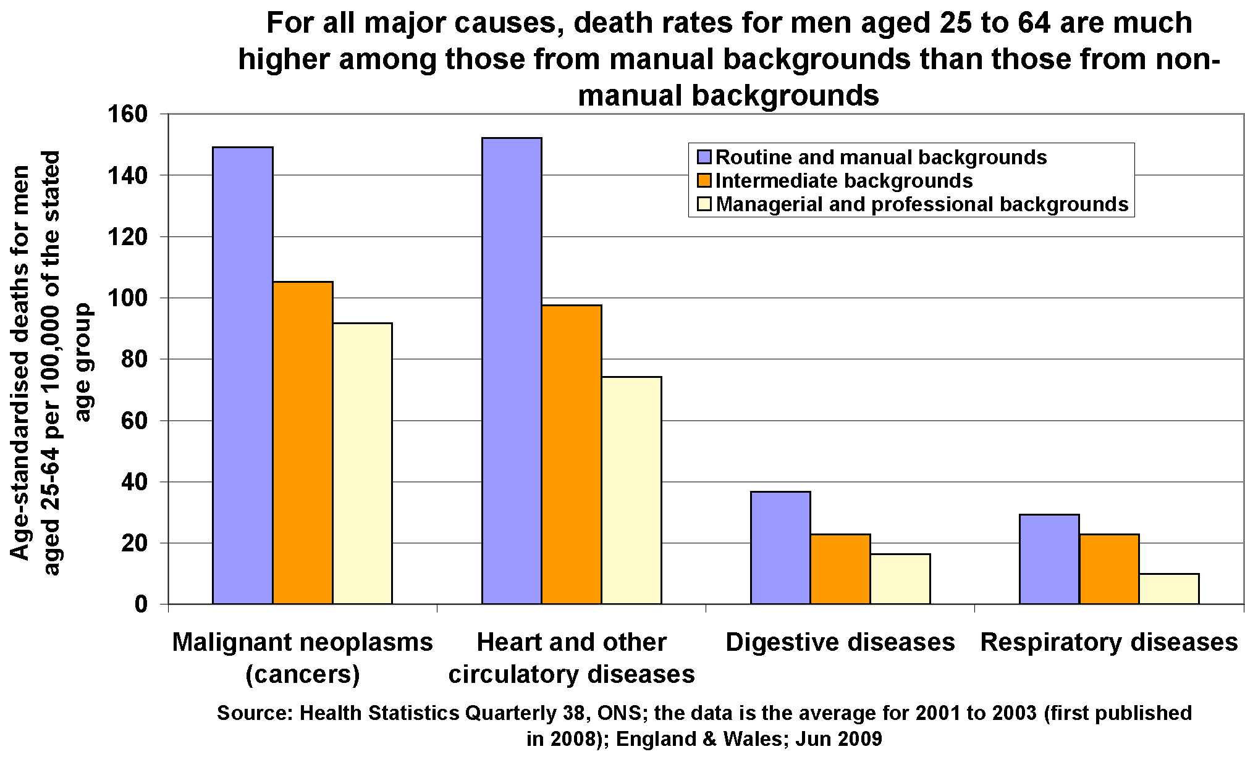
e.g. Social determinants of health

Slide 20
Reframing your phenomenon: reminder Framing by Aspect
Once the ‘broader category’ is defined, you can specify the key features or aspects that differentiate the cases in this broad category.
In this way one indicates how cases vary within a category
E.g. how do people accomplish non-interaction in similar social settings (train, buses, swimming pools, etc.)? Which verbal or non-verbal cues are being used to communicate ‘non-involvement’? What features of settings influence which cues are being used and how they are used?
It helps you see what is present and absent in a given case

Slide 21
6.B. Framing by aspect
E.g.: if you frame depression as a socially-determined disease…
You can compare depression with other such diseases (e.g. lung cancer)
In which disease is the influence of class and education the strongest?
In which disease is the influence of ethnic background, religion, gender, labour conditions, unemployment, social networks,…

Slide 22
Framing by aspect
E.g.: if you frame depression as a consequence of social exclusion…
You can explore how depression differs from other such consequences (e.g. unemployment)
Do “thin ties” and “thick ties” play a different role in depression and unemployment?
Does discrimination have the same effect in both cases?

Slide 23
Framing by aspect
E.g.: if you frame depression as a a case of bio-medicalisation…
You can compare how depression is constructed with other such bio-medical constructs (e.g. ADHD)
What role do pharmaceutical industries play in making the diagnosis more widely known?
What role do schools and teachers play in establishing the diagnosis?

Slide 24
Studying the literature: examples
Van de Velde, S. e.a. (2012), Gender differences in depression in 23 European countries. Cross-national variation in the gender gap in depression
Levecque, K. e.a.(2012) Psychological distress, depression and generalised anxiety in Turkish and Moroccan immigrants in Belgium
Missinne, S, e.a. (2012) Depressive symptoms among immigrants and ethnic minorities: a population based study in 23 European countries
Bruce, L. e.a. (1994) Socio-economic status and depression: the role of occupations involving control, direction and planning
Verhaeghe, M (2009), Stigmatisation and self-esteem of persons in recovery from mental illness: the role of peer support.
Wauterickx, N (2008) Parental divorce and depression: long-term effects on adult children
Karp, ( 2004) Speaking of Sadness: Depression, disconnection and the meaning of illness,
Karp (2012) Maps, Models, and Narratives: The Ways People Talk About Depression

Slide 25
Insights from the literature: what do we know already?
Positive correlation between low levels of depression and:
high levels of education, income
being male, married
Living in a good neighbourhood
being employed, …
Explanations / social mechanisms:
Sense of control about one’s own life (instead of being subjected to external powers or to other people’s will)
Sense of being able to fall back on other’s understanding and willingness to listen
Important cross-national differences

Slide 26
Building on the literature
Extending prior research ( narrow down your area or region you want to study)
Focus on a key subpopulation or subtype
E.g. age cohorts in particular countries, neighbourhoods, city/countryside,…
Use a new population
E.g. minorities, Middle Eastern and African countries,…
Use a different time period
e.g. comparison with similar diagnoses in the 1960s or 1930s,…
Use a new population or subpopulation to test a specific hypothesis
E.g. does the gender difference (e.g. rising risk for teenage girls) emerge across different countries?
Clarifying conceptual ambiguity within existing research
What is depression, from a sociological point of view?

Slide 27
Insights from the literature: what do we know already?
Time factor: risk-profiles can change throughout time
E.g. the longer you are depressed, the more difficult it will be to “heal” (e.g. long-term unemployment)
Operationalisation is important : (see how to measure depression)
e.g, use of general indexes of depression-and-distress-related feelings leads to an overestimation of the sex difference in depression. Besides depression, so the argument goes, these scales tap, so called ‘feminine greater expressiveness’.
Macro-factors: bio-medicalisation and the pharmaceutical industry play a big role in raising general awareness (making the diagnosis more attractive as there exist ready-made solutions in the form of medication)
Dehue, T. (2009) De depressie-epidemie

Slide 28
Insights from the literature: what do we know already?
Importance of cultural/symbolic dimension: how we talk about depression is a crucial factor
E.g. is it permitted to talk about (negative) intimate feelings?
E.g. has depression seen as something that “happens to you” or something that is your own responsibility, possibly even your own fault?
Karp, ( 2004) Speaking of Sadness: Depression, disconnection and the meaning of illness,
Karp (2012) Maps, Models, and Narratives: The Ways People Talk About Depression
Notes:
e.g. book by Lisa Malkki. “The need to help”, about volunteering for third world. Finland: you should not bother other people with your own problems. You should solve them by yourself, not talk about it. Little coincidence perhaps that suicide rates and depression are so high in Finland.
Similarly, stereotypes between Belgians and the Dutch. Belgians do not speak up for themselves, they are “binnenvetters”. Flanders as a suicide rate which is only second to Finland in Europe.

Slide 29
Interactive seminar…
Gather in groups of 2 or 3 persons
Discuss your research topics, by formulating answers to these five questions
Every person presents their answers to the question in turn
Give each other constructive feedback
Brainstorm about other possible answers for each other’s phenomenon
Notes:
Apply three creative heuristics GG in PP, Managemnaent in in Business, Organizational theory

Slide 30
Interactive seminar
a) Explain the social phenomenon/problem you have chosen
b) How would you go about doing preliminary social observation?
c) Apply three creative heuristics and explain how these help you generate ideas.
In and out of your comfortzone, Use a metaphor/analogy, Problematising the obvious, Reversing theories or concepts, Describe your phenomenon differently, Static and dynamic, Study the literature, Reframe your phenomenon (ame by case
, Framing by Aspect)
d) What is specifically sociological about your theories?
e) What makes this phenomenon socially significant?
Notes:
Problematising the obvious: Well accepted and carefully tested ideas are sometimes profoundly wrong

Slide 31
Assignment 1
Goal: Learn how to theorize creatively
“'Think sociologically’ about a social phenomena
Apply heuristics to engage in creative, disciplined, and independent theorizing

Slide 32
Instructions
A. Start with choosing a social phenomenon
You can draw on personal experience, media reports, stories…
Introduce the phenomenon briefly and reflect on why it interests you.
check Swedberg chapter 2
B. Imagine you were to conduct research on that particular phenomenon
Explain how you would engage in early 'social observation’ (Swedberg)
What sort of preliminary data do you try to find?
Where do you look or listen?

Slide 33
Instructions
C. Theorize!
Try to assemble relevant ideas, statistics, background, descriptions, related phenomena, explanations, etc. through free association. Theorize wildly!
Present the results of this theorization in two parts:
Give a summary of this free association process. Diagrams, drawings, etc. of this brainstorm session may be included at the end of your paper, as an appendix.
Apply at least three of the demonstrated heuristics (e.g. framing by case/aspect, analyzing latent functions, etc.) during your process of free association. Explain the heuristics, how you apply these, and to which insights they lead. The more alternative approaches, explanations, etc. you can generate in relation to your phenomenon, the better.

Slide 34
Instructions
D. Further reflect on your social phenomenon and adress the following topics:
Explain what is specifically sociological about your theorizations and the future research you suggest (see texts by Swedberg & Mills).
Explain why future research might demonstrate that it is a socially significant phenomenon (as described by Ragin & Amoroso).

Slide 35
IMPORTANT
Try to ‘open up’ the phenomenon by theorising and applying heuristics. Look for interesting (and not always obvious) questions and approaches to the phenomenon at hand.
There are no right or wrong answers… But, we will take into account whether the heuristics were applied correctly and how well you explain what you are doing.

Slide 36
Submission
!! quality above quantity !! Do not just fill your paper with words to reach the right amount, you waste both my time and yours.
Length: between 1800 - 2300 words
Send the assignment by email to me, Assignment One deadline 30 October at 9:00 am.

