Slide 1
Art and Politics
Critical theory i

Slide 2
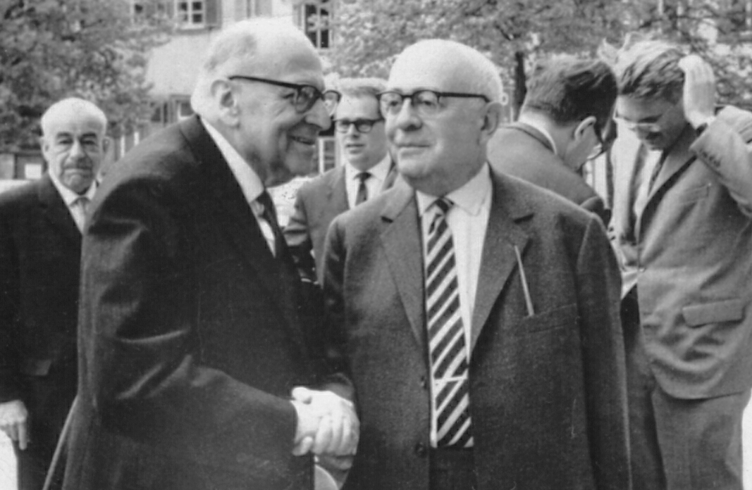

Slide 3
Critical Theory
Institute for Social Research, Frankfurt am Main
1930 Max Horkheimer named the director
Zeitschrift für Sozialforschung (Journal for Social Research)
Theodor W. Adorno (1903-1969), Walter Benjamin (1892-1940), Max Horkheimer (1895-1973), Herbert Marcuse (1898-1980)
1933 moved to Geneva, 1934 New York
1949 Adorno and Horkheimer return to Frankfurt

Slide 4
1951 reopening of the Institute
„Second generation“: Jürgen Habermas, Albrecht Wellmer
„Third generation“: Axel Honneth (current director of the Institute), Christoph Menke, Juliane Rebentisch

Slide 5
W. Benjamin: The Origin of German Tragic Drama (1928)
- The Arcades Project (1927-1940)
- The Work of Art in the Age of Mechanical Reproduction (1936)
- On the Concept of History (1940)
T. Adorno, M. Horkheimer: Dialectic of Enlightenment (1944)

Slide 6
H. Marcuse: Reason and Revolution (1941)
- Eros and Civilization (1955)
- One-Dimensional Man (1964)
- The Aesthetic Dimension (1978)
T. W. Adorno: Minima Moralia (1951)
- Negative Dialectics (1966)
- Aesthetic Theory (1970)

Slide 7
Theoretical Background
Social philosophy
(Western) Marxism
Psychoanalysis
Hegelian philosophy
Theory and praxis
Critique of (instrumental) rationality
Attention to contemporary art and culture

Slide 8
Commodity Fetishism
Commodity satisfies human wants – it has an use value and exchange value
Ideological effect – it is hard to see labour as the common source of all commodities and its values
Commodities appear to have life of their own

Slide 9
Reification
György Lukács (in History and Class Conciousness)
Commodity form as a universal structuring principle in capitalist society, including social institutions (law, administration, journalism), academic disciplines (economics, philosophy etc.)
Reification – the structural process whereby the commodity form permeats life in (capitalist) society

Slide 10
Art and Ideology
Autonomous art x the culture industry
Adorno x Benjamin
1. Critique of Culture Industry
Cultural industrial production presents exchange value as an enjoyable use value, i.e. the consumer enjoys money, that he himself paid for the experience
Strenghtening advanced capitalism as a total system
Restriction of the emancipatory potential of new technologies as well as of oppositional groups

Slide 11
Mass mediated art is subject to the same economic processes as other commodities
Art looses much of its ability to challenge the dominance of exchange value
Different interrelation of base and superstructure – base itself ideological
Mass art duplicates rather than challenge social reality

