Slide 1
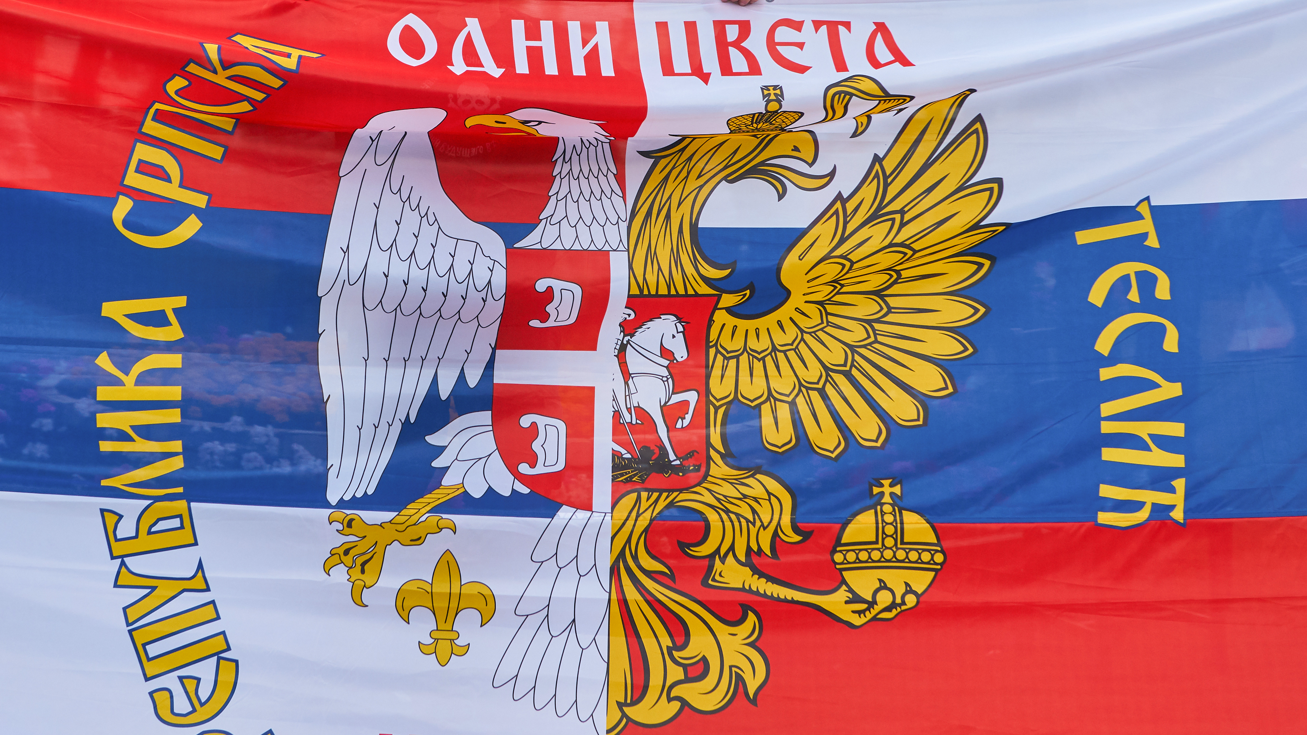
In what ways is Russia trying to expand its influence in Serbia?
Vladislav Vladimirovich Shatalov

Slide 2
Contents
In the perception of history
In the educational sphere
In the religious sphere
In the Defense industry sphere
In the energy sector
Through foreign relations
Sources

Slide 3
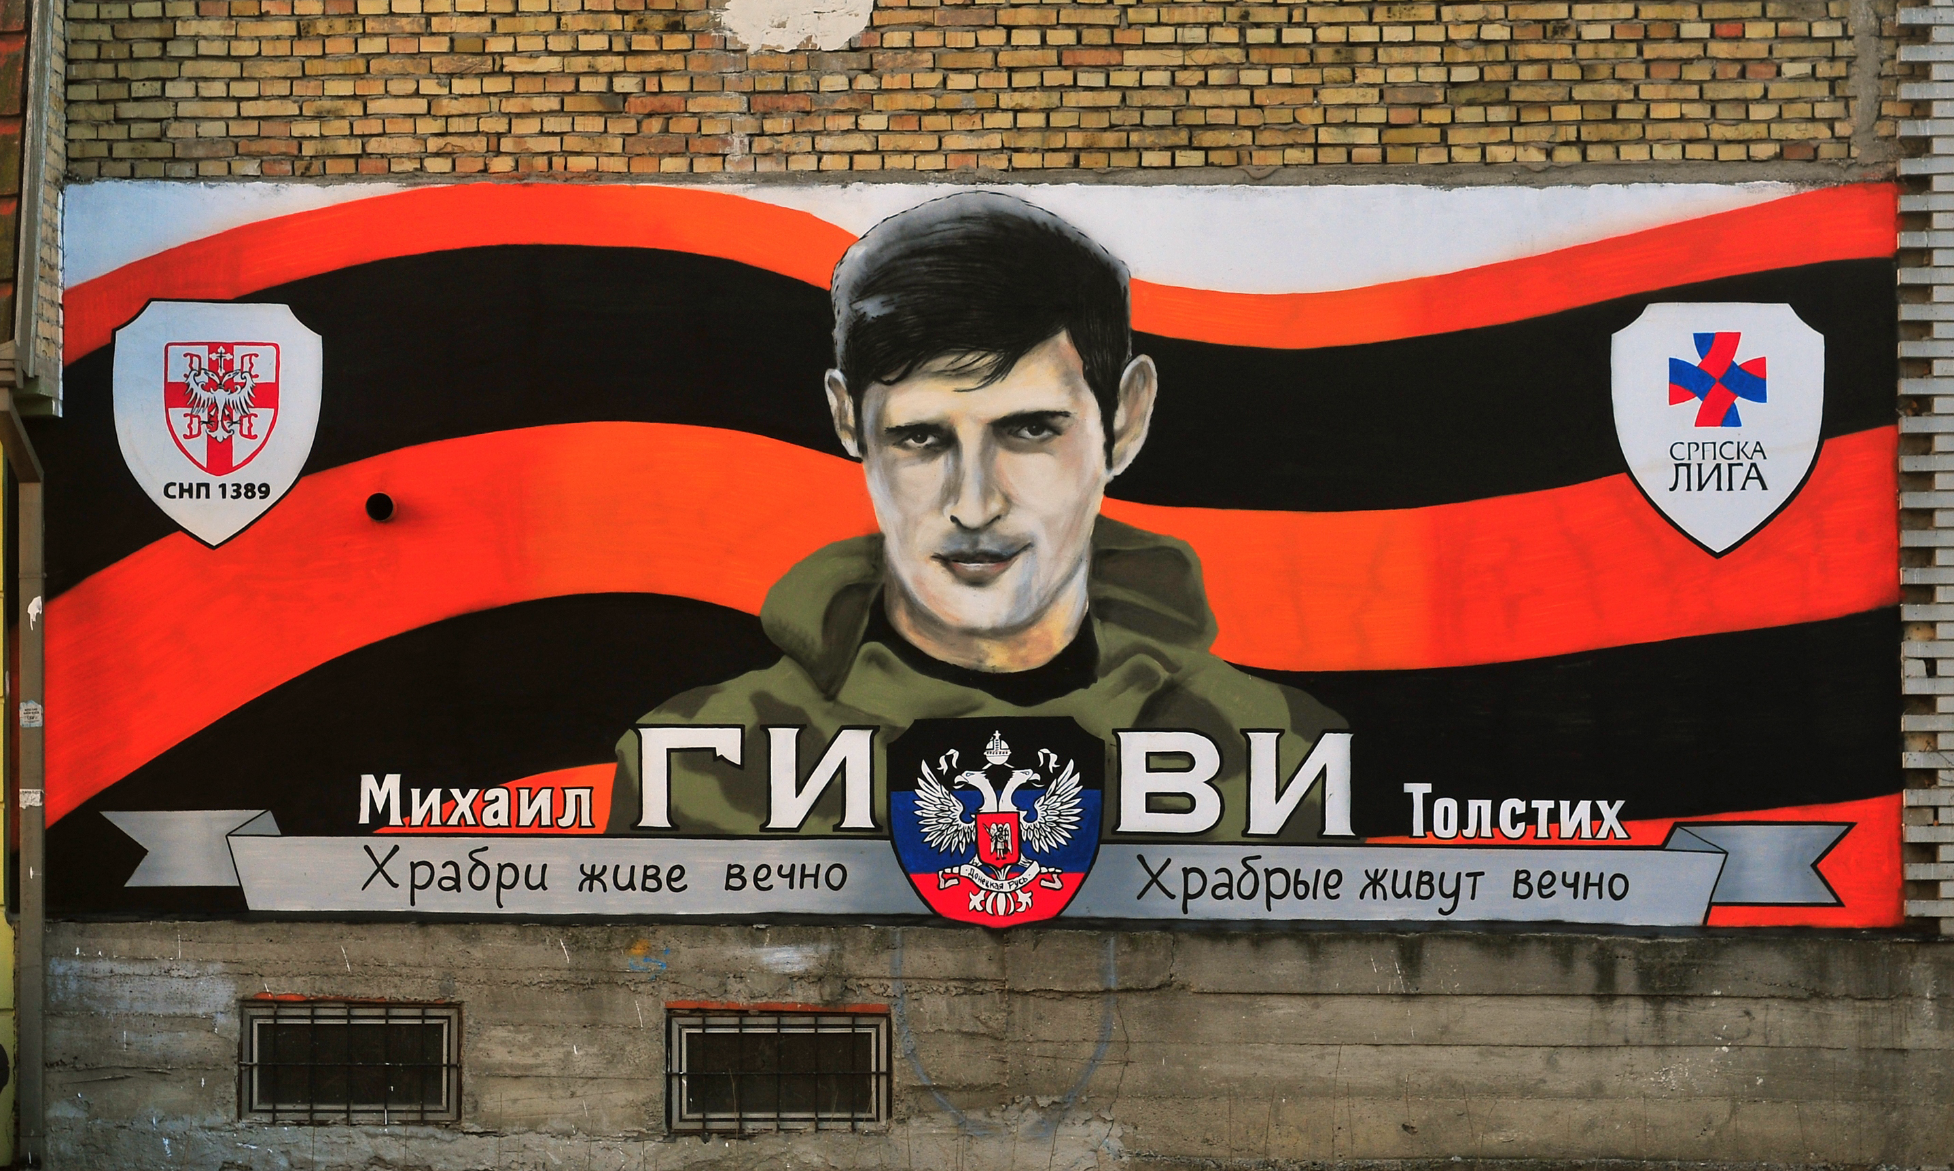
In the perception of history
Attempt at manipulation of history :
Yugoslav wars = War in Ukraine
Brotherly war to protect the Serbian minority = Brotherly war to protect the Russian minority
NATO supporting enemies of Serbia = NATO supporting Ukraine
Sanctions = Sanctions
Tito, as a Croat, who was anti-Serbian and anti-Russian (USSR)
Seems to be at least partially effective –
In 2022 80 percent of Serbians were against putting sanctions on Russia (Reuters)
In the same year 68 percent of Serbs held the belief that NATO started the conflict in Ukraine ( Euro parliament)
https://www.youtube.com/watch?v=bHy0QuHV0mE&t=17s
“Russians and Serbians brothers forever” In Belgrade
Mural to a DNR militia commander Michail Tolstich

Slide 4
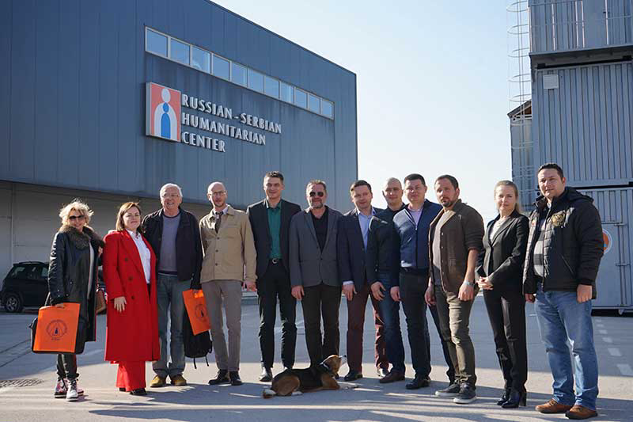
In the educational sphere
Russian support of military youth camps
Use of humanitarian and cultural center to continue to spread Russian influence and culture
Russia ha employed over 100 organisations to improve relations with Serbia
Popularization of Russian language in Serbian schools
2 Russian schools already built in Serbia with plans for more
Use of both Serbian state media, as well as Russian Sputnik Srbija and RT Balkan
E.N.O.T corp PMC taught led a patriotic youth camp in Serbia

Slide 5
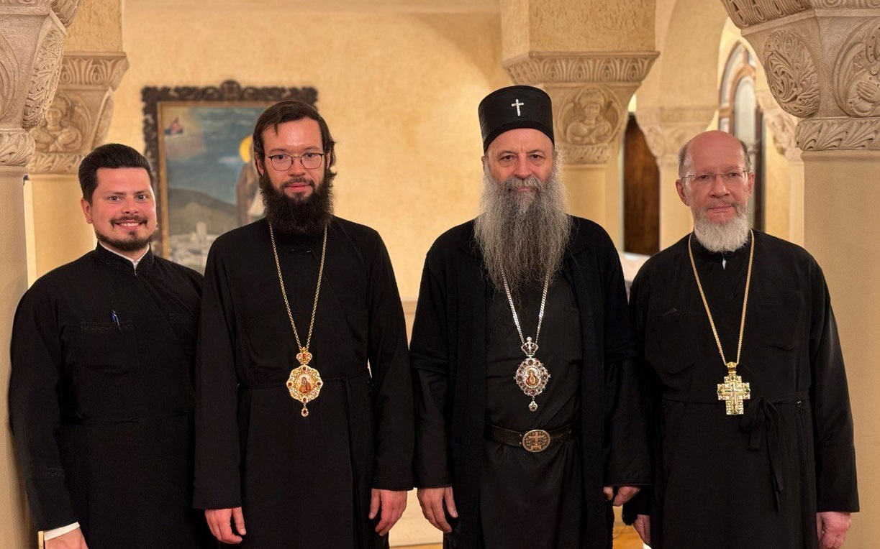
In the religious sphere
Financing the construction of churches
Gradual attempts to bring the churches closer
Support of counter-LGBT parades of movements by Russia
Support of Russian oligarchs through charities that help fund the Serbian church
Use of Serbian church to help limit those of Montenegro and Macedonia
Support of Serbian christians in Kosovo by the Russian Orthodox Church
New Orthodox Church of st. Sava in Belgrade
03.03.2024 – Meeting of Metropolitan Anthony of Volokolamsk and Patriarch Porfirije

Slide 6
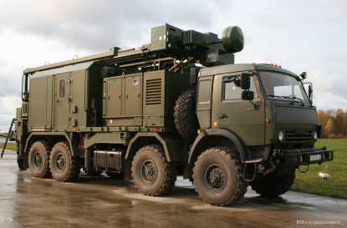
In the Defense industry sphere
Heavy reliance on Russian armaments - strong monopoly of Russian arms in certain areas of military
Chinese influence x Russian influence in Defense sphere
Purchase of Russian weapons even during Ukraine war – going against European sanctions
Russian military exercises (Joint response 2021) x NATO joint military exercise (Platinum wolf 2023)
Alleged Russian intelligence Center in NIŠ humanitarian Center
Serbia has denied entry to several prominent Russian anti-war citizens
Pantsir S1 self-propelled anti-aircraft weapon delivered in 2020
Repellent C anti-drone system delivered in 2024

Slide 7
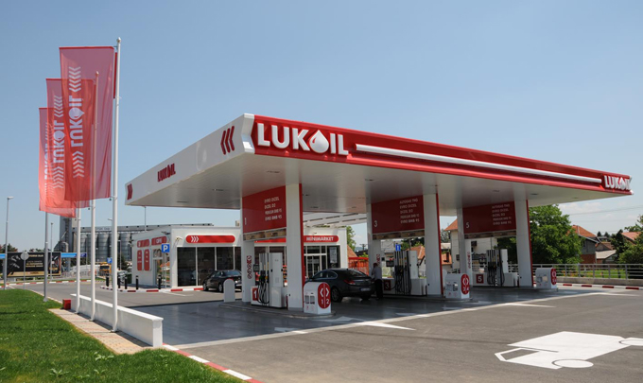
In the energy sector
Russia produces approximately 89 % of Serbian gas
Also owns most of the gas infrastructure and 50% of the only gas terminal in Serbia
Serbian petrol company Naftna Industrija Srbije was bought out by Gazprom in 2008 - Russia controls all Serbian refineries
Yet Serbia receives one of the cheapest prices for gas – up to 10 times compared to EU prices
A sizeable portion of oil and fuel is controlled by Russian giants such as Gazprom and LUKOIL
Due to sanctions attempts at prolonging Družba oil pipeline through Hungary to Serbia
Construction of Centre for Nuclear Science and Technology (CNST) by Rosatom

Slide 8
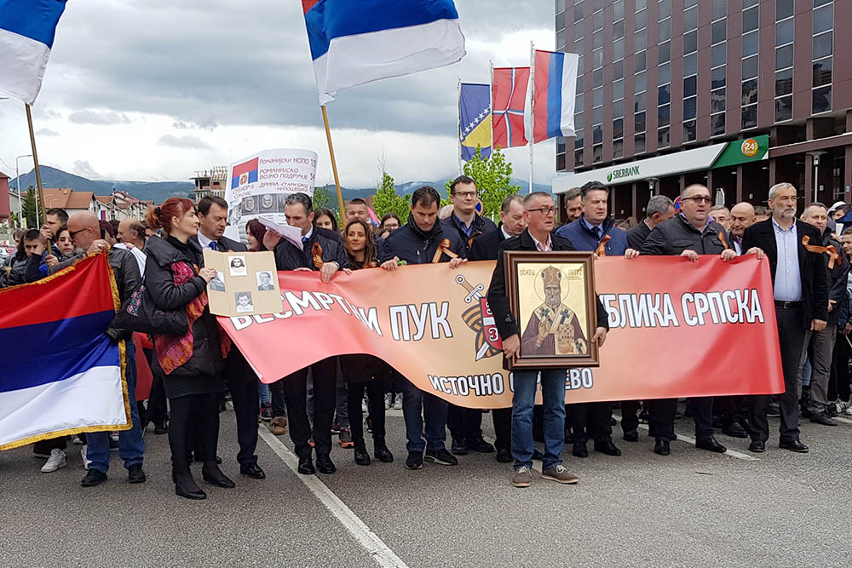
In foreign relations
Russia blocking UN recognition of Kosovo
Russia vetoed UN in regards to Yugoslav wars - In 2015 against Srebrenica massacre to be called genocide
Political and material support to Srpska republic in Bosnia
Russian vaccine diplomacy towards Serbia during the COVID 19 pandemic
Russo-Serbian friendship group
National Council for Coordination with Russia and China was established in 2017
Immortal regiment parade in Bosnia and Hercegovina

Slide 9
Sources
https://www.cfr.org/backgrounder/russias-influence-balkans#:~:text=By%20blocking%20UN%20recognition%20of,maintain%20friendly%20relations%20with%20Moscow.
https://carnegieendowment.org/politika/88828
https://www.europarl.europa.eu/RegData/etudes/BRIE/2023/747096/EPRS_BRI(2023)747096_EN.pdf
https://www.osw.waw.pl/en/publikacje/osw-commentary/2023-02-27/closer-to-west-serbias-foreign-policy-after-russian-invasion
https://support4partnership.org/en/news/russian-influence-in-serbia-from-fostering-cultural-ties-to-open-propaganda
https://www.reuters.com/world/europe/west-gains-advantage-it-vies-with-russia-influence-serbia-2023-03-01/
https://journals.sagepub.com/doi/10.1177/01445987231215445#:~:text=The%20Serbian%20national%20company%20responsible,et%20al.%2C%202023).
https://static.rusi.org/rusi_pub_228_op_russiachina_serbia_final.pdf

Slide 10
Thank you for your attention!

