Slide 1
The Constitutional Sociology of Europe:
Politics, Law and Society
Paul blokker, PhD
Institute of Sociological studies, Charles University
10 April, 2018

Slide 2
Constitutional Sociology
Summary last class
A European Constitution as an incremental or ‘grown’ constitution
Magic triangle: direct effect; supremacy, and preliminary ruling
EU integration as ‘integration through law’, juridification, legally driven
EU legal integration as market creation, producing winners and losers, and national resistance
Case-study: Hungary’s ‘backsliding’
2
Notes:
2

Slide 3
Constitutional Sociology
Final Exam
-The student will be evaluated at the end of the course by means of a written essay, to be handed in at the end of the semester (exact date will be stipulated);
The written essay will be of
BA: a minimum of 2.000 words, and needs to contain a bibliography with at least 5 academic resources.
MA: a minimum of 3.000 words, and needs to contain a bibliography with at least 10 academic resources.
3
Notes:
3

Slide 4
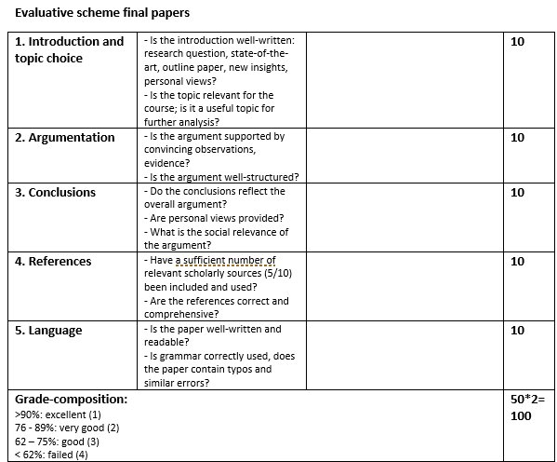
Constitutional Sociology
Final Exam
-
4
Notes:
4

Slide 5
Constitutional Sociology
Final Exam
-Possible topics:
Constitutionalism and populism/legal strategies of populists;
Constitutional resistance;
The rights and constitutional language of social movements and political parties, such as Podemos, Syriza, DiEM25;
The internet and constitutionalism/A Constitution of the Internet;
NB. Moodle contains a repository with helpful texts
5
Notes:
5

Slide 6
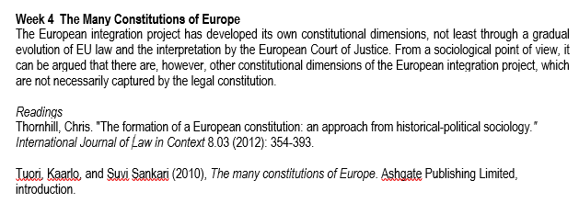
Readings
Constitutional Sociology

Slide 7
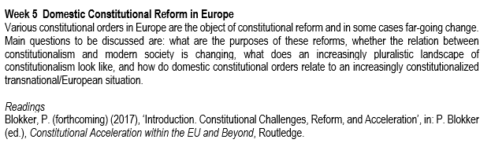
Readings
Constitutional Sociology

Slide 8
Objectives 1. The ‘many’ constitutions of Europe; 2. The tensions between a transnational-/supra-national and national legal orders; 3. National constitutional reforms
Constitutional Sociology

Slide 9
Constitutional Sociology
How many European Constitutions are there?

Slide 10
Many constitutions - Recently, legal pluralism as well as constitutional pluralism are key ways of describing the European situation; - Legal pluralism as a concept emerged in sociology in the early 19th century - Legal pluralism described the fragmented and incomplete nature of private law (patchworks) in contrast to, and distinct from, public law (as a monistic, coherent order)
Constitutional Sociology

Slide 11
Many constitutions - Legal pluralism consisted thus of a sociological approach to the law, which rejected the static models of public-legal normativity - Ideas of pluralism are now also used in describing the European order as well as in the global arena - Under the conditions of globalization, the hierarchy of national constitutional orders is necessarily suspended, and law is necessarily plural (Thornhil 2012)
Constitutional Sociology

Slide 12
Many constitutions - Constitutional pluralism is an explicit notion used very prominently in debates on EU law - This means that the ‘constitutionality’ of not only EU law is considered (including the Charter of Fundamental Rights), but also of the Eur. Convention of Human Rights, next to, or above ‘traditional’, national constitutional orders - Also, emphasis is also placed on the constitutional character of both the European Court of Justice and the Eur. Court on Human Rights
Constitutional Sociology

Slide 13
Many constitutions - Constitutional pluralism as an argument is used: a. in a descriptive sense, acknowledging the existence of separate but overlapping constitutional orders b. in a normative sense, arguing that pluralism is the best way to protect various identities
Constitutional Sociology

Slide 14
Many constitutions: European level - From a sociological view, what becomes clear is that the supranational and transnational levels are only partially constitutionally integrated - For instance, in EU law there is an emphasis on the market, but there is much attention for other constitutional dimensions, such as social distribution, identity, civic participation
Constitutional Sociology

Slide 15
Many constitutions - From a sociological view, it is necessary to consider this incomplete or sui generis character of constitutional pluralism; - The European order is not the same as the national order, and does not consist of a deep relation between popular sovereignty, national identity, territory, and jurisdiction;
Constitutional Sociology

Slide 16
Many constitutions - As Tuori argues, Europe is living in an era of a plurality of constitutions, and there even exists a plurality of pluralities of constitutions: 1. There are divergent conceptions; 2. Different concepts; 3. Different levels (national, transnational, subnational)
Constitutional Sociology

Slide 17
Many constitutions: a plurality of pluralisms 1. Legal pluralism 2. Sociological pluralism 3. Socio-functional pluralism 4. Cultural pluralism 5. Discursive pluralism
Constitutional Sociology

Slide 18
Legal (or Juridical) Pluralism - The attention is on competing legal structures on the transnational level; - The emphasis is on multiple sites of constitutional authority, the coexistence of national constitutional orders with other legal regimes, and the lack of a clear hierarchy between regimes
Constitutional Sociology

Slide 19
Sociological Pluralism - Some have argued, that we not only need to consider public law in the transnational arena, but also private law (Teubner 2012: Societal constitutionalism); - From this perspective, we can also consider constitutionalizing tendencies in private arrangements, such as in the area of internet (e.g. Google, Apple) (lex digitalis), the global economy (lex mercatoria), labour law, sports, ecology, and human rights;
Constitutional Sociology

Slide 20
Sociological Pluralism - These global constitutional formations are forms of constitutionalism without a state (Teubner); - Such ‘constitutions’ are concentrated around specific functions, and can be understood as partial constitutions that resolve issues of coordination and regulation in specific sectors/areas
Constitutional Sociology

Slide 21
Socio-functional pluralism - Constitutional pluralism, in a related way, can then also be understood as the more or less spontaneous emergence of legal orders around specific functions, such as the economic, the social, security, the legal, the cultural (Frerichs 2011)
Constitutional Sociology

Slide 22
Socio-functional pluralism - Constitutions can be understood as a relational concept, in Luhmann’s terms, as a form of “structural coupling”, between the law and politics, or between the law and the economy, or the law and society - Constitutions can constitute something anew, but they can equally constitutionalize an already existing sphere
Constitutional Sociology

Slide 23
Socio-functional pluralism - Tuori identifies: - economic constitution - juridical constitution - political constitution - social constitution - security constitution
Constitutional Sociology

Slide 24
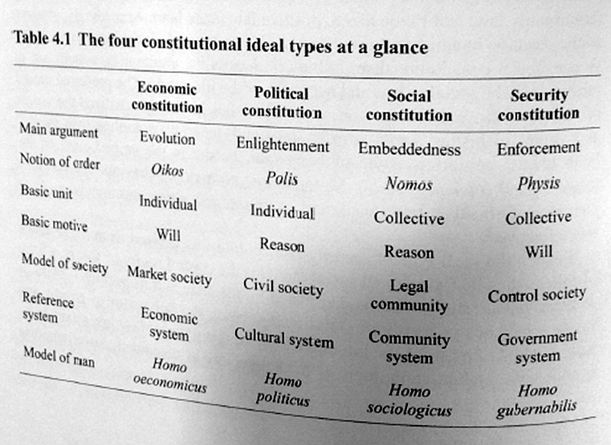
Many constitutions
Constitutional Sociology

Slide 25
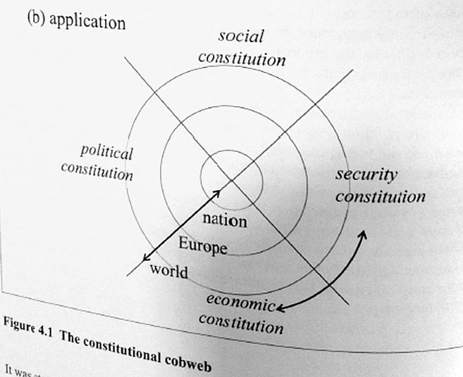
Many constitutions
Constitutional Sociology

Slide 26
Cultural pluralism - Different national constitutional experiences, trajectories, and cultures - Different ways of reacting to the emerging transnational constitutional regimes
Constitutional Sociology

Slide 27
Discursive pluralism - Two meta-language, imaginaries or mindsets (Dr Jekyll and Mr Hyde): order, status quo – self-rule, emancipation; - A related distinction is between instrumental rationality and value-rationality; - But pluralism goes beyond the order-emancipation dialectic (cf. Walzer, Frerichs, Leader): a range of higher principles informs distinctive understandings of constitutionalism; - In the context of, e.g., transnational social movements: not merely instrumental rationality, but equally value-rational engagements;
Constitutional Sociology

Slide 28
Discursive pluralism
Constitutional Sociology

Slide 29
European constitutionalisms 1950/60s: economic constitution 1960s-90s: juridical constitution 1990s/2000s: political constitution 2010s: security constitution
Constitutional Sociology

