Slide 1
Equivalence testing

Slide 2
Common practice
when p > α, researchers conclude there is no effect
e.g.: „there were no gender effects, p > .10”

Slide 3
How to support null in NHST?
when p > α, the result is simply not surprising (assuming null is true) or in other words, compatible with null
but that is no way a support for null:
with low power, we will observe high p-values even if null is false
is Bayes our only option?

Slide 4
Equivalence testing
true, we can never support null, but null does not have to be only that effect is exactly 0
we can reject null that the effect is larger (or smaller) than some specified value
this approach originates from pharmaceutical research, when it is often useful to show that a new cheap drug is not worse than other

Slide 5
TOST
two one-sided t-tests
H0₁: Δ ≤ –Δ_{L} and H0₂: Δ ≥ Δ_{U}
if both H0s are rejected, we conclude that
–Δ_{L} < Δ < Δ_{U}
i.e., the result is (for our purposes) equivalent to the zero effect

Slide 6
TOST
two one-sided t-tests
H0₁: Δ ≤ –Δ_{L} and H0₂: Δ ≥ Δ_{U}
if both H0s are rejected, we conclude that
–Δ_{L} < Δ < Δ_{U}
i.e., the result is (! for our purposes !) equivalent to the zero effect

Slide 7
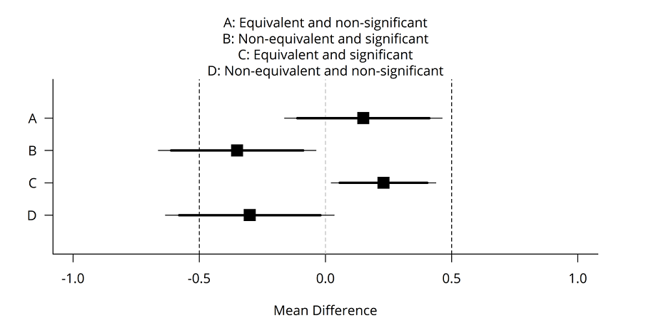
Possible outcomes
Notes:
Mean differences (black squares) and 90% confidence intervals (thick horizontal lines) and 95% confidence intervals (thin horizontal lines) with equivalence bounds ΔL = -0.5 and ΔU= 0.5 for equivalent, significant, significant and equivalent, and non-significant and non-equivalent test results.

Slide 8
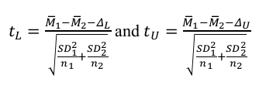
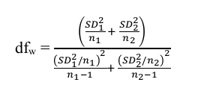
TOST
as a classic t-test
more universal Welch‘s version

Slide 9
example in R
install.packages("TOSTER")
library("TOSTER")
TOSTtwo(m1=5.25, m2=5.22, sd1=0.95, sd2=0.83, n1=95, n2=89, low_eqbound_d=-0.43, high_eqbound_d=0.43, alpha = 0.05)
just copy&paste to R

Slide 10
Reporting results
both tests need to be significant
however, we report only the one with the higher p-value

Slide 11
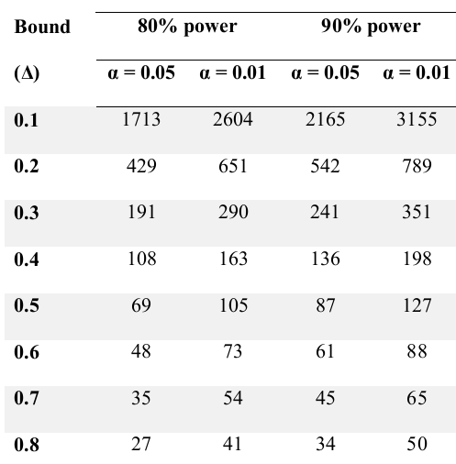
Power analysis
sample sizes for each group

Slide 12
Other tests
TOST can be shown to work for two-dependent samples t-test, one-sample t-test, correlations as well as meta-analyses
https://cran.rstudio.com/web/packages/TOSTER/vignettes/IntroductionToTOSTER.html
visualisation: http://rpsychologist.com/d3/equivalence/

