Slide 1
Practices and Tactics

Slide 2
Michel de Certeau
The Practice of Everyday Life (1984) and The Practice of Everyday Life Volume 2: Living and Cooking (1998)
Strong Catholic upbringing
Everyday life is a balance of 2 types of practices = strategy and tactics
Daily practices subvert concepts of routine
“view everyday practices as practices”

Slide 3
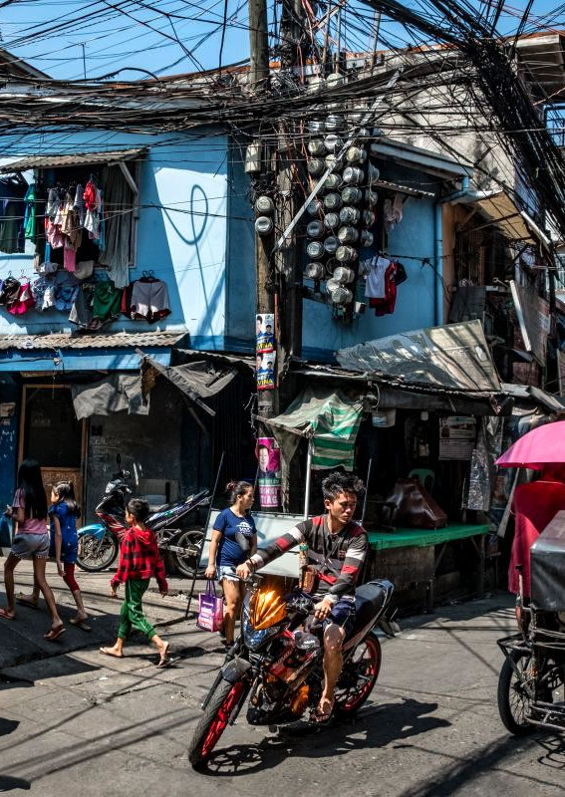
Strategies and Tactics
Strategies = produce and impose order to what is formally established
Tactics = everyday practices between the gaps of strategic control over space
Everyday practices as tactical – victories of weak over strong
Reading as activity of silent production
Daily practices as acts of appropriation and re-appropriation
Everyday practices are about spaces –place vs space

Slide 4
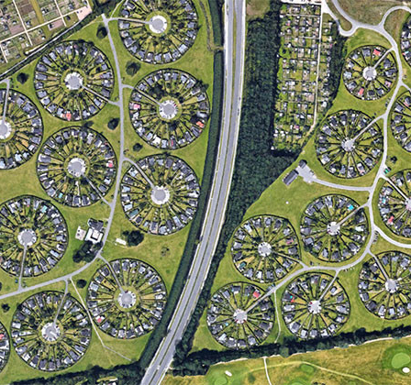
Certeau –culture
Subaltern or postcolonial studies
Microstoria and Altagsgeschichte
Everyday routines shape culture
Institutions as conditions and framework for action
“symbolism of the unconcious”
“Real city” vs “planned utopian city”
“reading, that’s poaching”

Slide 5
Making Do
Similar to Foucault but rejects systematic view of human experience
‘Ways of operating’ as ‘instructions for use’
‘Subversion from within’ –assimilate to and are assimilated by the system
Studied popular culture and mechanisms
Effect of television, cinema and the internet

Slide 6
Foucault
Foucault: Relationship between procedures and discourse
Struggle against feudal regime is assisted by semi-autonomous force
Imposed coherence on privileged practices

Slide 7
Bourdieu
Habitus representing social order
Isolates strategies
Strategies arise when people choose among traditions
Underlying principles govern strategies
Habitus as responsible for action rather than processes

Slide 8
Michel Augé
Non-Places: Introduction to an Anthropology of Supermodernity (1995)
‘non-place’ – cannot be defined as relational, historical or concerned with identity
Supermodernity produces non-places: hotels, chains, trains supermarkets
Opposition between place and space
Non-places: Spaces formed in relation to certain ends and relations individuals have with these spaces
Liminal space

Slide 9
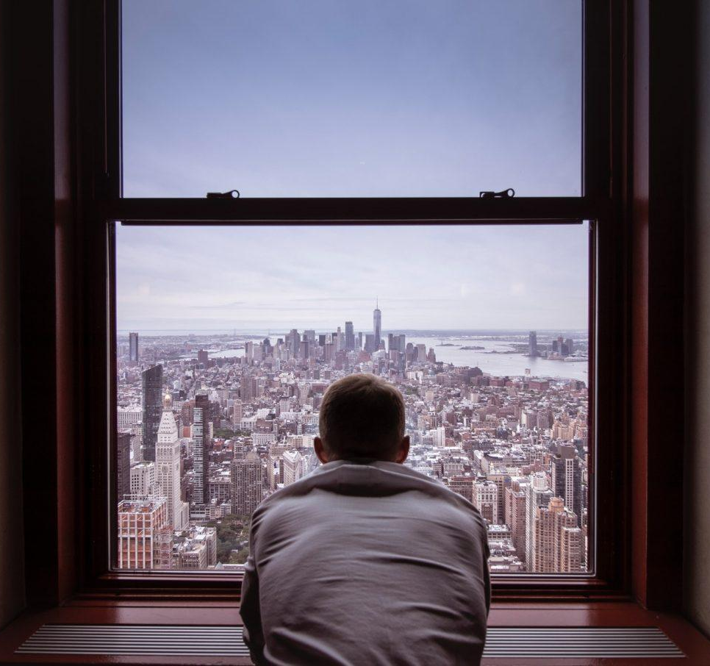
Michel Augé –cont.
“What emerges from the fading social norms is naked, frightened, aggressive ego in search of love and help. In the search for itself and an affectionate sociality, it easily gets lost in the jungle of the self; someone who is poking around in the fog of his of his or her own self is no longer capable of noticing that this isolation, this 'solitary-confinement of the ego' is a mass sentence” [Ulrich Beck, 40 in Bauman 2000:37].
Cultural constructions of space are being influenced by new technologies that facilitate communication
New system of manners

Slide 10
Questions: Walking in the City, Certeau
-What makes the walking in the street technique unique in order to research the semiotics of everyday life?
-What is the “blindness” of the people?
-What is the “threefold operation” of the city and how it decays?

Slide 11
Questions: Driving in the City, Thrift
- According to Meaghan Morris, why Certeau’s pursuit of the apotheosis of the ordinary creates several problems?
-Why must we add to the walking city its driving aspect?
-According to Katz, in what ways does the automobiles affect and shape our identities/personalities?

