Slide 1
Sociology of European Integration
Moodle page: https://dl1.cuni.cz/course/view.php?id=7256

Slide 2
8. Public participation in European integration

Slide 3
Public participation
What benefits do public authorities expect to get from citizens’ participation in rule-making, policy-making and decision-making? 3 analytical distinctions:
Instrumental (outcomes matter more than process) OR intrinsic (process matters more than outcomes)
Public goods and values (better policies or stronger communities) OR private goods and values (skills, information, status, income, benefits in health and wellbeing that are contingent on individual behaviour change)
Long-term (benefits of living in an environment where participation is ‘the norm') OR short-term (results of specific interventions)
There can also be victims/losers in participatory processes (e.g. if participatory policy-making has redistributive effects that produce benefits for some groups and disbenefits for others)

Slide 4
Benefits according to UK Civil Renewal Unit (2005)
tapping ‘local' knowledge and innovation,
reducing or avoiding conflict,
increasing awareness and understanding,
mobilising new resources including voluntary labour,
making programmes more sustainable by generating community ownership,
increasing individual or community self-reliance,
reducing transaction costs,
increasing social inclusion or cohesion,
generating trust and social capital,
making policy more enforceable by embedding it in social norms,
generating new groups and organisations and strengthening existing ones

Slide 5
The normalisation of participation in the Commission
Instruments of participatory democracy have existed since the creation of the European Community in the 1950s
consultation mechanisms with public and private interest groups
Constitutional Treaty (rejected in 2005 referenda) consecrated participatory democracy as a routine part of EU’s operational framework
Lisbon Treaty has same clause but without mentioning the term ‘participatory democracy’
Important distinction between
functional dimension of participation (interest representatives)
democratic dimension of participation (civil society organisations)
Affects not only who participates but how organisations behave
Saurugger, S. (2010) The Social Construction of the Participatory Turn: The Emergence of a Norm in the European Union, European Journal of Political Research 49(4): 471–95.

Slide 6
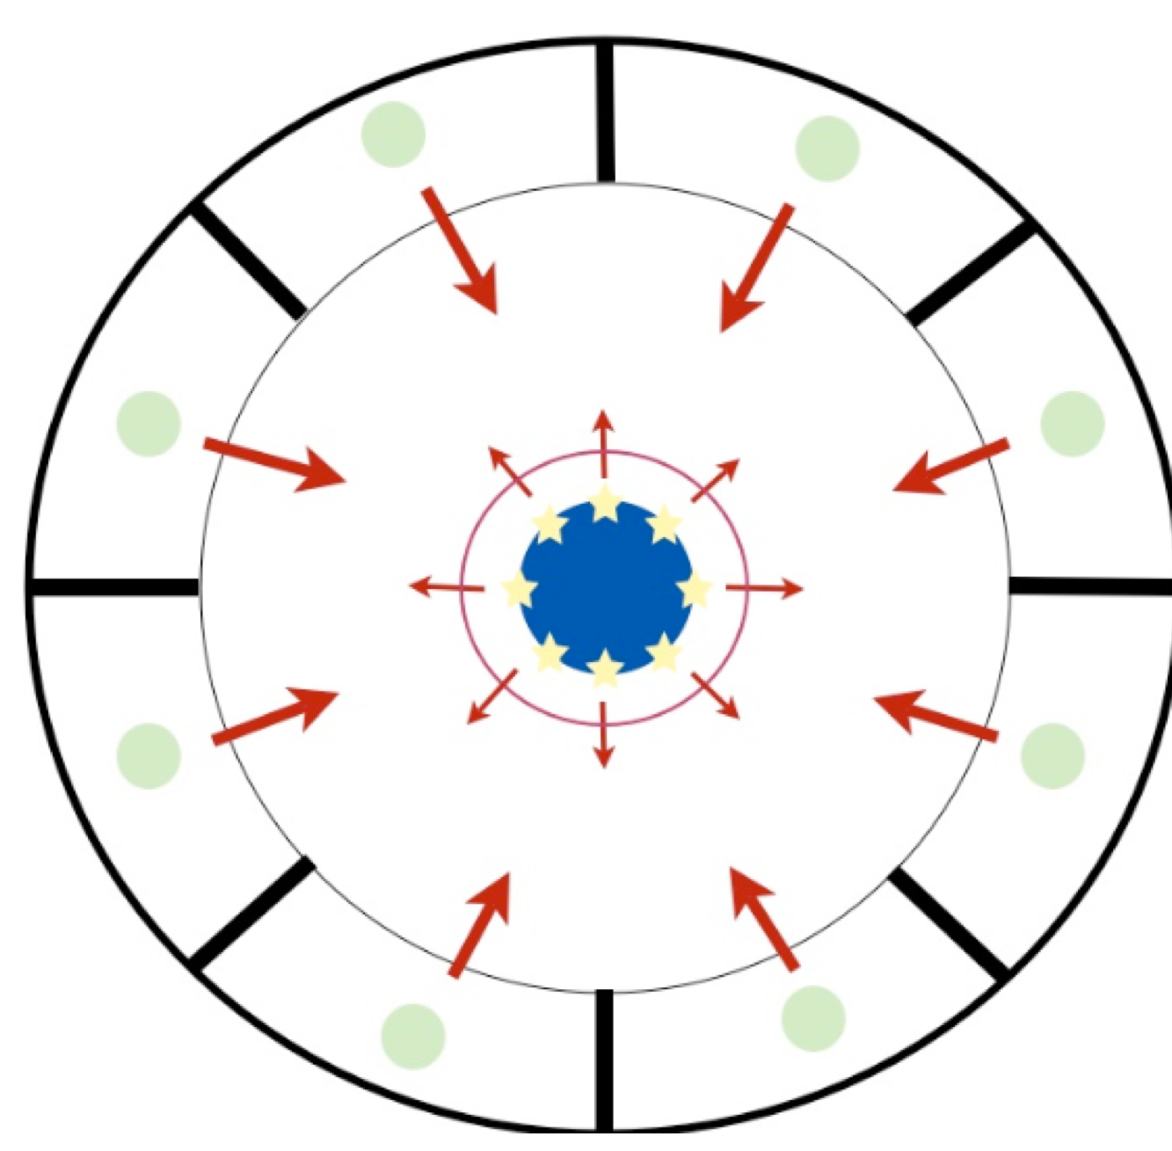
The hybridisation of participation in the Commission
Participation often bolted on to pre-existing policy-making tools
E.g. Your Voice in Europe online consultation platform designed by DG Internal Market for impact analysis, then (after 2001 White Paper) repackaged for ‘participatory’ consultation. However, original design choices precluded horizontal interaction among participants (as shown in image)
Dissemination strategies empower strong publics and issue publics
General public only get to know about consultations through the media
Organised civil society subverts the vertical process design
Networks of NGOs or individual NGOs set up pre-consultation discussion forums
Badouard, R. (2013) Conciling inclusion with impact on the decision? In: Lies, R. & Nan, P. (Eds.) Is Europe Listening to Us? Dartmouth: Ashgate: 153-172.
Available at: https://halshs.archives-ouvertes.fr/halshs-00823250

Slide 7
Norm entrepreneurs within Commission
‘Activist’ civil servants in DG Social Policy pioneered consultation mechanisms with civic associations in the fields of youth policy, social exclusion and racism or gender equality in 1990s
Michel Barnier, new regional policy Commissioner after 1999 Santer scandal, background with French Commission on National Public Debate (CNDP), sought to replicate same process at EU level
Forward Studies Unit (authors of 2001 White Paper on Governance) and associated legal scholars from Belgian Universities promoted participatory rule-making
DG Communication (authors of 2005 Plan D for democracy, dialogue and debate, from 2008 ‘Debate Europe’) promoted idea of European public sphere, especially online forums and debates
Participation norm good for EC, less so for EP: positional wars between institutions

Slide 8
External norm entrepreneurs
European thinktanks, consultants in participatory methods,
King Baudouin Foundation (Belgian NGO specialising in questions of European democracy and participatory initiatives, responsible for European Citizens’ Consultations)
Notre Europe (Jacques Delors Institute)
European Centre of Political Technologies
DEMOS (‘everyday democracy’)
European Policy Centre
EurActiv (media network for EU policy debates)
IBM Research
Academic and expert networks supported by EC research & development programmes
DEMO-net (Democracy Network)
PEP-NET (Pan European eParticipation Network)
European eParticipation study

Slide 9
European Citizens’ Consultations (2009)
Conception and design of participatory platform
Sequenced participation: inform > debate > propose > vote
Nationally segregated (to mirror parallel offline citizens’ debates in each country): national deliberation > European aggregation of proposals
Design accentuates intrinsic participation benefits: sociability, playfulness, learning, transformation, sensibilisation - citizenship-cultivating aims
How did publics actually take shape around participatory platform?
Logic of mobilisation / target institution usually hybrid national / European (mobilise international public for national policies or national publics for Community action)
Users transgress deliberative imperative: predominance of ‘aggregative’ over ‘deliberative’ activity (short threads, high ratio of proposals to messages, voting most common activity)
Users transgress national segregation: 30% of users visited a site outside their home country
Europeanised space, but not as intended
instrumental uses, issue-based alliances

Slide 10
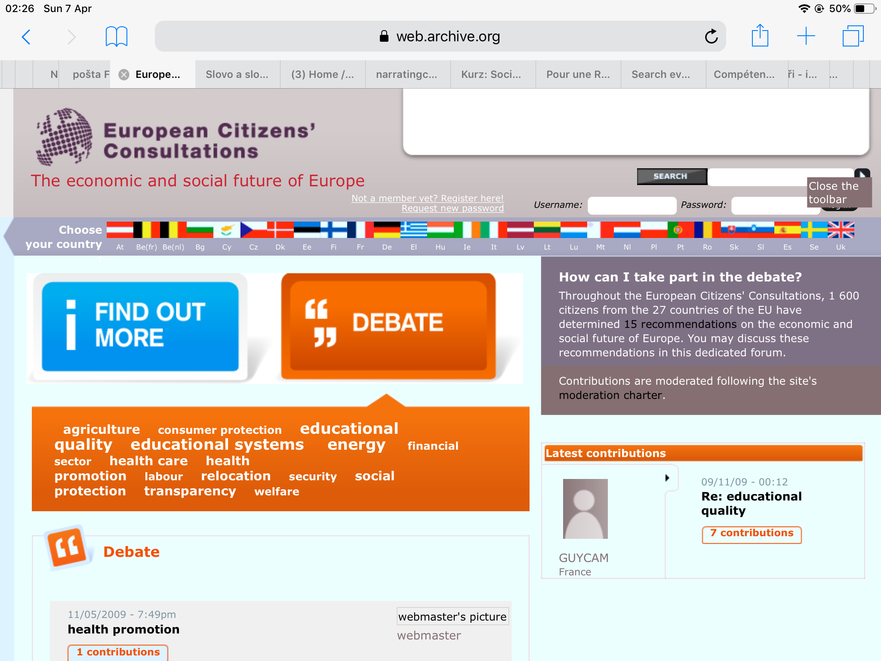
European Citizens Consultations 2009

Slide 11
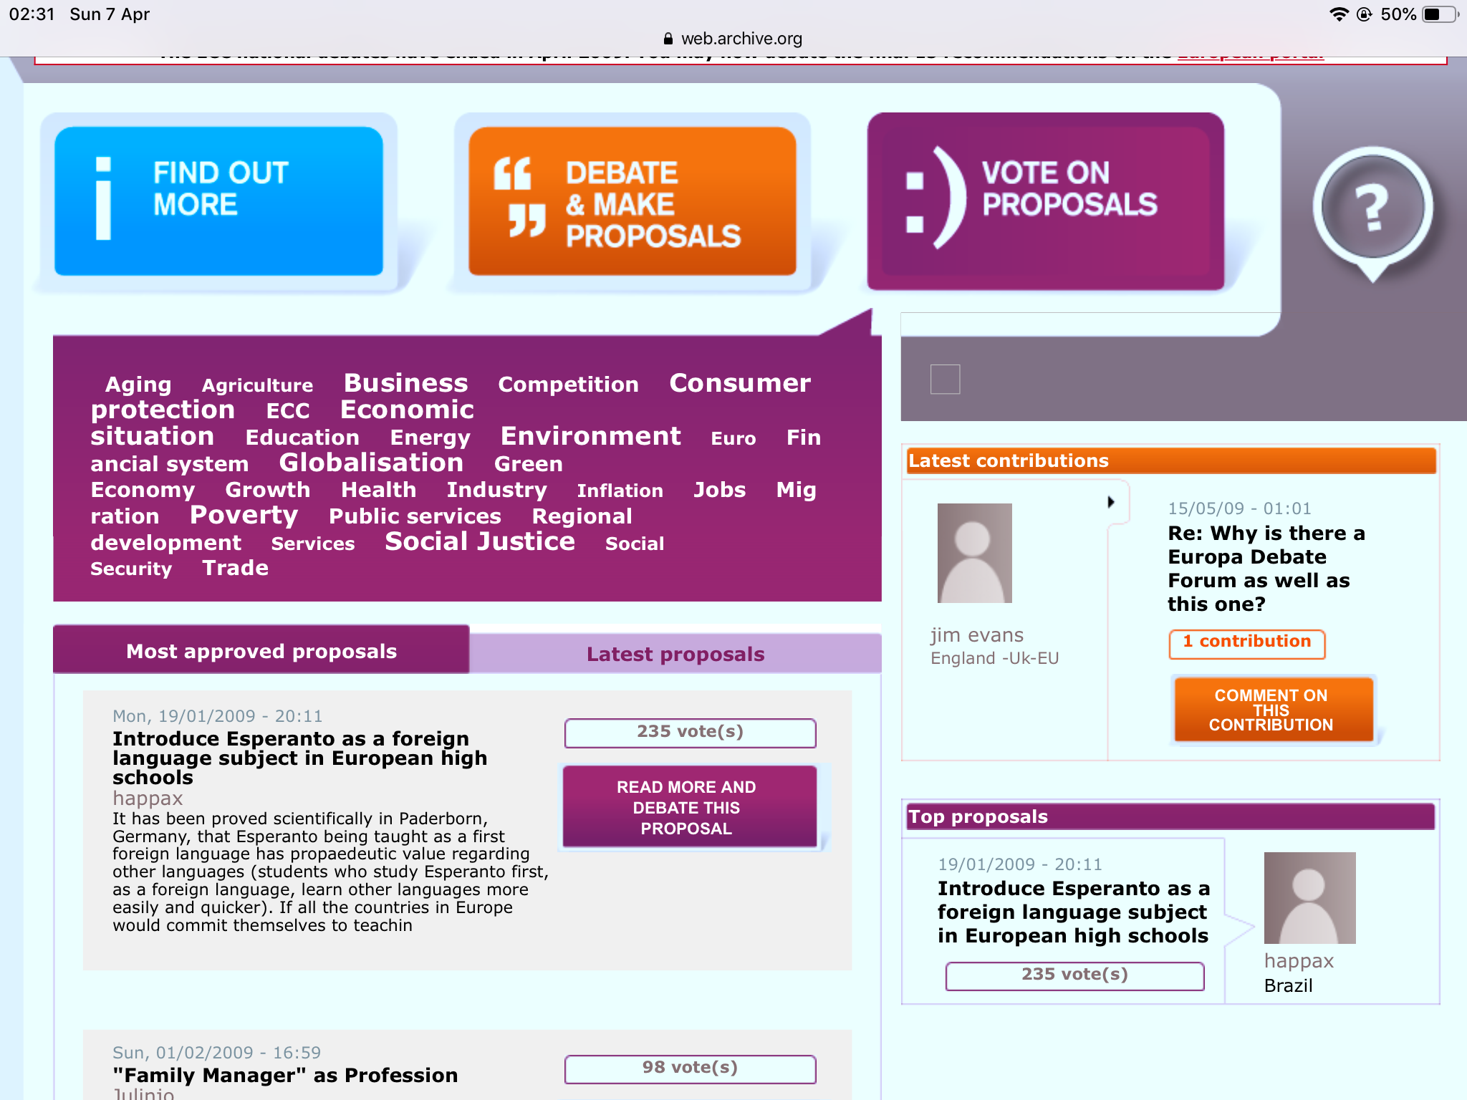
European Citizens’ Consultations 2009

Slide 12
Disappointment even from instrumental perspective
“Over the past decades there have been many attempts to test, improve, and sustain citizens' participation in the European Union”
“What all these attempts had in common was that they never really succeeded in achieving their main goal: to get citizens more meaningfully involved in the European Union’s decision-making process”
“Ultimately, the unstructured and under-funded process which unfolded through the ECCs never stood a chance of generating a critical mass of activities to fix the EU's democratic dilemmas”
(2018 evaluation report, King Baudouin Foundation / Open Society Foundations)

Slide 13
Shortcomings of research and policy on participation
Participation means both:
‘taking part’ (the normal, sociable phase of participation; unreflexive participation)
‘contributing’ and ‘benefiting’ (the exceptional phases of participation, when the existence of a group is interactively confirmed; reflexive participation)
(Zask, J. 2011, Participer; essai sur les forms démocratique de la participation. Paris: Le bord de l'eau.)
Attempts to generate or to measure the benefits of participation:
focus largely on how citizens could/should make contributions and redeem benefits
neglect the everyday politics of simply taking part
fail to test how ‘low-level’ civic resources like sociability are actually experienced in everyday situations by participants

