Slide 1
Effect sizes

Slide 2
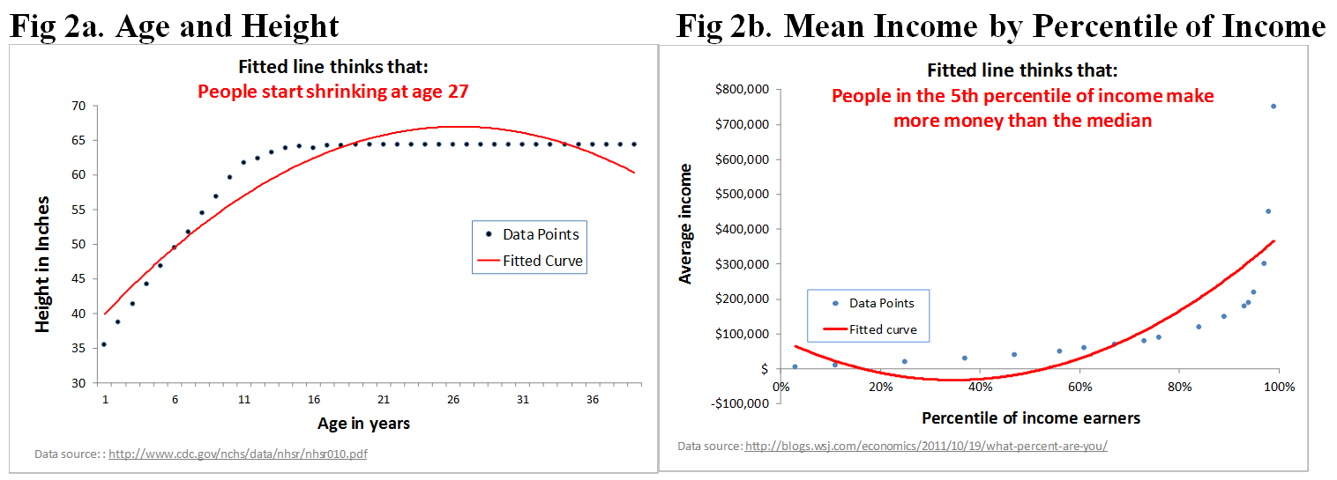
Intermezzo
Uri Gneezy from datacolada in Boston
http://datacolada.org/27

Slide 3
Practical (clinical) significance
how big / meaningful is the effect?
we do not care only about significance
with large enough sample, everything will be significnat (except for priming studies)

Slide 4
Two families of ESs
d – family
based on standardized mean difference
r – family
based on strength of association
(but you can convert between them easily - https://www.campbellcollaboration.org/this-is-a-web-based-effect-size-calculator/explore/this-is-a-web-based-effect-size-calculator)

Slide 5
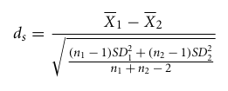
Cohen‘s d
http://rpsychologist.com/d3/cohend/
0,2 – 0,5 – 0,8

Slide 6
Paired data

Slide 7
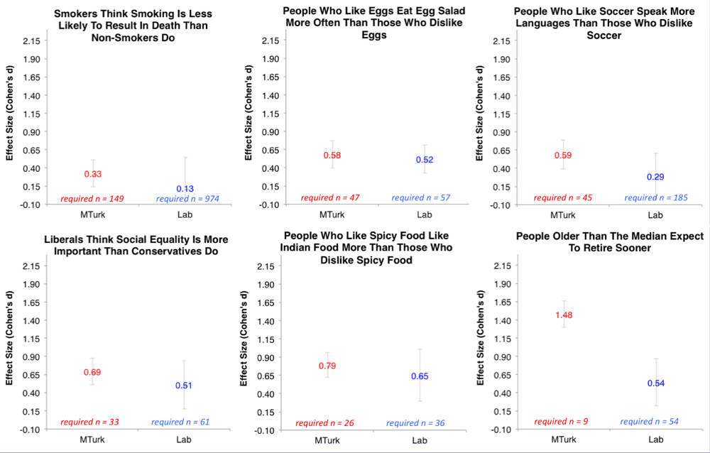
see also http://datacolada.org/18

Slide 8
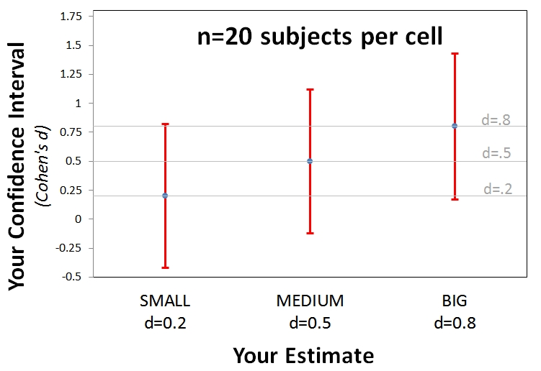
Precision of estimates
Notes:
http://datacolada.org/20

Slide 9
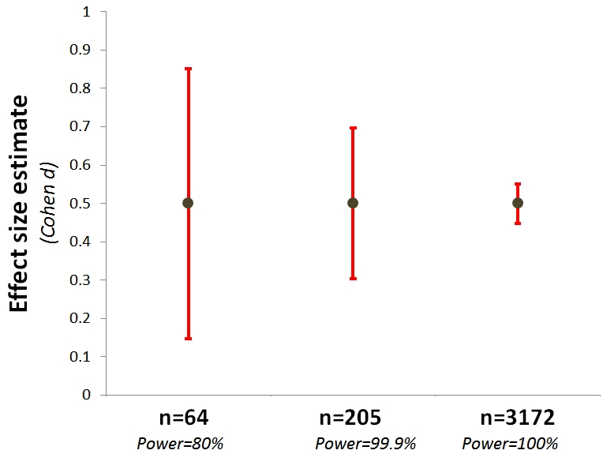
Precision of estimates
Notes:
http://datacolada.org/20

Slide 10
r – correlation & co.

