Slide 1
Confidence and credibility intervals

Slide 2
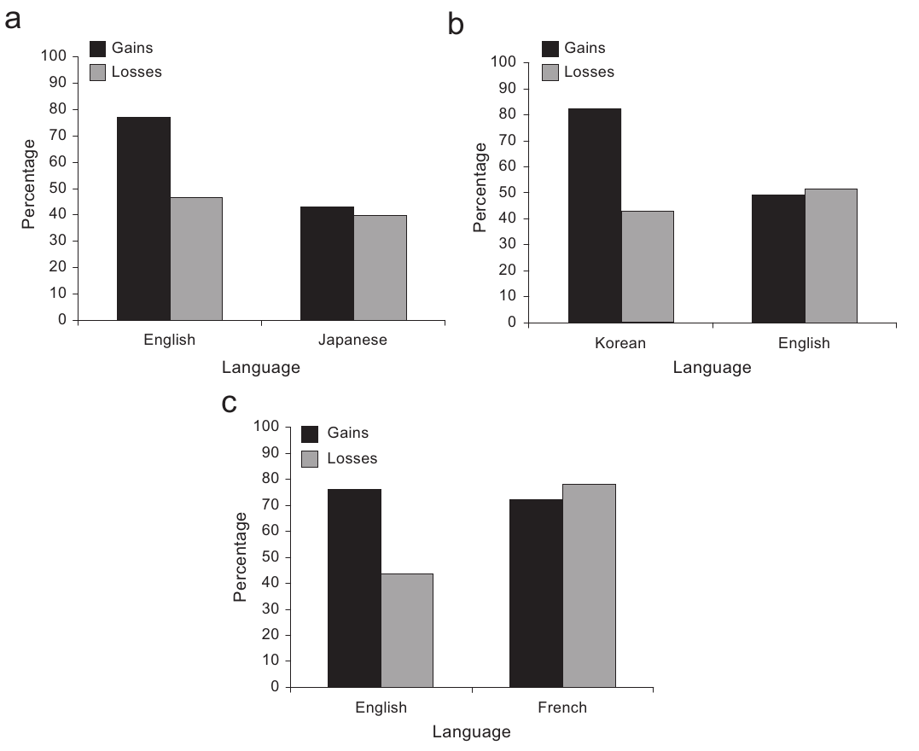
What is missing and why is it a problem?

Slide 3
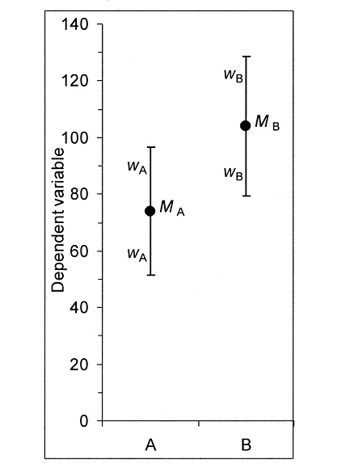

Slide 4
Confidence interval
= interval <L ; U> which in a long run contains the parameter of interest with a given probability (usually 0.95 -> 95%CI).
„Confidence intervals are a statement about the percentage of confidence intervals that contain the true parameter value.“ (Lakens)
is this true?

Slide 5
95% confidence interval
for simplicity, Z values are used below, although critical values from t-distribution would be more apropriate for obvious reasons (why?)
however, with increasing n, the difference disapears
Notes:
http://stattrek.com/online-calculator/t-distribution.aspx

Slide 6
Confidence interval
for 95% CI:
L = mean – 1.96 * SE
U = mean + 1.96 * SE
SE = standard error of an estimate = SD/sqrt(n)
1.96 * SE = w
2 * w = width of CI (from L to U)
for different confidence levels, different value instead of 1.96 is used (e.g., 2.58 for 99%CI)

Slide 7
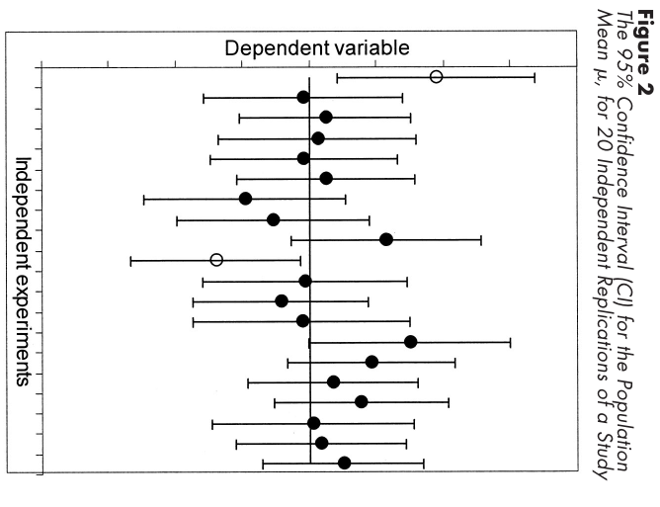
Interpreting Confidence Intervals
Notes:
http://rpsychologist.com/d3/CI/

Slide 8
from Cumming 2005
Hays (1973) described a CI as “an estimated range of values with a given high probability of covering the true population value” (p. 375).
It is essential, however, to be extremely careful whenever probability is mentioned in connection with a CI. It is correct to state that the probability that (M – w < μ < M + w) = .95, but this is a probability statement about the lower and upper limits, which vary from sample to sample.
It would be incorrect to state that our interval (51.85, 72.15) has probability .95 of including μ, because that suggests that μ varies, whereas μ is fixed, although unknown.
Notes:
z Cumming, G. & Finch, S. (2005). Inference by Eye: Confidence Intervals and How to Read Pictures of Data. American Psychologist, 60(2), 170.

Slide 9
Errors in interpretation
95% of all individual values will fall in the 95%CI
this is called prediction interval, with SE = SD*sqrt(1+1/n)
95% of all future sample means will fall in the 95%CI
capture percentage tells us how many will do (it is always less than 95%, namely 83,4%)
(Cumming & Maillardet, 2006)
Notes:
see R scripts from Lakens

Slide 10
Rules for interpretation
Rule of Eye 1: Identify what the means and error bars represent.
95%CI, 99%CI, ..., SE (= ½ 95%CI), SD (not very common)
also identify dependent variable, design, and the outcome of interest
Rule of Eye 2: Make a substantive interpretation of the means.
i.e., is the effect interesting and meaningfully large?

Slide 11
Alcohol and dishonesty

Slide 12
Rules for interpretation
Rule of Eye 3: Make a substantive interpretation of the CI
our CI is only one of many many possible CIs
its length is probably the most importatn feature
you should interpret the values in the interval, but how?
„Our CI is a range of plausible values for. Values outside the CI are relatively implausible.“
„Our data are compatible with any value of μ within the CI but relatively incompatible with any value outside it.“

Slide 13
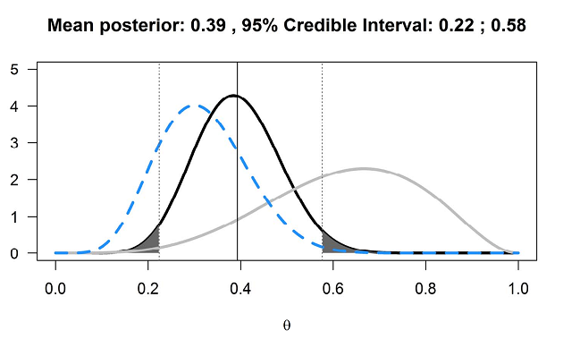
Credible intervals (Bayes version of CI)
they combine prior beliefs with data

Slide 14
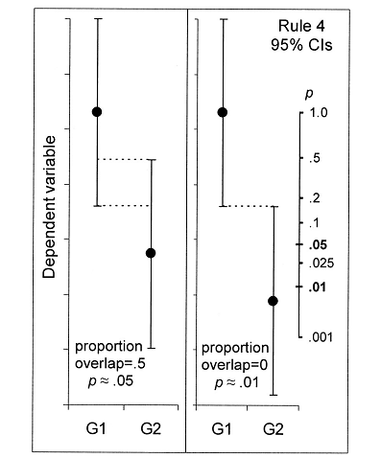
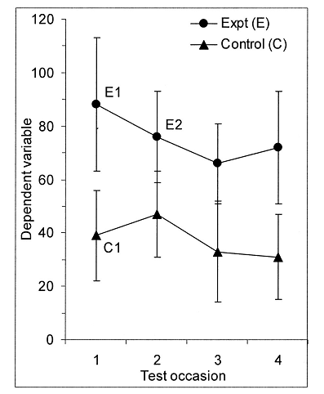
CIs in within-subject designs

Slide 15
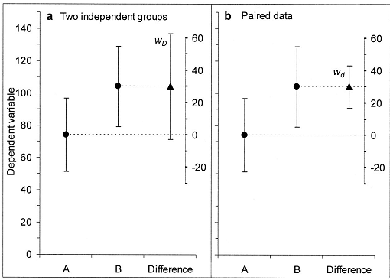
Independent vs paired data

Slide 16
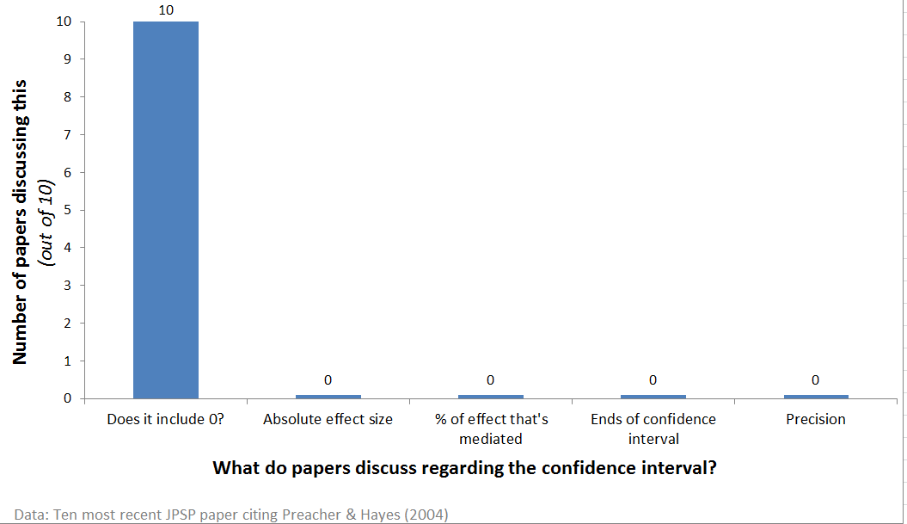

Slide 17
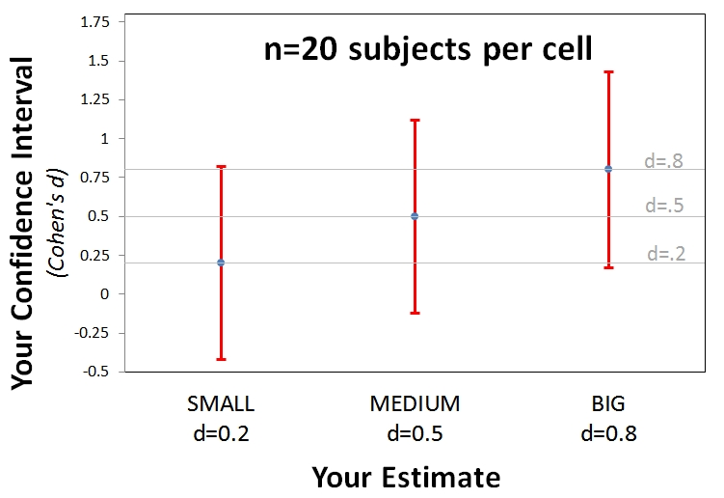
Precision of estimates
Notes:
http://datacolada.org/20

Slide 18
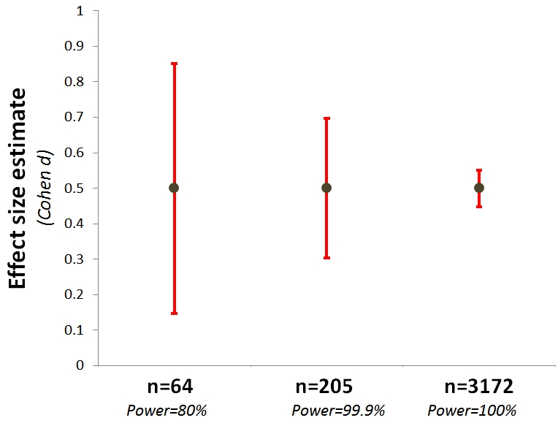
Precision of estimates
Notes:
http://datacolada.org/20

Slide 19
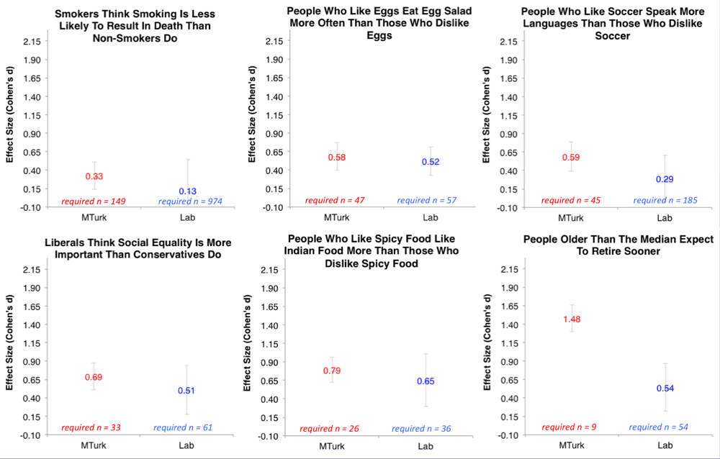
see also http://datacolada.org/18

