Slide 1
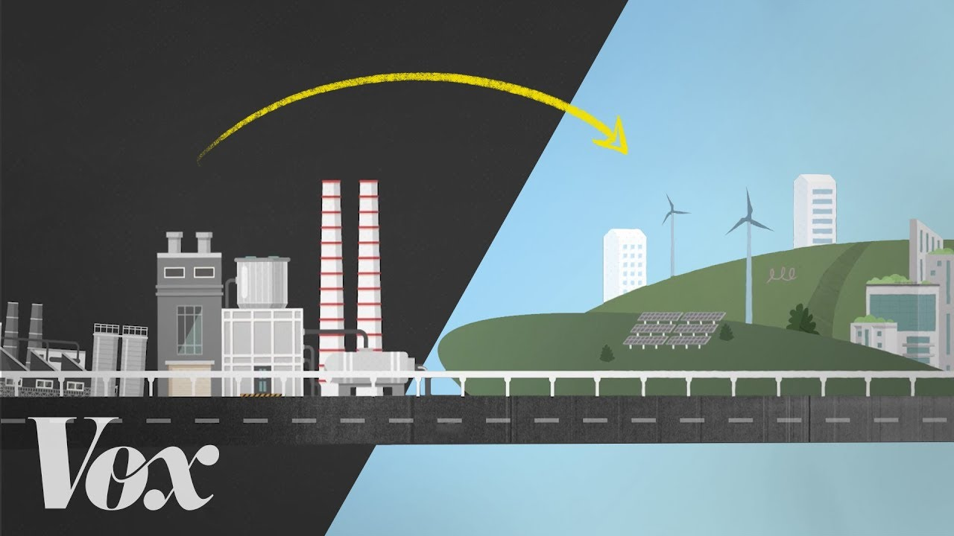
Germany: Review of the EP Position Paper
Philosophy, Economics and Politics: Current Debates JEM211
David Shin, Yannick Scharf, Sofia Zambrano, Irékani Alarcón Acosta
2020/2021
Source: The Green New Deal, explained. Video: Vox.

Slide 2
Pros
Well structured, human responsibility was clearly underlined, goal should be towards climate neutrality by 2050.
Emphasis on science-based approaches appreciated, and we agree on crucial implementation of these approaches as pivotal to increase better quality of life.
Direct citation of EP president Sassoli about climate change as an argument of global inequality welcomed. We see a link to climate refugees here.
Past climate issue examples (Fire in Australia, Amazon, melting ice caps and higher sea surface) reinforced the necessity of current debates on Green energy.
Key role of technological adjustments and transition to renewable energy. Technological innovation and joint research is a strategy how to secure both climate and economy.
We agree about the long-run social benefits of green technology investments

Slide 3
Cons
No additional references supporting the persuasive power of their arguments.
No emphasis on what EC and European member states achieved until now. They could have written about more positive achievements and relevance of EU in tackling climate change issues. Also no consideration of the social and economic costs of previous measures (e.g. Energiewende)
An elaboration on possible consequences for the European Union as well as an evaluation of the efficiency of different measures can be a good next step.
No stress on common budget consensus (EIB resources) and rational negotiations toward optimum. Unrealistic expectations and ultimata that can in the end lead to a failing of the whole negotiations benefit none, least our climate.
Also no emphasis on responsible and efficient use of means to prevent misuse of resources and meeting our objectives.

Slide 4
Thank you!
Source: The Green New Deal, explained. Video: Vox.

