Slide 1
Cultural Cleavages and the Rise of Radical Right Parties in Western Europe
Thareerat Laohabut
Chair of Comparative Political Science
Geschwister Scholl Institute of Political Science (GSI) LMU Munich
EPS programme at Charles University 03 November 2023
Contact: Thareerat.Laohabut@gsi.uni-muenchen.de

Slide 2
INTRODUCTION
Doctoral researcher at the Chair of Comparative Political Science, GSI, LMU Munich, Germany
Since April 2022
Teaching BA courses in Democratic Consolidation and Backsliding (2022), Party Politics and Party System in Germany (2023 & 2024), and Comparative Politics in Authoritarian Regime (schedule for summer 2024)
Guest lecturer at Department of Governance, Faculty of Political Science, Chulalongkorn University, Thailand
September 2023
Teaching BA and MA courses in Comparative Democracy in Europe and Comparative Party Politics in Europe, as well as leading a PhD seminar in Political Parties in Western Europe
Visiting researcher at Department of Comparative Politics, University of Bergen, Norway
March-April 2023
The Centre on Regional Democratic Governance (CREDGOV)
Paid trainee (Schuman Traineeship programme) at the European Parliament, Brussels, Belgium
October 2021-February 2022
Unit for Asia, Australia, and New Zealand, Directorate-General for External Policies of the Union (DG-EXPO)
Joint Master of Arts in European Politics and Society (EPS) with Erasmus Mundus Scholarship
October 2019-September 2021 (graduated with distinction)
Research track: Charles University, Leiden University, and Pompeu Fabra University (UPF)
Thesis: Assessing polarisation and party system deinstitutionalisation in multiparty Western Europe between 1998 and 2018 (9.2 out of 10)

Slide 3
OVERVIEW
Cleavages and European Political Landscape
Globalisation and Cultural Backlash
The Rise of Radical Right Parties
Electoral Choice, Voter Demand, and Party Supply
Summary

Slide 4
Want to hear your thought and feedback!
Please visit Slido.com with #9422436 and leave comment and feedback there! (completely anonymous)

Slide 5
10-minute group discussion (pre-class activity)
How and why can cultural cleavages trigger the rise of radical right parties across Europe?
1/16

Slide 6
Independent Variable (IV)
How and why can cultural cleavages trigger the rise of radical right parties across Europe?
Dependent Variable (DV)
2/16

Slide 7
Independent Variable (IV)
How and why can cultural cleavages trigger the rise of radical right parties across Europe?
Dependent Variable (DV)
Cultural cleavages
The rise of radical right parties
Mechanism
3/16

Slide 8
1. cleavages and European politics wise 2023/2024
In a society where an amalgamation of groups with substantial intra-group homogeneity and inter-group heterogeneity live together in one place, polarisation inevitably emerges (Esteban & Ray, 1994)
By nature, society is characterised by the building of conflicts and tensions (Shanin, 1966)
For instance, the division of two groups driven by inequality based on income and wealth, turns into class cleavages between bourgeoisie and working class (Deutsch, 1971)
Rokkan (2000) classified four classic cleavages as the key structure of the European political landscape
The centre and periphery cleavages
The religious cleavages
The rural and urban cleavages
The owner and worker cleavages
4/16

Slide 9
1. cleavages and European politics wise 2023/2024
Sartori (1976; 1990)’s classic theory points out that the translation of conflicts and cleavages into politics is not a matter of course but significantly depends on political organisation, especially political parties.
Political parties usually emerge and adjust along cleavage lines. When such cleavages are translated into political issues through parties, they become part of ideological patterning
Sartori (1976) observed and believed that ideological patterning, so-called polariation, has permeated through every section of society
Political parties have long been a cornerstone of group identity, and hence, ideological distances between parties can represent and reflect between-group distance and in-group homogeneity
Building on Down theory, electorates should be rational and ideologically motivated with regard to voting decision, in line with the alignment of parties on either a single policy or ideological continuum (Downs, 1957).
5/16

Slide 10
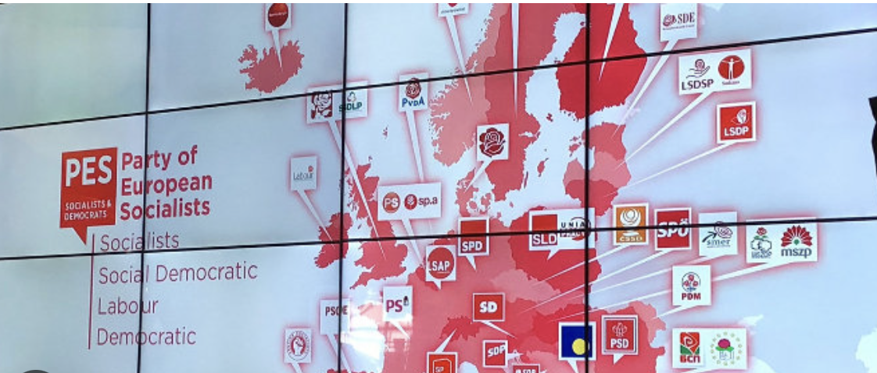
1. cleavages and European politics wise 2023/2024
6/16

Slide 11
2. Globalisation and cultural backlash wise 2023/2024
GLOBALISATION
Globalisation introduces the processes of denationalisation leading to the lowering and unbundling of national boundaries (Kriesi et al., 2008).
It opens up new opportunities for transnational, international and supranational mobilisation (Della Porta et a., 1999)
Given that in democratic politics, the political inclusion of citizens is mainly oriented towards nation state and a national affair. National politics remains the most important arenas for political mobilisation (Zürn et al. 2000)
Kriesi and his co-authors (2008) argue that the process of globalisation is perceived as a “new critical juncture” and results in ”the formation of new political cleavage” (p.4)
Their main argument is the processes of denationalization leads to the formation of a new structural conflict between winners and losers of globalisation
The new cleavage line between winners and losers of globalisation is expected to inevitably constitute potentials for process of political mobilisation within national political contexts.
Such potentials can be articulated at both electorates and political parties.
The new cleavage suggests the transformation of the demand and supply sides of electoral competition.
A new structural conflict between winners and losers of globalization
While the losers of globalisation are people whose life chances were traditionally protected by national boundaries. They perceive the weakening of these boundaries as a threat to their social status and security, the winners are those who benefit from the new opportunities resulting from globalisation (Kriesi et al., 2008, p.4-5)
7/16

Slide 12
2. Globalisation and cultural backlash wise 2023/2024
GLOBALISATION
The formation of winners and losers of globalisation is driven by three mechanisms
Economic competition
The erosion of politically based protected property rights leads to the clash between export-oriented firms and firms oriented towards the domestic market – a so-called sectoral cleavage
A sectoral cleavage indicates refers to the division between workers in exposed sectors and workers in sheltered sectors
Such a cleavage “cuts across the traditional class cleavage” and spill over to ethnic contexts, due to massive immigration into Western Europe
Cultural competition
Owing to massive immigration, migrants are perceived as potential threats to the standard and style of living of the natives in terms of jobs and the provision of the European welfare states granting social rights and privileges to the migrants as well as threats to the collective identity of the native population.
Political competition
Nation-states are losing part of their problem-solving capacity and scope of action, which means that the citizens’ political rights, which are mainly tied to the nation-states, are hollowed out
8/16

Slide 13
2. Globalisation and cultural backlash wise 2023/2024
CULTURAL BACKLASH
“Long-term structural changes in high-income post-industrial societies have been at the heart of culture shifts, particularly intergenerational population replacement, the rapid expansion of access to tertiary education, the growth of gender equality, migration flows creating societies that are more socially diverse, and processes of urbanisation”
Birth cohort is one of the strongest predictors of support for post-materialist values and socially liberal policy attitudes
Age-related differences in basic values and attitudes might theoretically be attributed to life-cycle effects, as people enter schooling and then the paid labor force, settle down with a partner to raise a family, and then eventually retire.
Period-effects, arising from watershed events stamping an indelible mark on public opinion, like feelings of security that existed on American soil before the perceived risks of terrorism after 9/11.
Cultural cleavages reflect enduring intergenerational differences based on birth-cohort effects: socialisation theory suggests that growing up under radically different circumstances from those that shaped earlier birth cohorts can leave an enduring mark on core values that subsequently endure throughout one’s life.
9/16

Slide 14
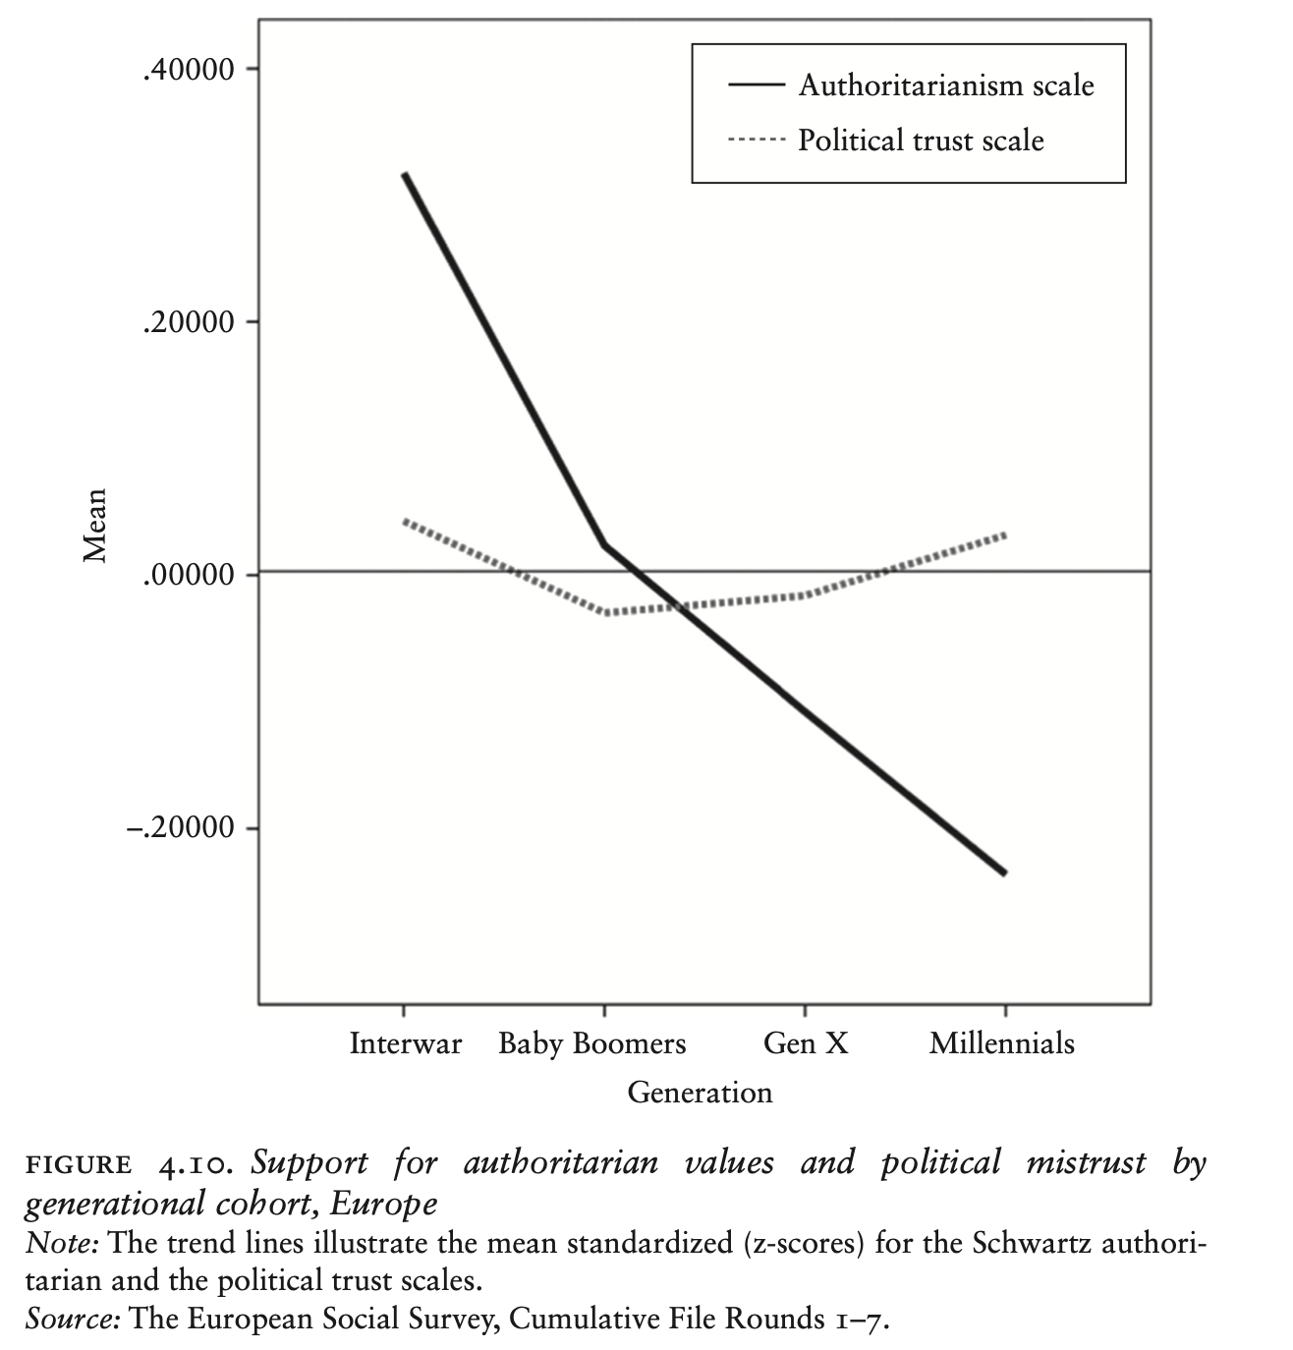
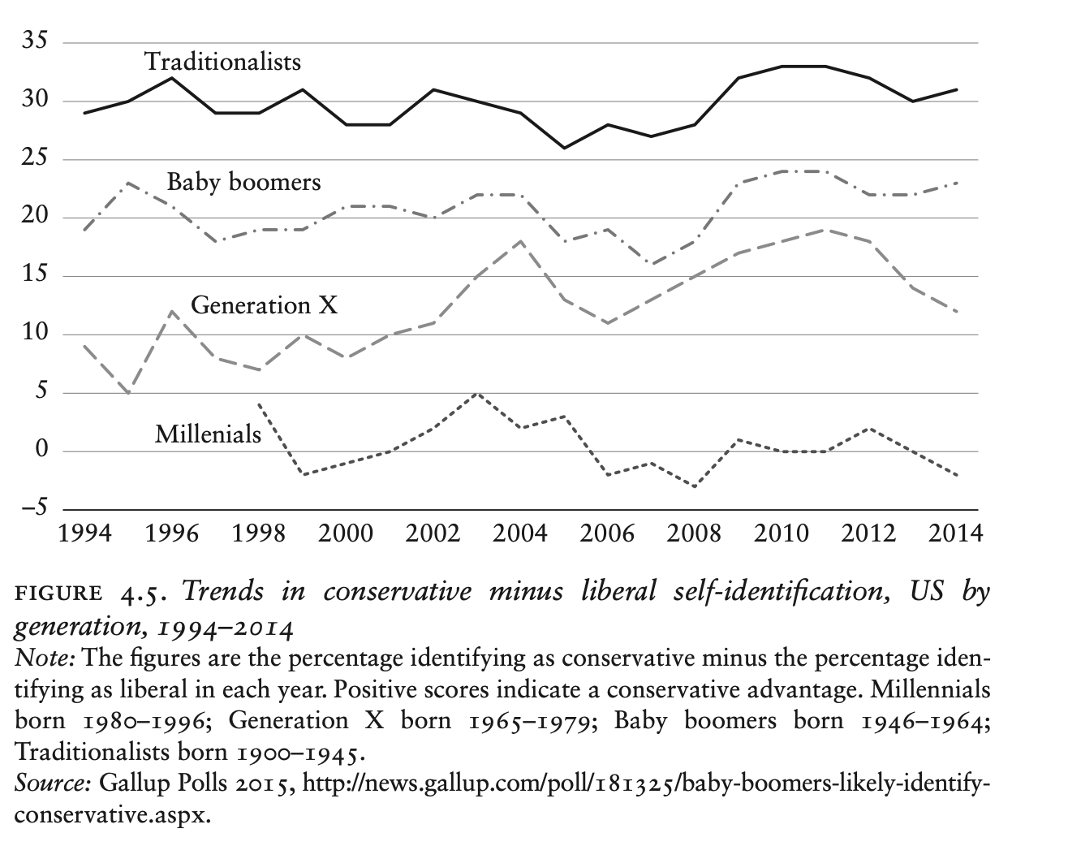
2. Globalisation and cultural backlash wise 2023/2024
10/16

Slide 15
Cultural Backlash
Globalisation
Intergenerational value changes
Dynamic changes ignited by endogenous factors
The processes of denationalisation
Dynamics changes due to the process of globalisation ignited by exogenous factors
11/16

Slide 16
3. the rise of radical right parties wise 2023/2024
Cultural cleavages
The rise of radical right parties
Mechanism
Electoral competition or market
12/16

Slide 17
4. Electoral choice, voter demand, and party supply wise 2023/2024
Elections is much like an economic market. Voters’ demands are anticipated and fulfilled within the political market when there are clearly established shared expectations about which parties or candidates are and are not viable (Cox, 1997)
The number and type of parties that voters are willing to vote for turns out to equal the number and type of parties that are willing and able to stand for election’ (Cox, 1997, p.8).
It is possible for political demands shared by a significant number of individuals to be left unsatisfied.
The situation tends to lead to electoral market failure, faciliting the rise of new parties
The impact of the new structural conflict on the structure of the political space depends on issue-mobilisation of political organisation, specifically referring to political parties.
The preferences of the voters change due to processes of social change that cannot be controlled by political organizations. But whether these changing preferences have political consequences or not fundamentally depends on their mobilization by political parties
Political parties play an important role in the cleavage formation (Mair, 1990; Sartori, 1990)
13/16

Slide 18
4. Electoral choice, voter demand, and party supply wise 2023/2024
The political mobilization of a latent structural potential by political parties provides dynamics of:
The transformation of the basic structure of the political space in a given country and of the parties’ positioning within the transforming space.
The political potentials (conflicts, issues and issue-specific preferences in the electorate) are articulated by the individual parties, i.e. the parties are restructuring the space.
The individual parties are repositioning themselves strategically within the emerging dimensional structure of the space and their competitors – their adjustment is in response to the changing structure.
The transformation of the basic structure is usually distinguished between an economic dimension and a cultural dimension of the integration–demarcation divide.
Social economic dimension
Social-economic policy, namely the regulation of market and construction of social protection by the state
Cultural dimension
Religion-related issues
14/16

Slide 19
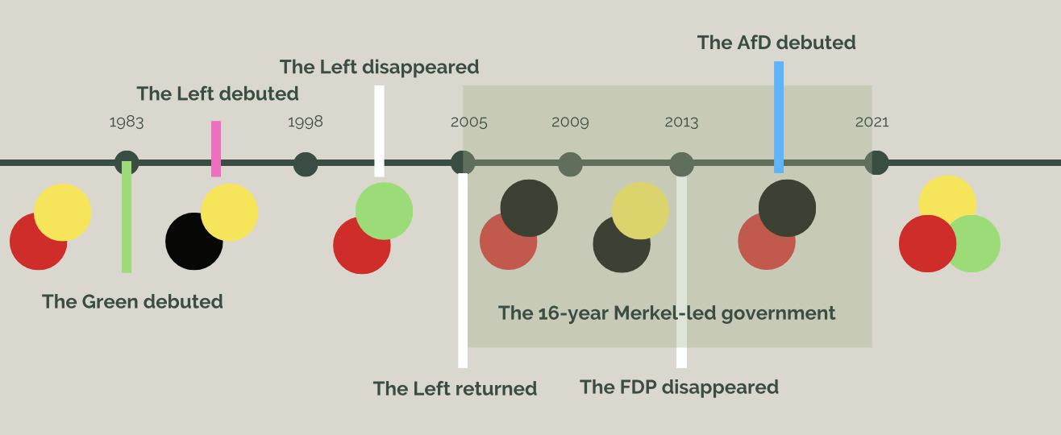
4. Electoral choice, voter demand, and party supply wise 2023/2024
THE MECHANISM OF SUPPLY- AND DEMAND-SIDE FACTORS IN ELECTORAL COMPETITION
Ivarsflaten (2008)’s findings suggested that no populist right party performed well in elections around 2002 without mobilising grievances over immigration. Several examples of radical right parties experiencing electoral success without mobilising grievances over economic changes or political elitism and corruption
The evolution of German party system change
15/16

Slide 20
5. summary wise 2023/2024
European political space has long been structured by four classic cleavages:
This session systemically delved into the relationship and connection between cultural cleavages and the rise of radical right parties in Western Europe
Following the Kriesi et al (2008)’s findings, the process of globalisation, as an exogenous factor, introduces the new structural conflict on the structure of the political space. On the other hand, Norris and Inglehart (2019)’s findings explain the cultural backlash against the silent revolution by introducing intergenerational value changes
16/16

Slide 21
Thank you for your attention
Email: Thareerat.Laohabut@gsi.uni-muenchen.de
Webpage: https://cps-lmu.org/people.html https://thareeratlaohabut.wordpress.com

