Slide 1
Encouraging Creative Thinking Bloom, good questions and creative tasks
Petra Vallin

Slide 2
Program
Double diaries
Bloom`s taxonomy
Good questions and creative tasks in a creative school

Slide 3
Double diaries – group discussion (10 min)
DOUBLE DIARY (for watching a video)
WHAT YOU SEE OR HEAR Describe what you have seen or heard in the video. You may copy what the people say in the video. It should be something that inspires you. | WHAT YOU FEEL/THINK Write your own comments that come to your mind about what has been said in the video. If you get stuck you may use the sentence starters below.

Slide 4
Bloom`s Taxonomy
APPLY
EVALUATE
REMEMBER
UNDERSTAND
CREATE
ANALYZE

Slide 6
What is BLOOM‘S TAXONOMY?
a classification system used to define and distinguish different levels of human cognitive skills (i.e., thinking, learning, and understanding etc.)
published in 1956 by a group of American psychologists (Benjamin Bloom), revised in 2001 by Anderson a Kratwohl
used to inform or guide the development of assessments
created in order to promote higher forms of thinking in education
now used more for creating appropriate objectives and tasks for our students)

Slide 7
NEW LEVEL

Slide 8
Why to use Bloom`s taxonomy?
to organize objectives of our lessons
to create well-balanced lessons
to give our students appropriate tasks and questions
to encourage creative thinking in education

Slide 9
How to promote creativity in children
Use Divergent Thinking
Our students tend to use convergent thinking, which means they answer basic questions that do not require any creativity. Divergent thinking is the exact opposite. This way of thinking requires students to be creative.
Have students to do a lot of brainstorming, encourage students to think differently and explore different perspectives, and help students make connections to their ideas.
Ask „good“ questions and give open-ended tasks that encourage divergent thinking.

Slide 10
https://psychologycompass.com/blog/creative/

Slide 12
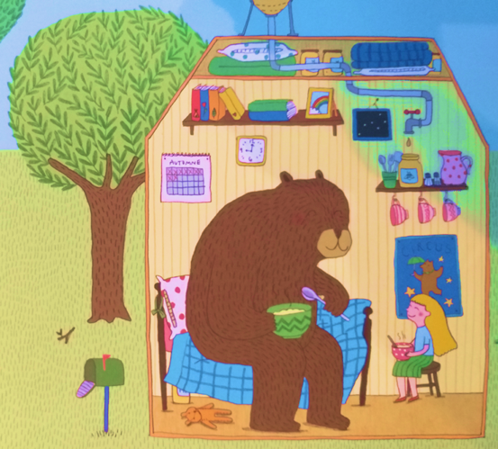

Slide 13
Questions before reading
What is the bear talking about with the girl?
Why is the girl smiling?
Which language are they speaking together?
How did the bear get to the house through the little door?
Is there anything weird in the picture? Is there something that could not happen in the real life?
Is it a dream or imagination?
Why are they meeting?
What happened on the roof?
Who is the third cup for?
Whose house is it?
Who did they met?
What happened before and after?
Why is the lettre box open?

Slide 14
Who is the author?
What was the artist thinking about when drawing the picture?
Are the characters real? Can you meet them in everyday life?
What relationship do they have?
What are they doing?
What gender dou you think they are?
Does she/he have tattoos or insects on her body?
What is the white circle?
How do they communicate?
How is like living where they are living?
What are they talking about?
How are you feeling about this picture?

Slide 15
Look at this picture. Which questions are coming to your mind?
Write at least 7.

Slide 16
Types of questions – which are which?
Do you know where these pictures come from? Which book?
What can you see in the picture?
Which tattoos does one of the character have?
Why do you think he wanted have the tattoos? What do they mean?
Who is the author of this book?
How many characters can you see?
What do you think the relationship between these two characters is?
Which names would you give to those characters?
Where do you think they live? What is their home?
What do you think will happen in the story in the first part?

Slide 17
Creative questions might appear in all school subjects.

Slide 18
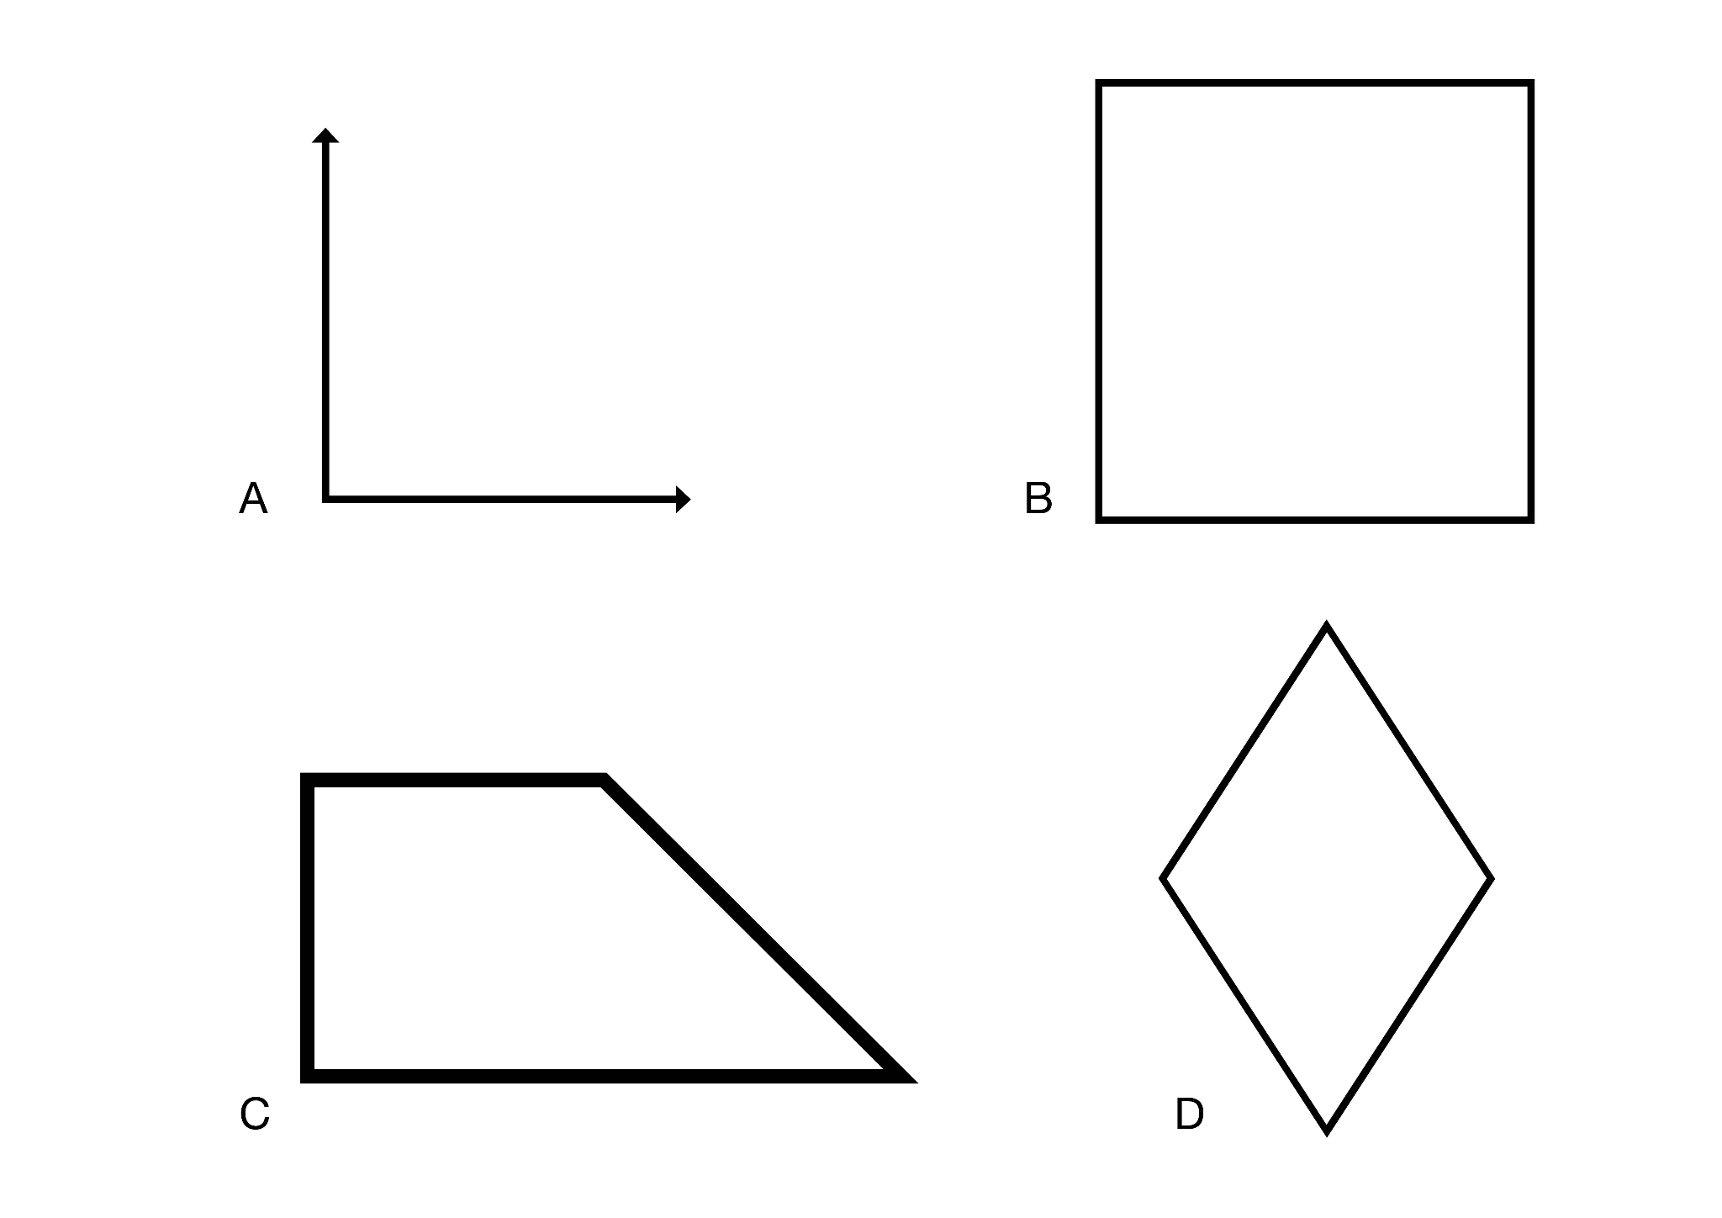

Slide 19
Is it ok to steal sometimes? In which situations?
What did the Little red riding hood and her grandma talk about in wolf`s stomach?
How do you recognize you are happy? Is it difficult to be happy?
What do you know about the mouse? What does it have in common with the cat?
What are the advantages and disadvantages of being a president?

Slide 21
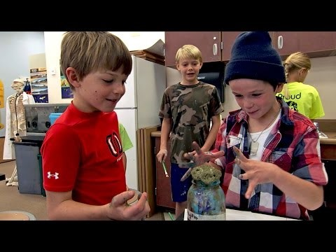
https://www.edutopia.org/practice/inquiry-based-learning-teacher-guided-student-driven

Slide 22
A school promoting creativity: Watch the video and try to answer the following questions:
What kind of tasks are the children working on?
Which teaching methods and strategies do teachers use?
What is the role of the teacher?
What makes this school „creative“?
Which competences are children acquiring while working on such tasks?

Slide 23
Two tasks in the video:
Seeds and eggs have mixed up in a laboratory. Decide which are which.
Make paint out of household items.

Slide 24
What teachers say about the inquiry-based learning:
Children are in charge: „Students guide the lesson“.
The teacher is only the facilitator: „Students are given the problem and then they drive it.
Children have power to change things: „Students are shaping where they want to go.“
Skills such as critical thinking and problem solving is promoted: „ We want the students to be critical thinkers and problem solvers.“
The projects are cross-curricular: „We want to show to the students that Maths is everywhere, Art is everywhere, Science is everywhere.“
Creative thinking is promoted: „Teachers are not taking over the creative process but they help it.“
It has positivite influence on children`s motivation: „Students are excited about finding answers to deeper level questions.“
We want them to love learning.

Slide 25
Inquiry-based learning as one of the creative approaches in education
primarily a pedagogical method, developed during the discovery learning movement of the 1960s as a response to traditional forms of instruction
highly creative approach in education
has its roots in constructivist learning theory
starts by posing questions, problems or scenarios - rather than simply presenting established facts
students have role of inquirers who will identify and research issues and questions to develop their knowledge or solutions
enables learning through an experience
teacher has a role of facilitator
teaching methods are generating new ideas!

Slide 26
REFLECTION: Tell us about …
Yellow – one piece of inspiration you got during this lesson
Blue – one new thing you have never thought about before
Red – one thing you have learnt and you`d like to always remember

