Slide 1
Jewish Enlightenment
„HASKALAH“

Slide 2
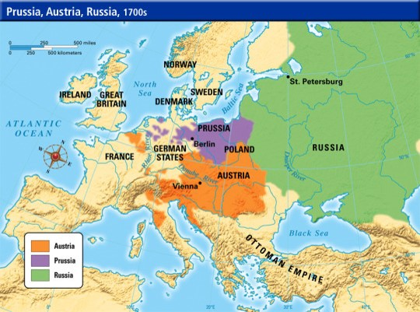
Historical context
Influence of European Enlightenment
Institute of „court – Jews“

Slide 3
Haskalah
Around 1770, Germany, Poland and Cenral Europe
ש – כ – ל = reason (sechel) – haskalah (rational wisdom) → Maskilim (followers)
Double purpose – emancipation of Jews as human being
- emancipation of Jews as Jews
Haskalah, Hasidim (founder - Israel ben Eliezer aka Baal Shem Tov), Mitnagdim (founder - Elijah ben Solomon Zalman, Gaon of Vilnius)

Slide 4
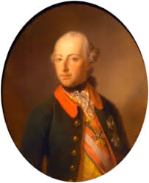
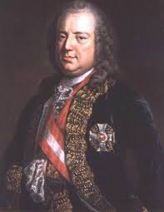
Education
Joseph II. (1782) Edict of Tolerance
– obligatory attendance at „normal“ or state school – needed for
marriage and Talmud study
- permission to study at state universities
Francis I. of Austria – rabbis have to study sciences and use the language of the country

Slide 5
1778 – first Haskalah school – Freischule (Hinukh Nearim), Berlin
1790s – schools for poor girls in Breslau, Dessau, Koenigsberg, Hamburg
1813 – school for boys and girls in Tarnopol
1820s-30s – network of schools in Russia
1810 – first training seminary for teachers in Kassel – others follow in Amsterodam, Budapest, Vilna…
Teaching language: german or russian

Slide 6
Language
1790 – French: language of the Jewish elite; German: language of the middle class.
fading of Yiddish – reason for antisemitism („Jews are deceiving non-Jews by using Yiddish in business transaction)
1806 – A Jewish Weekly in Amsterdam started to publishing in Dutch
1808 – Jewish Society in Amsterdam translated Bible and Siddur into Dutch
Revival of Hebrew – Biur by Moses Mendelssohn
Ha-Measef – first Hebrew publisher, Hevrat Doreshei Leshon Ever (Friends of Hebrew language
- 1783 – 1790 (regularly) and till 1811 (irregularly)
Bikurei ha-Itim (First fruits of the times) – 1821 – 1832, Vienna
Kerem Hemed (Vineyard of Delight) – 1833 – 1856, Vienna, Prague and Berlin

Slide 7
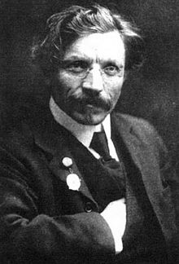
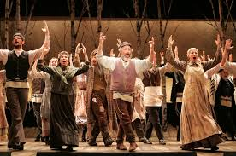
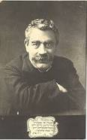
Literature
Sholem Aleichem (1859 – 1916) – Russian Empire
Tevye‘s Daughters
I. L. Peretz (1852 – 1915) – Poland
Hasidic, The Magician, Folktales

Slide 8
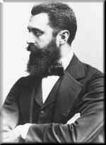
End of the Haskalah
Three outcomes – total assimilation
- anti-semitism
- zionism – Hovevei Zion (Lovers of Zion) – 1870
- promotion of immigration to Palestine
- Theodor Herzl, First Zionist Congress (Basel, 1897)

Slide 9
Homework
Please listen to this presentation. Read E. Schweid, The Idea of Modern Jewish Culture, chapter 5, pp 24 – 35.
Explain in your own words (300 – 400 words) how haskalah changed the character of Jewish education and what the social impact was.
Send me your paper via e-mail (jana.tomesova@ff.cuni.cz) before 17th April

