Slide 1
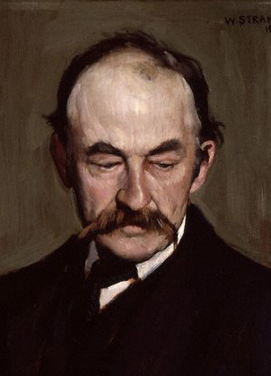
Naturalism: European and American
European Naturalism (Émile Zola, Thomas Hardy …)
influence of the natural sciences, dominated by Darwin’s theory of evolution based on the - rather trivialized - doctrine of the “survival of the fittest”),
strict determinism: narrative causality is regulated by impersonal biological or social forces, rather than by actions of individual characters, and
scientific methods of writing based on observation and experiment.
American Naturalism (Frank Norris, Stephen Crane, Theodore Dreiser, Jack London)
a great emotional involvement in the lives and passions of characters, e.g., Henry Fleming in Stephen Crane’s The Red Badge of Courage
chance and chaos instead of biological and social determinism: The Education of Henry Adams,
some authors (Frank Norris) prefer romance as an imaginative method of writing which is not based on the laws of objectivity and probability
Problem of objectivity (Howells‘ A Hazard of New Fortunes): if the author of a realistic novel places herself/himself to the position of the omniscient God (authorial omniscience), it does not guarantee the objectivity of the narrative. On the contrary, Howells‘ novel emphasizes a subjective perspective of the narrator: “The whole at moments seemed to him lawless, Godless; the absence of an intelligent, comprehensive purpose in the huge disorder.”
Top: Émile Zola in 1902 (aged 64). Bottom: Thomas Hardy at 53 by William Strang (1893)

Slide 2
The Education of Henry Adams (1906,1907)
An autobiography of Henry Adams (1838-1918), a descendant of two American presidents (John Adams, John Quincy Adams) and a Harvard professor of history.
the collapse of moral order and the final failure of the Enlightenment project of education (J.-J. Rousseau). Instead of developing the selves of their pupils, the educators demanded their self-effacement. As a result, they did not produce men, but mere manikins (dwarfs as well as “mannequins”). This is the end of the “central man,” since manikins are replacable by any other figure.
As a result, the universe has no longer any unity, such as that represented by medieval cathedrals. The Education, subtitled The Study of Twentieth-Century Multiplicity, is a sequel of Mount Saint Michel and Chartres: a Study of Thirteenth-Century Unity (1904). (see right bottom: Chartres)
Adams assumes that the unity of the universe is dynamic, based on the central source of power. In the Middle Ages, this source of power, including both fecundity and mercy, was believed to be Virgin Mary as the mother of God (this symbolism was alienated from the U.S. Americans by Puritanism but is still much alive in Latin America – e.g. Virgin Mary of Guadalupe, the national symbol of Mexico). This symbolism also informs the unity of medieval cathedrals. In the modern age, the cult of the Virgin was replaced by the cult of the machine as the source of power. However, this power can no longer be represented in anthropomorphic terms. Adams chooses a new invention generating electricity – the dynamo – which becomes a symbolic antithesis to the Madonna.
American Naturalism: traces the links between chaos, energy, and history. Convergence of radical investigative journalism (muckraking) exposing the crimes of big corporations (Ida Tarbell, The History of the Standard Oil Company, 1904) and the experimental social novel (Frank Norris, Stephen Crane, Theodore Dreiser), focusing also on animal-human relations (Jack London).

Slide 3
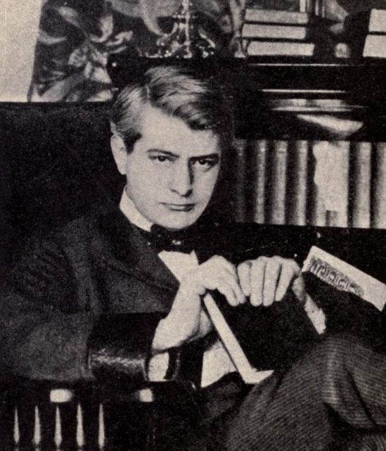
Frank Norris (1870-1902)
Although a native of Chicago, his life and most fictions are connected with California, from San Francisco through the Central Valley to the Death Valley. He became acquainted with the sources of naturalism (Darwin, Spencer) during his studies at UC Berkeley. Regrettably, he also imbibed ideologies of racism and antisemitism, which negatively influenced his fiction writing. He started his career as a journalist for the San Francisco Chronicle, reporting from South Africa. Later he covered the second U.S. – Spanish war in Cuba (1898) for the McClure Magazine. He died of the consequences of ruptured appendix.
Norris‘ major work is the unfinished “Wheat Trilogy” dealing with the growing of wheat and with the speculations with it on the stock exchange. Wheat as a natural product becomes a commodity and its fate represents the growth and transformation of U.S. capitalism, especially the rapid expansion of railroads and global trade.
The first part of the trilogy, The Octopus (1900) deals with the vain fight of the prosperous wheat farmers in San Joaquín Valley south of Stockton, California, against a railroad company. To seize their land the company assumes control of all important businesses and institutions and gains influence over the government. Neither the farmers‘ protests and armed resistance, nor poetry about their tragic fight succeed to rally public opinion against the company. The poet decides to appeal to the president of the company. Instead of the inhuman criminal he expects to see, he faces a cultivated gentleman. He comes to understand that the situation is the result of the power of the system, not of individuals.
The second part of the trilogy, the unfinished novel The Pit , combines the stories of a businessman speculating with wheat at the Chicago Board of Trade Building and of his love affair with an actress. The title of the novel, “the pit” indicates both environments, meaning the “trade pits” (corn elevators with which the hero speculates) as well as the stalls (most expensive seats) in a theatre.
Top: Norris at 31
Bottom: A Corner in Wheat,
D.W. Griffiths‘ 1909
silent film adaptation of an
episode from The Pit.

Slide 4
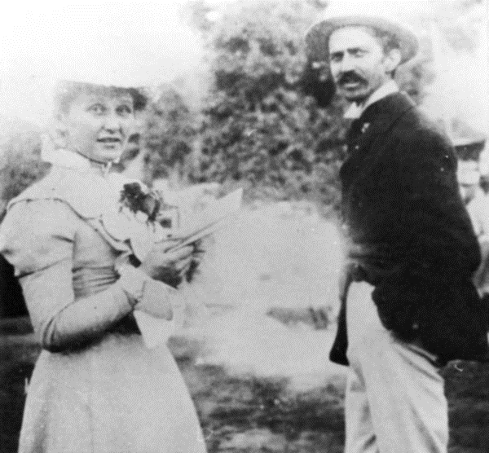
Stephen Crane (1871-1900)
Born in Newark, NJ, as a son of a Methodist minister from an old family of Puritan colonists of Connecticut. Began writing at 4 and had first articles published at 16. After an unfinished university study (Syracuse, NY) he worked as a reporter (mostly for New York Tribune) Like Norris, he covered the war in Cuba (1898) and almost died in a shipwreck (the tale “The Open Boat”). He lived with a former prostitute Cora Taylor, who also became a journalist covering with him the Greek-Turkish war in Greece. Died of tuberculosis at Badenweiler in the Schwarzwald (Germany).
His works deal with the aspects of violence in the life of individuals, and by their fight for survival in the inhuman society and nature. His first longer fiction, a novella Maggie: A Girl of the Streets (1893), is a depressive story about social decline and debasement of a young woman caused by her mother‘s alcoholism, male violence and social hypocrisy. Crane throws critical light on the unjust treatment of women and their sexuality.
His most important work, the first modern war novel, The Red Badge of Courage (1895), was written without any authentic war experience, but this does not mean that it lacks power.
Crane singled out the most important moral problem of the modern war: the absence of traditional heroism and its substitution with tremendous anxiety and fear.
Top: Crane at 23 in 1894
Bottom: Crane and Cora
Taylor

Slide 5
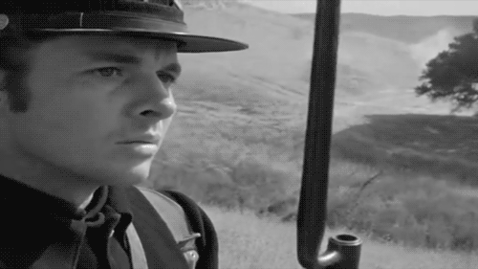
War and Heroism in The Red Badge of Courage
Henry Fleming, the hero of the novel, fails when he attempts to face the terror of hand-to-hand combat, and flees. Fortunately, he ends up in a group of wounded soldiers, and is also injured.
In spite of his good luck he inwardly suffers because of his lack of courage and failure in battle. His suffering is aggravated when he sees his friend Jim Conklin maimed and cannot prevent his death.
On the next day he suddenly starts to fight frantically. Seizing the regimental colors while under enemy attack, he re-establishes his reputation.
The important fact is that his ‘heroism’ does not have any moral or patriotic motive: it is an action of a similar kind as his escape from the battle line.
The moment of facing the impersonal and cruel war machinery becomes an experience of great personal importance for Henry.
Having resisted the awful power he is now ready to combat the egotism in himself.
In this way, he can understand the meaning of the violence and even have “a large sympathy for the machinery of the universe.”
War does not seem “unnatural” to him any longer, it is similar to processes and events in the universe.
Top: A comics version of the novel: Bear Alley Books (UK 2010)
Bottom: Henry Fleming in John Huston‘s The Red Badge of Courage (1951)

Slide 6
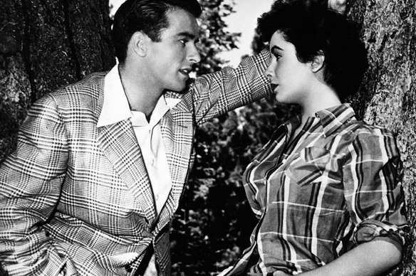
Theodore Dreiser (1871-1945)
Born in Indiana as a son of a German immigrant and a mother from a religious community of Mennonite farmers in Ohio. Attended University of Indiana without graduation, then worked as a journalist for the Chicago Globe and the St. Louis Globe-Democrat. Became a political activist (fought against lynching, supported Sacco and Vanzetti), later praised Soviet Russia and Stalin, joined the Communist Party of the U.S.
His best work is his first novel, Sister Carrie (1900). Its story undermines the myth of an innocent American girl created by Howells and others. Carrie Meeber comes from Wisconsin to Chicago, and soon loses her illusions about city life. To do away with everyday drabness and social insecurity she uses her charm to win a well-to-do lover, a seemingly affluent salesman. Later she becomes aware of his inferiority and finds a more wealthy and intelligent man, the manager of a fashionable bar. Though he has left his wife for her, he ceases to satisfy her, when he loses the money they stole, and becomes dependent on her. As a star in musical comedies Carrie no longer needs him, and he finally commits suicide.
Sister Carrie is important
- for the concentration on the desires, dreams and fears of average Americans,
- as the cause of Dreiser’s long-lasting fight with censorship. The first edition of the book was
suppressed by the publisher because of “immorality” and the novel could appear only after
seven years.
Other works include The Trilogy of Desire, modelled on a life of a Chicago speculator Charles T. Yerkes: The Financier (1912), The Titan (1914), and The Stoic (published posthumously in 1947). Uncontrollable sexual drive linked with attempts at the hero‘s social ascent are topics of The Genius (1915), a novel about a failed artist, and An American Tragedy (1925) about a social ascent of a poor boy ending with a murder and a capital punishment.
Top: Dreiser at 39 in 1910.
Bottom: Montgomery Cliff and Elizabeth Taylor in George Stevens‘ adaptation of American
Tragedy, A Place in the Sun (1951)

Slide 7
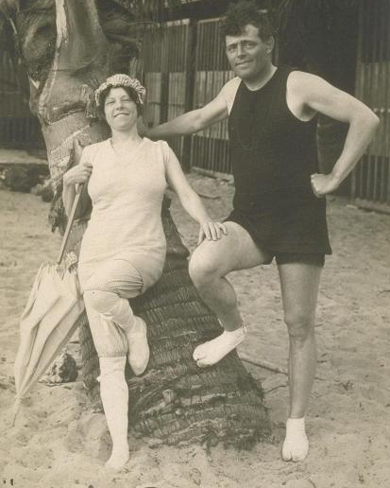
Jack London (1876-1916)
Born John Griffith Chaney. His mother was a music teacher and a spirtualist claiming to impersonate a famous Indian chief Black Hawk. His studies at UC Berkeley in 1897 (reading of Nietzsche) finished when his assumed father, an astrologer William Chaney, disclaimed his fatherhood and indicated that his mother had affairs with a number of men. London quit the school and went to the Klondike (north Canada) during the gold rush boom. As a journalist he later (1904) covered the Russo-Japanese war in Japan, Korea and China for the San Francisco Chronicle, was arrested twice and released only at a personal intervention of President Theodore Roosevelt.
Neither the career of the artist, a working-class self-made man in the semi-autobiographic Martin Eden (1909), nor the beastly life of a ruthless adventurer Wolf Larssen in The Sea-Wolf (1904) are for him solutions to the deepening individual and social crisis. His works seem to offer two ways from the universal chaos of the naturalists.
- a utopian golden age modelled more after his desires than after the Marxist doctrine - The
Iron Heel (1908), depicting the collapse of the long fascist reign of monopolies in the future,
- a return to nature: The Valley of the Moon (1913) - a young couple find peace in the rural
retreat of Sonoma County (wine growing region north of San Francisco), after the difficult life
in the Bay Area. L. spent his later life at the Beauty Ranch at Glen Ellen in the Sonoma County.
London was also an animal rights activist. His major works, The Call of the Wild (1903) and White Fang (1906), focus on the life of dogs losing instincts of subordination to humans, leaving civilization and rediscovering the values of the animal world. Overcoming anthropocentrism, London anticipates post-humanism.
Top: Jack London and his
second wife Charmian at
Waikiki in 1915. Bottom: The
dog Buck in Chris Sanders‘
2020 adaptation of The Call.

