Slide 1
The Impact of Animal-Product Consumption on the World around Us
Katarína Školárová
2021

Slide 2
introduction
Is going vegan really better for the environment?
My seminar work deals with the issue of the climate crisis and its possible solution - the vegan lifestyle.
The main aim of my work is to introduce the reader to the effects of meat and dairy consumption on our environment and explain how great is the part, that factory farming takes in the environmental crisis of our planet.
keywords: Veganism, Environment, Environmental Crisis, Animal-Product Consumption, Lifestyle

Slide 3
the main aims of my presentation
find out, how big is the part, that animal-product consumption plays in causing the climate crisis
raise awareness on these issues
to come up with some solutions, that can be applied to everyone’s daily life

Slide 4
What is veganism?
„Raising animals for food requires massive amounts of land, food, energy, and water. The byproducts of animal agriculture pollute our air and waterways. By shunning animal products, vegans are de facto environmentalists.“
a lifestyle that excludes, as far as possible, the consumption or any use of animals for human needs
a vegan diet does not contain any products or raw materials of animal origin, thus excluding meat, fish, dairy products, eggs, and sometimes also honey
it is an overall lifestyle that generally rejects or at least seeks to limit the use of animals in the garment, dermatological or entertainment industries and other areas of life

Slide 5
What is the climate change and the climate crisis?
changes of anthropogenic origin (made by human activity)
The current change is caused by a change in the atmosphere and the excessive formation of greenhouse gases (GHG).
The rapid warming of the Earth is causing major changes in the weather, which brings with itself issues like problems with growing a number of crops, which are people depending on, a lack of rainfall or, conversely, floods.

Slide 6
While we, Europeans, have not registered this change directly yet , it is people from third countries and developing countries who are affected the most; due to crop losses, home losses due to drought, floods or fires.

Slide 7
a number of greenhouse gases (GHG) naturally occur in the Earth´s atmosphere
Methane
Nitrous oxide
Water vapor
Carbon dioxide

Slide 8
The greenhouse gas contents of the atmosphere is being altered by human activity.
The result of this change is global warming.

Slide 9
What impact has the animal production on our environment?
The demand for food is growing more and more with growing population.
Meat and dairy products are a large part of this food production, and it is the demand for meat and meat products that is expected to double by 2050. (Steinfeld et al., 2006)
Intensive livestock production not only contributes to a high level of GHG emissions, but may lead to overuse of fertilisers and other inputs which create environmental problems, such as contaminated soil and increased nutrient levels in waterways. (Steinfeld et al., 2009).

Slide 10
methodology
tool of searching for adequate literature for my work:
Google Scholar
Keywords used:
veganism, climate change, climate crisis, environmental veganism, cause of climate change, climate veganism

Slide 11
research

Slide 12
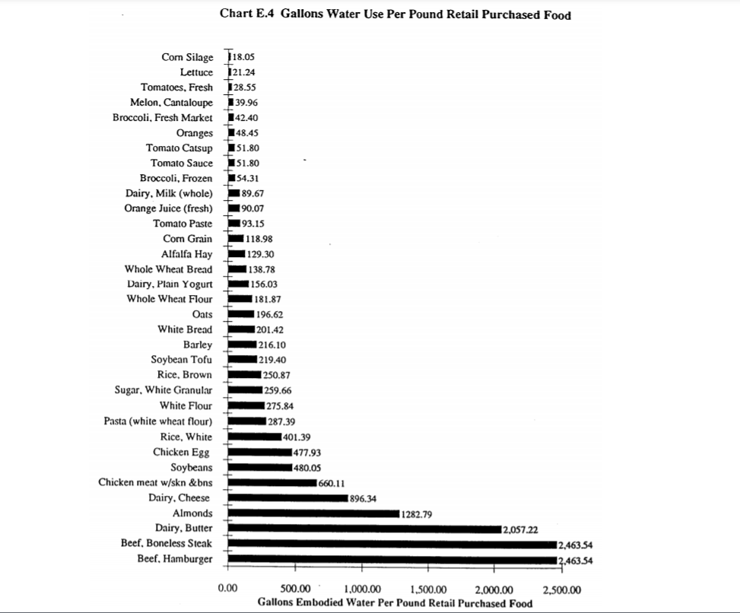
research - gallons of water used per pound retail purchased food
This study focuses on analyzing the amounts of water that are used to produce various types of food.
(Kreith, 1991, p.7)

Slide 13
research – the anthropogenic sources of methane
Methane is released by coal mining, landfills, and by agriculture, particularly through the digestive processes of beef and milk cows.
(Hardy, 2003, p.17)

Slide 14
results of my research
Reducing the demand for meat, dairy, and other animal products would therefore reduce it´s production and thus significantly reduce the amount of greenhouse gases and other pollutants produced by this industry.
Hence, the claim that a vegan or vegetarian diet is one of the greatest steps an individual can take to save the climate is true, and this way of life is really one of the possible solutions.

Slide 15
What can you do?
„We got here because of our lifestyle, so our lifestyle has to change.“
change your means of transportation
reduce your livestock-product consumption
conserve heat, electricity, and water
reduce waste

Slide 16
A short video dealing with the question if veganism really is better for our environment...
https://youtu.be/6oUG_Q5yBjY

Slide 17
conclusion
There are, of course, factors with bigger impact on the environment, such as the energetic sector, which we, as individuals, often have no control over. In comparison with the influence e.g. large corporations have, such a step may seem unnecessary or useless.
Climate veganism has its opposers, as well as people who strongly stand by its benefits. We can see there are valid arguments for veganism being helpful in reducing the impact of climate change.

Slide 18
list of references
Smithsonian Institution, “Smithsonian Researchers Show Amazonian Deforestation Accelerating,” Science Daily 15 Jan. 2002.
Theo van Kempen, “Whole Farm Water Use,” North Carolina State University Swine Extension, Jul. 2003
Rick Grant, “Water Quality and Requirements for Dairy Cattle,” NebGuide, Cooperative Extension, Institute of Agriculture and Natural Resources, University of Nebraska-Lincoln, 1996.
Marcia Kreith, “Water Inputs in California Food Production,” Water Education Foundation 27 Sept. 1991.
Daniele Fanelli, “Meat Is Murder on the Environment,” New Scientist 18 Jul. 2007.
Archer, D. & Rahmstorf, S., „The Climate crisis: An Introductory Guide to Climate Change, “ Cambridge University Press, 2010.
Raphaely, T. & Marinova, D., „Impact of Meat Consumption on Health and Environmental Sustainability, “ IGGY Global, 19 Oct. 2015.
Goodland, R., & Anhang, J. (2009). Livestock and climate change: What if the key actors in climate change are... cows, pigs, and chickens?. Livestock and climate change: what if the key actors in climate change are... cows, pigs, and chickens?.
von Mossner, A. W. (2021). Feeling Bad? Veganism, Climate Change, and the Rhetoric of Cowspiracy. In Veg (etari) an Arguments in Culture, History, and Practice (pp. 245-269). Palgrave Macmillan, Cham.
Ternes, B. (2013). Rapid Climate Change: Causes, Consequences, and Solutions.
Haldar, I. (2011). Global Warming: The Causes and Consequences. Readworthy.
Hardy, J. T. (2003). Climate change: causes, effects, and solutions. John Wiley & Sons.

Slide 19
Thank you for your attention! In case of any questions, please do not hestitate to contact me at katarina@skolar.name

