Slide 1
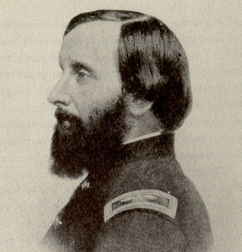
Emily Dickinson (1830-1886)
Born in Amherst, MA, where she lived for the rest of her life, leaving it only for a trip to D.C. and Philadelphia (1855), and a short stay (1847-8) at the Mount Holyoke Female Seminary (now Mount Holyoke College, still for women and transgender students) about 10 miles from Amherst. She also studied at Amherst Academy, her overall study (except primary school) lasted less than 8 years. It focused on English literature, Latin, geology, botany, history and arithmetic.
She never married, lived in seclusion and was considered eccentric, e.g., for her permanent wearing white dresses. In spite of her solitary life, she had a few friends, who influenced her emotionally and/or contributed to her literary creation:
- Benjamin Franklin Newton, a young attorney, introduced her to the works of William
Wordsworth and R.W. Emerson
- Susan Gilbert, her sister-in-law with whom she could have had a Platonic homoerotic
relationship, and who “with the exception of Shakespeare” has imparted her “more
knowledge than any one living.”
- Reverend Charles Wadsworth, a famous minister whom she met in Philadelphia and
corresponded with until his death in 1882.
- Samuel Bowles (and his wife Mary). Bowles was the owner and editor of Springfield
Republican where a few poems by D. (the only ones published in her lifetime) appeared
- Thomas Wentworth Higginson – an abolitionist and literary critic. He discouraged D.
from publishing before she would have produced a larger body of poems. After her death he
edited a selection from her poetry together with Mabel Loomis Todd (who was in love
with D.‘s brother Austin). Criticized Todd‘s changes in D‘s poems.
- Otis Philips Lord –a retired judge of Massachusetts Supreme Court. Read Shakespeare with D.
Top: a daguerrotype of
Emily Dickinson from
Mount Holyoke. Bottom:
Thomas W. Higginson

Slide 2
Dickinson’s Poetry: Introduction 1
Dickinson‘s poetry stresses and transcends the limits and determinations of the self – woman‘s position in a patriarchal society with puritanic and evangelical roots (marriage as a preparation for eternal life: husband-God, wife-church). In 1845 D. experienced a religious revival event in Amherst, but this did not make her a practising Christian. Her independence from Christian doctrine is evident from an ironical poem written to her dear friend Charles Wadsworth (a famous minister).
Poem 640 (on the right; Dickinson‘s poems are not titled but numbered):
- melting the figures of husband and God (“You” and eternal
“Life”)
- linking the Christian symbolic meaning of marriage and the
everyday houskeeping chores
- ironic metaphor: “our Life - His Porcelain” – a parallel between
death and the emptiness of housewife‘s life (dusting china cups).
- debasement of human life - individuals “discarded” and
replaced, like old cups with the new fashionable ones – the Sèvres
porcelain (French factory near Paris).
I cannot live with You—
It would be Life—
And Life is over there—
Behind the Shelf
The Sexton keeps the Key to—
Putting up
Our Life— His Porcelain—
Like a Cup—
Discarded of the Housewife—
Quaint— or Broke—
A newer Sevres pleases—
Old Ones crack.
(poem 640)

Slide 3
Dickinson’s Poetry: Introduction 2: In Search of New Eternity
Poem 712 – in the left column (the right column displays the text of the 1890 edition heavily edited by Mabel Loomis Todd who also added a rather meaningless title) ironically develops the religious allegory of death as the wedding of the soul with God.
The ironic effect is enhanced by the portrayal of death as an elegant and kind gentleman, whose politeness (“civility”) dispels the fears of the soul-bride.
However the fears reappear when the smooth progress out of the reality of everyday life (school, children, fields, grain) – marked by the repetition of the phrase “We passed” (anaphora) - comes to a halt (“We paused”) and the bride sees that the end of the journey is different from what is described in the religious doctrine: the grave instead of “Immortality”
The bride is deceived – like “Immortality,” the religious idea of “Eternity” promised unending joys of the Paradise, while here there is nothing else than the grave (“A Swelling in the Ground”) where she will lie for an endless time (“’tis Centuries – and yet / Feels shorter than the Day).
Thus, Dickinson’s poetry is in search of NEW ETERNITY, which is:
- inexpressible in religious or empirical terms (“feels shorter than the
Day”), but
- expressible in language or verse: “next time”, “another time”:
“Next time, to stay! / Next time, the things to see / By Ear unheard, / Unscrutinized by Eye - // Next time to tarry, / While the Ages steal - / Slow tramp the Centuries, / And the Cycles wheel!” (poem 160)
Because I could not stop for Death — He kindly stopped for me — The Carriage held but just Ourselves — And Immortality. We slowly drove — He knew no haste And I had put away My labor and my leisure too, For His Civility — We passed the School, where Children strove At Recess — in the Ring — We passed the Fields of Gazing Grain — We passed the Setting Sun — Or rather — He passed Us — The Dews drew quivering and Chill — For only Gossamer, my Gown — My Tippet — only Tulle — We paused before a House that seemed A Swelling of the Ground — The Roof was scarcely visible — The Cornice — in the Ground — Since then — 'tis Centuries — and yet Feels shorter than the Day I first surmised the Horses' Heads Were toward Eternity — (poem 712) | THE CHARIOT Because I could not stop for Death, He kindly stopped for me; The carriage held but just ourselves And Immortality. We slowly drove, he knew no haste, And I had put away My labor, and my leisure too, For his civility. We passed the school where children played, Their lessons scarcely done; We passed the fields of gazing grain, We passed the setting sun. We paused before a house that seemed A swelling of the ground; The roof was scarcely visible, The cornice but a mound. Since then 'tis centuries; but each Feels shorter than the day I first surmised the horses' heads Were toward eternity.

Slide 4
Writing on the Verge of Time and Eternity Freedom of Language
Dickinson’s language does not merely express her thoughts and sense images. She as a subject does not matter, nor does this universe: “An unconcern so sovereign / To Universe and me- / Infects my simple spirit / With Taints of Majesty” (poem 290 – on the right, at the bottom). As a result, the language is not fully under her control, but expresses its freedom in several ways:
By figures of speech: strange metaphors, against the uses of language: catachresis (-ses) [kata'kri:sis]: “sophistries of June,”“blue and gold mistake” (poem 130 – on the right)
By punctuation: p. does not represent syntactic structure or a grammatical /logical order, but shows them broken by rhythms of speech (see poem 290 – on the right)
By rhyming: slanted or half-rhymes (consonances, assonances) frustrate readers’ expectations of the harmony of sound and stress surprising connections between words (“true” - “throe” [throb], which specifies an abstract word “Agony” – see poem 241 on the right; here the half-rhyme is based on consonance: r’s in “true” and “throe”)
Ironically put, Dickinson‘s harmony of verse is “preconcerted with itself”:
preoccupied with itself and therefore seeming strange to anyone expecting pleasing rhythms or rhymes
harmonized only by itself, having an internal harmony, which to some may appear disharmonious (poem 290 on the right)
These are the days when skies resume
The old— old sophistries of June—
A blue and gold mistake.
(poem 130)
Of Bronze— and Blaze—
The North— Tonight—
So adequate— it forms—
So preconcerted with itself—
So distant— to alarms...
(poem 290)
I like a look of Agony,
Because I know it's true—
Men do not sham Convulsion,
Nor simulate, a Throe— (poem 241)
An Unconcern so sovereign
To Universe, or me—
Infects my simple spirit
With Taints of Majesty
[…]
My Splendors, are Menagerie—
But their Completeless Show
Will entertain the Centuries
When I, am long ago,
An Island in dishonored Grass—
Whom none but Beetles—know.
(poem 290)

Slide 5
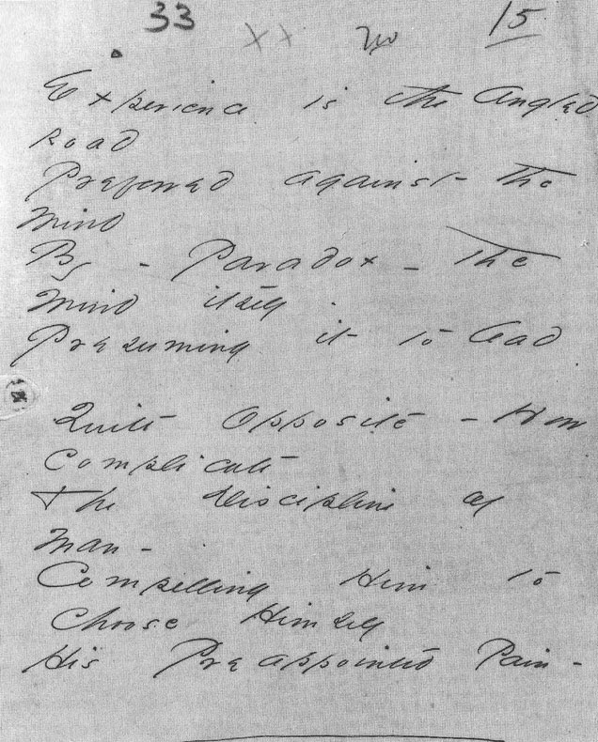
Publication History
In her lifetime, Dickinson published only seven of her poems.
The first edition of her poetry, containing 116 poems appeared under a simple title, Poems, in 1890. It was the work of her friend T.W. Higginson and of her acquaintance from Amherst, Mabel Loomis Todd (1856-1932), who was in possession of a substantial part of the manuscripts.
Another part of Emily’s papers belonged first to her sister Lavinia (1833-1899) and then to her niece Martha Dickinson-Bianchi (1866-1943), who published a selection of Emily Dickinson’s work under the title The Single Hound: Poems of Emily Dickinson (1914). Appearing at the dawn of Modernism, the book made Dickinson an influential poet with the new generation, including Ezra Pound (1885-1972), and especially Marianne Moore (1887-1972).
Gradually, Martha Dickinson published about seven-hundred poems in five collections. The publication of the poems owned by Mabel Todd had waited until 1945 because of the legal battle for the Dickinson property including Emily’s poems.
Only then, Mabel Todd’s daughter Millicent Todd Bingham (1880-1968) published a substantial selection of 668 poems entitled The Bolts of Melody, and the preparations of the critical edition of complete poems could begin.
In 1955 T.H. Johnson brought to light the whole corpus of 1775 poems. Though they were written in the provincial world of a former Puritan town, they have much more to say to the people of the twentieth or twenty-first centuries used to the global space created by technological civilization.
Above: the first posthumous edition by T.W. Higginson and M.L.Todd. Below: MS of D’s poem 910: “Experience is an Angled road”

