Slide 1
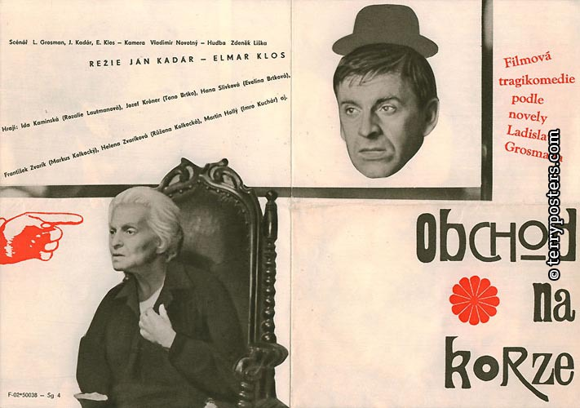
The Shop on the Main Street
Obchod na korze

Slide 2
The book

Slide 3
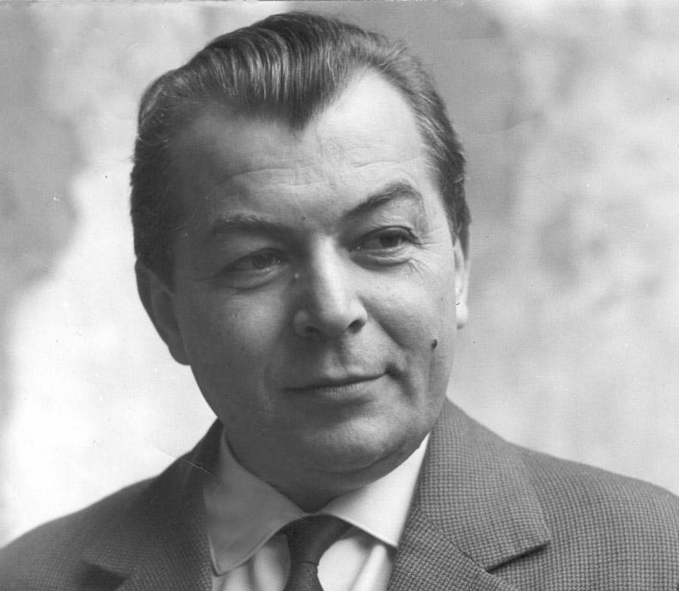
Ladislav Grosman
1921 (Slovakia, Humenné) – 1981 (Israel, small town near Tel-Aviv)
Writer, screenwriter, professor of Slavic literature
Author of novels about Holocaust
The shop on the Main Street (1965)
The Bride (1969)

Slide 4
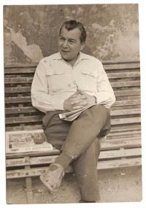
Ladislav Grosman
Persecuted during Holocaust due to his Jewish origin
Labor camp in Banská Bystrice
In Czechoslovakia he was working for different
newspapers and published The Shop on the Mainstreet
He emigrated to Israel after the invasion in 1968

Slide 5
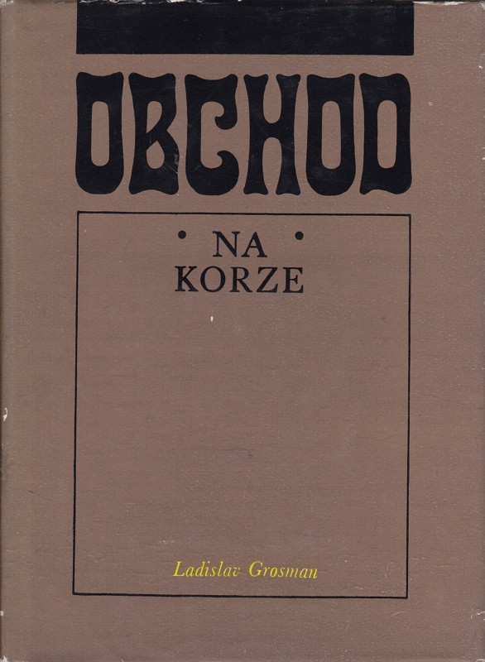
The Shop on the Main Street
Published 1965
First title – The Trap
Short novel

Slide 6
The movie

Slide 7
Ján Kaldár & Elmar Klos

Slide 8
Ján Kaldár & Elmar Klos
1918 (Budapest) – 1979 (Los Angeles)
Jewish origin
Kaldár survived the Holocaust by fleeing from a concentration camp
1910 (Brno) – 1993 (Prague)
They met in Prague right after the war
Together they shot 8 feature films during the 50’s and 60’s
Their cooperation stopped when Kaldár emigrated to USA

Slide 9
The Shop on the Mainstreet
1965
Directed by Ján Kaldár & Elmar Klos
Screenplay: Ladislav Grosman (Ján Kaldár & Elmar Klos)
Starring: Jozef Kroner, Ida Kamińska
First Czechoslovakian Oscar wining movie
Banned from cinemas during the Normalization period

Slide 10
Kaldár, Kamińska, Klos and the Oscar

Slide 11
The story

Slide 12
Tono Brtko, joiner, “ordinary man,“ becomes an “aryanizer” by a document, a piece of paper, given to him by his brother in law and a Hilnka’s guard commander Markus Kolkocký. Brtko suddenly becomes an owner of a small haberdashery originally owned by an old Jewish widow Rozálie Lautmanová. The nearly deaf widow doesn’t understand her situation and thinks that Tono Brtko is her new assistant. Tono also starts to repair her old furniture, eats delicious soups that Rozálie prepares but outside of the shop he acts like he does his job of being an aryanizer of Lautmanová. Brtko’s greedy wife is really happy he’s finally a rich man and a shop owner. Brtko has no reason to harm the old lady but he is afraid, he will be labelled as a “White Jew” for helping her. “A White Jew is worse than a Jew. He isn’t one of them, but he’s on their side!” says Kolkocký to Brtko. But than the day of the transport comes. Brtko finds out Lautmanová didn’t got the order for transport and decides to save her. But Rozálie doesn't seem to understand her situation and in a really emotional and tense scene Brtko and Lautmanová are both fighting to save their lives since they thing the other person is a threat to them. In the end Brtko sees through the window Kolkocký coming to the shop and pushes Lautmanová into a closet and closes quickly the door. But Kolkocký had no intention of entering the shop. When he walks away Brtko opens the closet door and finds out he had accidentally killed Rozálie. Horrified Brtko sees a hook in the ceiling and hangs himself.

Slide 13
Tono Brtko

Slide 14
Rozálie Lautmanová

Slide 15
Brtko‘s wife Evelína, Brtko, Brtko‘s sister in law and Brtko‘ brother in law Markus Kolkocký

Slide 16
The memorial on the main street celebrating free Slovakian state

Slide 18
Couple of notable and fun things
Jan Kadár at the Oscars: https://www.youtube.com/watch?v=A02DWktid5M
Ida Kamińska was a director of Yidish theatre in Warsaw
Ján Kadár directed a music video for the song Pramínek vlasů (https://www.youtube.com/watch?v=zOX299csGu8)
Juraj Herz who worked as an assistant director on The Shop on the Main Street is the director of next week’s movie The Cremator

Slide 19
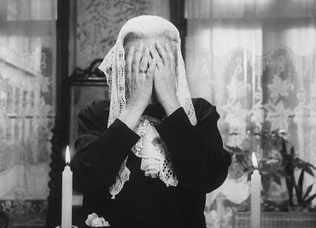
Thank you for your time
Valerie

