Slide 1
European Commission Proposal
Tatevik Vantsyan
Kevin Curran
Knut Øye Brandsås

Slide 2
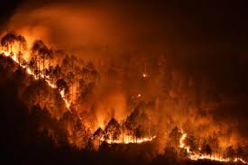
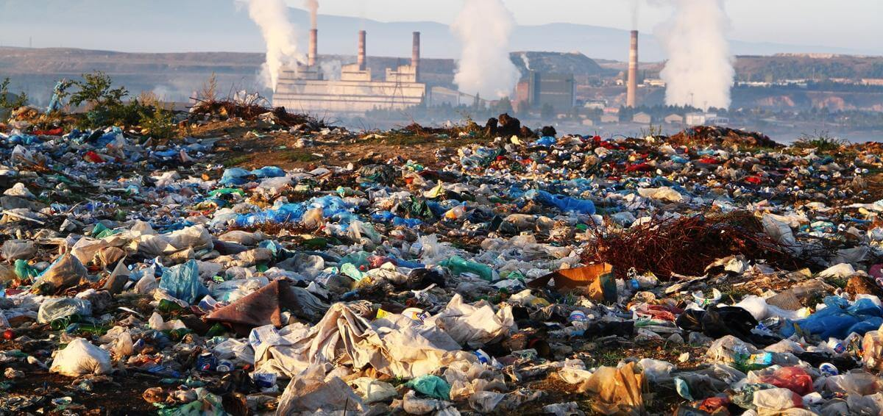
Background
Base case: Humans are contributing to climate change and we must act to curb our impact
Observable evidence from carbon intensive industry
About half of total greenhouse gas emissions
90% of biodiversity loss
Water stress
EU Impact
About 10% of world CO2 Emissions as a bloc
3rd largest in the world (absolute terms)
Production and use of energy accounts for about 75% of the EU’s greenhouse gas emissions
20% of greenhouse gas emissions come from extraction
Only 12% of material goods are derived from recycled materials

Slide 3
Long Term Effects Of Climate Change
Human mortality particularly in southern Europe
Air quality decreases
Increased prevalence of natural disasters
Food security
1 out of 8 million species at risk of being lost
Many plants and ecosystems could be irreparably damaged
Crop yields to fluctuate across the continent
Rising sea levels
Potential for further refugee crises based on arable and habitable land
Northward and inland
Particular impact on mediterranean and coastal areas of Southern Europe
Economic Impact
Energy demand for heating falls rapidly
Tourism, marine, agricultural industries upended
The poor and those that lack mobility are hurt the most
Notes:
For later, it could be worth pointing out to Poland that climate change leads to more people fleeing, potentially leading to more immigration to Europe

Slide 4
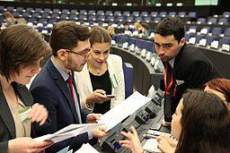
Disagreements Solutions
Budgets
Economic impacts
Sovereignty over national policy
Decoupling of economic and environmental aims
Protection of labor, innovation in industry
Long Term Transition
EIB Backing
Reinvestment in green industry
Primacy of collective action in areas that demand this coordination
Avoid future crises

Slide 5
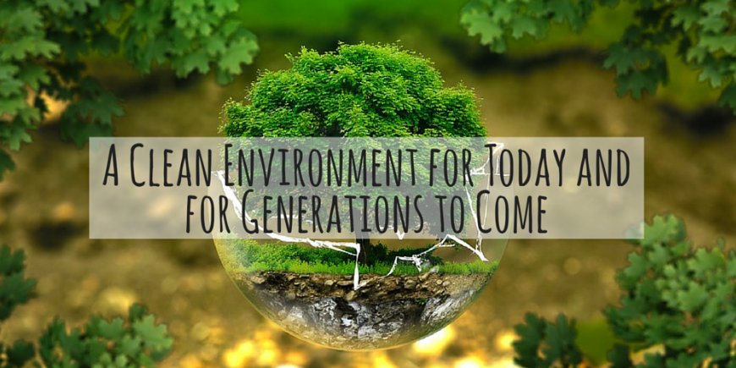
Action
Collective and ambitious
Carbon neutrality by 2050
Decrease CO2 emissions by 55% by 2030
Strong funding for the Multiannual Financial Framework
1.3% of gross national income
Discuss InvestEU expenditures as well

Slide 6
“In a world divided and beset by every type of conflict, the conviction is growing of a radical interdependence and consequently of the need for a solidarity which will take up interdependence and transfer it to the moral plane. Today perhaps more than in the past, people are realizing that they are linked together by a common destiny, which is to be constructed together, if catastrophe for all is to be avoided.” Paul II, P. J. (1987). Sollicitudo rei socialis.

Slide 7
References
Ayittey, F. K., Ayittey, M. K., Chiwero, N. B., Kamasah, J. S., & Dzuvor, C. (2020). Economic impacts of Wuhan 2019‐nCoV on China and the world. Journal of Medical Virology.
Paul II, P. J. (1987). Sollicitudo rei socialis.
Li, X., & Tilt, B. (2019). Public engagements with smog in urban China: Knowledge, trust, and action. Environmental science & policy, 92, 220-227.
McCloskey, B., & Heymann, D. L. (2020). SARS to novel coronavirus–old lessons and new lessons. Epidemiology & Infection, 148.
Mbeng, L. O. (2013). Informal waste recovery and recycling: alleviating poverty, environmental pollution and unemployment in douala, cameroon.
Krugman, P. (2010). Building a green economy. The New York Times Magazine, 5, 2-16.
Volintiru, C., Popescu, M. F., Franţescu, D., & Ciot, M. G. (2019). Political Support at EU Level for Energy and Environmental Policies. Romanian Journal of European Affairs, 19(2).
Babiker, M. H., & Eckaus, R. S. (2007). Unemployment effects of climate policy. Environmental science & policy, 10(7-8), 600-609.
Oberle, B., Bringezu, S., Hatfield-Dodds, S., Hellweg, S., Schandl, H., Clement, J., ... & Ekins, P. (2019). Global Resources Outlook 2019: Natural Resources for the Future We Want.

Slide 8
Allen, M., Antwi-Agyei, P., Aragon-Durand, F., Babiker, M., Bertoldi, P., Bind, M., ... & Cramer, W. (2019). An IPCC Special Report on the impacts of global warming of 1.5° C above pre-industrial levels and related global greenhouse gas emission pathways, in the context of strengthening the global response to the threat of climate change, sustainable development, and efforts to eradicate poverty. Switzerland.
Thuiller, W., Lavorel, S., Araújo, M. B., Sykes, M. T., & Prentice, I. C. (2005). Climate change threats to plant diversity in Europe. Proceedings of the National Academy of Sciences, 102(23), 8245-8250.
Ballester, J., Robine, J. M., Herrmann, F. R., & Rodó, X. (2011). Long-term projections and acclimatization scenarios of temperature-related mortality in Europe. Nature Communications, 2(1), 1-8.
Ullah, E. (2020). The Novel coronavirus outbreak: A challenge beyond borders. Pak J Surg Med, 1(1), 8-9.
Liu, S. L., & Saif, L. (2020). Emerging viruses without borders: The Wuhan coronavirus.
Gostin, L. O., & Hodge, J. G. (2020). US Emergency Legal Responses to Novel Coronavirus: Balancing Public Health and Civil Liberties. JAMA.
Gostin, L. O., & Hodge, J. G. (2020). US Emergency Legal Responses to Novel Coronavirus: Balancing Public Health and Civil Liberties. JAMA.

Slide 9
Thank You!

