Slide 1
The Constitutional Sociology of Europe:
Politics, Law and Society
Paul blokker, PhD
Institute of Sociological studies, Charles University
15 May, 2018

Slide 2
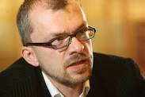
Constitutional Sociology
Special announcement
Jean Monnet Lecture by prof. Zdeněk Kühn
“The decline of liberal constitutionalism in Central and Eastern Europe”
Thursday 17 May – 11.00am
Room J1031
2
Notes:
2

Slide 3
Constitutional Sociology
Summary last class
Challenges to constitutional democracy
Economic crisis
Secessionism/regional identity
Obsoletion
Populism/sovereigntism
Transnational constitutionalism
-
3
Notes:
3

Slide 4
Constitutional Sociology
Final Exam
-The student will be evaluated at the end of the course by means of a written essay, to be handed in at the end of the semester
(i. 31 May; ii. 30 June);
The written essay will be of
BA: a minimum of 2.000 words, and needs to contain a bibliography with at least 5 academic resources.
4
Notes:
4

Slide 5
Constitutional Sociology
Final Exam
-Possible topics:
The emergence of illiberal democracy;
The internet and constitutionalism/A Constitution of the Internet;
>> Anthony Giddens, A Magna Carta for the Digital Age (https://www.washingtonpost.com/news/theworldpost/wp/2018/05/02/artificial- intelligence/?noredirect=on&utm_term=.c2119f1cd239)
NB. Moodle contains a repository with helpful texts
5
Notes:
5

Slide 6
Constitutional Sociology
Final Exam
-Possible topics:
Deliberative democracy and constitutional reform;
Participation of civil society actors in constitution-making;
Civil society actors as promoters of human rights;
6
Notes:
6

Slide 7
Constitutional Sociology
Final Exam
-Recommendation:
Write a 250-abstract, in which you explain your topic, why it is relevant for the course, what is interesting and novel about the topic
Create a 1-page outline of the paper, with introduction - method part - main argument part – results - conclusions
7
Notes:
7

Slide 8
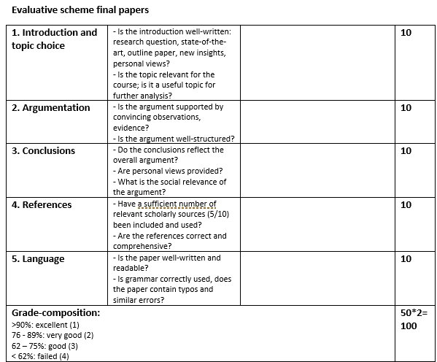
Constitutional Sociology
Final Exam
-
8
Notes:
8

Slide 9
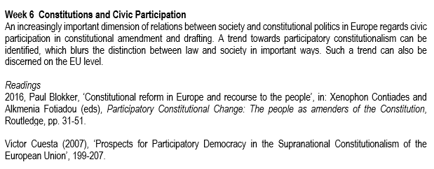
Readings
Constitutional Sociology

Slide 10
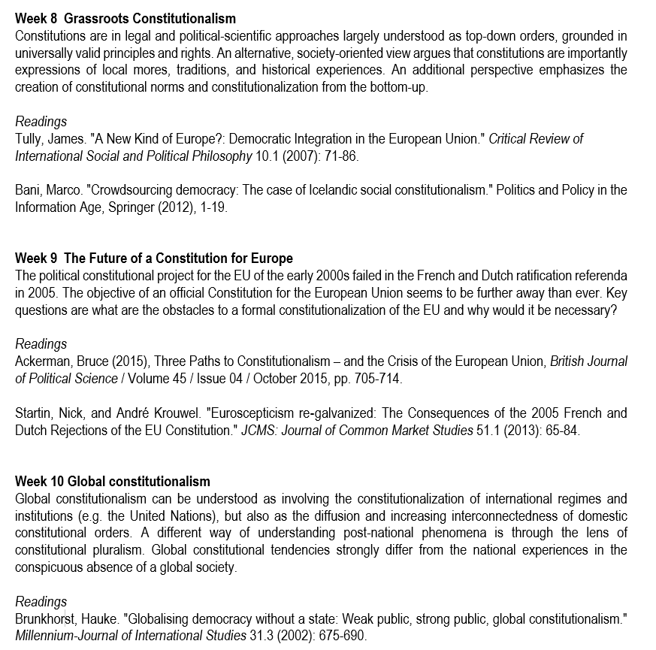
Readings
Constitutional Sociology

Slide 11
Objectives 1. Constitutional theory and the people/civic participation 2. Legitimacy and the European constitutional order 3. Challenges to constitutional democracy: populism
Constitutional Sociology

Slide 12
Constitutional Sociology
What is the relation between the Constitution and the People?

Slide 13
1. Constitutional Theory and the People
Constitutional Sociology

Slide 14
1. Constitutional Theory and the People Four different approaches: 1. Legal constitutionalism; 2. Political constitutionalism; 3. Popular constitutionalism; 4. Democratic constitutionalism
Constitutional Sociology

Slide 15
1. Constitutional Theory and the People Legal constitutionalism a. constitution is legal document providing preconditions for democracy; b. constitution is superior law with entrenched fundamental rights and subject to judicial review; c. constitution as reflection of reasonable consensus on the preconditions of democracy in the form of rights and fundamental law;
Constitutional Sociology

Slide 16
1. Constitutional Theory and the People Legal constitutionalism: the People a. Legal constitutionalism needs popular support, in terms of people’s positive endorsement; b. Constitutional norms are first of all interpreted by constitutional judges, who have a better understanding of the ‘truth’; c. Direct participation in constitutional interpretation or constitutional change by citizens not necessary;
Constitutional Sociology

Slide 17
1. Constitutional Theory and the People Political constitutionalism a. constitution is a basic framework for resolving disagreements over the right and the good; b. constitutions are the ‘limits that a mature democracy places upon itself’; c. emphasis on including wide range of people’s judgments; d. failure to acknowledge disagreement on rights and fundamental values can be a form of domination in its own right;
Constitutional Sociology

Slide 18
1. Constitutional Theory and the People Political constitutionalism: the People a. Political constitutionalism gains popular support by means of a well-function representative, parliamentary democratic system; b. it is the parliamentary institutions, which provide inclusion of a range of different voices; c. participation through representatives, but not thorugh direct participation of the People;
Constitutional Sociology

Slide 19
1. Constitutional Theory and the People Popular constitutionalism a. Dualistic democracy: normal politics (constitutional constraints) and constitutional politics (mass mobilization for change, ‘heightened constitutional consciousness’); b. Constitutional change happens when a comprehensive consensus emerges; c. Constitutional moments constitute specific periods/time frames in which prominent constitutional norms are being redefined;
Constitutional Sociology

Slide 20
1. Constitutional Theory and the People Popular constitutionalism: the People a. In popular constitutionalism, the role of citizens in constitutional change is acknowledged, in a process of constitutional awareness, mobilization of society, mobilization of the institutions; b. The role of the People remains a largely societal, informal one: initiative; c. There is less attention for more robust, continuous ways of constitutional involvement by citizens;
Constitutional Sociology

Slide 21
1. Constitutional Theory and the People Democratic constitutionalism a. Strong critique on legal and political constitutionalism: deficient in terms of democracy; b. Legal constitutionalism in particular leads to ‘depoliticization’ and ‘juridification’; c. Democratic constitutionalism criticizes the status quo of liberal constitutionalism, and the lack of its democratic legitimacy;
Constitutional Sociology

Slide 22
1. Constitutional Theory and the People Democratic constitutionalism: the People a. A ‘multiplicity’ of sites of democratic participation: in procedures of ‘normal’ constitutional politics as well as in constitution-making; b. Ordinary: constitutional initiatives; referendums Constitution-making: constitutional assembly; deliberative forums; c. Constitutional change as permanent and open process;
Constitutional Sociology

Slide 23
2. Legitimacy and the European constitutional order
Constitutional Sociology

Slide 24
2. Legitimacy and the European constitutional order - A key problem in any constitutional order is legitimacy: ‘how to transform the sheer exercise of power into the legitimate exercise of power’ (Ackerman 2015)?; - Legitimacy is hence about a relation between the rulers/institutions and wider society; - Max Weber originally proposed three ways: tradition – charisma – bureaucratic rationality
Constitutional Sociology

Slide 25
2. Legitimacy and the European constitutional order - Ackerman proposes in the context of constitutional democracy three ‘ideal types’:
Constitutional Sociology
Constitutional change | Legitimacy | Examples
revolutionary constitutionalism | founding myth/charisma broad public recognition | France, Italy, Poland
insider constitutionalism | tradition elitist expertise/statesmanship | Great Britain
elitist constitutionalism | elitist expertise/statesmanship | Germany, Spain

Slide 26
2. Legitimacy and the European constitutional order Any future constitution of the European Union faces great difficulties: - different national experiences/constitutional cultures - elitist constitutional experience on the EU level - great challenges from: 1. national-sovereigntist, populist governments as well as 2. grass-roots anti-austerity movements
Constitutional Sociology

Slide 27
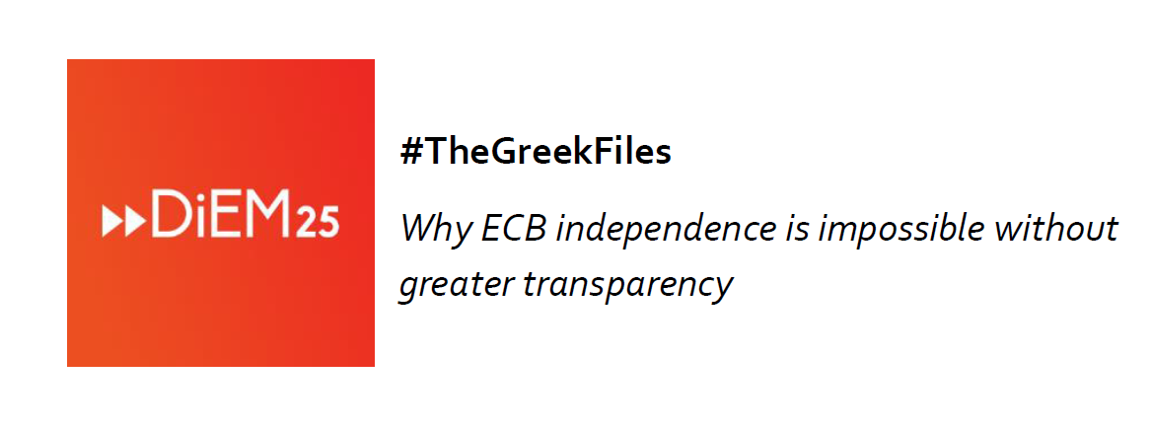
5. Trans-European movements and constitutional claims
Constitutional Sociology

Slide 28
5. Trans-European movements and constitutional claims Example An intriguing example of a transnational social movement using both legal procedures and public claims made by regards the legal action undertaken by Yanis Varoufakis (former Greek minister of Finance, and leader of the transnational movement DiEM25) and the German MEP Fabio de Masi; Varoufakis and de Masi are legally assisted by professor A. Fischer-Lescano in a legal case against the European Central Bank (ECB) (Case T-798/17) (2018/C 042/55);
Constitutional Sociology

Slide 29
5. Trans-European movements and constitutional claims Example The transnational social movement DiEM25 uses a distinctive form of legal action, legal mobilization, as well as the makes public claims with regard to the nature of the European political and constitutional order. Since 2016, Varoufakis and DiEM25 have been campaigning for transparency regarding ECB decisions to discontinue Greek access to ECB liquidity, in particularly in relation to external legal opinions that were commissioned by the ECB before it took the decisions.
Constitutional Sociology

Slide 30
5. Trans-European movements and constitutional claims Example The ECB has refused to make the legal opinions public, invoking the need to protect an ‘attorney-client privilege’ (letter ECB, 17-9-2015), and has failed so far to give clear justifications for its actions; Varoufakis invokes principles of democracy and self-rule (legitimacy through participation/voice), while strongly criticizing a justification based purely on the rule of law (‘bureaucratic rationality’), or worse, arbitrary discretionary power;
Constitutional Sociology

Slide 31
5. Trans-European movements and constitutional claims Example As DiEM25 has stated: When a decision to close down a country’s banks is made in secret and in the absence of clear rules, arbitrary discretionary power decides the outcome against any concept of democratic accountability and in a manner that de-legitimises totally the EU’s decision-making in the eyes of Europe’s citizens.
Constitutional Sociology

Slide 32
5. Trans-European movements and constitutional claims
Constitutional Sociology

Slide 33
5. Trans-European movements and constitutional claims Example As DiEM25 Italy, we believe that creating a united, democratic, federal Europe by 2025 is the core of the political project of our movement, as the very name Democracy in Europe Movement 2025 illustrates. Capturing the citizens’ drive, in all the countries of the Union, to have their say, and believing that we cannot leave referendums in the hands of reactionary and nationalist forces, we therefore propose that DiEM25 launch a pan-European campaign to hold a non-binding referendum for the whole continent. The goal: to ask the Europeans to elect a Constituent Assembly for the EU together with the 2024 European elections. This Assembly would then write a democratic constitution that would replace all existing European Treaties (DiEM25, Naples, Nov. 2017).
Constitutional Sociology

Slide 34
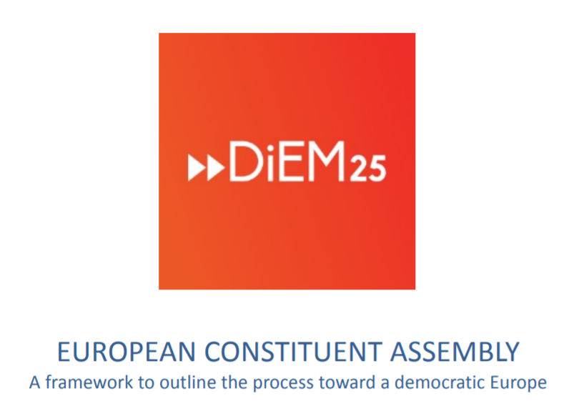
5. Trans-European movements and constitutional claims
Constitutional Sociology

Slide 35
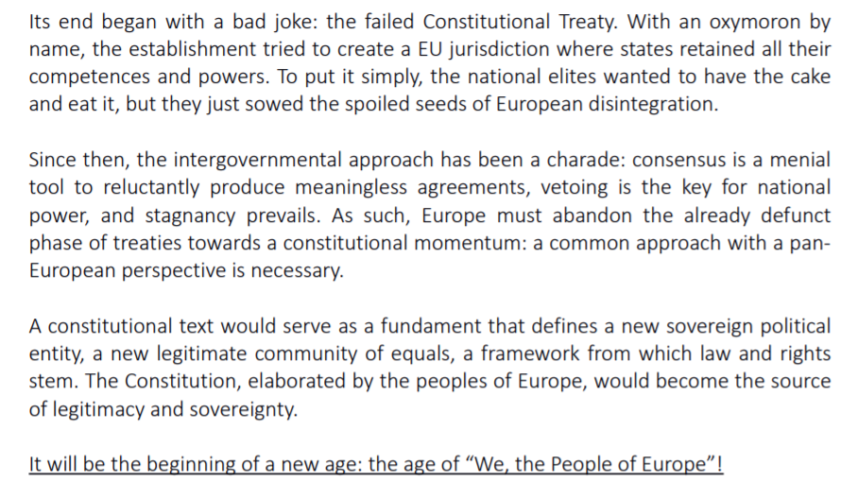
Example …
Constitutional Sociology

Slide 36
5. Trans-European movements and constitutional claims
Constitutional Sociology
https://www.youtube.com/watch?v=RoT0LsrB840

Slide 37
3. Challenges to constitutional democracy: populism
Constitutional Sociology

Slide 38
3. Challenges to constitutional democracy: populism - In at least two EU member states – Hungary and Poland – the constitutional democratic system is strongly challenged in the name of the People or even the Nation; - One of the populist arguments is that liberal constitutionalism is a ‘foreign import’ and does not dovetail with national/local traditions and ideas
Constitutional Sociology

Slide 39
3. Challenges to constitutional democracy: populism Specifically regarding constitutionalism, populism entails: 1. Popular sovereignty, meaning that the will of the People should be central to politics and ought not to be limited, and the relation between citizens and institutions should be direct E.g., constitutional experts close to the populist government in Poland have argued in favour of an idea of democracy in which the ‘nation as a political community of all citizens that constitute the state is the primary category’, against a view, in which ‘the attribute of sovereignty is transferred to the law itself, in particular to the most important of normative acts – the constitution’
Constitutional Sociology

Slide 40
3. Challenges to constitutional democracy: populism Specifically regarding constitutionalism, populism entails: 2. Extreme majoritarianism, meaning that the political will of the (ethnic) majority should have the final say in politics, without being hindered by minorities (internal or external) Populists such as Orbán and Kaczynski refer to ‘enemies’, ‘those that oppose us’ and do not support ‘our political project’, ‘good’ and ‘bad’ members of society, and often equate enemies with international, liberal forces (the ‘George Soros network’, the ‘international bureaucrats’, ‘pro-migrant NGOs’, or ‘pseudo-civil society organisations’ )
Constitutional Sociology

Slide 41
3. Challenges to constitutional democracy: populism Specifically regarding constitutionalism, populism entails: 3. Instrumentalism, meaning that the law and the constitution are used to promote the interests and objectives of the majority, as frequent as necessary The new Hungarian Fundamental Law, has, since its adoption in 2012, already been amended 6 times (anno 2018), while before its entering into force in 2012, and from the moment Fidesz gained its supermajority in 2010, the prior, 1989 Constitution was amended 12 times.
Constitutional Sociology

Slide 42
3. Challenges to constitutional democracy: populism Specifically regarding constitutionalism, populism entails: 4. Legal resentment, an attitude towards the law that is sceptical towards ideas of neutrality, legal rationality, judicial independence, liberal rule of law Kornel Morawiecki, the interim speaker of the Polish lower house, the Sejm: ‘[t]he good of the nation is above the law. If the law conflicts with that good, then we’re not allowed to treat it as something that we can’t break’.
Constitutional Sociology

Slide 43
3. Challenges to constitutional democracy: populism Legitimacy problems of post-1989 constitutions: - lack of authenticity/charisma (foundational moment) - erosion elitist expertise/statesmanship - lack of wide societal support (learning, interaction)
Constitutional Sociology

Slide 44
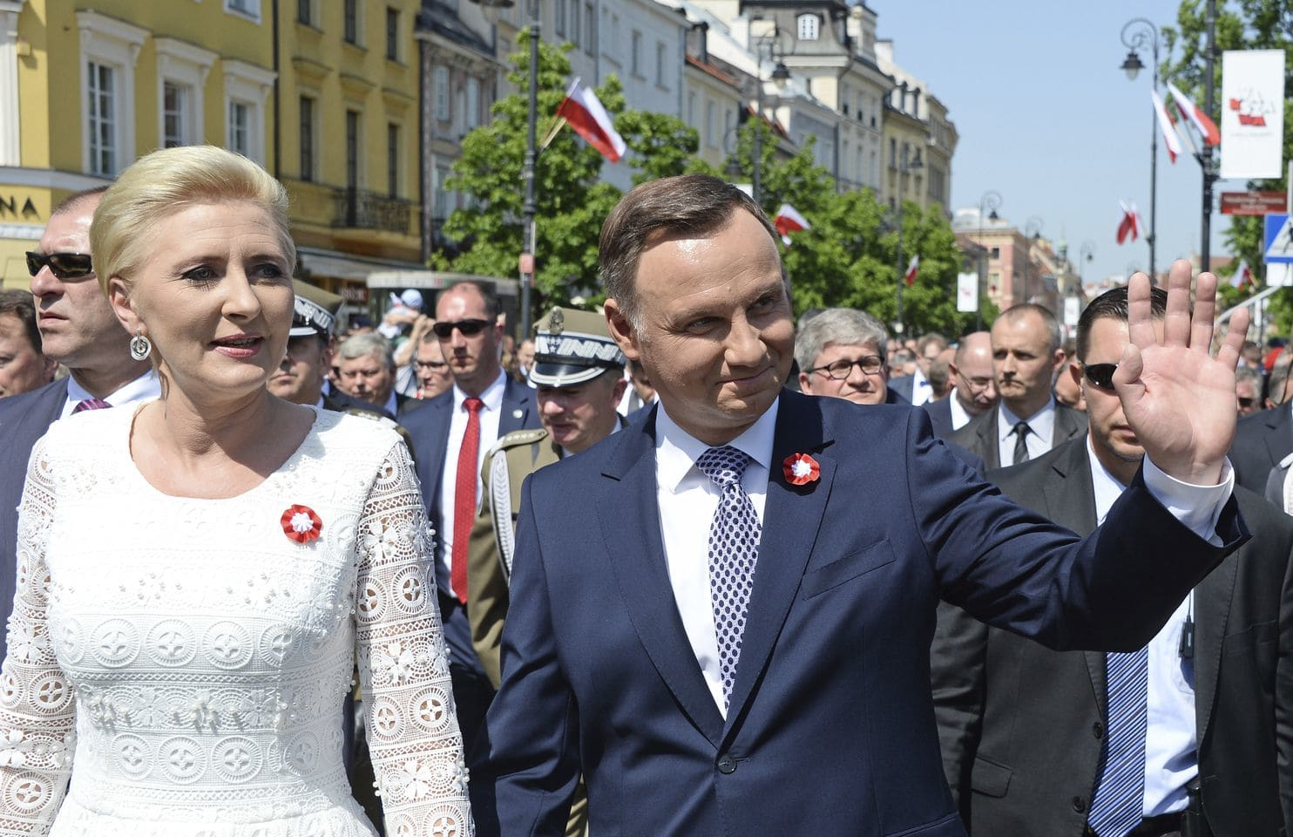
3. Challenges to constitutional democracy: populism
Constitutional Sociology
Poland’s president Duda said on 3 May that he wants Poles to vote in a referendum in November 2018 on whether they support changing the constitution
PiS claims the current Constitution allowed former communists to hold on to their privileges
Duda told those that citizens deserved a debate on the nation’s existing constitution, which dates back to 1997. He said the Polish people “deserve to reflect” on whether to make changes to the constitution or “draft a new one” almost three decades since Poland emerged from communism.

Slide 45
3. Challenges to constitutional democracy: populism
Constitutional Sociology
According to Marcin Matczak (const. lawyer):
“President Duda has been trying for some time to convince citizens that the current Constitution, which is barely 20 years old, is outdated. He has even advanced the bizarre argument that every generation should have its own constitution, and that young people such as his daughter (currently studying law) did not vote in the current one.”
“The President has a second, anti-elite argument: that the current method of constitutional amendment is undemocratic. According to Article 235 of the Constitution, amendments require a qualified majority in both houses of parliament; if an amendment concerns key chapters of the Constitution, a referendum is also required. President Duda argues that amendments are prepared by the elite, with their outcomes only presented to citizens for their approval.”

Slide 46
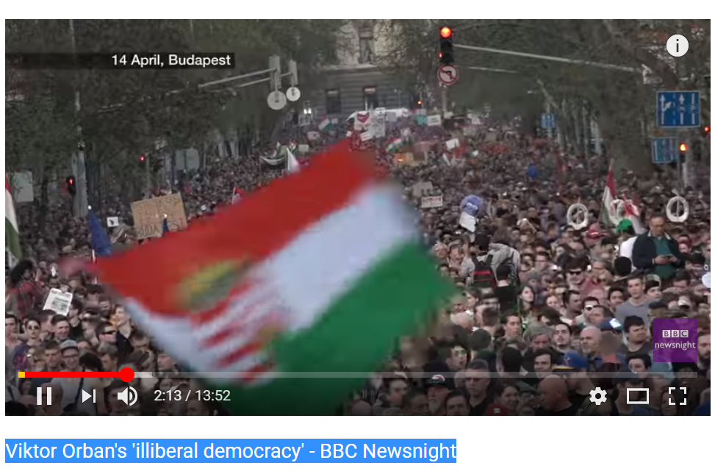
Constitutional Sociology
https://www.youtube.com/watch?v=QrfbtUpWOsc

